Slide 1
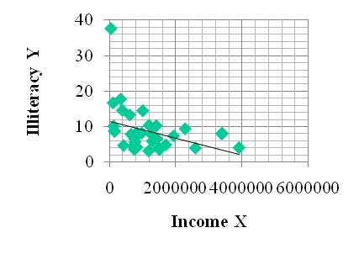
The Standard Regression Model and its Spatial Alternatives.
Relationships Between Variables
and
Building Predictive Models
Briggs Henan University 2010

Slide 2
Spatial Statistics
Descriptive Spatial Statistics: Centrographic Statistics
  single, summary measures of a spatial distribution
  - Spatial equivalents of mean, standard deviation, etc..
Inferential Spatial Statistics: Point Pattern Analysis
Analysis of point location only--no quantity or magnitude (no attribute variable)
  --Quadrat Analysis
  --Nearest Neighbor Analysis, Ripley’s K function
Spatial Autocorrelation
  One attribute variable with different magnitudes at each location
    The Weights Matrix
    Global Measures of Spatial Autocorrelation
    (Moran’s I, Geary’s C, Getis/Ord Global G)
    Local Measures of Spatial Autocorrelation (LISA and others)
Prediction with Correlation and Regression
  Two or more attribute variables
    Standard statistical models
    Spatial statistical models
☑
☑
☑
Briggs Henan University 2010

Slide 3
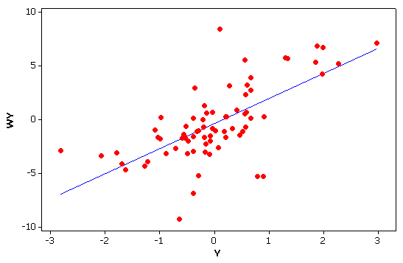
Bivariate and Multivariate
All measures so far have focused on one variable at a time
  univariate
Often, we are interested in the association or relationship between two variables
  bivariate.
Or more than two variables
  multivariate
income
education
Y
income
gender*
education
X₁
X₂
*Gender = male or female
Briggs Henan University 2010

Slide 4
Correlation and Regression
The most commonly used techniques in science.
Review standard (non-spatial) approaches
Correlation
Regression
Spatial Regression
Why it is necessary.
How to do it.
Briggs Henan University 2010

Slide 5
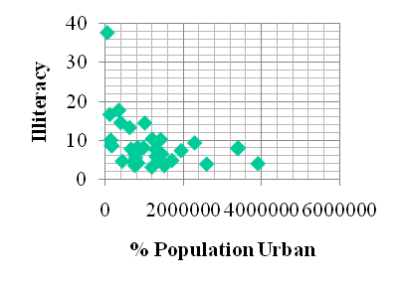
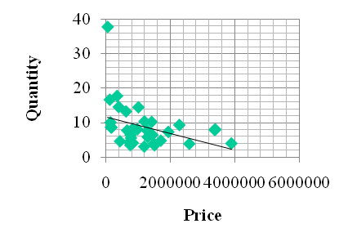
Correlation and Regression
What is the difference?
Mathematically, they are identical.
Conceptually, very different.
Correlation
Co-variation
Relationship or association
No direction or causation is implied
Y X X₁ X₂
Regression
  Prediction of Y from X
  Implies, but does not prove, causation
  X (independent variable) Y (dependent variable)
Regression line
predicts
Briggs Henan University 2010

Slide 6
Correlation Coefficient (r)
The most common statistic in all of science
measures the strength of the relationship (or “association”) between two variables e.g. income and education
Varies on a scale from –1 thru 0 to +1
  +1 implies a perfect positive association
  As values go up (⬆) on one, they also go up (⬆) on the other
    income and education
  0 implies no association
  -1 implies perfect negative association
  As values go up on one (⬆) , they go down (⬇) on the other
    price and quantity purchased
Full name is the Pearson Product Moment correlation coefficient,
(⬆) (⬇)
(⬆) (⬆)
-1
0
+1
Briggs Henan University 2010

Slide 7
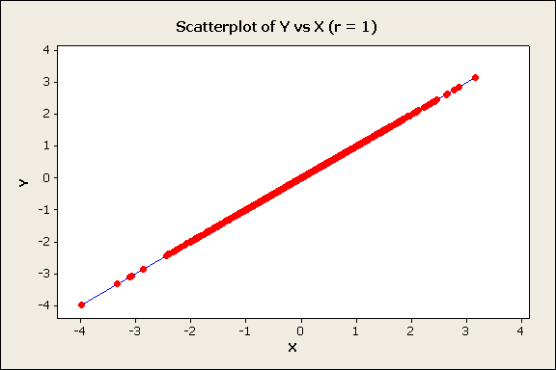
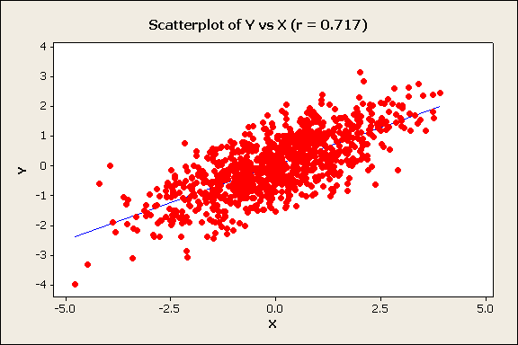
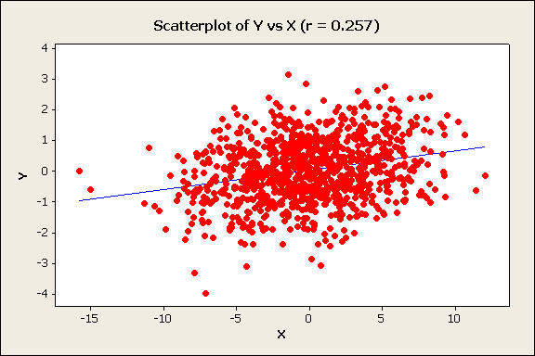
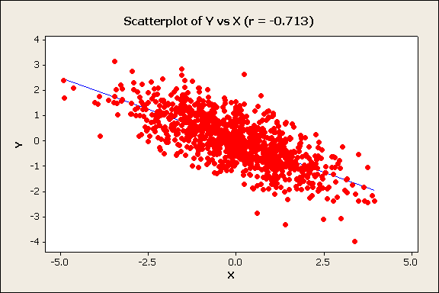
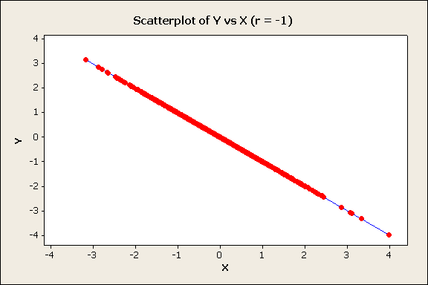
Examples of Scatter Diagrams and the Correlation Coefficient
Positive
r = 1
r = 0.72
r = 0.26
perfect
positive
Income
strong
positive
weak
positive
Education
Negative
r = -0.71
r = -1
Quantity
strong
negative
perfect
negative
Price
Briggs Henan University 2010

Slide 8
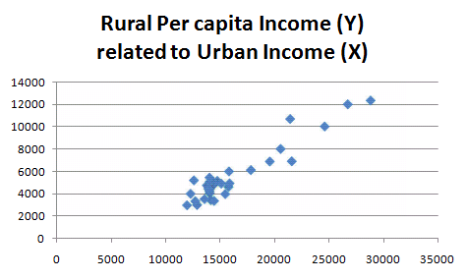
Correlation Coefficient: example
Correlation coefficient
= 0.9458
(see later for calculation)
China Provinces 29
excludes Xizang/Tibet, Macao, Hong Kong, Hainan, Taiwan, P'eng-hu
Briggs Henan University 2010

Slide 9
Pearson Product Moment Correlation Coefficient (r)
“product” is the result of a multiplication
X * Y = P
Moments about the mean
∑
n
(
x
−
X
)(
y
−
Y
)
i
i
r
=
i
=
1
n
S
S
x
y
∑
S_{y}=
n
(
Y
i
−
Y
)
2
=
i
1
N
Where Sx and Sy are the standard deviations of X and Y, and X and Y are the means.
∑
S_{X}=
n
(
X
−
X
)
2
i
=
i
1
N
Briggs Henan University 2010

Slide 10
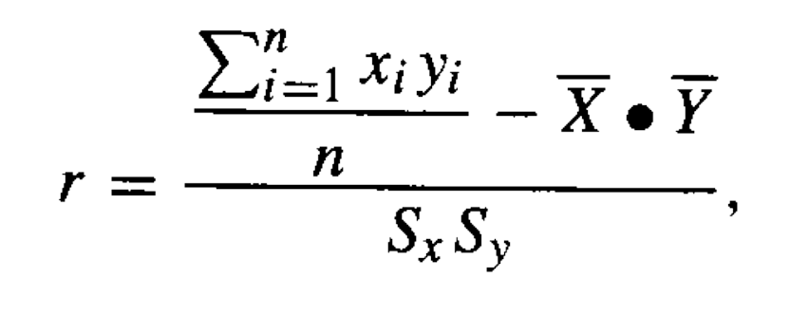
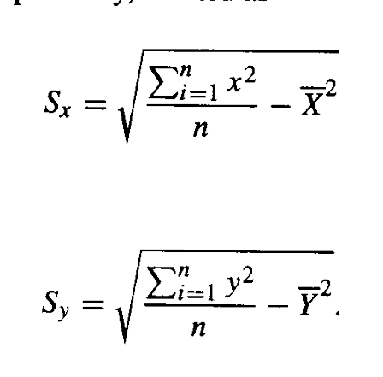
Calculation Formulae for
Correlation Coefficient (r)
Before the days of computers, these formulae where easier to do “by hand.”
See next slide for example
Briggs UT-Dallas GISC 6382 Spring 2007

Slide 11
Calculating r for urban v. rural income
Province | UrbanIncome | x-xMean | x-xMean2 |  | RuralIncome | y-ymean | y-ymean2 |  | (x-xM)(y-yM)
Anhui | 14086 | -2376 | 5646195 |  | 4504 | -1202 | 1444970 |  | 2856323
Zhejiang | 24611 | 8149 | 66403391 |  | 10008 | 4302 | 18506611 |  | 35055694
Jiangxi | 14022 | -2440 | 5954441 |  | 5075 | -631 | 398248 |  | 1539917
Jiangsu | 20552 | 4090 | 16726690 |  | 8004 | 2298 | 5280487 |  | 9398142
Jilin | 14006 | -2456 | 6032783 |  | 5450 | -256 | 65571 |  | 628950
Qinghai | 12692 | -3770 | 14214200 |  | 3346 | -2360 | 5569926 |  | 8897867
Fujian | 19557 | 3095 | 9577958 |  | 6880 | 1174 | 1378114 |  | 3633114
Heilongjiang | 12566 | -3896 | 15180159 |  | 5207 | -499 | 249070 |  | 1944459
Henan | 14372 | -2090 | 4368821 |  | 4807 | -899 | 808325 |  | 1879209
Hebei | 14718 | -1744 | 3042137 |  | 5150 | -556 | 309213 |  | 969880
Hunan | 15084 | -1378 | 1899359 |  | 4910 | -796 | 633726 |  | 1097120
Hubei | 14367 | -2095 | 4389747 |  | 5035 | -671 | 450334 |  | 1406005
Xinjiang | 12258 | -4204 | 17675066 |  | 4005 | -1701 | 2893636 |  | 7151587
Gansu | 11930 | -4532 | 20540587 |  | 2980 | -2726 | 7431452 |  | 12355015
Guangxi | 15451 | -1011 | 1022470 |  | 3980 | -1726 | 2979314 |  | 1745353
Guizhou | 12863 | -3599 | 12954042 |  | 3005 | -2701 | 7295774 |  | 9721613
Liaoning | 15800 | -662 | 438472 |  | 6000 | 294 | 86395 |  | -194633
Nei Mongol | 15849 | -613 | 375980 |  | 4938 | -768 | 589930 |  | 470959
Ningxia | 14025 | -2437 | 5939809 |  | 4048 | -1658 | 2749193 |  | 4041000
Beijing | 26738 | 10276 | 105592633 |  | 11986 | 6280 | 39437534 |  | 64531489
Shanghai | 28838 | 12376 | 153161108 |  | 12324 | 6618 | 43797011 |  | 81902373
Shanxi | 13997 | -2465 | 6077075 |  | 4244 | -1462 | 2137646 |  | 3604252
Shandong | 17811 | 1349 | 1819336 |  | 6119 | 413 | 170512 |  | 556973
Shaanxi | 14129 | -2333 | 5443694 |  | 3438 | -2268 | 5144137 |  | 5291796
Sichuan | 13904 | -2558 | 6544246 |  | 4462 | -1244 | 1547708 |  | 3182543
Tianjin | 21430 | 4968 | 24679311 |  | 10675 | 4969 | 24690276 |  | 24684793
Yunnan | 14424 | -2038 | 4154147 |  | 3369 | -2337 | 5461891 |  | 4763349
Guangdong | 21574 | 5112 | 26130781 |  | 6906 | 1200 | 1439834 |  | 6133841
Chongqing | 15749 | -713 | 508615 |  | 4621 | -1085 | 1177375 |  | 773841
SUM | 477403 | 0.00 | 546493254 |  | 165476 | 0.00 | 184124210 |  | 300022824
AVERAGE | 16462 | 0.00 | 18844595 |  | 5706 | 0.00 | 6349111 |  | 10345615
 | Sx= SQRT( | 18844595 | ) |  | Sy= SQRT( | 6349111 | ) | r = | 10345615/4341/2520
 | = |  | 4341 |  | = |  | 2520 | = | 0.9458

Slide 12
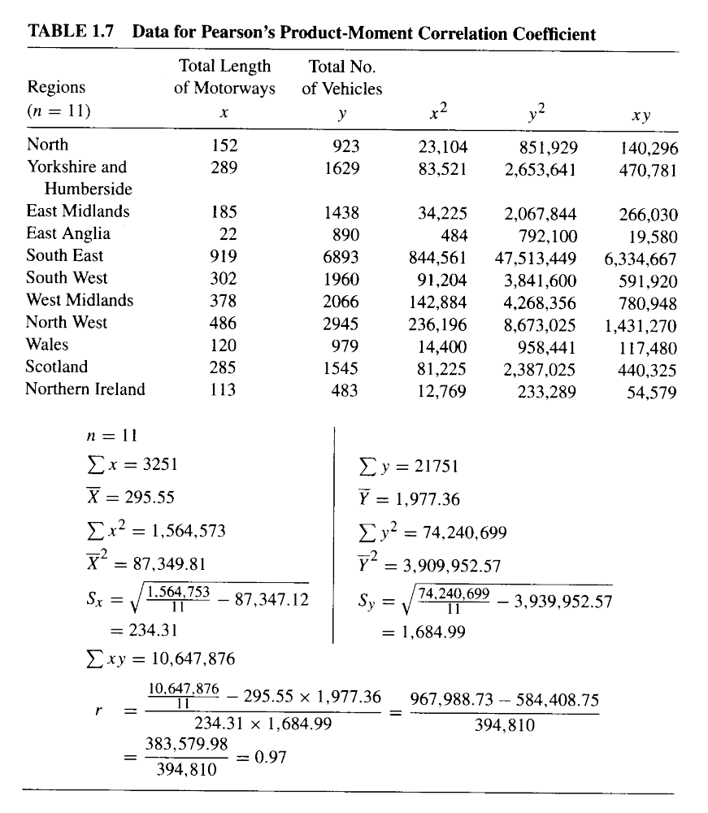
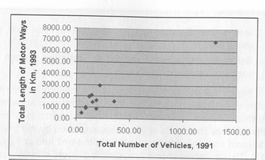
Correlation Coefficient example using “calculation formulae”
Scatter Diagram
Source: Lee and Wong
Briggs Henan University 2010

Slide 13
Regression
Simple regression
  Between two variables
    One dependent variable (Y)
    One independent variable (X)
Multiple Regression
  Between three or more variables
    One dependent variable (Y)
    Two or independent variable (X₁ ,X_{2…})
Y
X
Y
income
gender*
education
X₁
X₂
Briggs Henan University 2010

Slide 14
Simple Linear Regression
Concerned with “predicting” one variable (Y - the dependent variable) from another variable (X - the independent variable)
Y = a +bX +ε
ε = residual= error = Y_{i}-Ŷ_{i} =Actual (Y_{i} ) – Predicted (Ŷ_{i} )
    a is the intercept —the value of Y when X =0
    b is the regression coefficient or slope of the line
    —the change in Y for a one unit change in X
Y_{i}
Y
Regression line
Ŷ_{i}
b
1
a
X
X
0
Briggs Henan University 2010

Slide 15
Ordinary Least Squares (OLS)
--the standard criteria for obtaining the regression line
The regression line minimizes the sum of the squared deviations between actual Y_{i} and predicted Ŷ_{i}
Y_{i}
Ŷ_{i}
Min ∑(Y_{i}-Ŷ_{i})²
Y_{i}
Ŷ_{i}
Briggs Henan University 2010

Slide 16
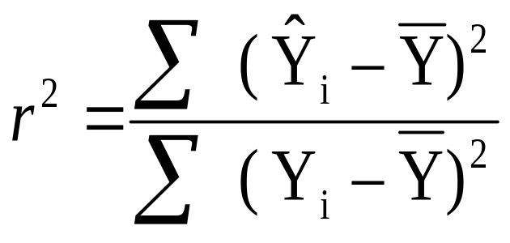
Coefficient of Determination (r²)
  The coefficient of determination (r²) measures the proportion of the variance in Y (the dependent variable) which can be predicted or “explained by” X (the independent variable). Varies from 1 to 0.
  It equals the correlation coefficient (r) squared.
SS Regression or Explained Sum of Squares
SS Total or Total Sum of Squares
Note:
SS Total or Total Sum of Squares
SS Regression or Explained Sum of Squares
SS Residual or Error Sum of Squares
=
+

Slide 17

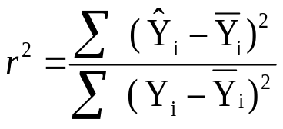
Partitioning the Variance on Y
Y
Y
Y
SS Total
or Total Sum of Squares
SS Regression
or Explained Sum of Squares
SS Residual
or Error Sum of Squares
Briggs Henan University 2010

Slide 18
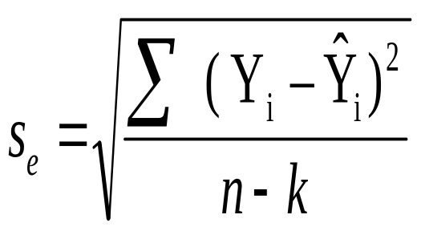
Standard Error of the Estimate (s_{e})
Measures predictive accuracy: the bigger the standard error, the greater the spread of the observations about the regression line, thus the predictions are less accurate
S_{e}² = error mean square, or average squared residual
= variance of the estimate, variance about regression
^{(called sigma-square in GeoDA)}
Sum of squared residuals
Number of observations minus degrees of freedom
(for simple regression, degrees of freedom = 2)
Briggs Henan University 2010

Slide 19
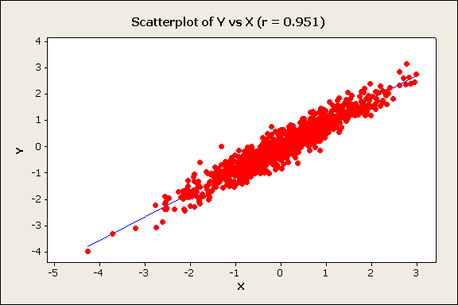
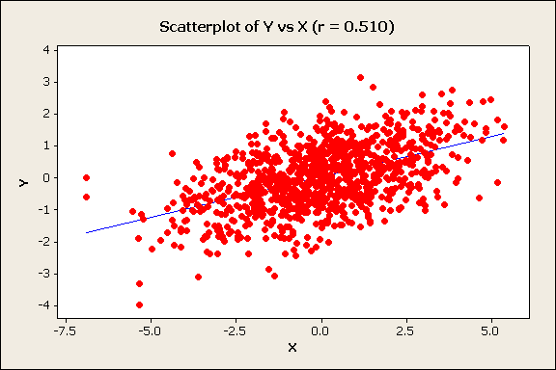
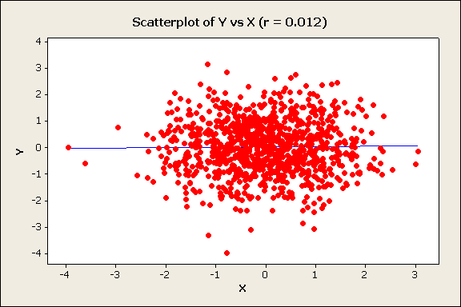
Coefficient of determination (r² ), correlation coefficinet (r), regression coefficient (b), and standard error (S_{e})
(Values are hypothetical and for illustration of relative change only)
r² = 0.94 r = .97
S_{e}= 0.3
r² = r = 1
S_{e}= 0.0
S_{y} = 2
b = 2
r² = 0.51 r = .71
S_{e}= 1.1
b = 1.1
perfect
positive
Very strong
strong
r² = 0.26 r = .51
S_{e}= 1.3
b = 0.8
r² = 0.07
S_{e}= 1.8
b = 0.1
r² = r= 0.00
S_{e}= S_{y} = 2
moderate
weak
b = 0
none
Regression
line in
blue
As the coefficient of determination gets smaller, the slope of the regression line (b) gets closer to zero.
As the coefficient of determination gets smaller, the standard error gets larger, and closer to the standard deviation of the dependent variable (Y) (S_{y} = 2)

Slide 20
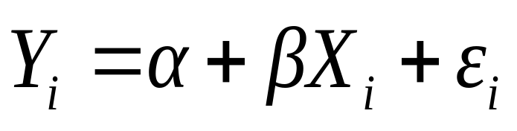
Sample Statistics, Population Parameters and Statistical Significance tests
Y_{i} = a +bX_{i} +ε_{i} a and b are sample statistics
which are estimates of
population parameters α and β
β (and b) measure the change in Y for a one unit change in X. If β = 0 then X has no effect on Y, therefore
Null Hypothesis (H₀): in the population β = 0
Alternative Hypothesis (H₁): in the population β ≠ 0
Thus, we test if our sample regression coefficient, b, is sufficiently different from zero to reject the Null Hypothesis and conclude that X has a statistically significant affect on Y
Briggs Henan University 2010

Slide 21

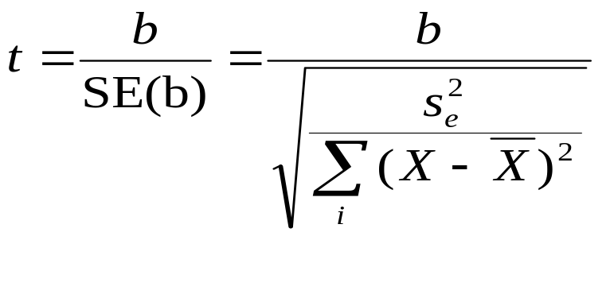
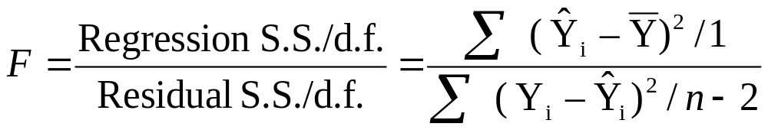
Test Statistics in Simple Regression
Test statistic for b is distributed according to the Student’s t Distribution (similar to normal):
where is the variance of the estimate,
with degrees of freedom = n – 2
A test can also be conducted on the coefficient of determination (r² ) to test if it is significantly greater than zero, using the F frequency distribution.
It is mathematically identical to the t test.
Briggs Henan University 2010

Slide 22
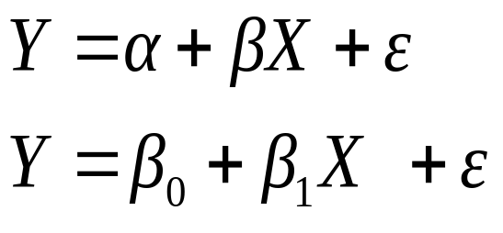
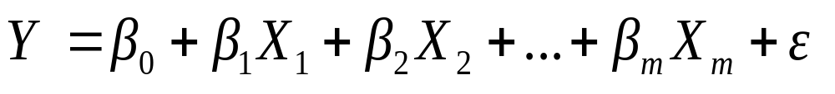
Multiple regression
Y
We can rewrite simple regression as:
income
gender*
education
X₁
X₂
Multiple regression: Y is predicted from 2 or more independent variables
    β₀ is the intercept —the value of Y when values of all X_{j} = 0
    β₁… β _{m} are partial regression coefficients which give the change in Y for a one unit change in X_{j}, all other X variables held constant
    m is the number of independent variables
Briggs Henan University 2010

Slide 23
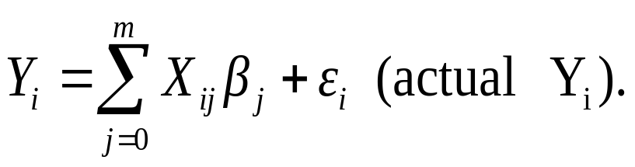
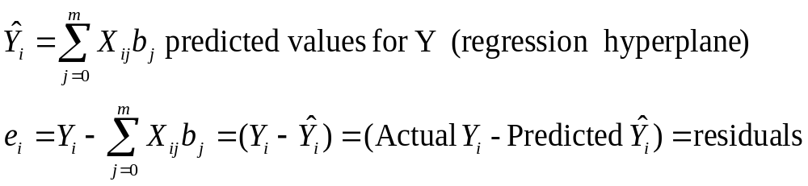
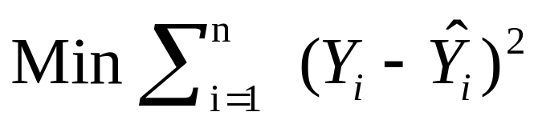
Multiple regression: least squares criteria
or
As in simple regression, the “least squares” criteria is used. Regression coefficients b_{j} are chosen to minimize the sum of the squared residuals (the deviations between actual Y_{i} and predicted Ŷ_{i})
The difference is that Ŷ_{i} is predicted from 2 or more independent variables, not one.
Regression
hyperplane

Slide 24
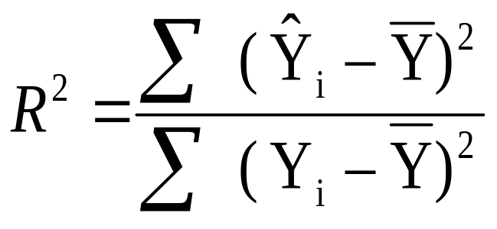
Coefficient of Multiple Determination (R²)
  Similar to simple regression, the coefficient of multiple determination (R²) measures the proportion of the variance in Y (the dependent variable) which can be predicted or “explained by” all of X variables in combination.
  Varies from 0 to 1.
SS Regression or Explained Sum of Squares
Formulae identical to simple regression
SS Total or Total Sum of Squares
As with simple regression
SS Total or Total Sum of Squares
SS Regression or Explained Sum of Squares
SS Residual or Error Sum of Squares
=
+

Slide 25
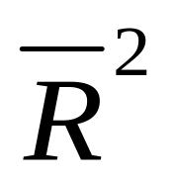
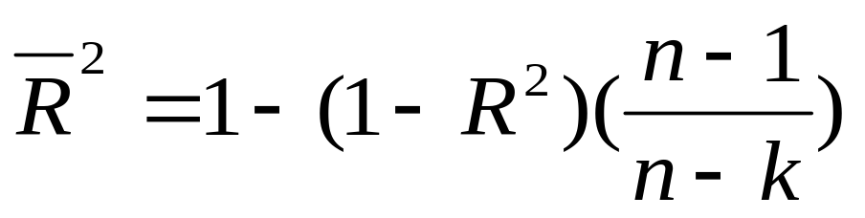
Reduced or Adjusted
R² will always increase each time another independent variable is included
  an additional dimension is available
  for fitting the regression hyperplane
  (the multiple regression equivalent
  of the regression line)
Adjusted is normally used instead of R² in multiple regression
Not perfect
Y
perfect
X₁
X₂
k is the number of coefficients in the regression equation, normally equal to the number of independent variables plus 1 for the intercept.
Briggs Henan University 2010

Slide 26
Interpreting partial regression coefficients
The regression coefficients (b_{j}) tell us the change in Y for a 1 unit change in X_{j}, all other X variables “held constant”
Can we compare these b_{j} values to tell us the relative importance of the independent variables in affecting the dependent variable?
  If b₁ = 2 and b₂ = 4, is the affect of X₂ twice as big as the affect of X₁ ?
No, no, no in general!!!!
The size of b_{j} depends on the measurement scale used for each independent variable
  if X₁ is income, then a 1 unit change is $1
  but if X₂ is rmb or Euro(€) or even cents (₵)
  1 unit is not the same!
  And if X₂ is % population urban, 1 unit is very different
Regression coefficients are only directly comparable if the units are all the same: all $ for example
Y
b
a
1
X

Slide 27
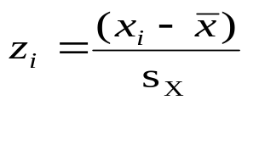
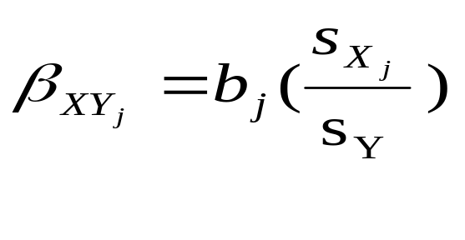
Standardized partial regression coefficients Comparing the Importance of Independent Variables
How do we compare the relative importance of independent variables?
We know we cannot use partial regression coefficients to directly compare independent variables unless they are all measured on the same scale
However, we can use standardized partial regression coefficients (also called beta weights, beta coefficients, or path coefficients).
They tell us the number of standard deviation (SD) unit changes in Y for a one SD change in X)
They are the partial regression coefficients if we had measured every variable in standardized form
Note the confusing use of β for both standardized partial regression coefficients and for the population parameter they estimate.

Slide 28
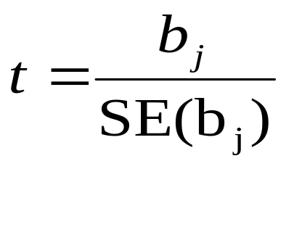
Test Statistics in Multiple Regression: testing each independent variable
A test can be conducted for each partial regression coefficient b_{j} to test if the associated independent variable influences the dependent variable. It is distributed according to the Student’s t Distribution (similar to the normal frequency distribution):
Null Hypothesis H_{o} : b_{j} = 0
.
with degrees of freedom = n – k, where k is the number of coefficients in the regression equation, normally equal to the number of independent variables plus 1 for the intercept (m+1).
The formula for calculating the standard error (SE) of b_{j} is more complex than for simple regression , so it is not shown here.
Briggs Henan University 2010

Slide 29
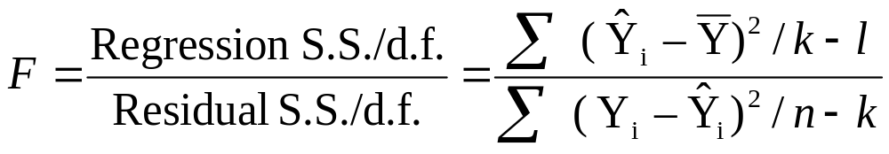
Test Statistics in Mutiple Regression testing the overall model
We test the coefficient of multiple determination (R² ) to see if it is significantly greater than zero, using the F frequency distribution.
It is an overall test to see if at least one independent variable, or two or more in combination, affect the dependent variable.
Does not test if each and every independent variable has an effect
Similar to the F test in simple regression.
  But unlike simple regression, it is not identical to the t tests.
It is possible (but unusual) for the F test to be significant but all t tests not significant.
Again, k is the number of coefficients in the regression equation, normally equal to the number of variables (m) plus 1.

Slide 30
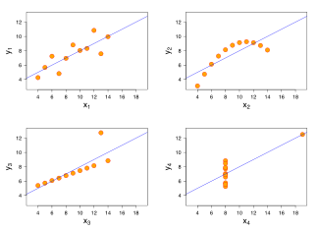
Always look at your data
Don’t just rely on the statistics!
Anscombe's quartet Summary statistics are the same for all four data sets:
mean (7.5),
standard deviation (4.12), correlation (0.816) regression line
(y = 3 + 0.5x).
Anscombe, Francis J. (1973). "Graphs in statistical analysis". The American Statistician 27: 17–21.
Briggs Henan University 2010

Slide 31
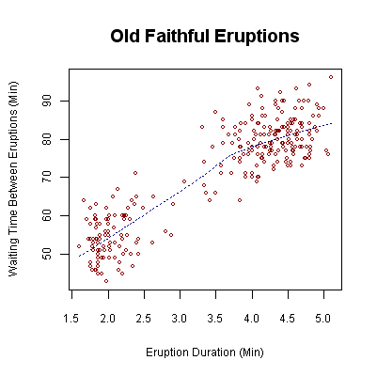
Real data is almost always more complex than the simple, straight line relationship assumed in regression.
Waiting time between eruptions and the duration of the eruption for the Old Faithful Geyser in Yellowstone National Park, Wyoming, USA. This chart suggests there are generally two "types" of eruptions: short-wait-short-duration, and long-wait-long-duration.
Source: Wikipedia
Briggs Henan University 2010

Slide 32
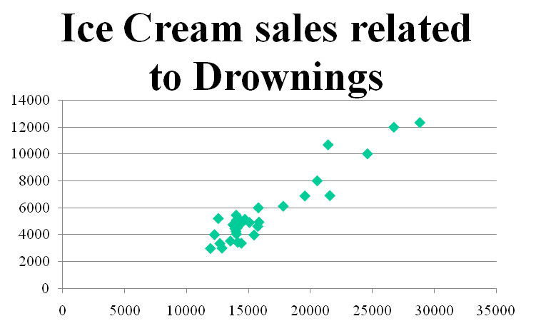


Spurious relationships
Eating ice cream inhibits swimming ability.
--eat too much, you cannot swim
Omitted variable problem
--both are related to a third variable not included in the analysis
Help!
Summer temperatures:
--more people swim
(and some drown)
--more ice cream is sold
Briggs Henan University 2010

Slide 33
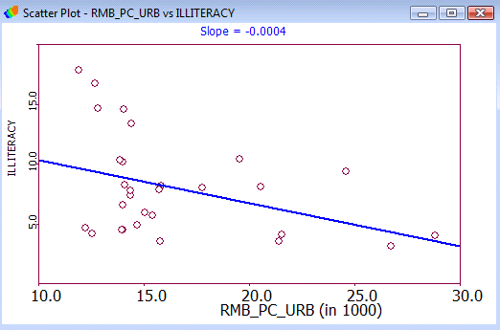
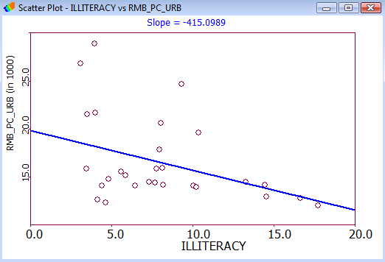
Regression does not prove direction or cause!
Income and Illiteracy
Provinces with higher incomes can afford to spend more on education, so illiteracy is lower
  Higher Income>>>>Less Illiteracy
The higher the level of literacy (and thus the lower the level of illiteracy) the more high income jobs.
  Less Illiteracy>>>>Higher Income
Regression will not decide!
Illiteracy
Income
Income
Illiteracy
Briggs Henan University 2010

Slide 34
Spatial Regression
It doesn’t solve any of the problems just discussed!
You always must examine your data!
Briggs Henan University 2010

Slide 35
Spatial Autocorrelation & Correlation
Spatial Autocorrelation: shows the association or relationship between the same variable in “near-by” areas.
Standard Correlation
shows the association or relationship between two different variables
Each point is a
geographic location
Education
“next door”
income
In a neighboring or near-by area
education
education
Briggs Henan University 2010

Slide 36
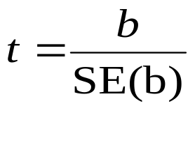
If Spatial Autocorrelation exists:
correlation coefficients and coefficients of determination appear bigger than they really are
    biased upward
    You think the relationship is
    stronger than it really is
    the variables in nearby areas
    affect each other
  Standard errors appear smaller than they really are
    exaggerated precision
    You think your predictions are better than they really are
    since standard errors measure predictive accuracy
    More likely to conclude
    relationship is statistically significant.
(We discussed this in detail in the lecture on Spatial Autocorrelation concepts.)
Briggs Henan University 2010

Slide 37
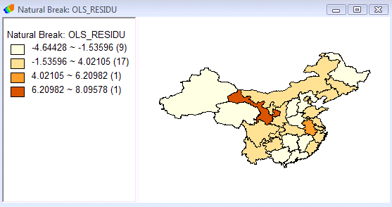
How do I know if I have a problem?
For correlation, calculate Moran’s I for each variable and test its statistical significance
  If Moran’s I is significant, you may have a problem!
For regression, calculate the residuals
Y_{i}-Ŷ_{i} =Actual (Y_{i} ) – Predicted (Ŷ_{i} )
Then:
map the residuals: do you see any spatial patterns?
  --if yes, you may have a problem
Calculate Moran’s I for the residuals: is it statistically significant?
  --if yes, you have a problem
Briggs Henan University 2010

Slide 38
What do I do if SA exists?
Acknowledge in your paper that SA exists and that the calculated correlation coefficients may be larger than their true value, and may not be statistically significant
Try to fix the problem!
Briggs Henan University 2010

Slide 39
How do I fix SA?
Step 1:
Try to identify omitted variables and include them in a multiple regression.
Missing (omitted) variables may cause spatial autocorrelation
Regression assumes all relevant variables influencing the dependent variable are included
  If relevant variables are missing, model is misspecified
Step 2:
If additional variables cannot be identified, or SA still exists, use a spatial regression model
Briggs Henan University 2010

Slide 40
Spatial Regression: 4 Options
Spatial Autoregressive Models
  Lag model
  Error model
Spatial Filtering
--based on eigenfunctions (Griffith)
Spatial Filtering
--based on Ripley’s K and Getis-Ord G (Getis)
Others
We will consider the first option only.
  simpler and the more commonly used
  Getis and Griffith 2002 compare the first three
  Getis, A. and Daniel Griffith (2002) Comparative Spatial Filtering in Regression Analysis Geographical Analysis 34 (2) 130-140

Slide 41
Spatial Lag and Spatial Error Models:
mathematical comparison
Spatial lag model
values of the dependent variable in neighboring locations (WY) are included as an extra explanatory variable
  these are the “spatial lag” of Y
Spatial error model
values of the residuals in neighboring locations (Wε) are included as an extra term in the equation;
  these are “spatial error”
W is the spatial weights matrix
Y = β₀ + λ WY + Xβ + ε
Y = β₀ + Xβ + ρWε + ξ
ξ is “white noise”

Slide 42
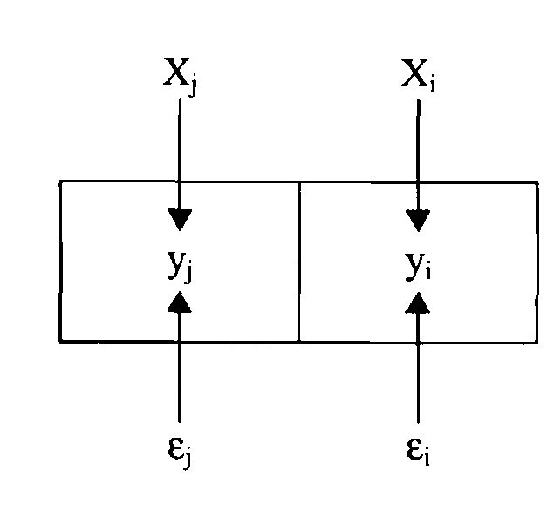
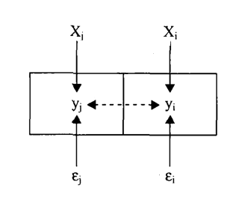
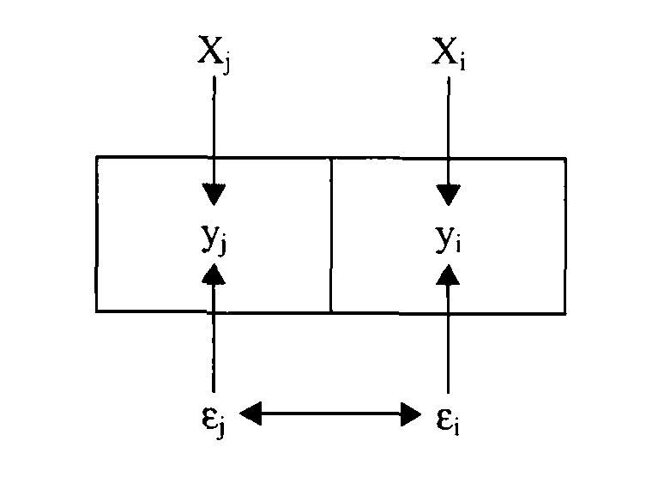
Spatial Lag and Spatial Error Models: conceptual comparison
Ordinary Least Squares
OLS
SPATIAL LAG
SPATIAL ERROR
No influence from neighbors
Dependent variable influenced by neighbors
Residuals influenced by neighbors
Baller, R., L. Anselin, S. Messner, G. Deane and D. Hawkins. 2001. Structural covariates of US County homicide rates: incorporating spatial effects,. Criminology , 39, 561-590
Briggs Henan University 2010

Slide 43
Lag or Error Model: Which to use?
Lag model primarily controls spatial autocorrelation in the dependent variable
Error model controls spatial autocorrelation in the residuals, thus it controls autocorrelation in both the dependent and the independent variables
Conclusion: the error model is more robust and generally the better choice.
Statistical tests called the LM Robust test can also be used to select
  Will not discuss these
Briggs Henan University 2010

Slide 44
Comparing our models
Which model best predicts the dependent variable?
Neither R² nor Adjusted can be used to compare different spatial regression models
Instead, we use Akaike Information Criteria (AIC)
  the smaller the AIC value the better the model
  Note: can only be used to compare models with the same dependent variable
k is the number of coefficients in the regression equation, normally equal to the number of independent variables plus 1 for the intercept term.
Akaike, Hirotuga (1974) A new look at statistical model identification IEEE Transactions on Automatic Control 19 (6) 716-723
Briggs Henan University 2010

Slide 45
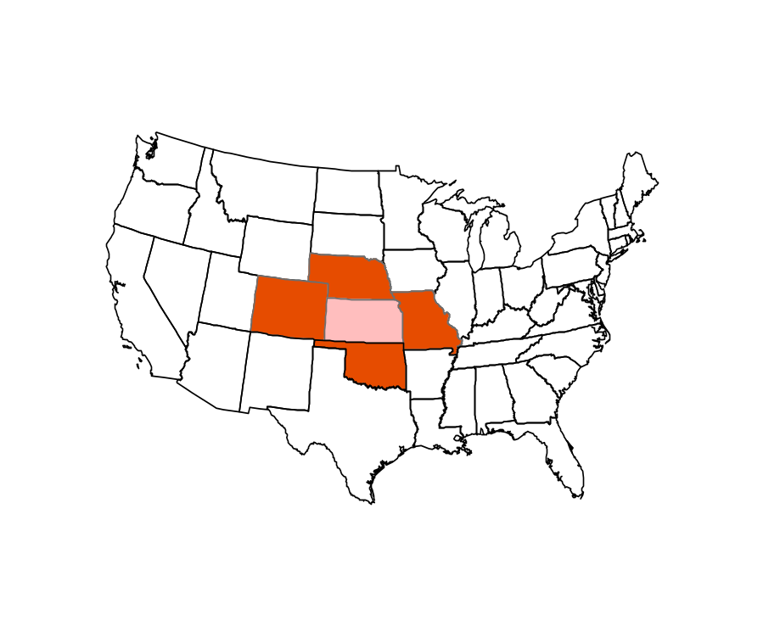
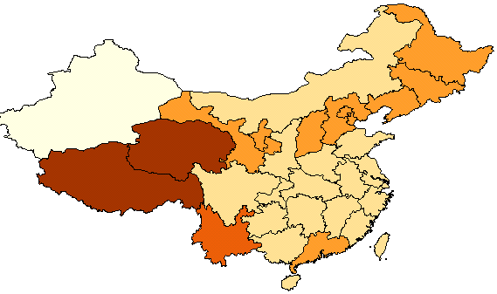
Geographically Weighted Regression
The idea of Local Indicators can also be applied to regression
Its called geographically weighted regression
It calculates a separate regression
for each polygon and its neighbors,
  then maps the parameters from the model, such as the regression coefficient (b) and/or its significance value
Mathematically, this is done by applying the spatial weights matrix (W_{ij}) to the standard formulae for regression
See Fotheringham, Brunsdon and Charlton Geographically Weighted Regression Wiley, 2002
X_{i}
Briggs Henan University 2010

Slide 46
Problems with Geographically Weighted Regression
Each regression is based on few observations
  the estimates of the regression
  parameters (b) are unreliable
Need to use more observations than just those with shared border, but
  how far out do we go?
  How far out is the “local effect”?
Need strong theory to explain why the regression parameters are different at different places
Serious questions about validity of statistical inference tests since observations not independent
X_{i}
Briggs Henan University 2010

Slide 47
What have we learned today?
Correlation and regression are very good tools for science.
Spatial data can cause problems with standard correlation and regression
The problems are caused by spatial autocorrelation
We need to use Spatial Regression Models
Geographers and GIS specialists are experts on spatial data
  They need to understand these issues!
Briggs Henan University 2010

Slide 48
Briggs Henan University 2010

