Slide 1
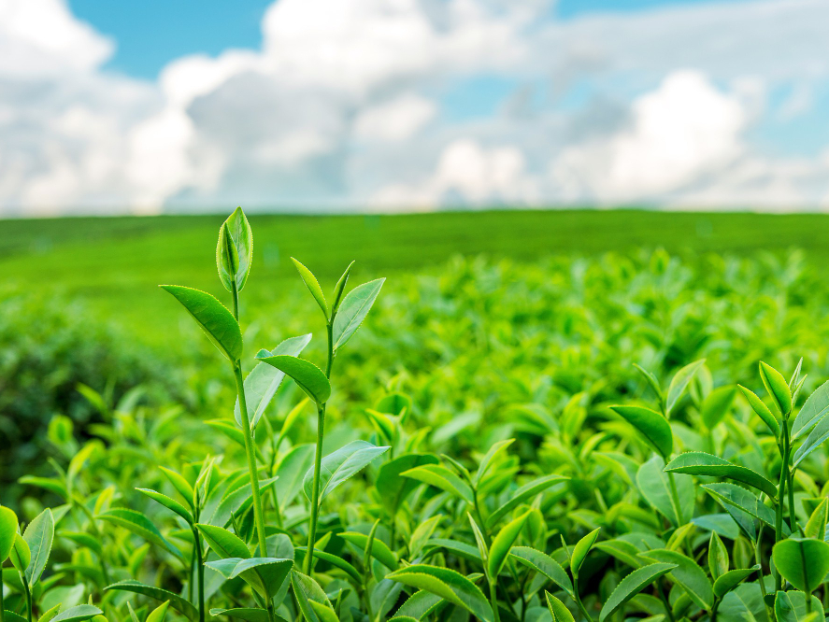
The Impact of Climate Change on Agriculture
Ceren Tekin 32492

Slide 2
Project Idea
This project explores how climate change impacts agricultural productivity and sustainability.
Key variables include:
- Temperature
- Rainfall
- CO2 Levels
- Crop Yield

Slide 3
Dataset
Source: Kaggle Dataset by Waqar Ali
Covers the years 2014 to 2024 across multiple countries.
Variables:
- Region
- Year
- Average Temperature (°C)
- Precipitation (mm)
- Crop Yield (tons/hectare)
- Extreme Weather Events (per year)

Slide 4
Hypothesis
Null Hypothesis (H₀): Climate variables have no significant impact on crop yield.
Alternative Hypothesis (H₁): Climate variables (temperature, precipitation, CO2) significantly impact crop yield.

Slide 5
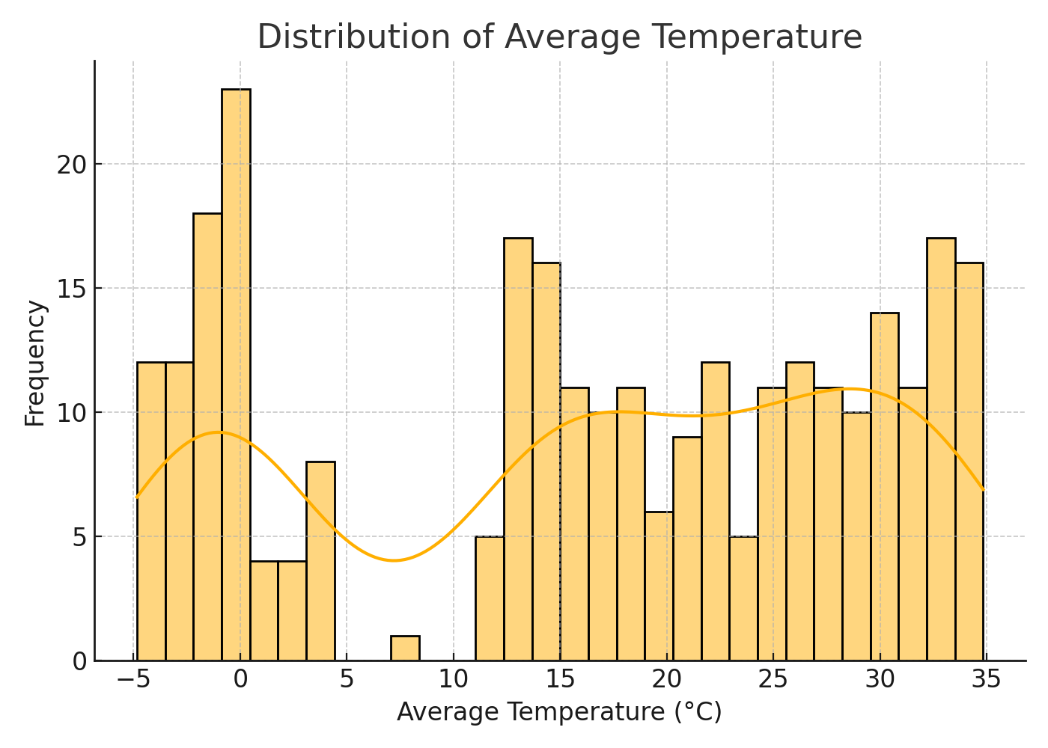
Univariate Analysis

Slide 6
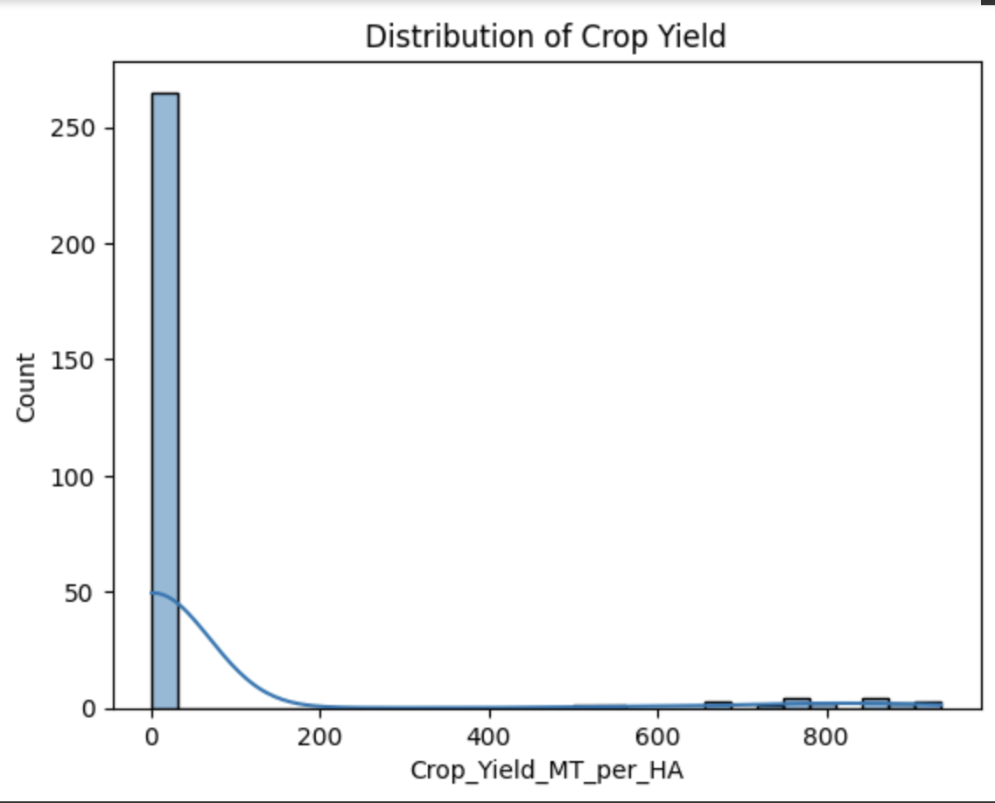
Univariate Analysis

Slide 7
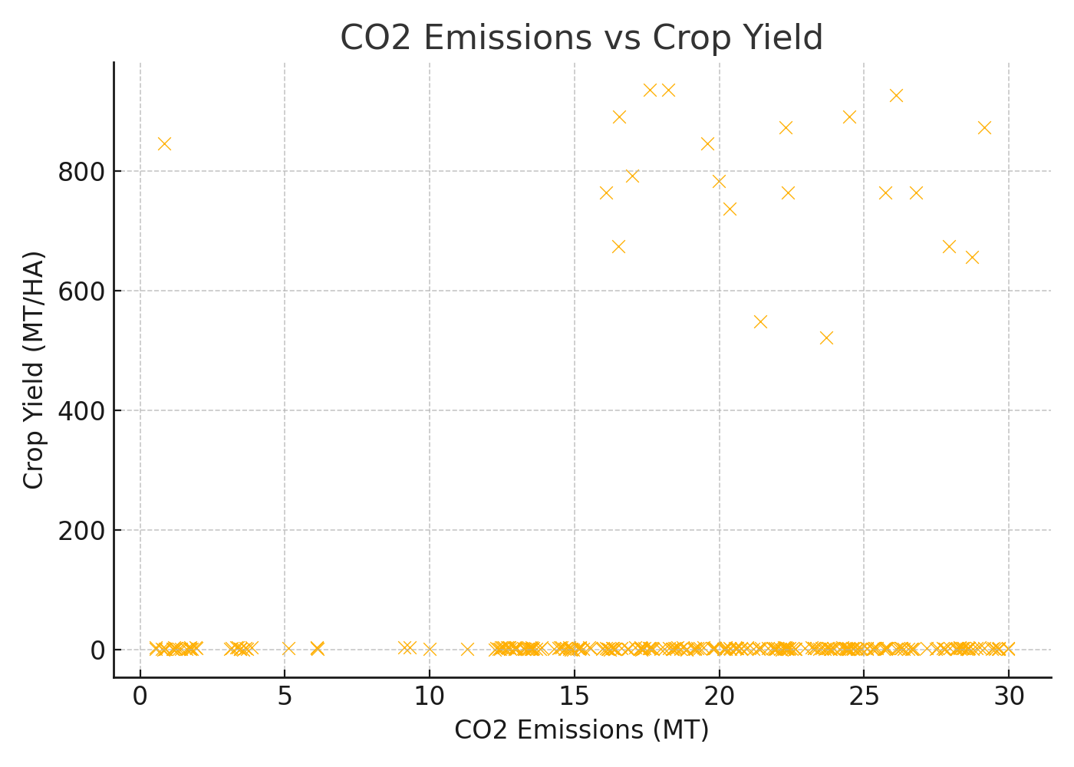
Bivariate Analysis

Slide 8
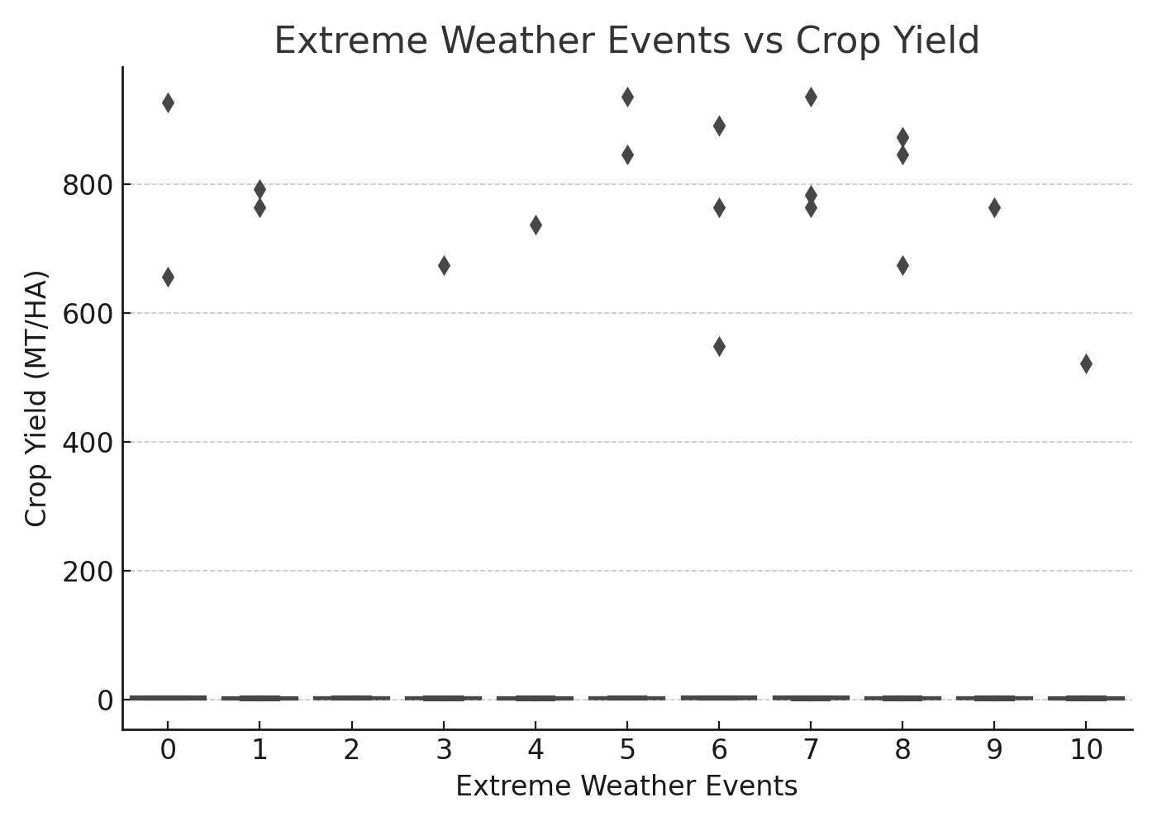
Bivariate Analysis

Slide 9
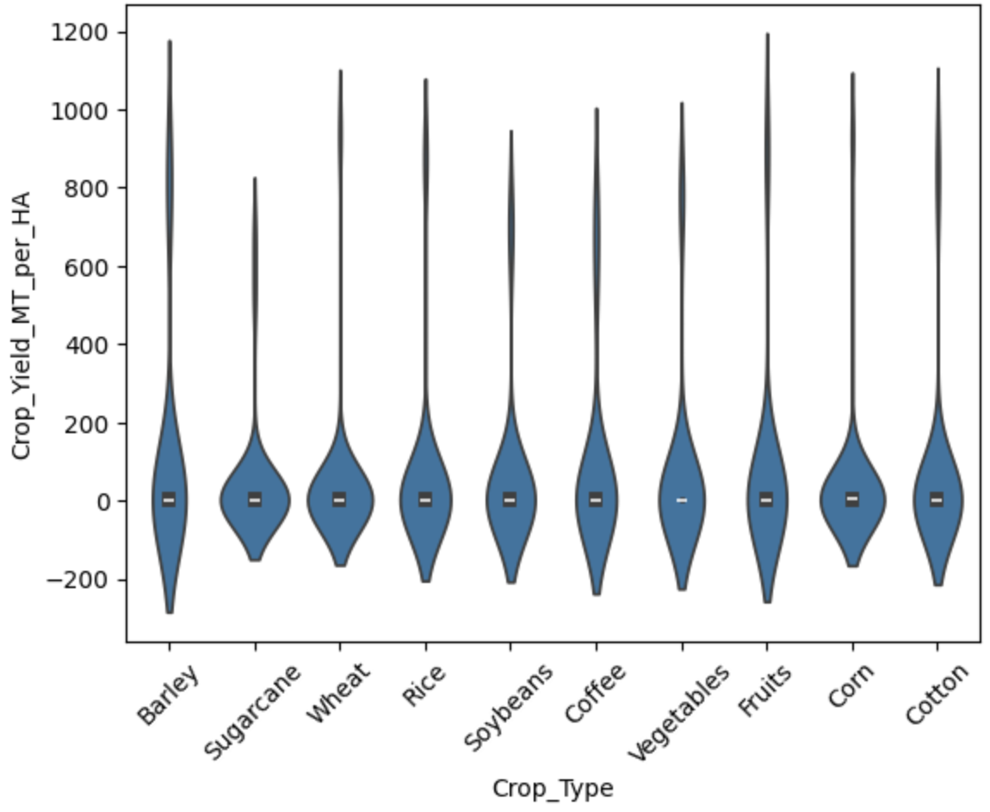
Bivariate Analysis

Slide 10
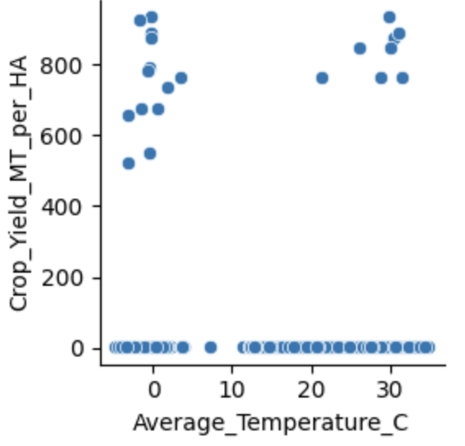
Bivariate Analysis

Slide 11
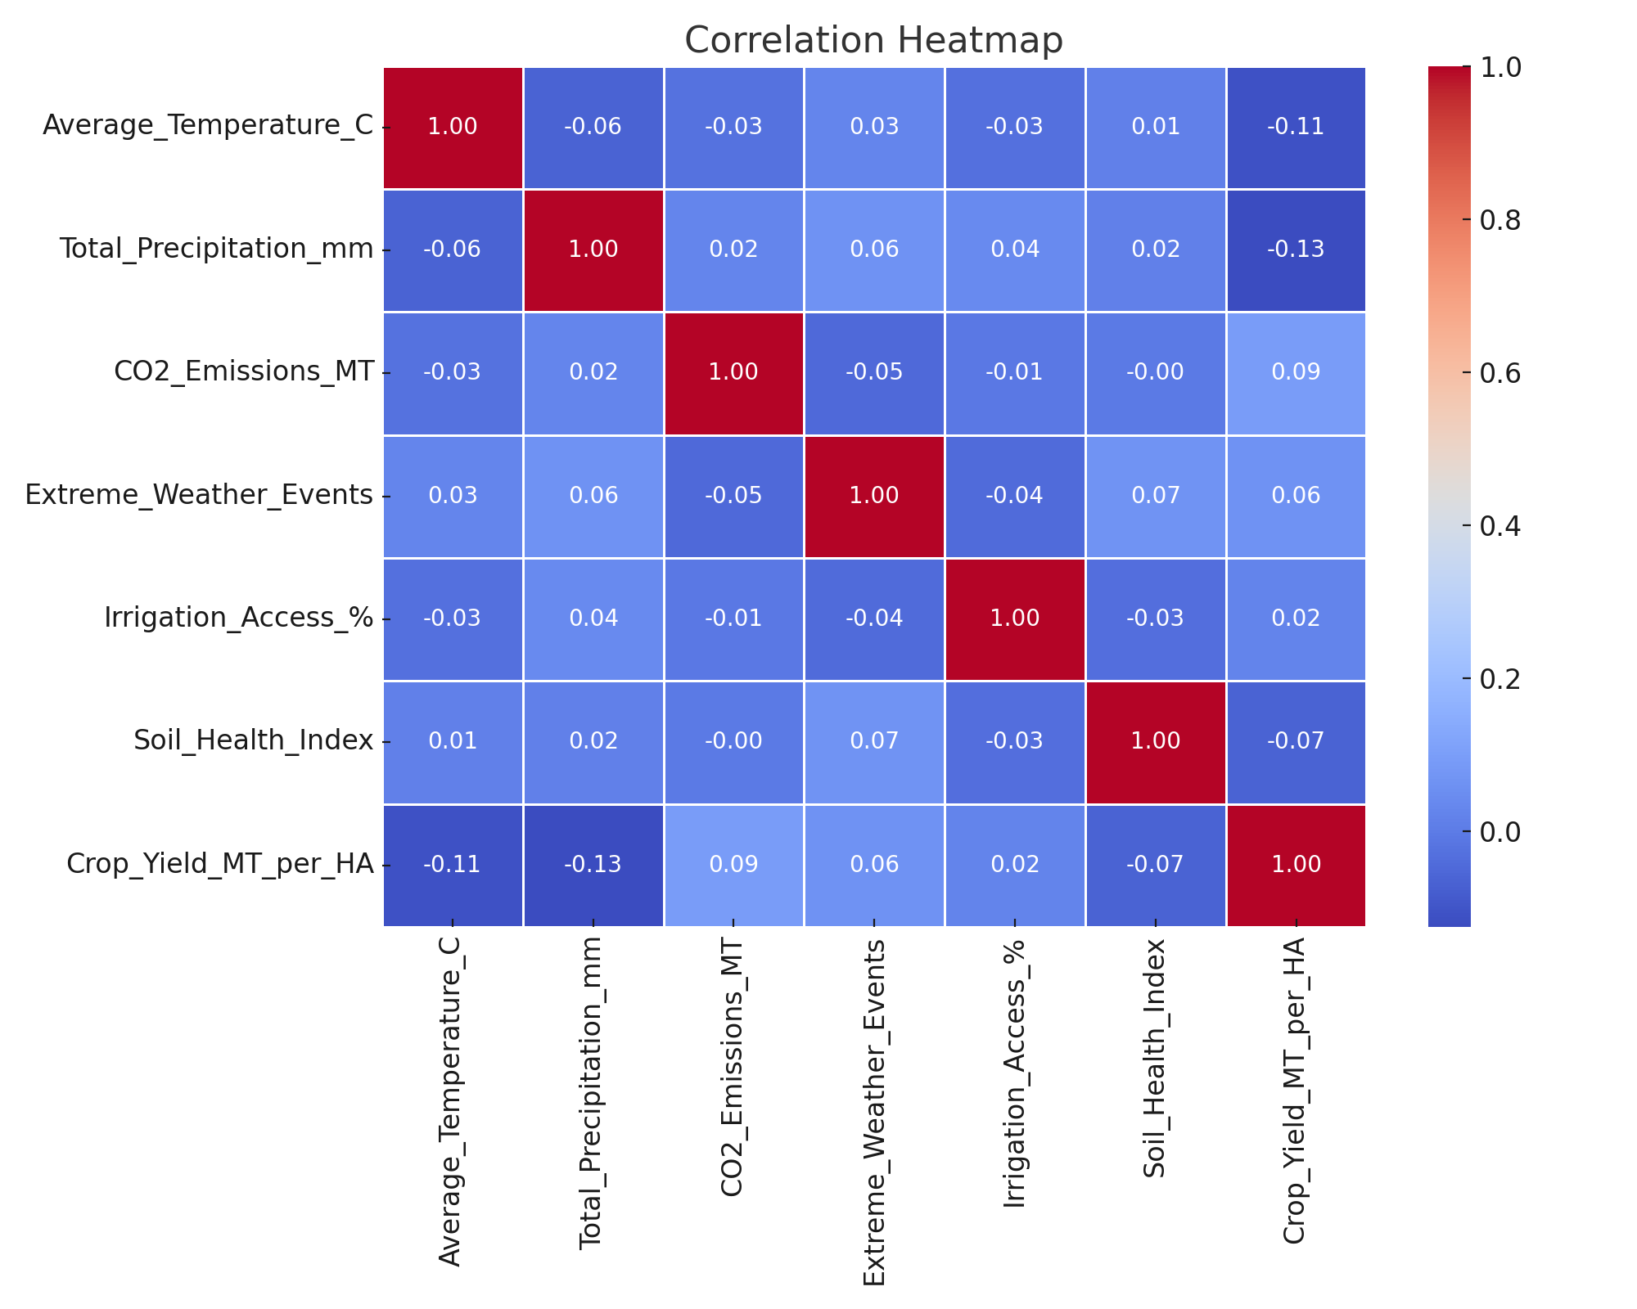
Multivariate Analysis

Slide 12
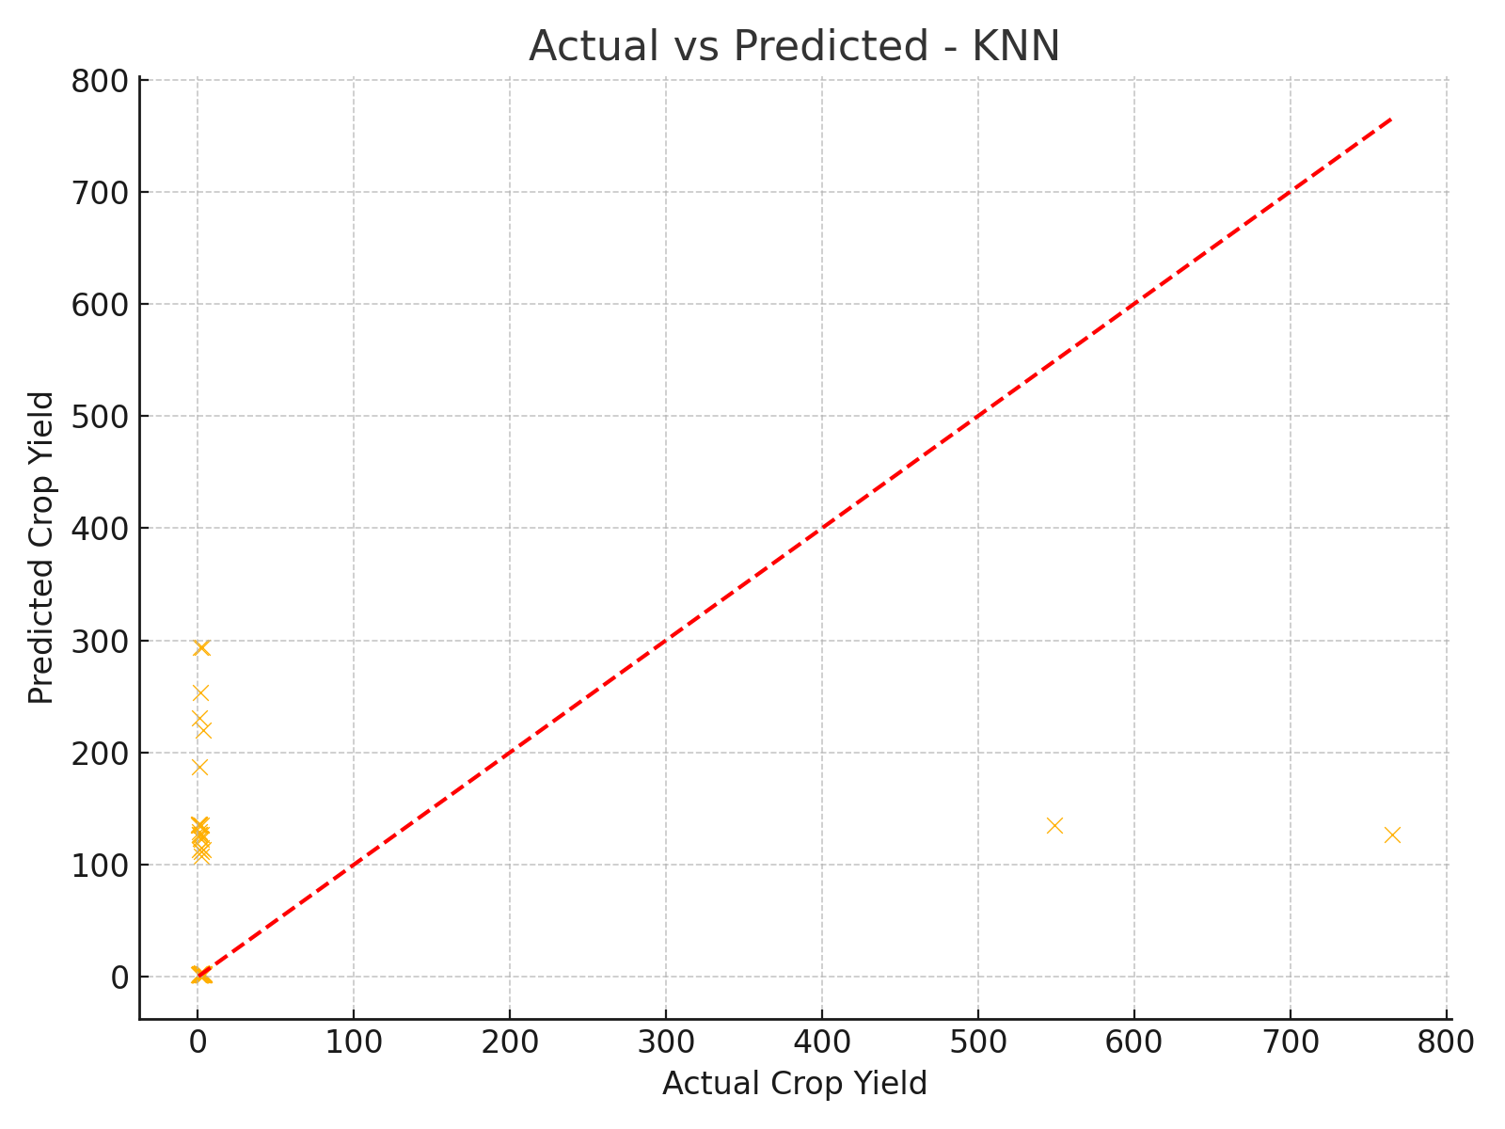
Regression Analysis

Slide 13
Conclusion
- Climate factors significantly impact crop yield.
- Findings support the rejection of the null hypothesis.
- Results can help inform adaptive farming policies.
Future work: Add soil data, socio-economic variables, fertilizer usage.

