Slide 1
Netflix Viewing Patterns Analysis
Ceren Ennice 29524

Slide 2
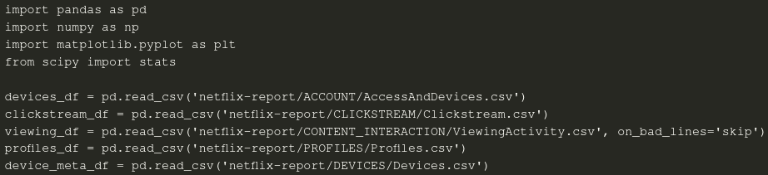
Data Preparation & Aggregations
These steps load the Netflix data, clean and merge tables, convert duration strings to seconds, and build summary tables that each graph will use. Nothing is plotted yet the code just prepares the data.

Slide 3
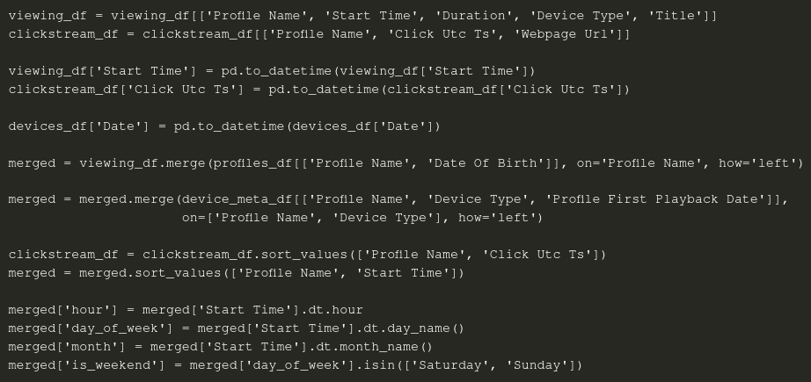
Data Preparation & Aggregations - Merging & Preprocessing Part 1/3

Slide 4
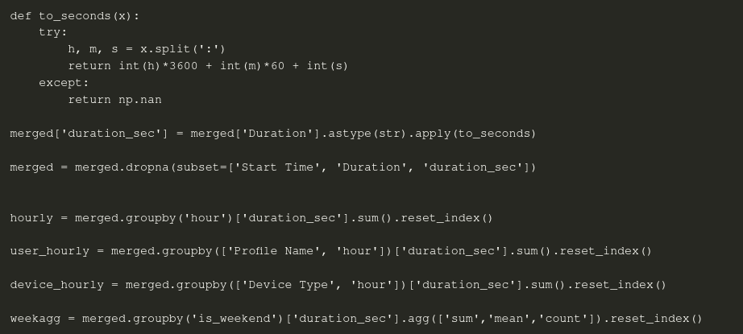
Data Preparation & Aggregations - Merging & Preprocessing Part 2/3

Slide 5
Data Preparation & Aggregations - Merging & Preprocessing Part 3/3
monthly = merged.groupby('month')['duration_sec'].sum().reindex(
['January','February','March','April','May','June','July','August','September','October','November','December']
).dropna().reset_index()
profile_device = merged.groupby(['Profile Name','Device Type'])['duration_sec'].sum().reset_index()
user_totals = merged.groupby('Profile Name')['duration_sec'].sum().reset_index()
device_totals = merged.groupby('Device Type')['duration_sec'].sum().reset_index()

Slide 6
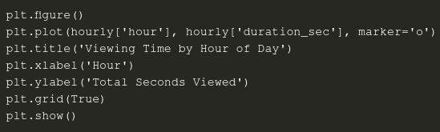
Viewing Time by Hour of Day

Slide 7
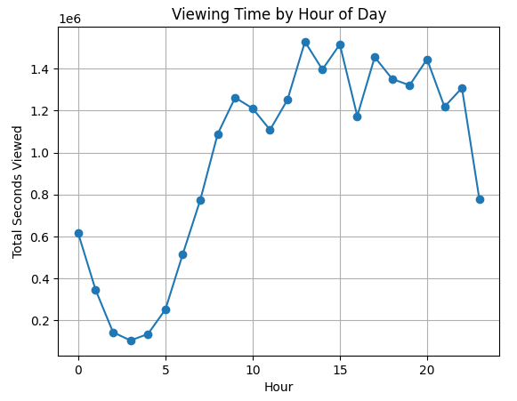
Viewing Time by Hour of Day
• People watch the least between 2 a.m. and 5 a.m. • Watching grows fast after 6 a.m. and stays high until night. • The biggest peak is around 1 – 2 p.m.; a smaller bump appears near 8 – 10 p.m. • Very late at night (11 p.m.–midnight) the numbers drop again.

Slide 8
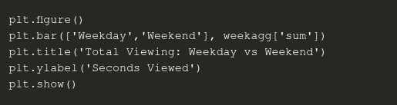
Total Viewing: Weekday vs Weekend

Slide 9
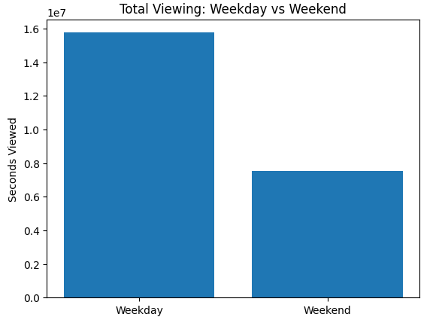
Total Viewing: Weekday vs Weekend
• Weekdays add up to about twice as many seconds as weekends. • So, most viewing still happens Monday–Friday.

Slide 10
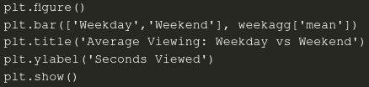
Average Viewing per Day: Weekday vs Weekend

Slide 11
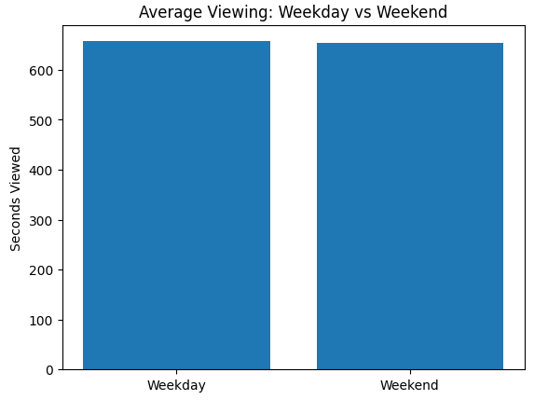
Average Viewing per Day: Weekday vs Weekend
• A single weekday and a single weekend day look almost the same (~650 s). • The higher total on weekdays is only because there are five weekdays vs two weekend days.

Slide 12
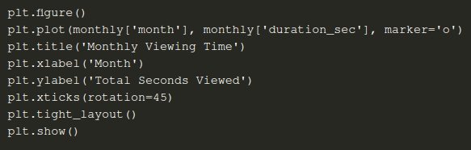
Monthly Viewing Time

Slide 13
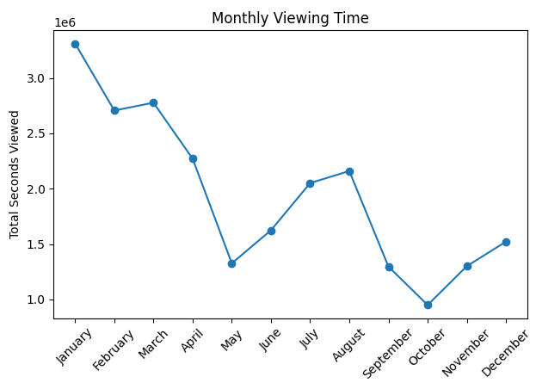
Monthly Viewing Time
• January is the top month; March also stays high. • Viewing falls in May and is lowest in October. • It rises again in November and December. • This hints at more free time in winter and less in late spring/early autumn.

Slide 14
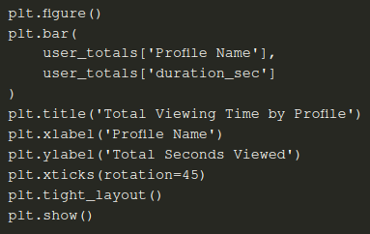
Total Viewing Time by Profile

Slide 15
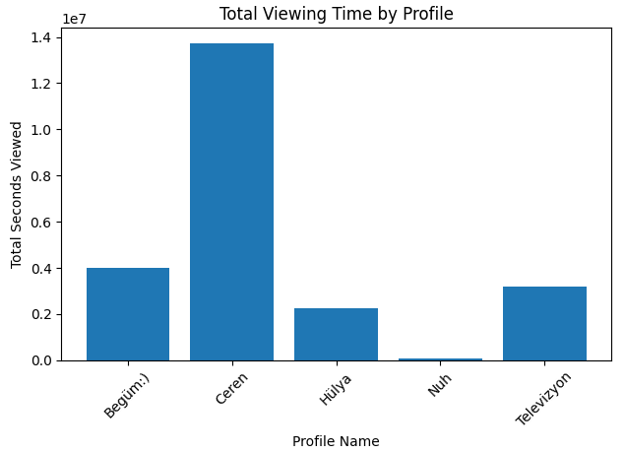
Total Viewing Time by Profile
• Ceren watches the most—far more than anyone else. • Begüm:) and Televizyon are mid‑range. • Hülya watches some but not a lot. • Nuh watches almost nothing.

Slide 16
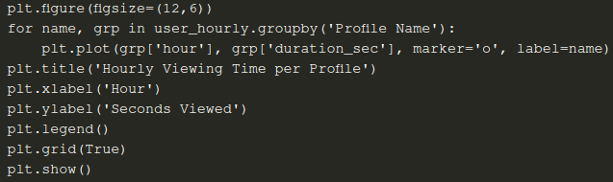
Hourly Viewing Time per Profile

Slide 17
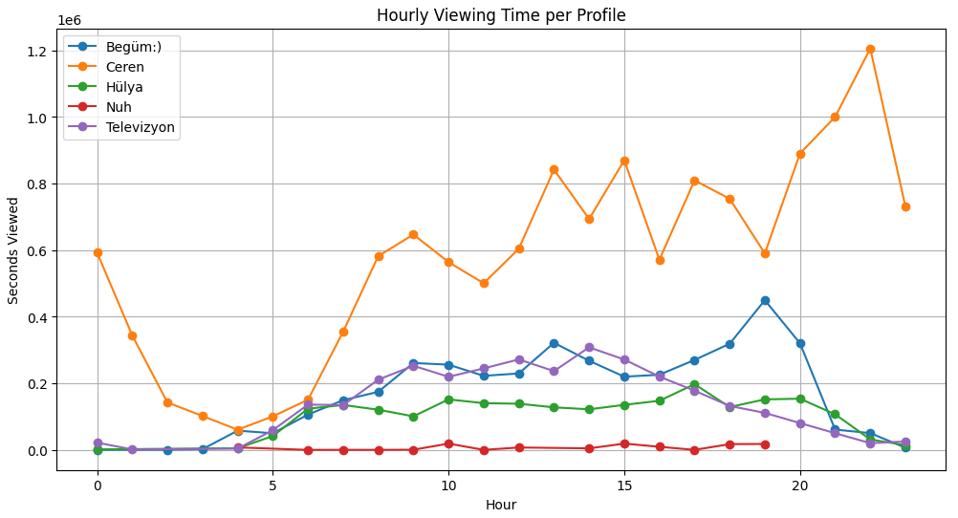
Hourly Viewing Time per Profile
• Ceren is active almost all day, with big spikes at lunch and late evening. • Begüm:) mainly watches after 6 p.m., peaking around 8–9 p.m. • Hülya and Televizyon watch in the late morning and early afternoon. • Nuh stays near zero at every hour.

Slide 18
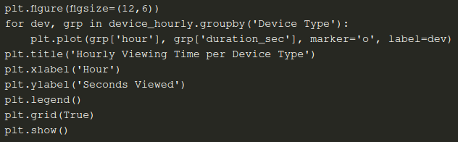
Hourly Viewing Time per Device Type

Slide 19
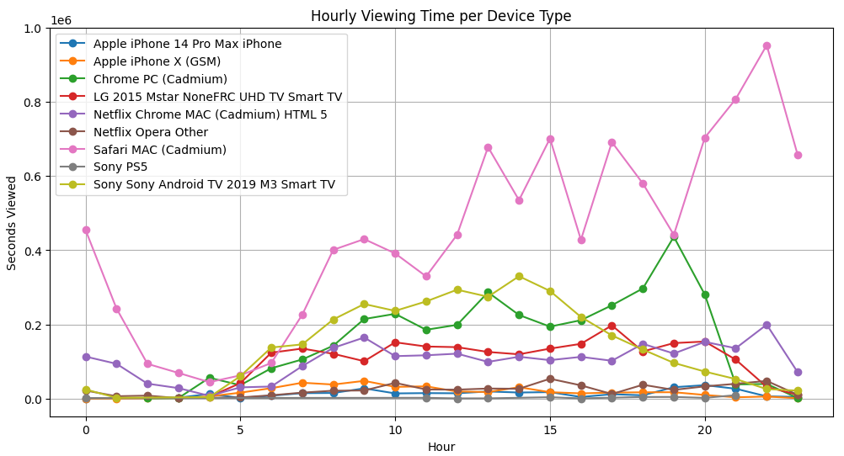
Hourly Viewing Time per Device Type
• Safari MAC dominates; usage climbs through the day and peaks late at night. • Chrome PC and Sony Smart TV rise from morning, peaking around 7–8 p.m. • Phones (iPhone 14 Pro Max, iPhone X) show steady use, mostly evenings. • Consoles and other browsers stay low all day.

Slide 20
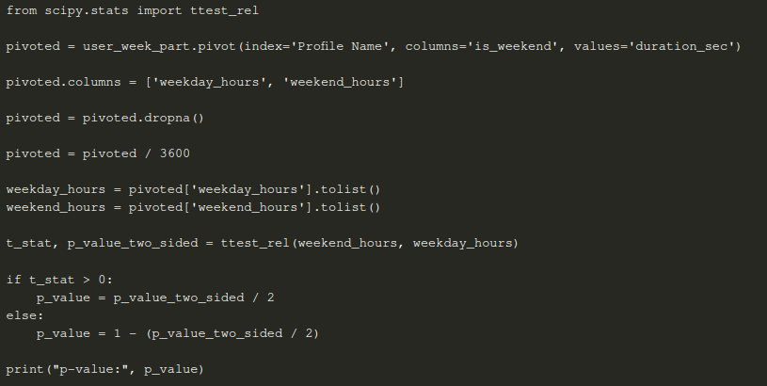
Hypothesis Testing

Slide 21
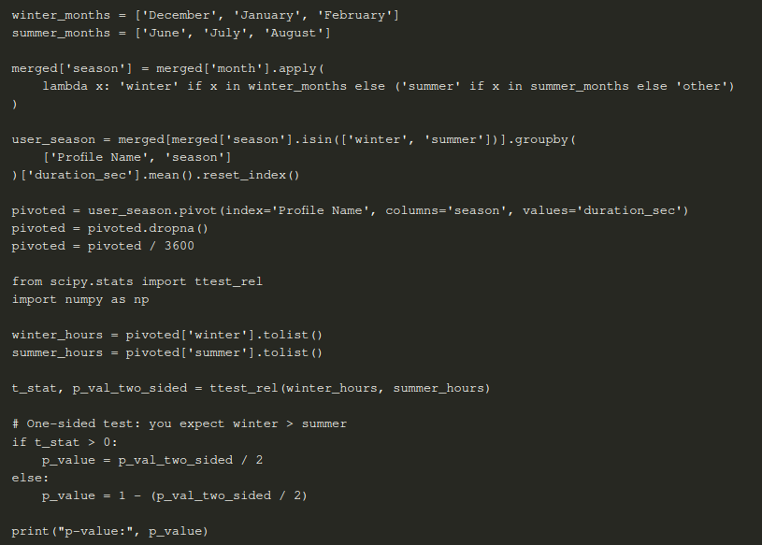
Hypothesis Testing

Slide 22
Hypothesis Testing
The hypothesis tests for both increased weekend viewing and increased winter viewing did not yield statistically significant results. The p-value for weekend vs. weekday viewing was approximately 0.186, and for winter vs. summer viewing, it was about 0.161 — both above the commonly used significance threshold of 0.05. This means that, based on the data, we do not have strong enough evidence to conclude that users watch significantly more on weekends or during winter months. While there may be a trend toward increased viewing during these periods, the observed differences could also be due to random variation in user behavior.

Slide 23
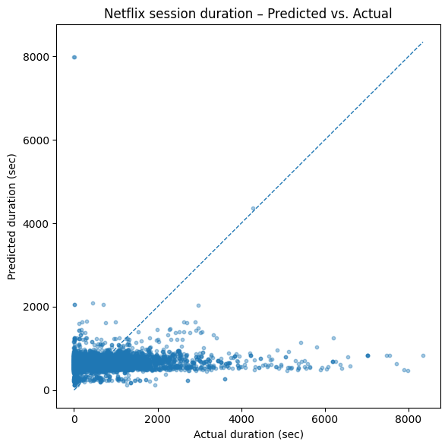
Session Length Estimation
GradientBoostingRegressor
The scatter shows the model hugs short sessions < 1 000 s and badly under-predicts anything longer.
• MAE ≈ 10 min and R² near zero confirm the algorithm captured little pattern — session length looks almost random once hour, device and profile are controlled for.
• A richer temporal context (e.g. past-session lags) or a zero-inflated model might do better, but simple gradients are not enough here.

Slide 24
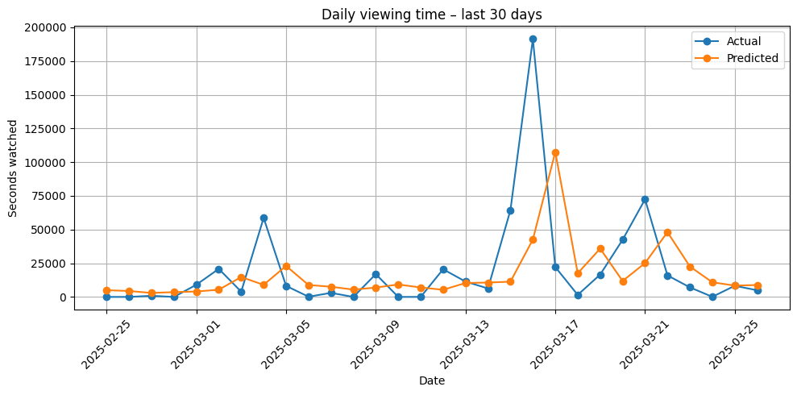
Daily Viewing Time Estimation

Slide 25
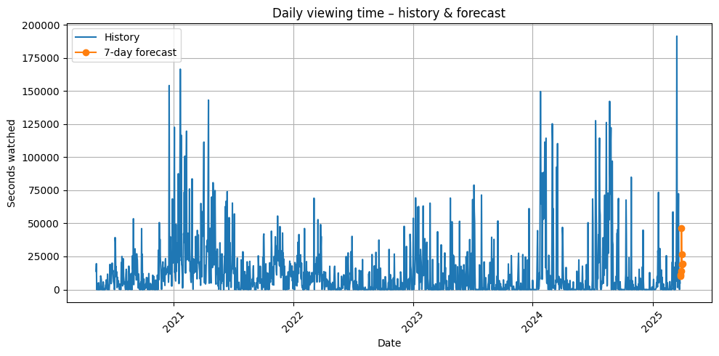
Daily Viewing Time Estimation
• On the last 30 days the GBM follows the broad ups-and-downs (R²≈0.31) but still misses big spikes.
• The right-hand markers extend the model 7 days ahead; forecasts trend upward after a lull, matching the usual mid-month rebound.
• Because viewing can jump 10× day-to-day, even a 3.5-hour MAE is reasonable, yet highlights how noisy household behaviour is.

Slide 26
Conclusion
The analysis broadly supports these ideas:
Hourly pattern: Viewing is minimal overnight, climbs sharply after 6 a.m., and shows two clear surges— a midday bump (around 13:00) and a stronger evening peak (18:00‑23:00).
Weekday vs weekend: Total seconds are higher on weekdays simply because there are five of them, but the average per day is almost identical, confirming similar engagement once day‑count is controlled.
Seasonality: Winter and early‑spring months (January–March) dominate; activity dips in late spring and early autumn, then rises again in November–December, matching the “more TV in colder months” expectation.
Device & profile insights: A single Mac‑Safari setup drives most viewing, and one profile (“Ceren”) accounts for almost half of all screen time, suggesting heavy individual influence on household patterns.

