Slide 1

CARBON FOOTPRINT OF AIR TRAVEL
TEAM NAME: VENÜS
Ceren Umay Özten
Büşra Aydın
Melis Küçük

Slide 2

Project Name: Carbon Footprint of Air Travel
Challenge: What Is Our Carbon Footprint?
Aim: Carbon Footprint of the Air Travel application aims to inform people by evaluating the person's air travel according to the departure and arrival airport points selected by the person.
Tools Used in Project:
Microsoft SQL Management Studio 2018
C#
Visual Studio 2017
(Logo of Application)
1

Slide 3
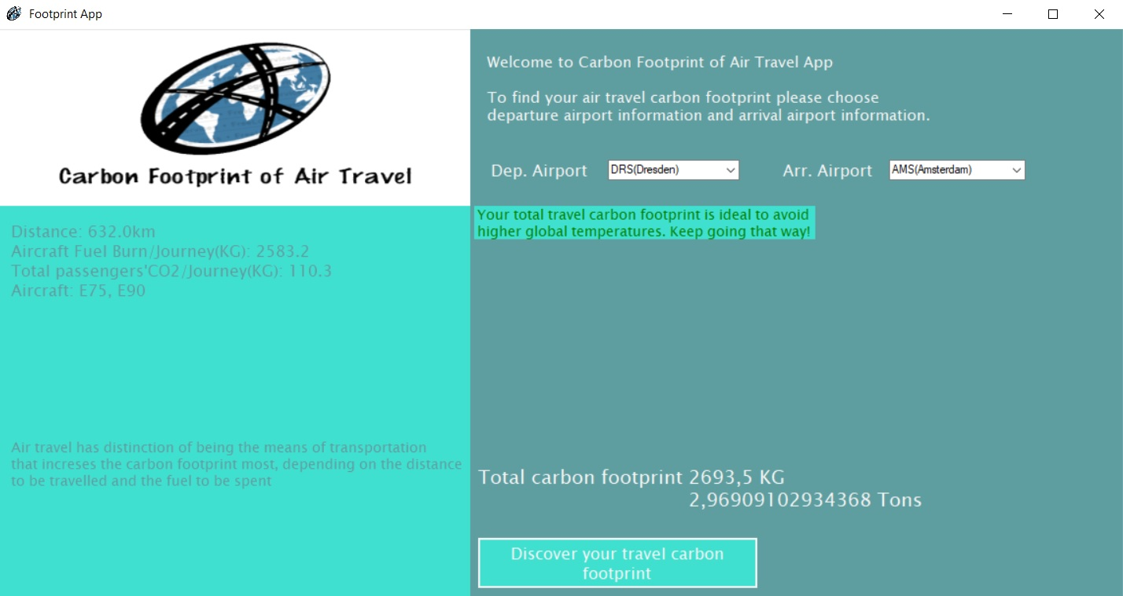
2

Slide 4
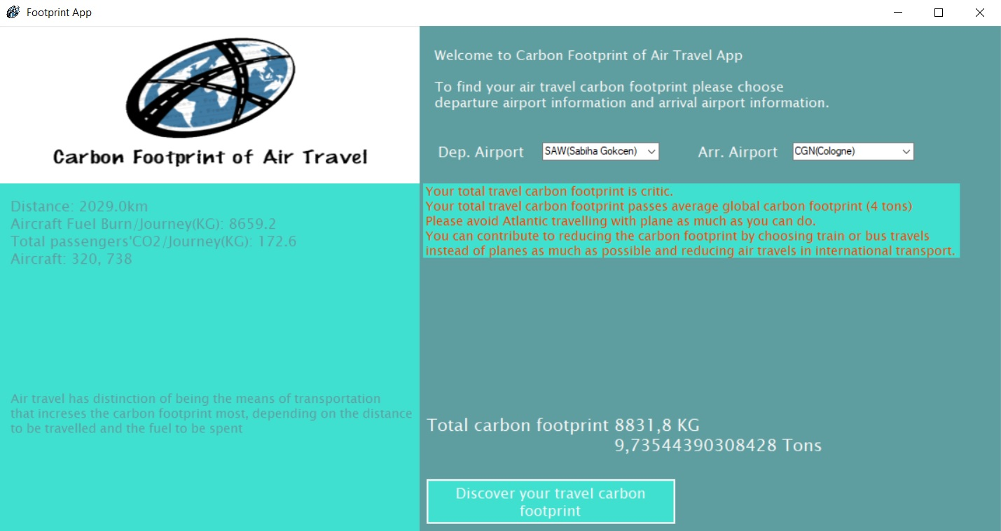
3

Slide 5

4

Slide 6
Solution: The carbon footprint application, which is designed to help map carbon sources, is designed to determine the amount of carbon emissions of travel between airports and shows information messages in green, orange and red colors according to the total footprint between airports. These colors indicate that the amount of carbon footprint of people who will use airports is at normal, critical and dangerous levels. Collective consciousness of everyday people can make huge contribution to decreasing of global carbon footprint and this is agreed by among scientists around the world.
5

Slide 7
RESOURCES
https://www.icao.int/environmental-protection/Carbonoffset/Pages/default.aspx
6

