Slide 1


Secure Student Informatıon System Usıng PHP and PostgreSQL
181180762 Erkin Berk Türe
181180060 Ceren Umay Özten
181180761 Doğukan Okçu

Slide 2
GENERAL STRUCTURE OF THE SYSTEM
In the process of developing the system first we design modules of the structure and combine modules for implementing application design
config.php
Contains database connection and additional functions for information system.
index.php
Index.php main page for authentication and authorization for user_type. If user logged in systems skips index page directly shows profile page. In all pages checks user for logged in by using sessions( user no, user password and user type)
profile.php
Profile page checks user type and if it is admin , shows admin’s profile view which has manage courses and listing courses.If user_type is student , profile page shows students enrolled courses, all courses and student informations. Which also have logout post request inside.
coursecrud.php
This module also works like profile.php because first user’s authentication then user_type is checked and show admin and student completely different pages.
For student view, students can add and drop courses.
For admin view, admins create and delete courses which students enroll.
The system is designed for enabling students to login securely and then enabling to safely do course selections, add and drop course events for students on the other hand create and delete course events by using their admin privileges for lectures

Slide 3
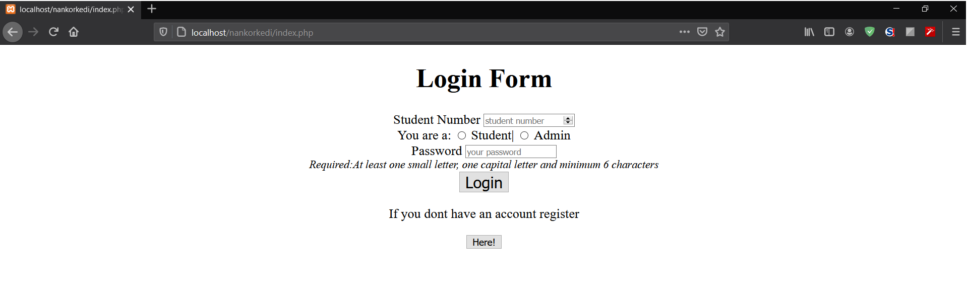
USER OPERATIONS
Users can reach login screen by typing ‘index.php’ module
index.php module enables every user to login first, by making the necessary server connections through xampp in localhost
Registration process keep user type as user_type which can be admin or student.
If user is already registered, user can be directed to url extensions as student or admin profile
If user is not registered, user can click the ‘here’ button in index module for creating a new user registration

Slide 4
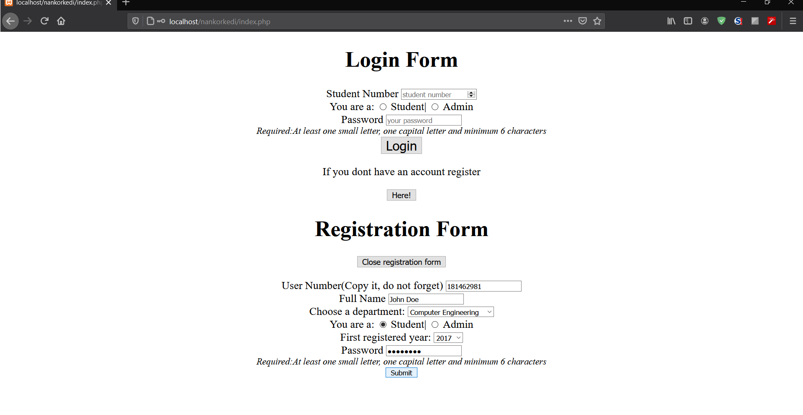
USER Registratıon
In registering process userd enter user number which is created automatically while registering, full name, registered department, user type, first registered year and password
If registering process is successful, users can drop, delete, add and view the registered course information in the system with allowance of their authorization and limitation of user type
SQL-based database holds information of each registered studenti teacher and course with management of Postgre SQL database system using ‘pgAdmin’

Slide 5
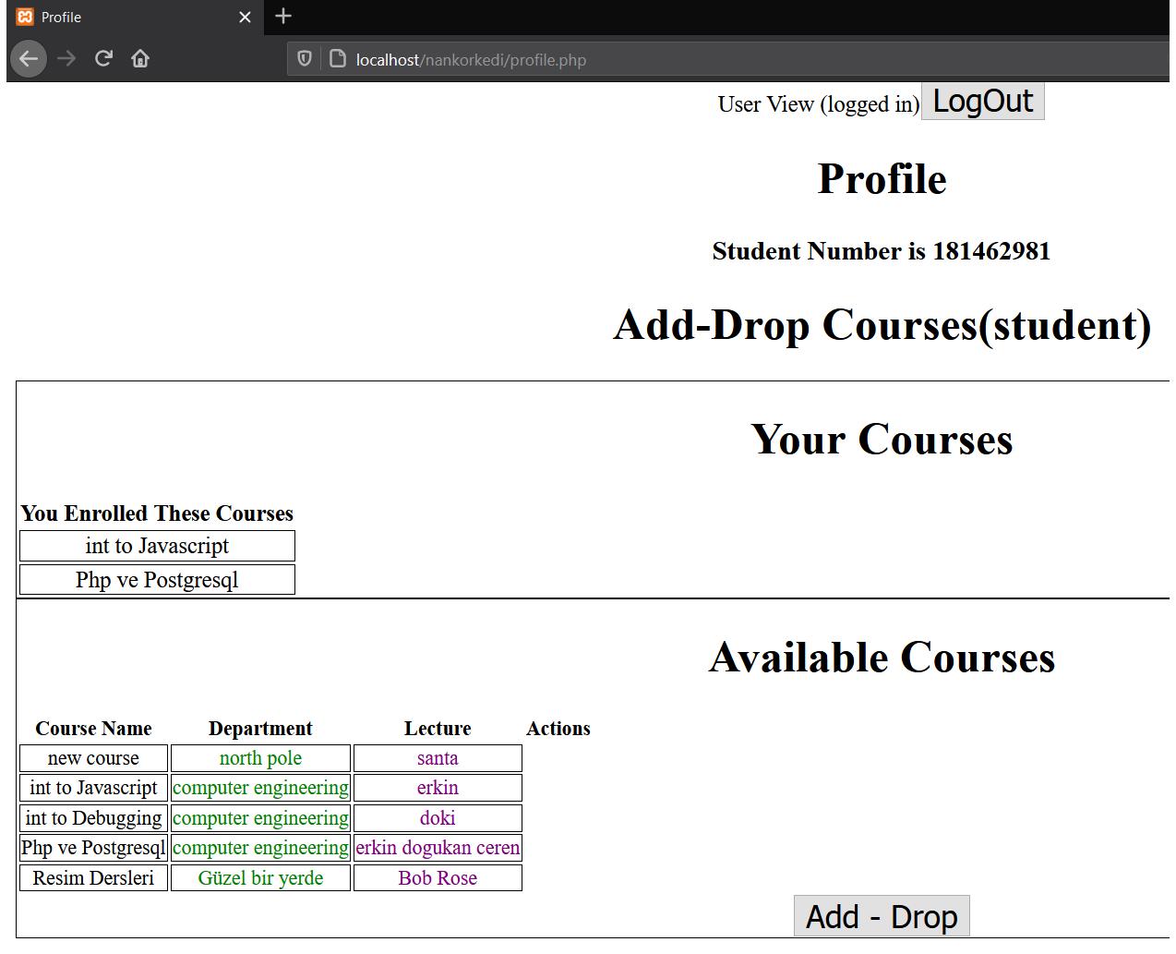
STUDENT OPERATIONS
Students log in system by choosing their user type as student with their own randomly generated student numbers which created during registering process and their passwords
Student numbers are starting with number ‘181’
Student passwords must be consisting of at least one small letter, one capital letter and minimum 6 characters
In student profile there is ability to view courses which is registered by student number, add and drop desired course
Student can exit profile after pushing ‘LogOut’ button

Slide 6
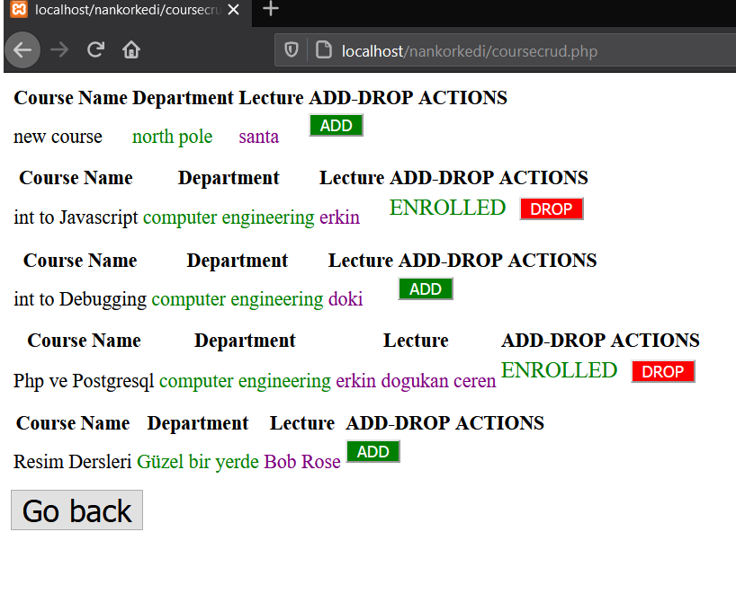
STUDENT add-drop course operatıons
Students can add and drop courses in coursecrud php modue
Once student add the course , ‘ENROLLED’ sign and drop operation appears
These courses listing from courses table and controls happens with enrollment table using student’s number

Slide 7
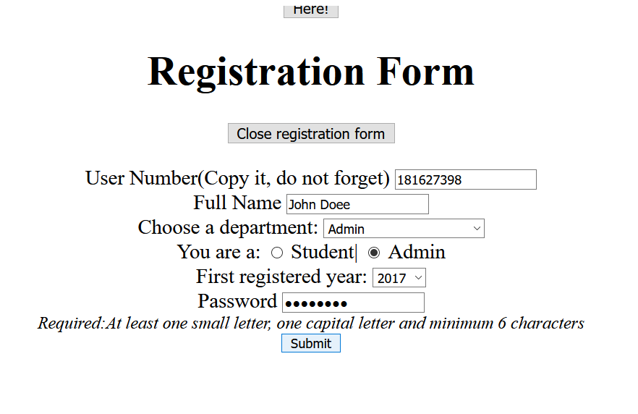
Admın (lecturer) Registratıon
Lecturers log in through login system by choosing their user type as admin with their own randomly generated admin numbers which created during registering process and their passwords
Admin numbers are starting with number ‘181’
Admin passwords must be consisting of at least one lowercase, one uppercase and minimum 6 characters

Slide 8
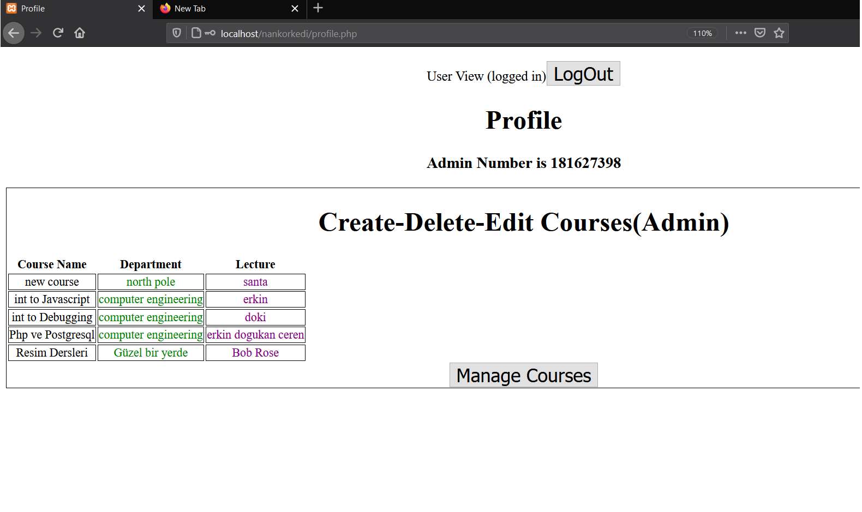
Admın OPERATIONS
On admin profile there is ability to view the courses which is registered by admin number on profile allowing admin to fill in required course name, lecturer and department fields
Lecturer has ability to delete courses as well
Lecturer can log out by pushing LogOut button

Slide 9
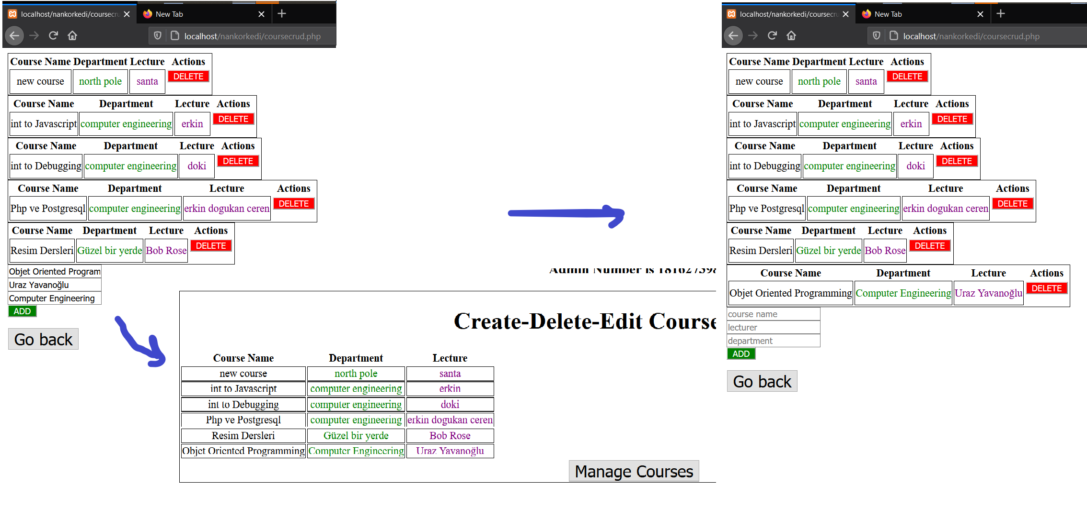
Admın OPERATIONS (create and delete course)
Admin create course and delete course action images;

Slide 10
WORKING ORDER OF SERVICES
Student Information system provides registration and login according to the user number given by the system ‘password and user type’
The system stores encrypted password with md5 hashing algorithm
The system creates and deletes (CRUD) operations
Our services enable users to be fast, secure and confident about their password security

Slide 11
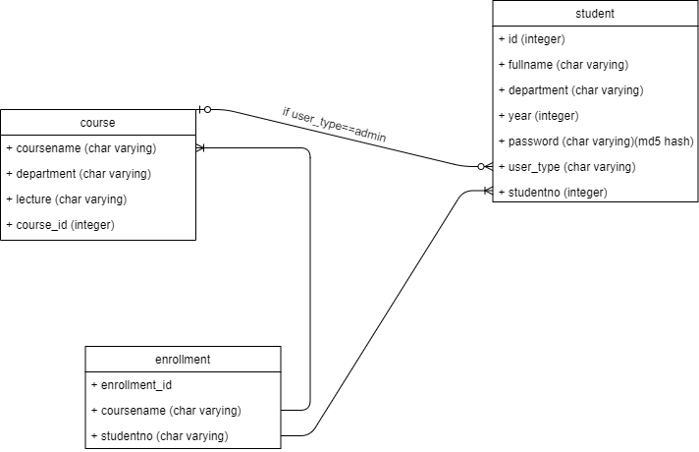
WORKING ORDER OF SERVICES
User can sign up and use different features depending on the user type
Relation between tables on time of course addition, deletion, replacement and updating is build up with an intermediate table that holds common features as a key

Slide 12
SECURITY ADDITIONS
Within scope of Secure coding use several Secure coding techniques
We use prepare and execute functions instead of typing directly the query functions with their connections to PHP Data Objects
With prepare and execute functions we prevent SQL injections by client side

Slide 13
SECURITY ADDITIONS
md5 hashing and PHP Form security used during database storation and later comparison of the password created during user registration
‘htmlspecialchars’ functions prevent malicious scripts that are created by client side and secure $_SERVER[‘PHP_SELF’] global variable from Cross-site scripting (XSS) vulnerability
isset($_SESSION[‘login’]) funtions prevent client side from enter profile site through url address and control whether user makes valid login or not

