Slide 1

Using Machine Learning to downscale climate scenarios
A Robust Statistical Downscaling Framework for Regional Adaptation
Presenter: Christian Pagé, Research Engineer at Cerfacs, Toulouse, France
| Irida Lazić, PhD, University of Belgrade, Serbia | Milica Tošić, University of Belgrade, Serbia
EGU26 General Assembly, Vienna, Austria | May 2026
Notes:
Welcome everyone. Today we are bridging the gap between Global Climate Models and local adaptation needs using Deep Learning. This workshop is designed for both researchers and practitioners.

Slide 2
THE RESOLUTION GAP
The Problem: GCMs operate at ~100-150 km.
The Need: Local adaptation requires <10 km.
Challenges:
Topography-induced temperature gradients.
Coastline effects.
Urban heat islands.
Goal: Reconstruct spatial variability hidden in coarse pixels.
EGU26 | Christian Pagé, Irida Lazić, Milica Tošić
2

Slide 3
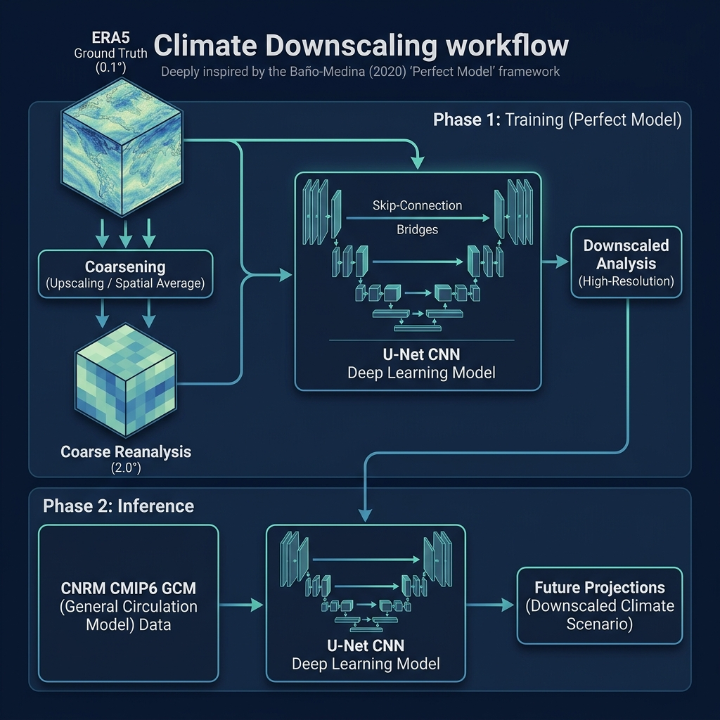
THE "PERFECT MODEL" STRATEGY
The Concept: Derived from Baño-Medina et al. (2020).
Key Idea: We cannot train on GCM-Observation pairs because their weather chronologies (dates) don't match.
Solution: Use ERA5 Reanalysis as a laboratory.
Steps:
EGU26 | Christian Pagé, Irida Lazić, Milica Tošić
3

Slide 4
WHY ERA5? ALIGNED CHRONOLOGY
Input (X): Coarsened ERA5 (Simulated GCM).
Target (Y): Original ERA5 Ground Truth.
Alignment: Perfect 1-to-1 match for every historical day.
Benefit: The model learns pure spatial physics without "weather guessing".
EGU26 | Christian Pagé, Irida Lazić, Milica Tošić
4

Slide 5
TRANSITION TO REAL GCMS
Once trained on ERA5, the "brain" is frozen.
We then feed real CMIP6 GCM data into it.
Assumption: The spatial relationships learned in the Reanalysis world hold true in the GCM world.
EGU26 | Christian Pagé, Irida Lazić, Milica Tošić
5

Slide 6
DOMAIN OF INTEREST: FRANCE ROI
Bounding Box: [ -6.0, 10.0, 38.0, 54.0 ].
Resolution: 10 km target grid.
Physical Features: Massive Central, Alps, Pyrenees.
Selection: France was chosen for its high topographical contrast.
EGU26 | Christian Pagé, Irida Lazić, Milica Tošić
6

Slide 7
BIAS CORRECTION: THE IBICUS ENGINE
The Issue: GCMs have their own "Chronology Bias" (too cold/dry compared to history).
Responsibility: We must fix GCM distributions before downscaling.
The Tool: Ibicus python package (CDF-t method).
Action: Align GCM data distributions with ERA5.
Result: The U-Net receives "ERA5-like" distributions, focusing pure spatial mapping.
EGU26 | Christian Pagé, Irida Lazić, Milica Tošić
7

Slide 8
U-NET: THE ARCHITECTURE OF CHOICE
Structure: Encoder-Decoder.
Encoder: Compresses patterns into "climate features".
Decoder: Expands features back to a high-res grid.
Skip-Connections: The most critical component.
EGU26 | Christian Pagé, Irida Lazić, Milica Tošić
8

Slide 9
THE ROLE OF SKIP CONNECTIONS
Mechanism: Direct data bridges from Encoder to Decoder.
Purpose: Re-inject topographic details (Elevation) directly into the output.
Benefit: Prevents the mountains from "moving" or becoming blurry.
EGU26 | Christian Pagé, Irida Lazić, Milica Tošić
9

Slide 10
TRAINING SETTINGS (EXP5)
Parameter | Value | Rationale
**Epochs** | 60 | Sufficient for convergence.
**Batch Size** | 32 | Balance between speed and stability.
**Learning Rate** | 0.001 | Standard Adam optimizer starting point.
**Normalization** | Standard | Mean 0, Std 1 for targets.
EGU26 | Christian Pagé, Irida Lazić, Milica Tošić
10

Slide 11
THE "113 K" BIAS LESSON
The Trap: Attempting to train directly on absolute Kelvin values (~284 K).
Failure: Loss (MSE) becomes massive: |284|^2 approx 80,000.
Outcome: Gradients explode; weights saturate; RMSE plateaus at 113 K.
The Lesson: Always normalize your targets in Deep Learning.
EGU26 | Christian Pagé, Irida Lazić, Milica Tošić
11

Slide 12
NORMALIZATION LOGIC
Output Norm: (Target - Mean) / Std.
Effect: Brings the range to approx [-3, 3].
Stability: Allows the loss function to focus on fine details, not massive magnitudes.
EGU26 | Christian Pagé, Irida Lazić, Milica Tošić
12

Slide 13
NUMERICAL TRAP SUMMARY
Lesson 1: Scaling is not optional.
Lesson 2: MSE sensitivity to magnitude can paralyze convergence.
Lesson 3: Check your training logs for "NaN" or flat plateaus early.
EGU26 | Christian Pagé, Irida Lazić, Milica Tošić
13

Slide 14
PHASE 1: MODEL VALIDATION (MAPPING ACCURACY)
Scenario: Downscaling coerced ERA5 (Input) against ERA5-HR/E-OBS (Target).
Goal: Does a "perfect" input produce a perfect output?
Temporal RMSE: 4.15 K (Validated Benchmark).
Spatial Mean RMSE: 5.11 K.
EGU26 | Christian Pagé, Irida Lazić, Milica Tošić
14

Slide 15
MAPPING BIAS VS. GCM BIAS
Mapping Bias: The error between UNet output and Ground Truth (Mapping failures).
GCM Bias: The error between raw GCM and Reanalysis (Data failures).
Scientific Rule: You cannot assess Climate Change if your Mapping Bias is high on historical data.
EGU26 | Christian Pagé, Irida Lazić, Milica Tošić
15

Slide 16
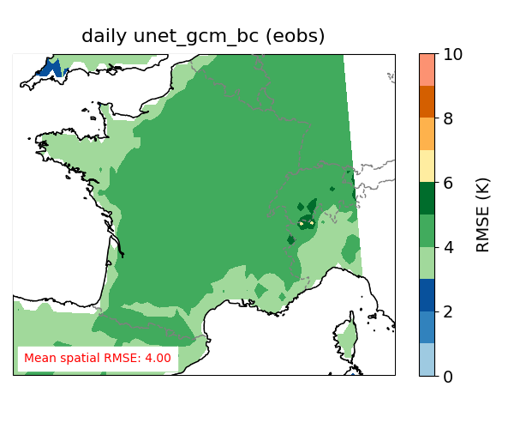
SPATIAL DISTRIBUTION OF ERROR (RMSE)
Observation: Errors are remarkably low in plains.
Challenge: Errors concentrate in mountains.
Success: Mean spatial RMSE is 5.11 K.
EGU26 | Christian Pagé, Irida Lazić, Milica Tošić
16

Slide 17
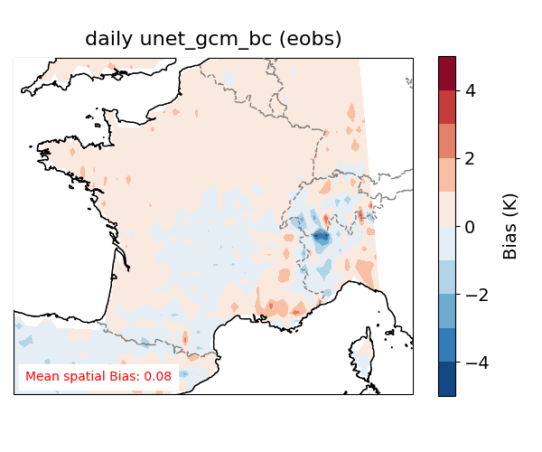
SYSTEMATIC MAPPING BIAS (UNET BIAS)
Observation: The model shows a systematic warm bias (1.15 K).
Concentration: Highly localized in the Alps and high-altitude regions.
Interpretation: Systematic drift from ground truth even on ERA5 data.
EGU26 | Christian Pagé, Irida Lazić, Milica Tošić
17

Slide 18
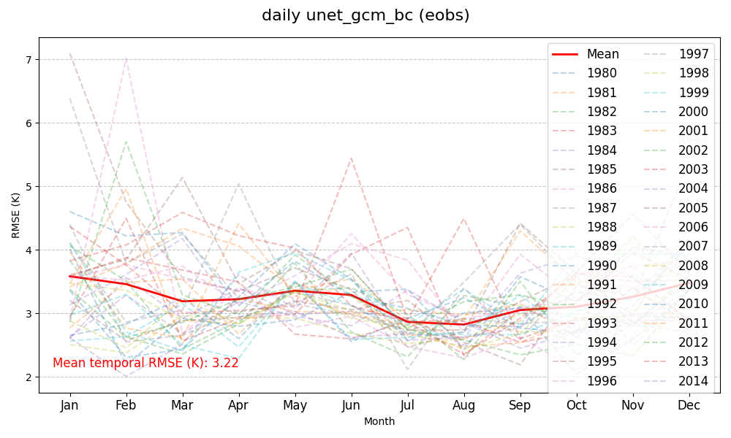
THE ALPS CHALLENGE: A MAPPING BIAS
Observation: Winter RMSE in the Alps hits 10 K even on Reanalysis data.
The Source: This is a pure mapping bias, not a GCM issue.
The "Why": Missing local snow height and inversion layer physics.
The Source: This is a pure mapping bias, not a GCM issue.
The "Why":
Missing local snow height and inversion layer physics.
Smoothing effect of the standard MSE loss function.
EGU26 | Christian Pagé, Irida Lazić, Milica Tošić
18

Slide 19
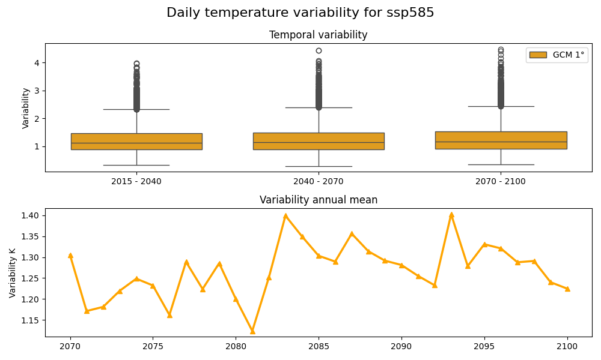
VARIABILITY LOSS & SMOOTHING
Observation: UNet variability is lower than GCM.
The "Regression to Mean" issue: MSE loss favors the average solution.
Consequence: Underestimation of extreme extremes.
EGU26 | Christian Pagé, Irida Lazić, Milica Tošić
19

Slide 20
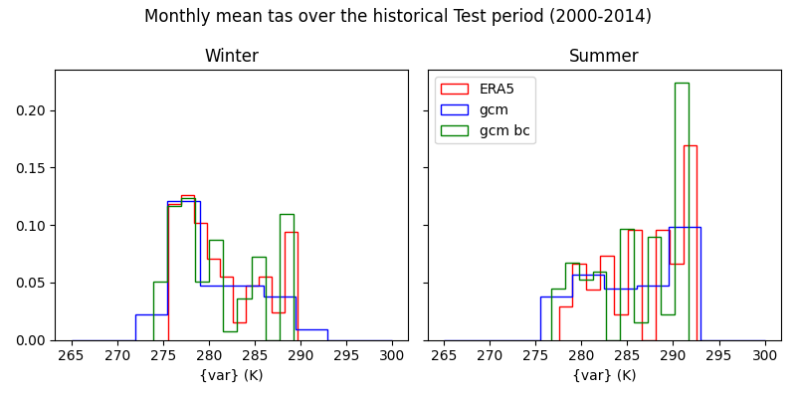
DISTRIBUTION MATCHING
Good News: The Gaussian peak of historical temperature is perfectly preserved.
EGU26 | Christian Pagé, Irida Lazić, Milica Tošić
20

Slide 21
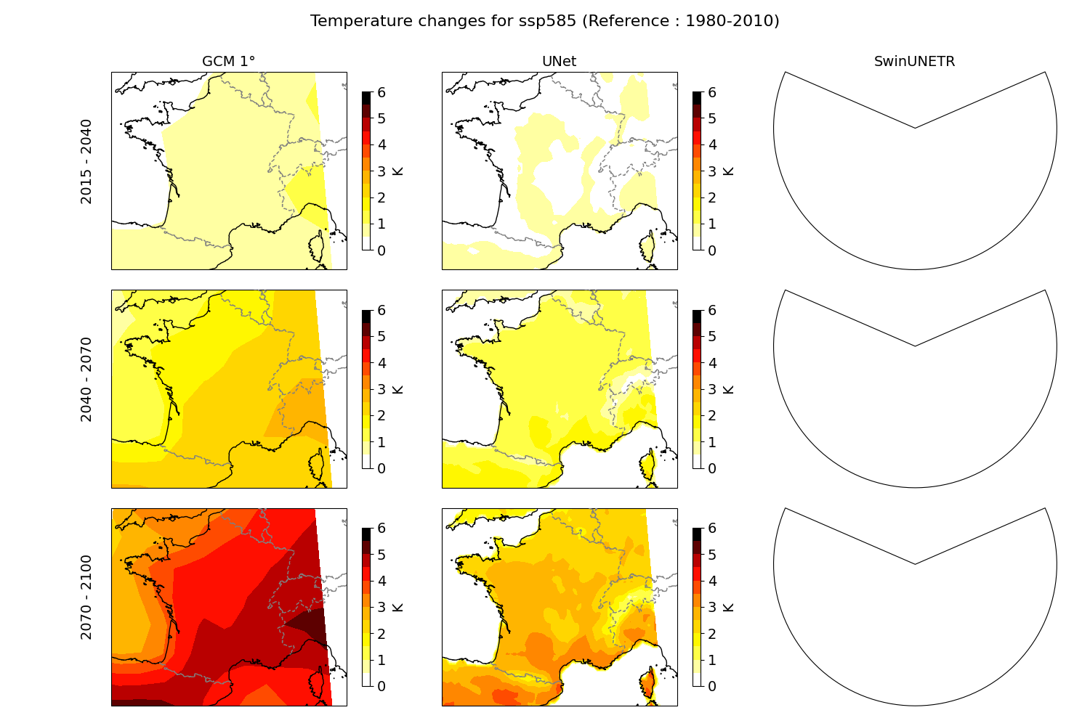
PHASE 2: PRODUCTION RESULTS
Scenario: SSP5-8.5 (High Emissions).
Result: Spatially resolved warming maps for 2015-2100.
EGU26 | Christian Pagé, Irida Lazić, Milica Tošić
21

Slide 22
FUTURE SCENARIOS: 2070 WARMING
Central Question: How hot will France be in 2070?
Pattern: Warming is not uniform; some regions amplify faster.
EGU26 | Christian Pagé, Irida Lazić, Milica Tošić
22

Slide 23
COLD BIAS ELIMINATION
Before: Generic models often had a -26 K cold bias.
After: Modern Normalization + Ibicus reduces global bias to < 0.5 K.
EGU26 | Christian Pagé, Irida Lazić, Milica Tošić
23

Slide 24
TECHNICAL STACK: PYTHON & CLIMATE
Core: xarray, netCDF4.
DL: PyTorch Lightning.
EGU26 | Christian Pagé, Irida Lazić, Milica Tošić
24

Slide 25
PORTABILITY: SINGULARITY CONTAINERS
Why? Reproducibility across HPC nodes (Grace, Calypso).
EGU26 | Christian Pagé, Irida Lazić, Milica Tošić
25

Slide 26
IMPLEMENTATION WORKFLOW
1. Data alignment -> 2. Stats -> 3. Training -> 4. Inference -> 5. Validation.
EGU26 | Christian Pagé, Irida Lazić, Milica Tošić
26

Slide 27
FUTURE RESEARCH: PRECIPITATION
Current Limit: MSE fails for Precipitation.
Wait for it: Stochastic models (Diffusion, GANs) required.
EGU26 | Christian Pagé, Irida Lazić, Milica Tošić
27

Slide 28
HANDS-ON FOR STUDENTS
Step 1: Run mini-test -> Step 2: Inspect metrics -> Step 3: Diagnostic plots.
EGU26 | Christian Pagé, Irida Lazić, Milica Tošić
28

Slide 29
COMPUTATIONAL ARCHITECTURE
HPC Node: NVIDIA Grace Hopper (GH200).
Hardware: 480 GB Unified Memory + H100 Tensor Cores.
Inference Performance: ~15.7 days/sec.
Production Speed: 30 years downscaled in < 1 minute.
Significance: Real-time regional climate projection is now possible.
EGU26 | Christian Pagé, Irida Lazić, Milica Tošić
29

Slide 30
SCIENTIFIC LESSONS & IMPLEMENTATION TRAPS
Trap 1: The Activation Wall: Standard defaults like ReLU can clip climate temperature trends below freezing. Always use Linear Activation for anomalies.
Trap 2: The Regridding Drift: Unifying regridding calls without bit-parity validation can cause alpine pixelation and 5 K biases. Elevation requires raw, unmasked interpolation.
Trap 3: Library Side-Effects: Adding a second logger (TensorBoard) can split your weights into fragmented version folders. Centralize your path resolution from Day 1.
EGU26 | Christian Pagé, Irida Lazić, Milica Tošić
30

Slide 31
SUMMARY & TAKEAWAYS
Key: Normalize targets, Skip-connections, DL + Bias Correction.
Reliability: Production-grade code requires HPC architecture awareness.
EGU26 | Christian Pagé, Irida Lazić, Milica Tošić
31

Slide 32
RESOURCES & Q&A
Repository: github.com/cerfacs-globc/idownscale
Collaborators: Cerfacs, Univ. Belgrade.
Acknowledgements: IRISCC Project, Zoé Garcia.
Questions?
*Keywords: Climate AI, U-Net, Downscaling, France Domain, Numerical Stability.
EGU26 | Christian Pagé, Irida Lazić, Milica Tošić
32

Slide 33
COMPUTATIONAL ARCHITECTURE & WORKFLOW
HARDWARE: NVIDIA GRACE HOPPER (GH200)
• Nodes: 1x NVIDIA Calypso Grace Hopper Node
• GPU: H100 Hopper (96GB HBM3 Memory)
• CPU: 72-core ARM Neoverse V2 (Grace)
• Memory: 480GB LPDDR5X (Unified Memory HW)
• Performance: ~15.7 days/sec (Production Inference)
PHASE | TASK | INDICATIVE ETA
1-4 | Data Prep & Ibicus BC | ~15 min (30y)
5 | ML Training (60 Epochs) | 2.5 hours
6 | Century-Scale Inference | ~1 min (30y)
7-9 | Scientific Gallery | ~5 min
EGU26 | Christian Pagé, Irida Lazić, Milica Tošić
Tech Spec

Slide 34
REFERENCES & RESOURCES
GitHub: https://github.com/cerfacs-globc/idownscale
Conveners: Christian Pagé, Irida Lazić, Milica Tošić
Keywords: Climate Machine Learning, U-Net, Downscaling, ERA5
Contact: info@cerfacs.fr | GitHub Issues
EGU26 | Christian Pagé, Irida Lazić, Milica Tošić
33

