Slide 1
מסלול DevOps Engineer
קמפוס ת"א נובמבר 2023
שם המרצה: רון חדד

Slide 2
Cryptography Introduction
DevOps Course

Slide 3

History
When Julius Caesar sent messages to his generals, he didn't trust his messengers. So he replaced every A in his messages with a D, every B with an E, and so on through the alphabet. Only someone who knew the “shift by 3” rule could decipher his messages.
And so we begin…
Cryptography is the science of using mathematics to encrypt and decrypt data

Slide 4
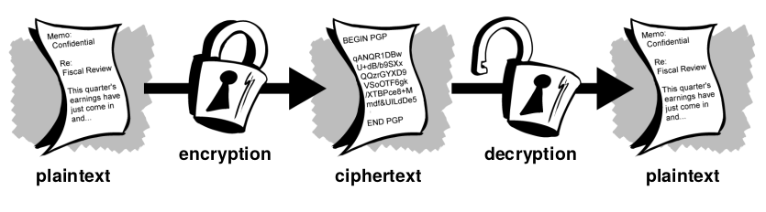
How does cryptography work?
A cryptographic algorithm, or cipher, is a mathematical function used in the encryption and decryption process. A cryptographic algorithm works in combination with a key—a word, number, or phrase—to encrypt the plaintext. The same plaintext encrypts to different ciphertext with different keys.

Slide 5
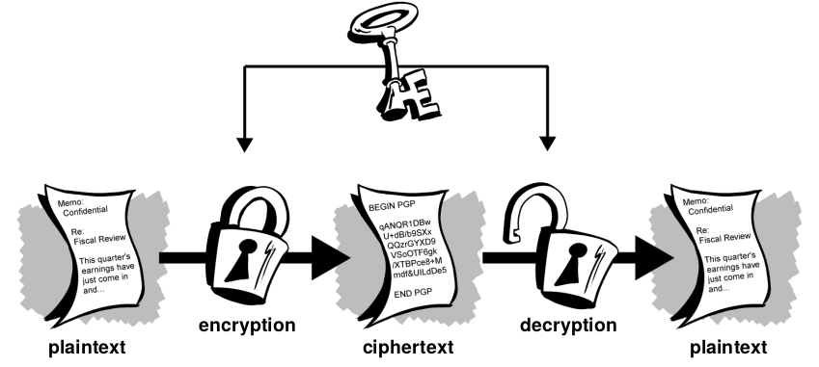
Symmetric-key encryption
In conventional cryptography, also called secret-key or symmetric-key encryption, one key is used both for encryption and decryption.

Slide 6
Symmetric-key encryption
Very fast
Useful for encrypting data that is not going anywhere
Easy to rotate
Demo here

Slide 7
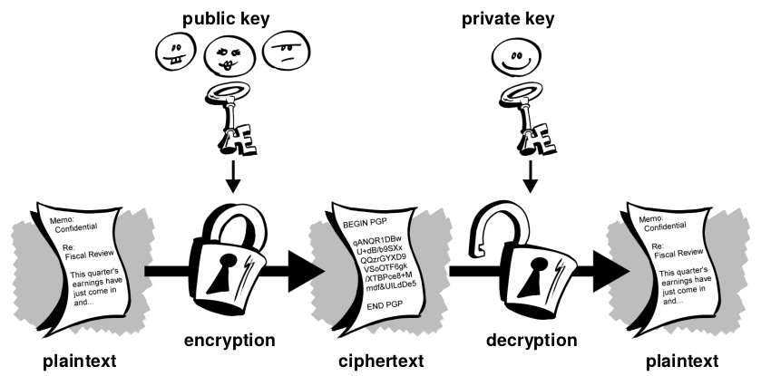
Asymmetric-key encryption (Public encryption)
Public key cryptography is an asymmetric scheme that uses a pair of keys for encryption: a public key, which encrypts data, and a corresponding private, or secret key for decryption

Slide 8
Asymmetric-key encryption (Public encryption)
You publish your public key to the world while keeping your private key secret.
Anyone with a copy of your public key can then encrypt information that only you can read.
It is infeasible to deduce the private key from the public key.
Anyone who has a public key can encrypt information but cannot decrypt it. Only the person who has the corresponding private key can decrypt the information.
Allows people who have no preexisting security arrangement to exchange messages securely.

Slide 9

The state-of-the-art usage

Slide 10
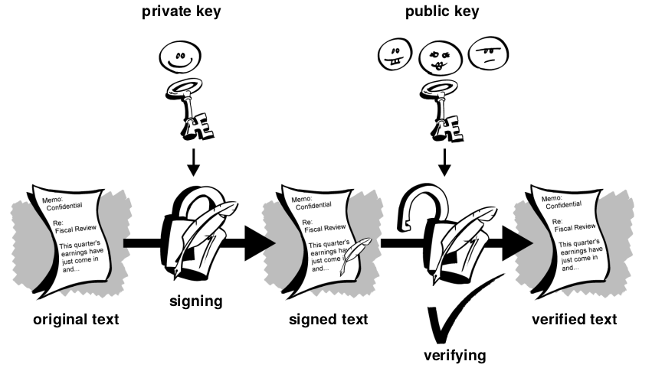
Asymmetric-key encryption (Digital signatures)
Digital signatures enable the recipient of information to verify the authenticity of the information’s origin, and also verify that the information is intact

Slide 11
Asymmetric-key encryption (Digital signatures)
public key digital signatures provide authentication and data integrity.
Instead of encrypting information using someone else’s public key, you encrypt it with your private key.
If the information can be decrypted with your public key, then it must have originated with you.
A digital signature also provides non-repudiation, which means that it prevents the sender from claiming that he or she did not actually send the information.
link

Slide 12

The “state-of-the-art” usage

Slide 13
Asymmetric-key encryption
The most famous asymmetric key algorithm is called RSA
Use ssh-keygen command to generate your key-pair

Slide 14
Digital Certificates
In a public key environment, it is vital that you are assured that the public key to which you are encrypting data is in fact the public key of the intended recipient and not a forgery.
Digital certificates, or certs, simplify the task of establishing whether a public
key truly belongs to the purported owner
A digital certificate consists of three things:
A public key
Certificate information. (“Identity” information about the user, such as name, user ID, and so on.)
One or more digital signatures from CA

Slide 15
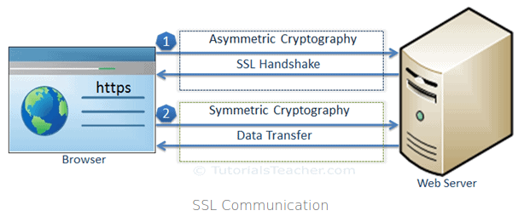
Simple TLS/SSL communication

Slide 16
tls/ssl
The client sends a request for a web page to the secure web site using https:// in the URL. This makes a connection to port 443 by default.
The server sends the certificate with public key to the client.
The client(browser) validates the certificate by checking the ca signature and ensures it has not expired or been revoked.(to do this the ca cert needs to be in the browser trusted store)
The client creates a random symmetric key (known as a session key) used to encrypt the web page content, and then encrypts the symmetric key with the public key obtained from the web server.
The encrypted information is sent to the web server. The web server decrypts and obtains the symmetric key (session key). The web server uses the symmetric key to encrypt information between the client and the server
link

Slide 17
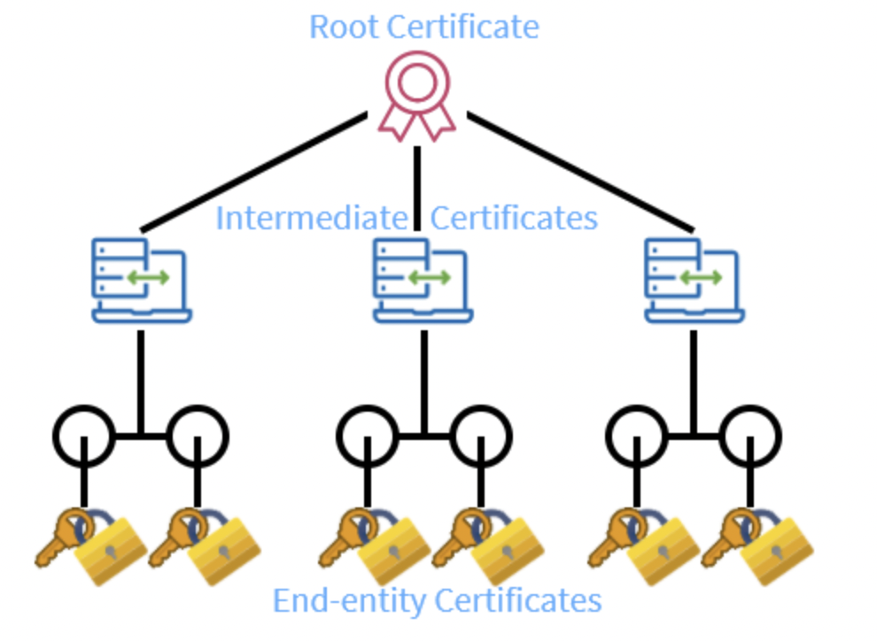
chain of trust

Slide 18
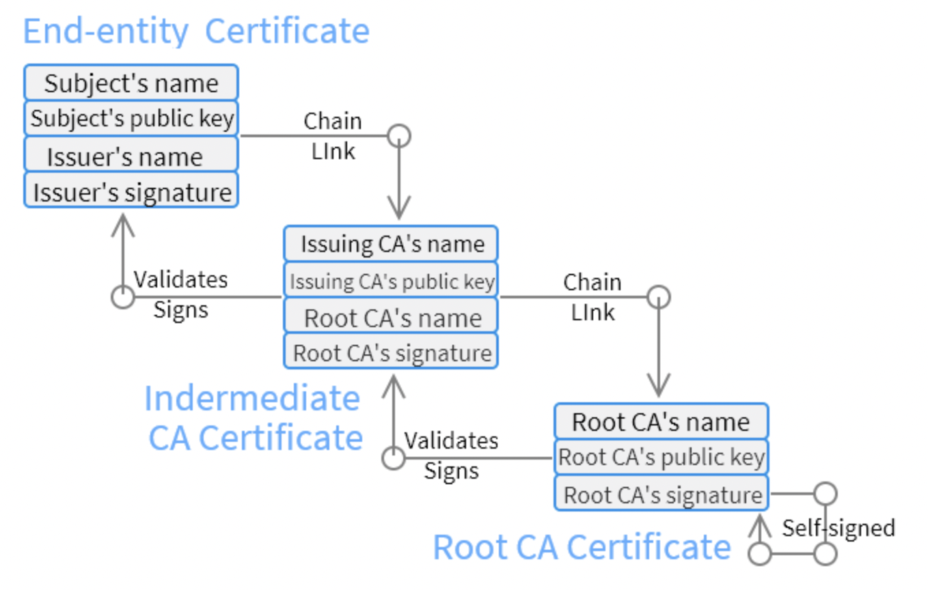

Slide 19

Thanks for your time ☺

