Slide 1
מסלול DevOps Engineer
קמפוס ת"א נובמבר 2023
שם המרצה: רון חדד

Slide 2
Virtualization

Slide 3

What we’ve done so far….
Linux, Git, Python, some security and development aspects… We can build applications!
But …
Applications run businesses. If applications break, businesses break. Sometimes they even go bust. These statements get truer every day!

Slide 4
The bad old days
Most applications run on servers
In the past, we could only run one application per server
So, the story usually went something like this... Every time the business needed a new application, IT would go out and buy a new server
This resulted in huge numbers of servers operating as low as 5-10% of their potential capacity

Slide 5

Hello VMware!
VMware, Inc. gave the world a gift — the virtual machine (VM)
Technology that would let us safely and securely run multiple business applications on a single server
IT no longer needed to procure a brand new oversized server every time the business asked for a new application
They could run new apps on existing servers that were sitting around with spare capacity

Slide 6
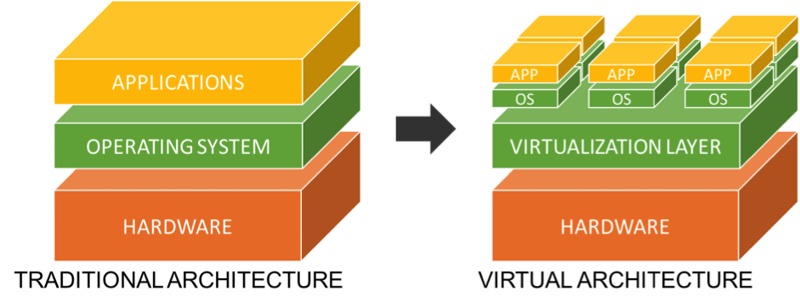
Virtualization defined
“In computing, virtualization refers to the act of creating a virtual (rather than actual) version of something, including virtual computer hardware platforms, storage devices, and computer network resources.” - wikipedia

Slide 7


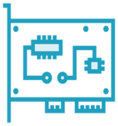
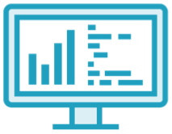


Many forms of virtualization
Server
Storage
Network
Desktop
I/O
Application

Slide 8
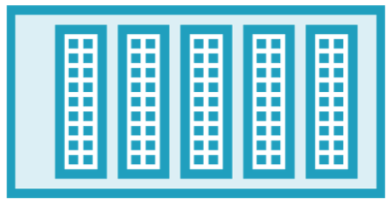
Virtualization defined
OS no longer has to be bound to the server that it runs on
Most well-known form of virtualization is
server virtualization
The virtualization layer is an abstraction layer
The OS is abstracted from the hardware
APP
OS
APP
OS
APP
OS
Virtualization Layer
Server

Slide 9
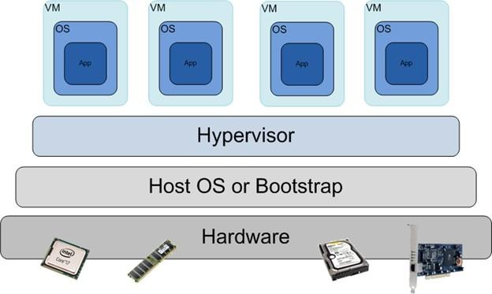
Hypervisor
A hypervisor or virtual machine monitor (VMM) is a computer software, firmware or hardware that creates and runs virtual machines.

Slide 10
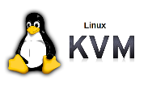


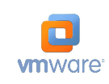
Type 1 vs. Type 2 Hypervisor
Type 1 Hypervisor
Loaded directly on the hardware
Hyper-V
KVM
Type 2 Hypervisor
Loaded in an OS running on the hardware
Virtual Box
VMWare

Slide 11


Type 1 vs. Type 2 Hypervisor
VM
VM
VM
VM
VM
VM
VM
Hypervisor
Hypervisor
OS
Type 1 Bare Metal Hypervisor
Type 2 Hosted Hypervisor

Slide 12



Virtualization management
Virtualization Management Layer
VM
VM
VM
VM
VM
VM
VM
VM
VM
VM
VM
VM
VM
VM
VM
Hypervisor
Hypervisor
Hypervisor
Virtual Host
Virtual Host
Virtual Host

Slide 13
IT Challenges Before Virtualization
Data centers are out of space
AC power panels are out of capacity
Backups are slow and expensive
Server utilization is VERY LOW
Administrators are struggling with troubleshooting
Load balancing for all applications is nearly impossible

Slide 14

















Data centers before and after
Software is strongly dependent of hardware
APP
& OS
APP
& OS
APP
& OS
APP
& OS
APP
& OS
APP
& OS
APP
& OS
APP
& OS
APP
& OS
APP
& OS
APP
& OS
APP
& OS
APP
& OS
APP
& OS
APP
& OS
APP
& OS
APP
& OS

Slide 15



Data centers before and after
What is virtualized in software becomes relatively independent of underlying hardware
APP
& OS
APP
& OS
APP
& OS
APP
& OS
APP
& OS
APP
& OS
APP
& OS
APP
& OS
APP
& OS
APP
& OS
APP
& OS
APP
& OS
APP
& OS
APP
& OS
APP
& OS
APP
& OS
APP
& OS
Virtualization Layer

Slide 16
Virtualization Benefits
Easily add new servers
Reduce maintenance time
Availability that was once very difficult and expensive becomes standard
Stack is portable - move VMs from one server to another is easy
Significantly improve Disaster Recovery time (BCDR)
Reducing Energy Consumption
Apps can scale easily

Slide 17
Complexities Introduced by Virtualization
Greater demands on all resources
Blended Storage and Network I/O
Greater complexity in troubleshooting

Slide 18
Summarizing the Benefits of Virtualization
Greater datacenter and administrative efficiency
Increased ROI for data center, servers, and administrative staff
Higher availability
Greater business agility
Decreased business risk
Ability to do more with less

Slide 19
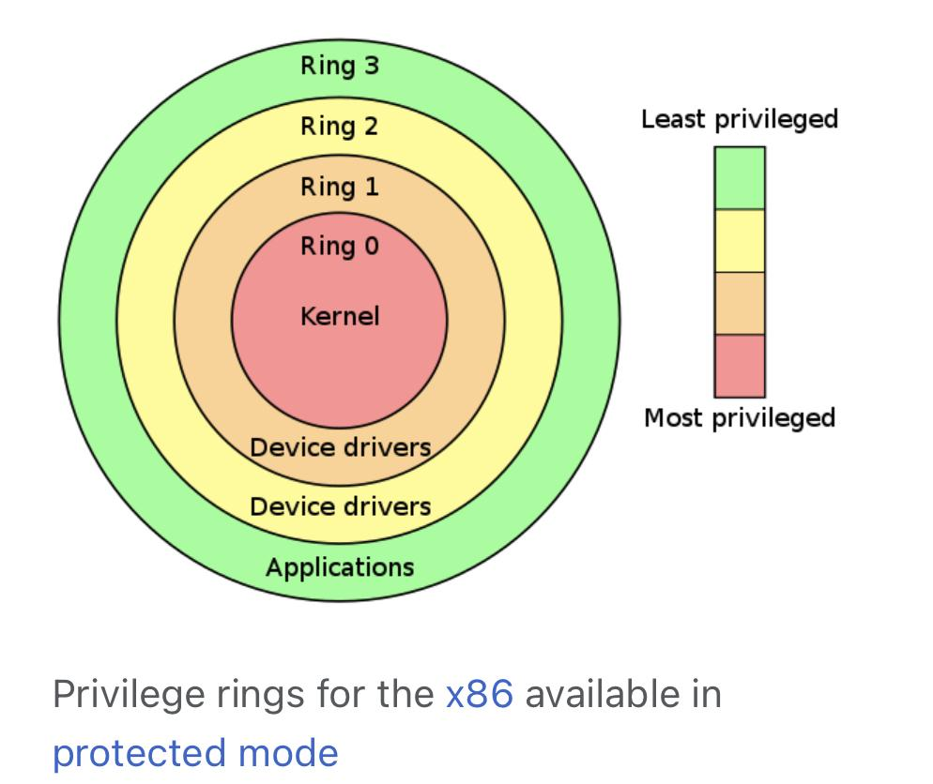
Sensitive instructions
An example of a sensitive instruction that runs from user space in a virtual machine (VM) that the virtual machine monitor (VMM) must interrupt or translate is the CPU's "HLT" instruction.he VMM manages the underlying resources.
The HLT instruction is a privileged instruction that causes the CPU to enter a low-power state and wait for an interrupt. This can be used by the operating system to conserve power. However, when executed from within a VM, the VMM must intercept the instruction in order to prevent the VM from halting the entire system

Slide 20
Full Virtualization
Paravirtualization
Hardware-assisted Virtualization
link

Slide 21
VMM methods
Trap-and-Emulate: The VMM intercepts the sensitive instruction and emulates its behavior in software, allowing the instruction to be executed without affecting the host system.
Binary Translation: The VMM translates the sensitive instruction into a different instruction or sequence of instructions that can be executed without causing issues.
Paravirtualization: The VMM provides a special interface for the VM to access privileged operations, allowing the VM to perform the operations in a way that the VMM can control and monitor.
Direct Execution: The VMM allows the sensitive instruction to execute directly on the host system, but with the VMM's protection mechanisms in place, such as memory isolation, in order to prevent the instruction from affecting the host system.
Hypercall: The VMM provides a hypercall mechanism that allows the guest OS to request privileged operations which will be handled by the VMM in a safe way.
Hardware-assisted virtualization: The VMM uses the CPU's hardware-assisted virtualization features, such as Intel VT-x or AMD-V, to create a virtualized environment for the VMs, allowing them to execute their own instructions while the VMM manages the underlying resources.

Slide 22
VIRTUAL BOX FOCUS

Slide 23
Virtual box
VirtualBox, a type-2 hypervisor developed by Oracle, uses a combination of several methods to handle sensitive instructions from user space in virtual machines (VMs).
The most common method used in VirtualBox is trap-and-emulate, where the VMM intercepts sensitive instructions and emulates their behavior in software. This allows the instructions to be executed without affecting the host system, and allows for maximum compatibility with a wide range of guest operating systems.
VirtualBox also uses binary translation for some sensitive instructions, this method is used to convert the guest instruction into a sequence of host instructions that can be executed safely.
Additionally, VirtualBox also uses direct execution for some sensitive instructions that can be executed directly on the host system with protection mechanisms, such as memory isolation, in place to prevent the instruction from affecting the host system.
Additionally, VirtualBox has also implemented Hypercall mechanism to handle some sensitive instructions, this allows the guest operating system to request privileged operations, which will be handled by the VMM in a safe way.

Slide 24
Network connection type2
In a type-2 hypervisor, such as VirtualBox, the virtual machine monitor (VMM) typically handles network connections for virtual machines (VMs) using a technique called "network address translation" (NAT).
NAT allows the VMs to access the network as if they were connected directly to it, while the VMM handles the translation of the VMs' network addresses to the host's network addresses. This allows the VMs to communicate with other devices on the network, while also hiding the VMs' network addresses from the rest of the network.
When a VM initiates a network connection, the VMM intercepts the request and assigns a virtual IP address to the VM. The VMM then uses this virtual IP address to route the traffic to the host's network interface. The host's network interface is then responsible for sending the traffic to the actual destination.
When the host receives a response, the VMM intercepts the response and routes it to the appropriate VM based on the virtual IP address. This allows the VMs to communicate with the outside network without the need for additional IP addresses or network configuration.
also: open vSwitch

Slide 25
cpu handling type2
CPU access for virtual machines (VMs) using a technique called "time slicing" or "cpu scheduling".
When a virtual machine is running, the VMM allocates a certain amount of CPU time to the VM, allowing it to execute its instructions for a certain period of time, before switching to another VM. This is done using a scheduler that allocates CPU time to each VM based on their priority and resource requirements.
The VMM uses the CPU's hardware-assisted virtualization features, such as Intel VT-x or AMD-V, to create a virtualized environment for the VMs, allowing them to execute their own instructions while the VMM manages the underlying resources.
When a VM requires access to the CPU, the VMM schedules the VM to run, allowing it to execute its instructions for a certain period of time, also called time slice, before switching to another VM. This allows multiple VMs to share the same physical CPU and run concurrently.
Additionally, the VMM can also use other methods such as providing a virtual CPU, which is a software-emulated CPU that is presented to the VM. This allows the VM to execute instructions without the need for hardware virtualization support.

Slide 26
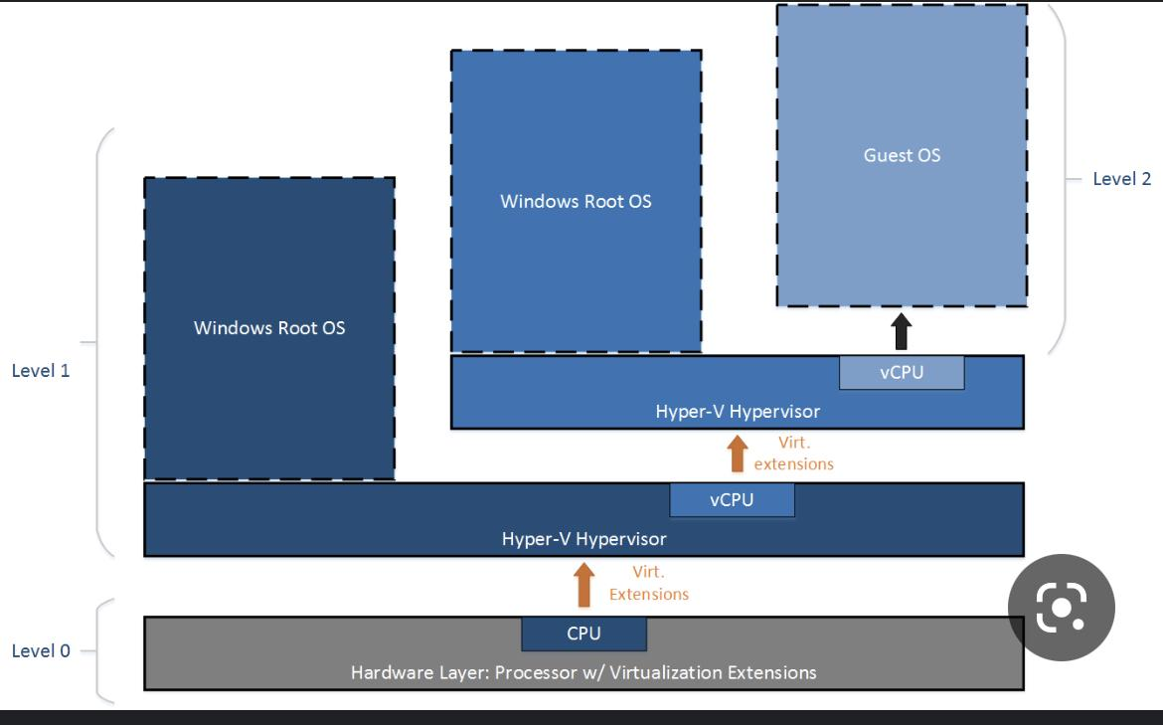
HyperV:
אי אפשר לחבר בין שני adapters
יש פעולות שאפשר לבצע עליהם רק ב powershell
Private vswitch
מאפשר תקשורת רק בין virtual adapters שמחוברים למכונות וירטואליות
Internal vswitch
מאפשר תקשורת רק בין virtual adapters שמחוברים למכונות וירטואליות ול management operating system
External vswitch
מאפשר תקשורת בין virtual adapters שמחוברים למכונות וירטואליות ול management operating system. הוא משתמש ב physical adapter יחיד או בכמה בשביל להתחבר ל switch פיזי

Slide 27
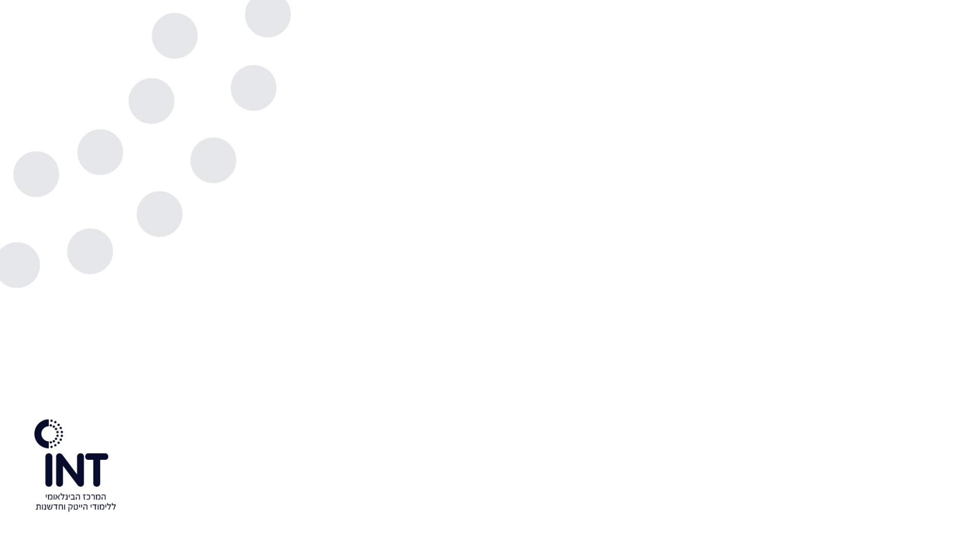

Create a VM using KVM
Kernel-based Virtual Machine (KVM) allows linux kernel to function as hypervisor
Follow https://ubuntu.com/blog/kvm-hyphervisor (Requires a processor with hardware virtualization)

Slide 28
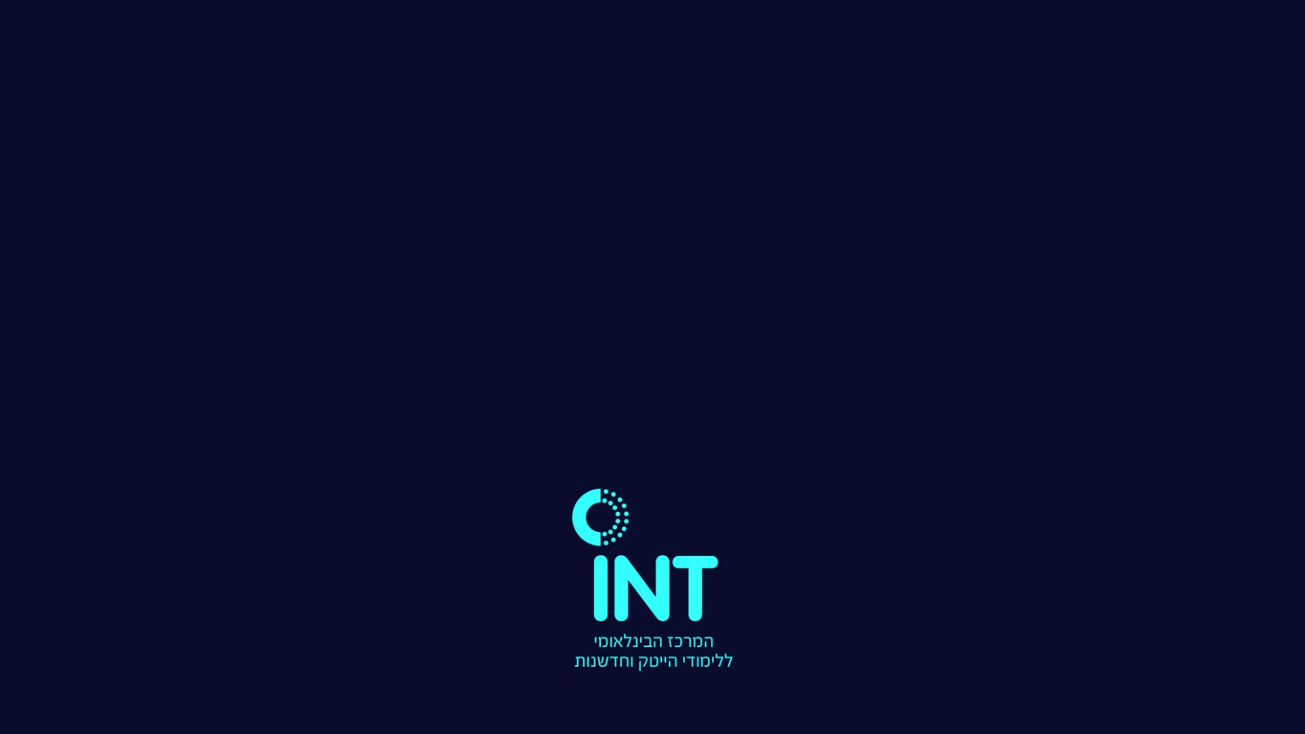
Thanks for your time ☺

