Slide 1
מסלול DevOps Engineer
קמפוס ת"א נובמבר 2023
שם המרצה: רון חדד

Slide 2
Webservers

Slide 3



Agenda
Apache - In this class
Ngnix - We will meet in the Kubernetes module

Slide 4
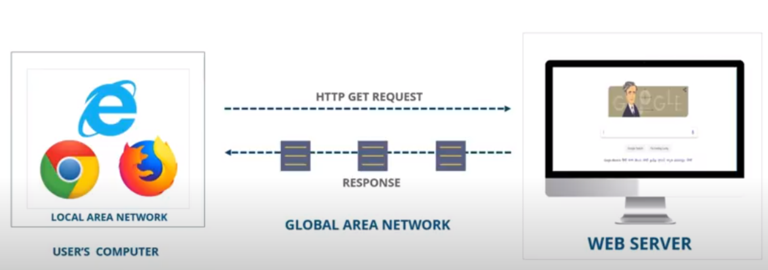
What is Web Server
Responsible for accepting HTTP requests from web clients and serving them HTTP responses
Usually in the form of web pages containing static (text, images etc) and dynamic (scripts) content
The Apache Web server is the most popular

Slide 5
What is Web Server
Running a Website is much more than opening a port and serving a few HTML pages. There are tremendous aspects that web server covers:
Concurrency - serving multiple requests
ACL (access control list)
Security (TLS termination)
Caching
Mapping urls to different locations
Logging
etc…

Slide 6
Apache Web Server
The most popular
Cross-platform (Linux, Windows, MacOS), lightweight, robust
Apache is free and open-source
Apache has great modularity, which allows it to be integrated with numerous other applications. e.g. the LAMP stack which
includes the Apache Web server alongside MySQL, PHP, Perl, and Python

Slide 7


Install Apache WS on Amazon EC2
In your AWS account, create an EC2 instance (Amazon Linux AMI with HTTP access from the internet)
Connect to the instance over SSH
Install httpd
On Unix, the httpd program is run as a daemon that executes continuously in the background to handle requests. Once the server has started and performed a few preliminary activities such as opening its log files, it will launch several child processes which do the work of listening for and answering requests from clients
Verify that the server is up and running (how?)

Slide 8
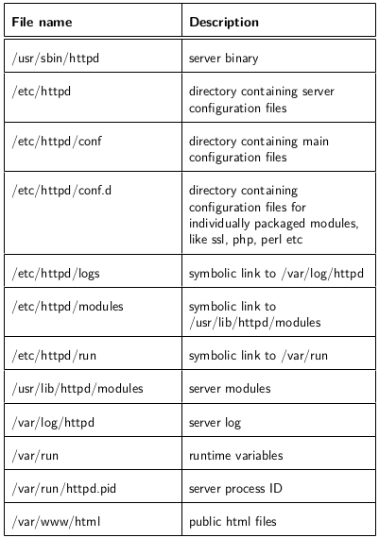
Apache Common Files

Slide 9
Apache Configuration files
The first thing that httpd does when it is invoked is to locate and read the configuration file /etc/httpd/conf/httpd.conf
Important entries:
ServerRoot is the path to the server’s configuration, error and log files
ServerName
DocumentRoot - web documents (html files, images etc) location
ErrorLog
Listen

Slide 10
Create HTML content
Under /var/www/html create index.html file with the following content:
<html>
<head> <title> sample site </title> </head>
<body> Hello World </body>
</html>
Check that this file is being served by the server
Check you httpd service status by service httpd status. Why are there 9 different processes? What are their job? (Read about StartServers, MinSpareServers, MaxSpareServers directives)
Which linux user handles the spawned processes? how can you check it?

Slide 11
httpd.conf syntax: Directory, Files and Location
Directory and Files directives allow you to specify the configurations separately for each directory or files serving the web pages:
Serve content to specific IP ranges while denying other ranges
Limit access to certain files
more…

Slide 12
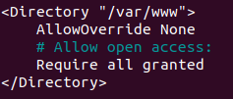


httpd.conf syntax: Directory, Files and Location tags
<Directory /> declares the block for the root (/) directory and all subdirectories.
Options directive declares which server features are valid for the specified directory.
AllowOverride directive governs whether the restrictions imposed by the Options can be overridden by specific settings inside the .htaccess files
The Require provides a variety of different ways to allow or deny access to resources
Files directive is very similar to Directory.
Directory governs the scope of permissions (or restrictions) by directory name, while Files do the same on the file name level.
Notes:
recall indexes (comment out conf.d/welcome.conf)

Slide 13

httpd.conf syntax: Directory, Files and Location
Location directive is used to limit the scope of enclosed directives by URLs.
Use <Location> to apply directives to content that lives outside the filesystem
The <Location> functionality is especially useful when combined with the SetHandler directive:

Slide 14
.htaccess files - distributed configuration files
.htaccess files provide a way to make configuration changes on a per-directory basis. A file, containing one or more configuration directives, is placed in a particular document directory, and the directives apply to that directory, and all subdirectories thereof.
Same syntax as the main configuration files
Only use .htaccess files when you don't have access to the main server configuration file
When AllowOverride is set to allow the use of .htaccess files, httpd will look in every directory for .htaccess files
Since the .htaccess file is loaded every time a document is requested, use it should be avoided when possible

Slide 15
httpd.conf directives- order of processing
The configuration sections must be placed in a very particular order to make
sure they behave as intended.
Order of Precedence: Directory, .htaccess, Files, Location
Directives of the same type are processed in the order they appear in the configuration file
In general, Apache configuration file is parsed top to bottom, thus, included files are parsed right at their include location.

Slide 16
Restrict access to the server
Read about Require directive and deny access to specific ip or range (use sudo service httpd reload to apply the new configurations)
Using <FIles> directive and Require, expose file to specific ip only
Using Location directive, expose /server-status endpoint is common practice to check server availability and healthy. Add the following Location tag. Check the endpoint:
<Location /server-status>
SetHandler server-status
Require host *.gov.il
</Location>
As you can see, the information returned contains sensitive data about the server. We would like to restrict access to authorized hosts noly. Use Require host directive to allow access from Amazon instances only (*.compute.amazonaws.com)

Slide 17
Rewrite directive
The Redirect setting allows you to map an old webpage to a new URL. This
could be the case if you changed domain, for example, or moved around a lot of
files, renaming and deleting them
Use Redirect or RewriteRule directive to redirect cnn.html page to https://edition.cnn.com/

Slide 18
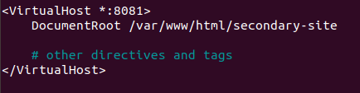
httpd.conf syntax: VirtualHost directive
Virtual Hosts is an important, powerful feature that allows you to run several websites from a single computer. Virtual Hosts can use almost any option normally used in the httpd.conf file. To make you better understand this, you can treat Virtual Hosts as individual customized httpd.conf files nested inside the main httpd.conf file

Slide 19
Two apache websites on different ports
From the same EC2 instance, we would like to serve two different websites on different ports:
The previous (default) one in http://<ip>:80
A new website in http://<ip>:8081
Open port 8081 in your instance’s security group
Add a VirtualHost tag to your httpd.conf binded to port 8081 (something similar to the one in previous slide, to your choice) and add some static pages to your site.
Don’t forget to configure the server to listen to port 8081
Verify that you can visit both the site binded to port 80, and to the new one in port 8081

Slide 20
Dynamic Content with CGI
The Common Gateway Interface (CGI) is a method used by web servers to run external programs (known as CGI scripts), most often to generate web content dynamically
CGI is simply the definitions (specifications) for web servers how to run scripts and send the results back to the server
The job of the CGI script is to read info that the browser has sent (via the server) and to generate some form of valid response
Once it has completed its task, the CGI script finishes and exits
Perl is a very popular language for CGI scripting

Slide 21
Webserver - CGI program communication
During the CGI transaction, the server and the browser also set environment variables, so that they can communicate with one another.
These variables are available to the CGI programmer, and are half of the story of the client-server communication. e.g. query params appended to url in GET request:
Other communication between the server and the CGI program happens over standard input (STDIN) and standard output (STDOUT)
When you POST a web form to a CGI program, the data in that form is bundled up into a special format and gets delivered to your CGI program over STDIN

Slide 22
Dynamic content on your web site
Make sure CGI is enabled on your httpd.conf
Write a CGI program:
In the directory set by Apache for CGI programs, create app.py file
All output from your CGI program must be preceded by a MIME-type header. This is HTTP header that tells the client what sort of content it is receiving. Most of the time, this will look like:
Content-type: text/html
Execute your program by http://<server ip>/cgi-bin/app.py,
troubleshoot, or explore error_log file if needed
In your CGI script, use Python os module to display all of the environment variables that are being passed to it by the server

Slide 23
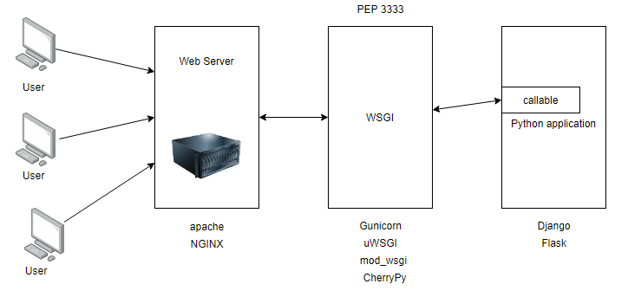
WSGI Servers - deploying Flask for production
A Web Server Gateway Interface (WSGI) server implements the web server side of the WSGI interface for running Python web applications.
Common web apps (Django, Flask..) implement the application side of the WSGI standard, so you can focus on app code
Common web servers (Apache, Nginx) implement standard WSGI container

Slide 24
Deploying Flask in Apache
Follow Flask docs to integrate simple flask webserver as an app backend for Apache
Hints:
Use sudo service httpd status to monitor your Apache server status
Use sudo service httpd restart if your changes in httpd.conf have not been applied
In the <VirtualHost *>, allocate new port for Python app: <VirtualHost *:8081>. Don’t forget to open this port in the instance’s security group in AWS console.
Investigate server failures in Apache log file located in /etc/httpd/logs/error_log
Amazon Linux running Python 2.7 by default, this yum install mod_wsgi will install Apache module which is compatible with Python 2. Use yum search wsgi to search for the correct package.
In Amazon Linux, install python3 packages by pip3 install…
You can locate the path of an installed package using pip show <package>
https://stackoverflow.com/questions/42050982/flask-wsgi-no-module-named-flask

Slide 25

Thanks for your time ☺

