Slide 1
DevOps מסלול
שם המרצה: רון חדד

Slide 2
Welcome to DevOps Course
Introduction Phase

Slide 3


Today agenda:
Administrations
Personal meetings
DevOps
Tools Installation

Slide 4

Course Staff
Teacher: Ron Hadad
Teacher Assistant: ???
Course coordinators: Amilia, Adi Shilo

Slide 5
Course Grading
85% attendance is classes
You must have a passing grade (60) in the exercises and exams at the end of each level.
it’s a small world

Slide 6
This course
Twice a week class
5 Levels (an exam or time consuming exercise at the end of each level)
Small exercise almost every week
Lots of demos during class (you are highly recommended to try by yourself)
Final project

Slide 7
Help
Technical support:
Mail: ronhadad22@gmail.com
Phone: 0508992936
Moodle forums
Administrative support:
Netta
Adi
student list

Slide 8
How to get accepted to work?
Do your homework
Do with me the demonstrations in class
Follow the attached documentations
Don’t give up after a bad interview
Learn and explore by yourself!
Be honest

Slide 9
Working environments
Pycharm 2021 community edition
Git (no need to install manually - will be install via PyCharm)
Open a GitHub account
Docker desktop
Ubuntu WSL or VirtualBox
For mac m1 users UTM
ChatGPT, Bard
draw.io

Slide 10
Expectations
Read docomentations
Reducing sources for bugs
CLI control
Under the hood understanding
Avoid from GUI as much as possible
Try things & and be optimistic
Generic code

Slide 11
Why devops?
Agile
Microservices/Nanoservices architecture and containers(docker, k8s..)
Cloud

Slide 12
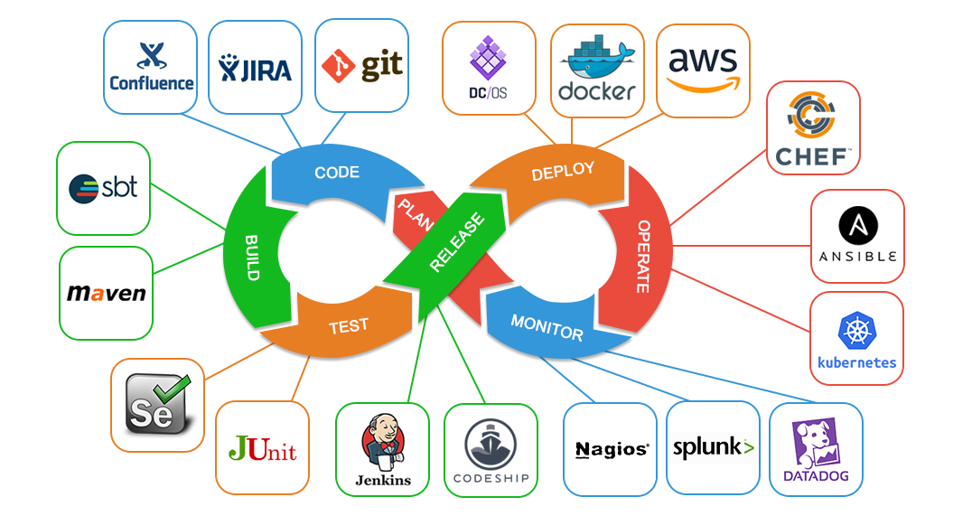
DevOps

