Slide 1
מסלול DevOps Engineer
קמפוס ת"א נובמבר 2023
שם המרצה: רון חדד

Slide 2
Git Version Control System
Content contributed by Université de Rennes 1 / UMR IRISA

Slide 3

What is a version control system ?
http://en.wikipedia.org/wiki/Revision_control
Revision control [...] is the management of changes to documents,
computer programs, large web sites, and other collections of information.
Changes are usually identified by a number or letter code, termed the
”revision number” [...]. For example, an initial set of files is ”revision 1”.
When the first change is made, the resulting set is ”revision 2”, and so
on.
Each revision is associated with a timestamp and the person making the
change. Revisions can be compared, restored, and with some types of files,
merged.

Slide 4
Use cases
Keeping an history - the history is browseable, include deleted content
Working with others - share, merge changes done by others, ensure that nothing is accidentally overwritten
Branching - multiple variants of the same software
Working with external contributors
Scaling (take a look at https://github.com/torvalds/linux)

Slide 5

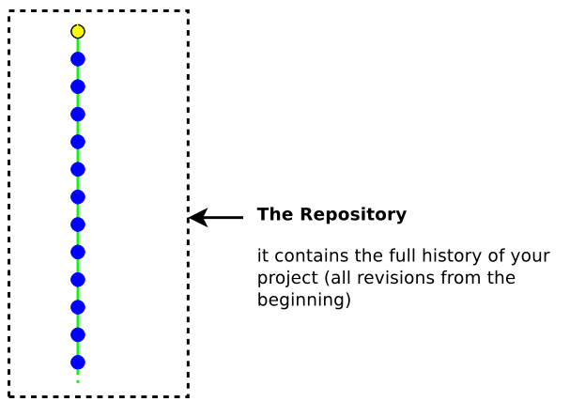
“Repository”

Slide 6
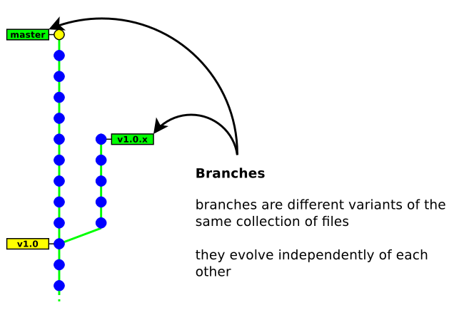
“Repository”

Slide 7
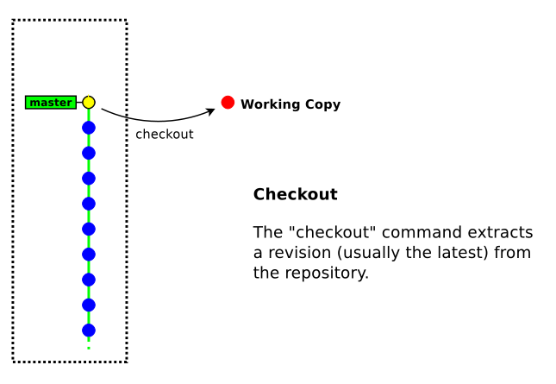
“Repository”

Slide 8
Repository address
A repository is identified with a URL. VC tools offer multiple ways of interacting with remote repositories
Dedicated protocol (git://)
Direct access over SSH (ssh:// git+ssh://)
Over http (http:// https://)

Slide 9
What shall be stored into the repository?
Source files (.c .cpp .java .py .js . . . )
Build scripts / project files (main.tf, k8s.yaml, Makefile, configure.sh …)
Documentation files (.txt README . . . )
You should not store auto-generated files, datasets, large files, files there is no chance you will edit in the future

Slide 10

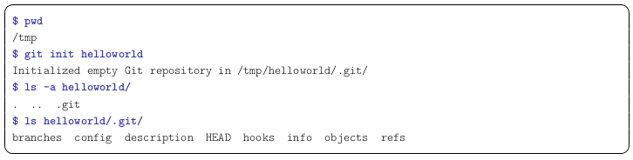
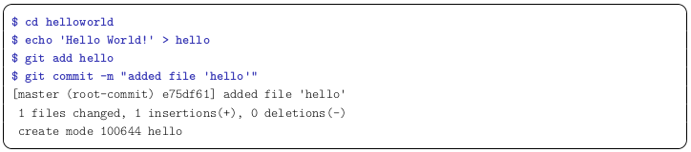
Create a repo locally
git init myrepo command creates a new clean repo locally.
The repository is located in myrepo/.git
Note: The .git/ directory contains your whole history, do not delete it
Create a new file in myrepo folder, and commit it by:
git add hello
git commit -m “add hello”

Slide 11
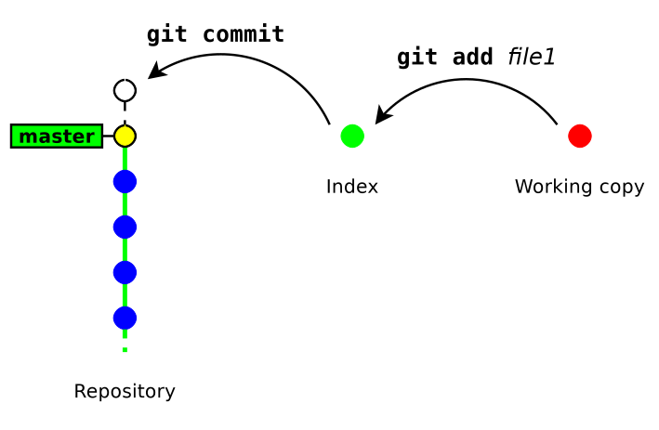
The staging area (aka the “index”)
Git introduces an intermediate space : the staging area (also called index)

Slide 12
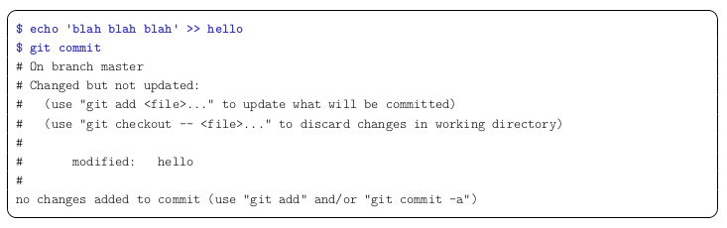
The staging area (aka the “index”)
In the below example, Git complains because the index is unchanged (nothing to commit). We need to run git add to copy the file into the index

Slide 13
Remove files
Let’s try to remove hello file by rm command and commit the change
If you just use rm, you will need to follow it up with git add <fileRemoved>.
git rm hello does this in one step. It removes the file from the index and from the working copy. But how could we restore the deleted hello file?
git reset cancels the changes in the index (and possibly in the working copy). git reset drops the changes staged into the index, but the working copy is left intact
git reset --hard drops all the changes in the index and in the working copy

Slide 14
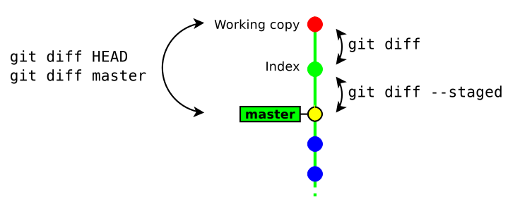
Show differences
git diff [ rev a [ rev b ] ] [ -- path . . . ] shows the differences between two revisions rev a and rev b. By default rev a is the index, rev b is the working copy
git diff --staged [ rev a ] [ -- path . . . ] shows the differences between rev a and the index. By default rev a is HEAD (a symbolic references pointing to the last commit)

Slide 15
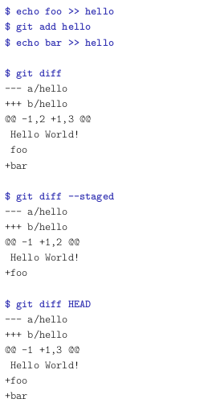
Show differences (cont.)

Slide 16
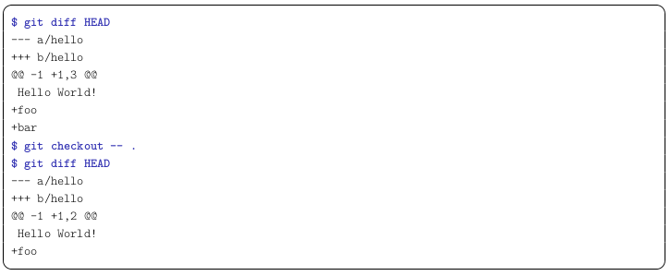
Resetting changes in the working copy
We’ve seen how to use git reset to reset changes in the index or both in the working copy and the index together. How could we reset changes in the working copy only? There is a trick using git checkout command. This command restores a file (or directory) as it appears in the index (thus it drops all unstaged changes)

Slide 17
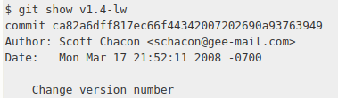
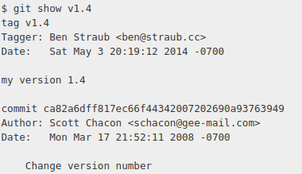

Tag your commits
Git has the ability to tag specific points in a repository’s history as being important
git tag listing the existing tags in Git
Git supports two types of tags: lightweight and annotated
lightweight tag:
It’s just a pointer to a specific commit
Created by git tag <tag> (e.g. git tagv1.4-lw)
Shown by git show v1.4-lw
annotated tag:
stored as full objects (like commits). They’re checksummed; contain the tagger name, email, and date; have a tagging message
e.g.

Slide 18
Other local commands
git status show the status of the index and working copy
git show show the details of a commit (metadata + diff)
git log show the history
git mv move/rename a file (equivalent to: “cp src dst && git rm src && git add dst”)

Slide 19
Practice it all together
1. Create a new repository
2. Create a new file, add it to the index and commit it
3. Modify the file and make a new commit
4. Rename the file (either with git mv or git add+git rm), do a git status
before committing (to ensure the renaming is correctly handled)
5. Delete the file and commit it
6. Create two new files and commit them. Then modify their content in the
working copy and display the changes with git diff

Slide 20
Practice it all together (cont.)
7. Add one file into the index but keep the other one. Display the changes
between:
• the index and the working copy
• the last commit and the index
• the last commit and the working copy
8. run git reset to reset the index
9. run git reset --hard to reset the index and the working copy

Slide 21
Git Branches

Slide 22
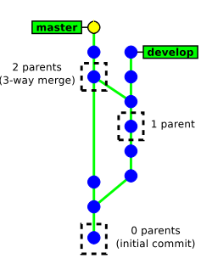
How GIT handles its history
Each commit object has a list of parent commits:
• 0 parents → initial commit
• 1 parent → ordinary commit
• 2+ parents → result of a merge
Commits are identified with SHA-1 hash (160 bits) computed from:
• the committed files
• the meta data (commit message, author name, . . . )
• the hashes of the parent commits
A commit id (hash) identifies securely and reliably its content and all the previous revisions.

Slide 23
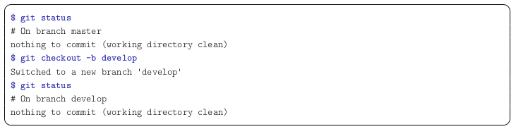
Creating a new branch
git checkout -b new branch [ starting point ]
New branch is the name of the new branch
Starting point is the starting location of the branch (possibly a commit id, a tag, a branch, . . . ). If not present, git will use the current location.

Slide 24
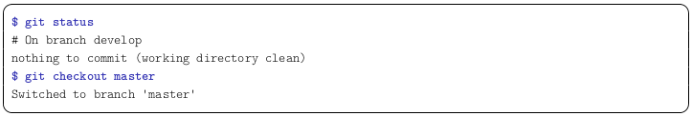
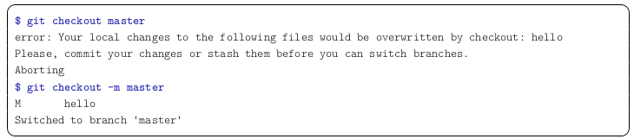
Switching between branches
git checkout [-m] branch name
Note: it may fail when the working copy is not clean. Add -m to request merging your local changes into the destination branch.

Slide 25
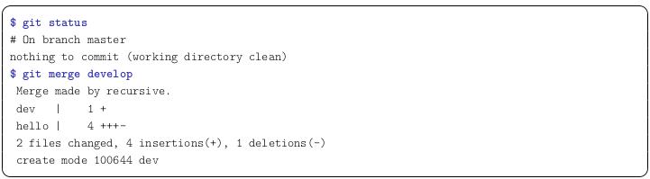
Merging a branch
git merge other_branch will merge the changes in other_branch into the current branch.
The result of git merge is immediately committed (unless there is a conflict)
The new commit object has two parents (the merge history is recorded)
git merge applies only the changes since the last common ancestor in the other branch. If the branch was already merged previously, then only the changes since the last merge will be merged.

Slide 26
Merge conflicts
In case of a conflict:
• unmerged files (those having conflicts) are left in the working tree and marked as “unmerged”
• the other files (free of conflicts) and the metadata (commit message, parents commits, ...) are automatically added into the index (the staging area)
Git will refuse to commit the new revision until all the conflicts are explicitly resolved by the user

Slide 27
Resolving conflicts
In order to resolve a conflict:
edit the files manually, then run git add (to check the file into the index) or git rm (to delete the file)
Then, once all conflicting files are checked in the index, you just need to run git commit to commit the merge
Note: we will never resolve conflicts that way. It’s much better to resolve using a merge tool like the one integrated into PyCharm

Slide 28
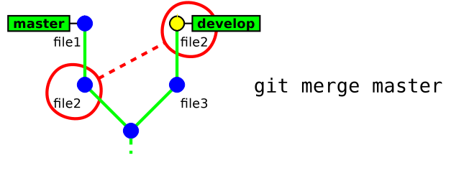
Conflicts example

Slide 29
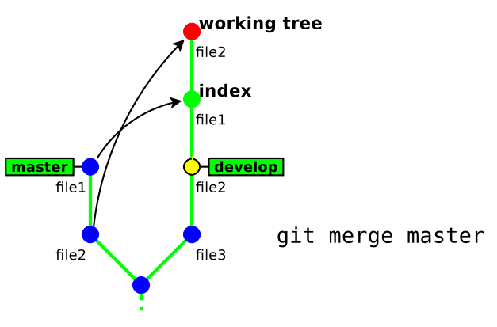
Conflicts example

Slide 30
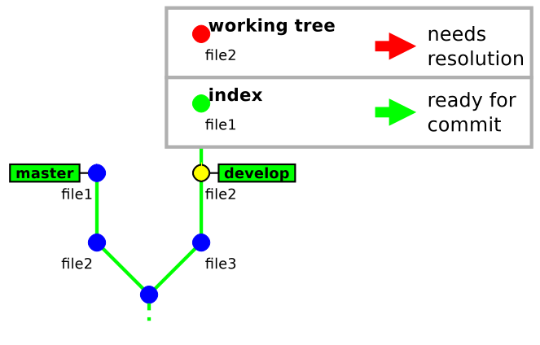
Conflicts example

Slide 31
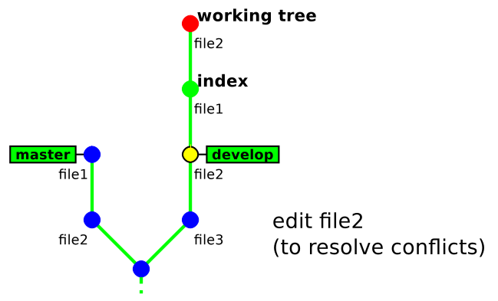
Conflicts example

Slide 32
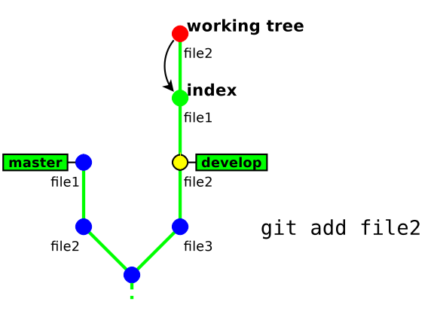
Conflicts example

Slide 33
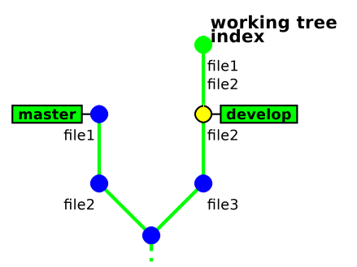
Conflicts example

Slide 34
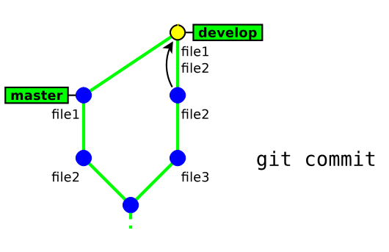
Conflicts example

Slide 35
Deleting Branch
git branch -d branch_name
This command has some restrictions, it cannot delete the current branch (HEAD)

Slide 36
Practice branches
1. create a new branch named “dev”
2. make some commits in this branch
3. go back to branch “master” and make some commits
4. merge branch “dev” into “master”
5. make a new commit in each branch so as to generate a conflict (edit the same part of a file)
6. merge branch “dev” into “master”, and fix the conflict
7. merge “master” into “dev”

Slide 37
Working with remote

Slide 38
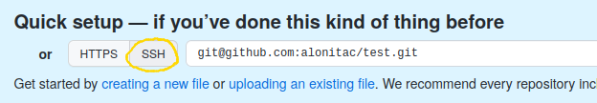
Communicate with GitHub using SSH
If you don’t have a local git repository with which you’ve practiced git commands, create one (git init…)
Create a new repo in GitHub that will represent the remote repository for your local git practicing repo
Let’s practice git communication over SSH. Follow GitHub docs, generate SSH key (if needed) and add its public key to you GitHub account
Follow GitHub’s instructions to add the new create repo as a remote for your local practicing git repo:

Slide 39
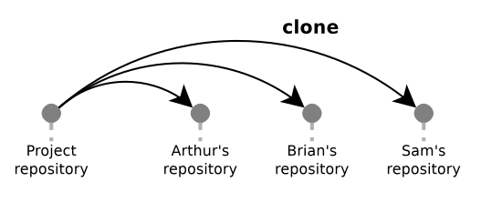
Clone
Each team member clone a copy of the repo from a centralized remote source by git clone <repo url>

Slide 40
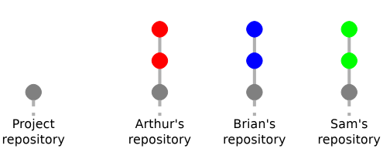
Working locally
Each team member contributes to the project, commit changes locally

Slide 41
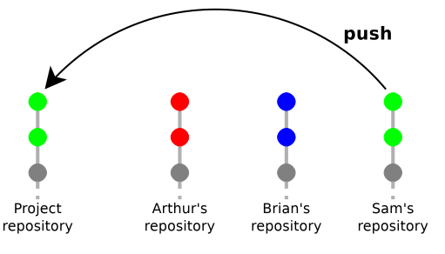
Push to remote
Sam pushes his code by git push
Basic syntax git push <remote> <branch>
If the branch is tracking an upstream branch, then the local changes (commits) are propagated to the remote branch. Otherwise nothing is uploaded.
In case of conflict git push will fail and require to run git pull first

Slide 42
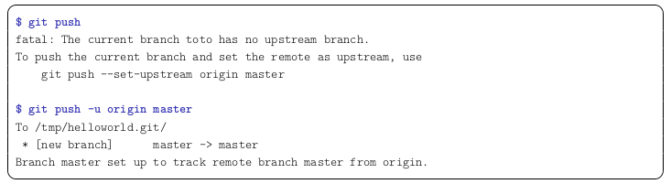
Push to remote (cont.)
-u/--set-upstream configures the local branch to track the remote branch (you should always use it!):
Tags are not automatically pushed. Use --tags flag sends all of your local tags to the remote: git push <remote> --tags

Slide 43
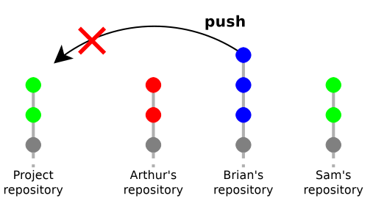
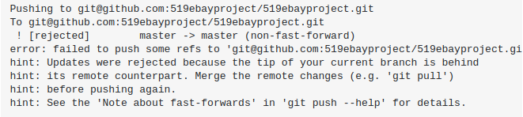
Push rejected
Brian’s push is rejected because his branch does not contain Sam’s changes

Slide 44
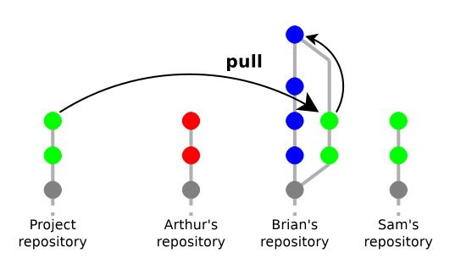
Pull (fetch & merge)
Brian’s pulls from remote. Now his local copy is up-to-date with remote so he can push safely.
git fetch <remote> <branch> e.g git fetch origin master
Will download the remote content but not update your local repo's working state, leaving your current work intact
Will be stored under <remote>/<branch> e.g. origin/master

Slide 45
Pull (fetch & merge) cont.
git pull <remote> <branch> e.g git pull origin master
Fetch content from a remote repository and immediately update the local repository to match that content (by merge commit)
If not exists, the pull process will create a new local merge commit containing the content of the new diverged remote commits

Slide 46
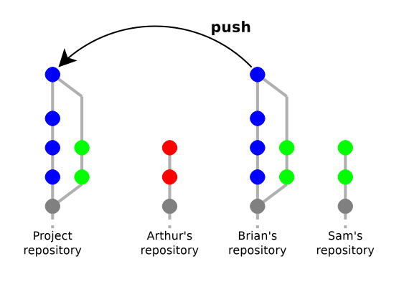
Pull again

Slide 47
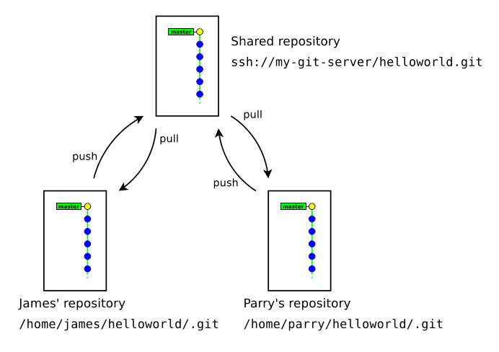
Pull push dynamic
It is possible to work with multiple remote repositories. Add remote by git remote add <name> <url>

Slide 48
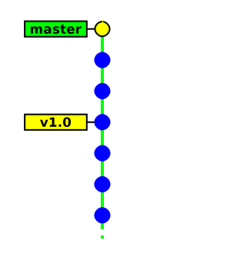
Detach state
git checkout on an arbitrary commit or a tag (anything that is not a branch) puts your in “detached HEAD” state. You can commit, but your history be lost if you don’t create any branch (or tag) to reference them.

Slide 49
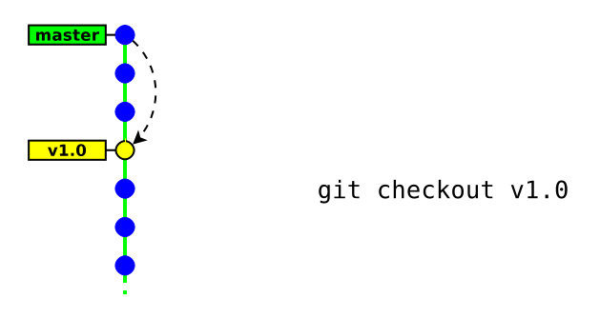
Detach state (cont.)

Slide 50
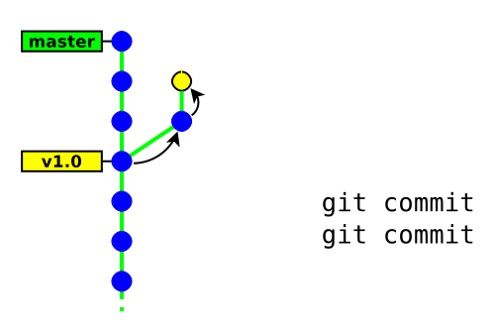
Detach state (cont.)

Slide 51
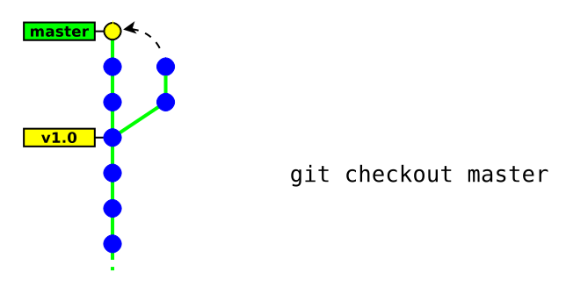
Detach state (cont.)

Slide 52
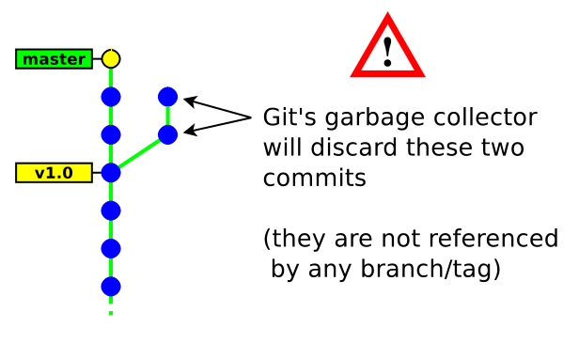
Detach state (cont.)

Slide 53
Best Practices
Commit as often as you can (keep independent changes in separate commits)
Compare your branch (using PyCharm) before preparing a commit
In commit messages, describe the rationale behind of your changes (it is often more important than the change itself)
Use a .gitignore file to ignore generated files (*.o, *.a, . . . )
Don’t be fully desynchronised → run git pull enough often to avoid accumulating conflicts
Merge from the mainstream branch to your feature branch enough often
GIT is not forgiving, do not ignore its warnings and do not use --force unless you have a clear idea of what you are doing

Slide 54

Thanks for your time ☺

