Slide 1
Design Patterns
Removing Pain From Design
Erik Peterson

Slide 2
A Disclaimer
You probably know most of these

Slide 3
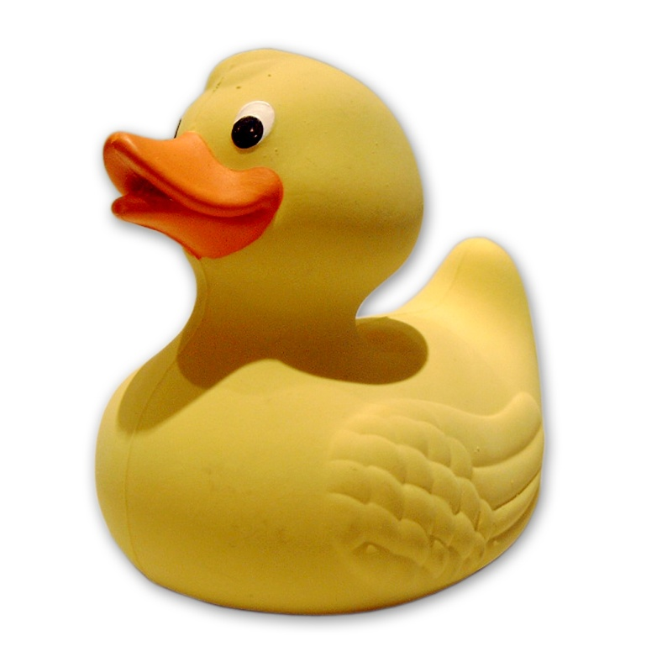
Ducks!

Slide 4

Interfaces
Code to an abstraction, not an implementation

Slide 5
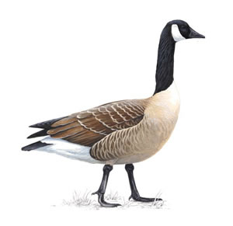
What about other birds?

Slide 6
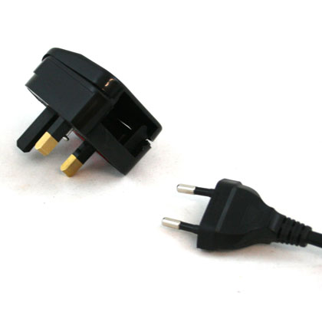
Adapter Pattern
Wraps the interface of one class into an interface that can be used by a specific client

Slide 7
Adapter Pattern
Can treat similar objects with different APIs as the same object
Very useful for wrapping third-party objects

Slide 8
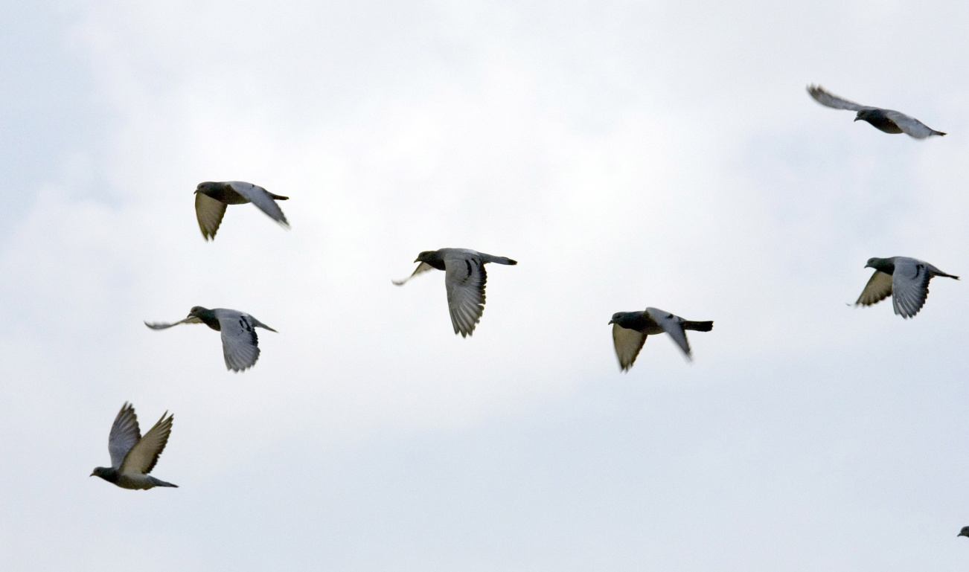
What the flock?
Now we need a way to count all of these birds…

Slide 9

Decorator Pattern
Allows additional behavior to be added to a class dynamically

Slide 10
Decorator Pattern
Allows additional functionality to be added to a class without changing the class itself
Decorator class must implement the interface of the class being “decorated”

Slide 11
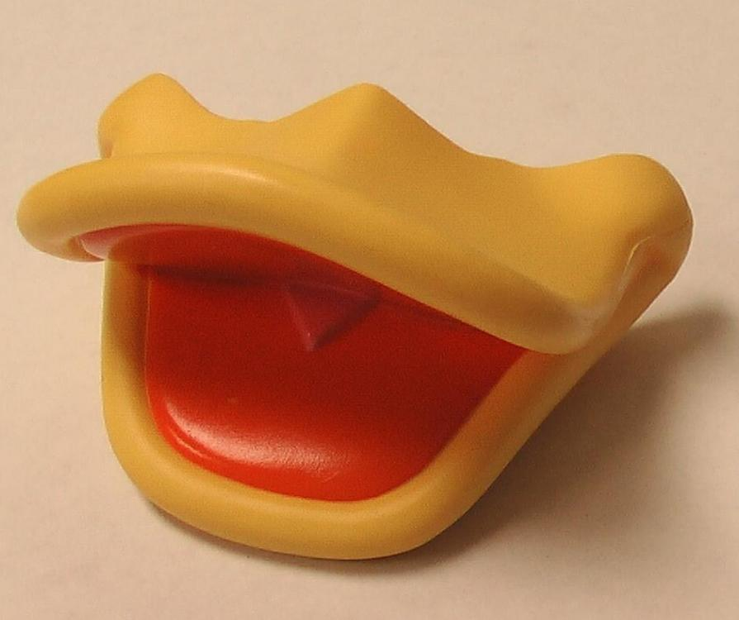
How to build a duck
Now we have two types:
Quackable
Countable

Slide 12
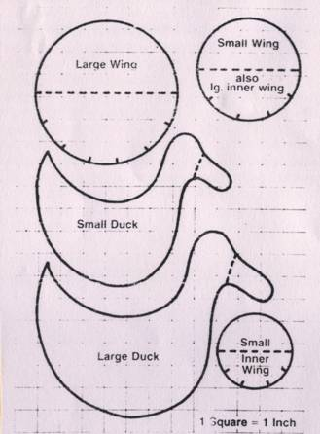
Factories
Encapsulate object creation

Slide 13

Abstract Factory Pattern
Used to represent a group of factories that can create a common element

Slide 14
Factories
Simplify the code used to instantiate an object
Ensures all dependencies are created at time of instantiation

Slide 15

About that flock…
We need a way to go through the flock and check up on each bird, but how?

Slide 16
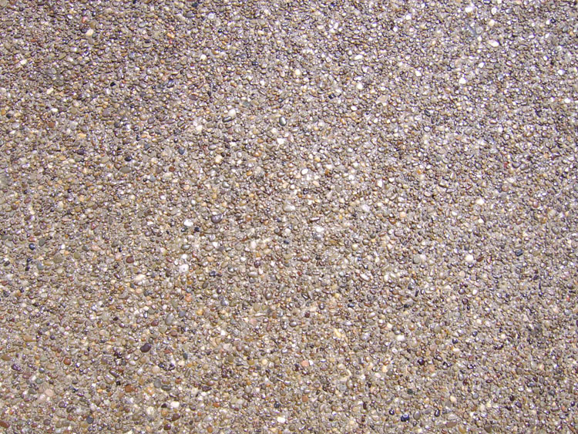
Iterator Pattern
Encapsulates how to navigate an aggregate sequentially without exposing its internal structure

Slide 17
Iterator Pattern
If the data structure a list of objects is stored in might change, this keeps that change located in one class

Slide 18
Another way of changing behavior
Different ducks behave in different ways
Some might even migrate to different locales in the winter!

Slide 19
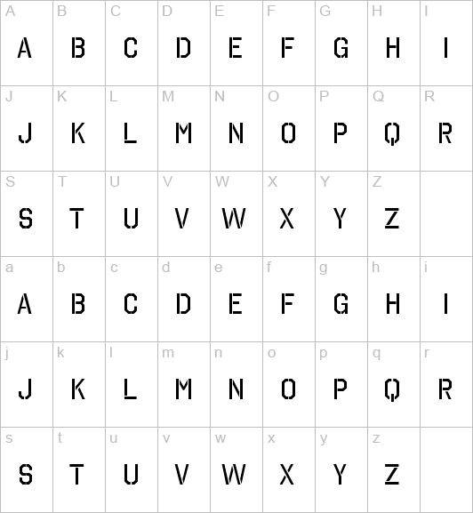
Template Method Pattern
Allows an inherited class to change the behavior on a base class by implementing an abstract (or virtual) method on the base

Slide 20
Template Method Pattern
Good example of Open-Closed Principle in action
Requires use of a base class

Slide 21
Managing the Barn
Our farmers want a way of easily managing the basic tasks around the barn…
… introducing the Barn Automator 3000 Deluxe!

Slide 22

Command Pattern
Encapsulates requests, allowing
the consumer to take in different
types of commands

Slide 23
Command Pattern
Invoker doesn’t need to know how to execute a particular command
The command contains a method (ex: “Execute”) that calls the correct object to perform the action

Slide 24
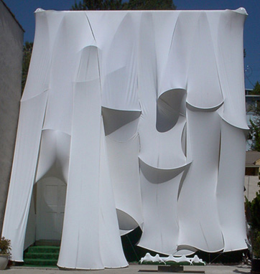
Facade Pattern
Provides a single, unified interface that wraps a set of subsystem interfaces

Slide 25
Facade Pattern
Consumer
High-Level Interface
Sub-Interface 1
Sub-Interface 2
Sub-Interface 3

Slide 26
Types of Facades
Adapter
Repository
Gateway

Slide 27
Changing of the Guard
Our barn has farmers who work shifts. This causes some problems:
Some farmers are more relaxed than others
Some ducks are more trouble than others

Slide 28
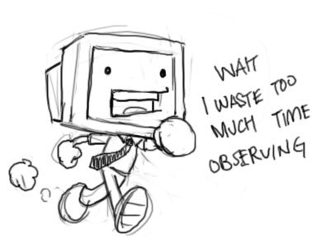
Observer Pattern
Allows for an observable object to maintain a list of objects that observe it, and notify them by calling a method on the observer

Slide 29
Observer Pattern
Allows any number of objects to subscribe to an event
Flexible because observable object doesn’t know or care about what is observing it

Slide 30
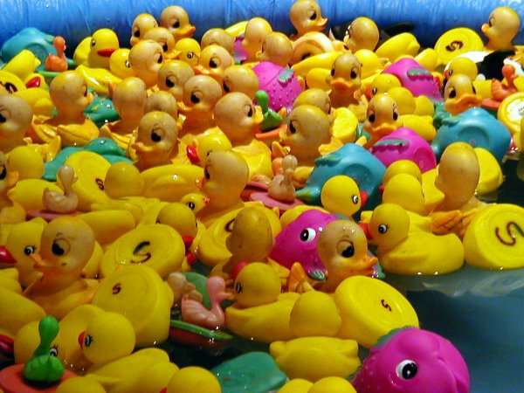
Bringing Order to Chaos
We now have a lot of birds, but how do we sort them?

Slide 31

Strategy Pattern
Encapsulates an algorithm away from a client so that they can be interchangeable

Slide 32
Strategy Pattern
Any algorithm can be used on an object
Allows for behavior to be changed at run-time

Slide 33
Logging
… or “Man, newing up objects sucks”

Slide 34
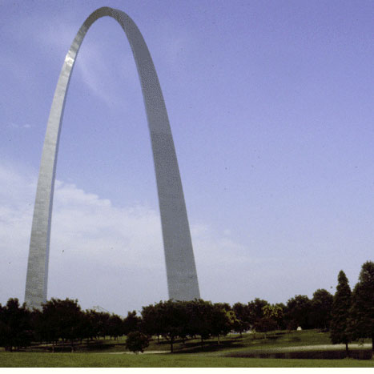
Static Gateway Pattern
Provides a simple way of consuming a service while also abstracting away how the service works
* defined by J.P. Boodhoo
http://codebetter.com/blogs/jean-paul_boodhoo/archive/2007/10/15/the-static-gateway-pattern.aspx

Slide 35
Static Gateway Pattern
Sometimes you don’t want to “new up” one or more objects to do simple tasks
Examples: Logging, resolving objects using IoC

Slide 36
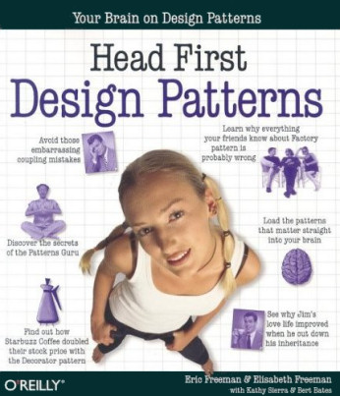
Buy this book!

Slide 37
Me:
cerikpete@gmail.com
http://erikbase.wordpress.com
Repository:
git://github.com/cerikpete/designpatterns.git

