Slide 1

Cerino ligutom III
Alexandros pappas

Slide 2
What is AngularJS?
AngularJS is an open source structural framework for dynamic web apps.
It lets you use HTML as your template language and lets you extend HTML’s syntax to express your application’s components clearly and succinctly.
Originally developed in 2009 by Misko Hevery and Adam Abrons.
Now maintained by google.

Slide 3
Core Features of AngularJS
Data-binding
Scope
Controller
Services
Filters
Directives
Templates
Routing
Model View Whatever
Dependency Injection

Slide 4
Basic Structure of an AngularJS App
<html ng-app=“app”>
<head>
<script src=“path/to/angular.min.js"></script>
<script src="app/services.js"></script>
<script src="app/directives.js"></script>
<script src="app/routes.js"></script>
<script src="app/controllers.js"></script>
<script src="app/app.js"></script>
</head>
<body>
<div ui-view></div> // If you’re using UI Router ($stateProvider)
</body>
</html>

Slide 5
How to create a controller
angular
.module(‘<module_name>’, [<dependencies>])
.controller(‘< ctrl_name>’, function <ctrl_name>(<dependencies>) {
// Implementation
});

Slide 6
Example – Creating a Controller
angular
.module('app.controllers', [])
.controller('HomeController', function HomeController($scope) {
$scope.text = ‘Hello World’;
});

Slide 7
Routing using UI Router ($stateProvider)
There are many ways to handle the routes in AngularJS
$urlRouterProvider
$routeProvider
$stateProvider
But for this presentation, we’ll be using UI Router

Slide 8
How to create and use the UI Router ($stateProvider)
angular
.module(‘routes’, [‘ui.router’])
.config(function($stateProvider) {
$stateProvider
.state(‘home’, {
url: ‘/home’,
template: ‘<div>Hello World</div>’,
controller: ‘HomeController’
})
}); // URL would be: “http://localhost:port/home

Slide 9
2-Way Data-Binding
Is the automatic synchronization of data between the model and view components.
The view is a projection of the model at all times.
When the model changes, the view reflects the change, and vice versa.

Slide 10
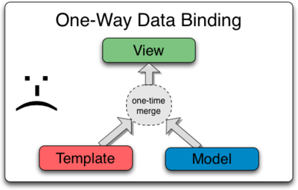
Data Binding in Classical Template Systems
Notes:
Most templating systems bind data in only one direction:
they merge template and model components together into a view.
After the merge occurs, changes to the model or related sections of the view are NOT automatically reflected in the view.
Worse, any changes that the user makes to the view are not reflected in the model.
This means that the developer has to write code that constantly syncs the view with the model and the model with the view.

Slide 11
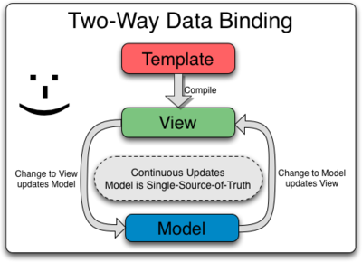
Data Binding in AngularJS Templates
Notes:
AngularJS templates work differently.
First the template (which is the uncompiled HTML along with any additional markup or directives) is compiled on the browser.
The compilation step produces a live view.
Any changes to the view are immediately reflected in the model, and any changes in the model are propagated to the view.

Slide 12
AngularJS Expressions and Interpolation
AngularJS expressions are JavaScript-like code snippets that are mainly placed in interpolation bindings.
{{ text }}
Where text is a variable assigned with a value in the controller
Examples of valid expressions:
{{ 1 + 2 }}
{{ a + b }}
{{ user.name }} // Assuming user is an object, we access the name property
{{ items[index] }}

Slide 13
Factory
.factory() is a method on our module that takes a name and a function that defines the service. Once defined, we can inject and use that particular service in other components, like controllers , directives, and others like this:
var app = angular.module(‘myApp', []);
app.controller('AppController' , function($scope, myFactory) {
$scope.data = myFactory.getData();
});

Slide 14
Service
The same thing as a factory, a .service() is a method on our module and it also takes a name and a function, that defines the service. We can inject and use that thing exactly the same way we did with the factory.
app.controller('AppController' , function($scope, MyService) {
$scope.data = MyService. controller();
});

Slide 15
So what is the differene between a service and a factory?
A service is instantiable while a factory is not
A service is a constructor function whereas a factory is not.
A factory function is really just a function that gets called, which is why we have to return an object explicitly.
Notes:
https://blog.thoughtram.io/angular/2015/07/07/service-vs-factory-once-and-for-all.html

