Slide 1
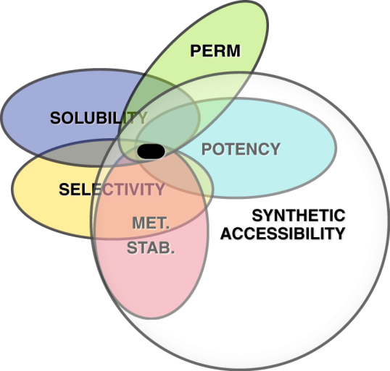
CHEMOINFORMATICS LAB 2

Slide 2
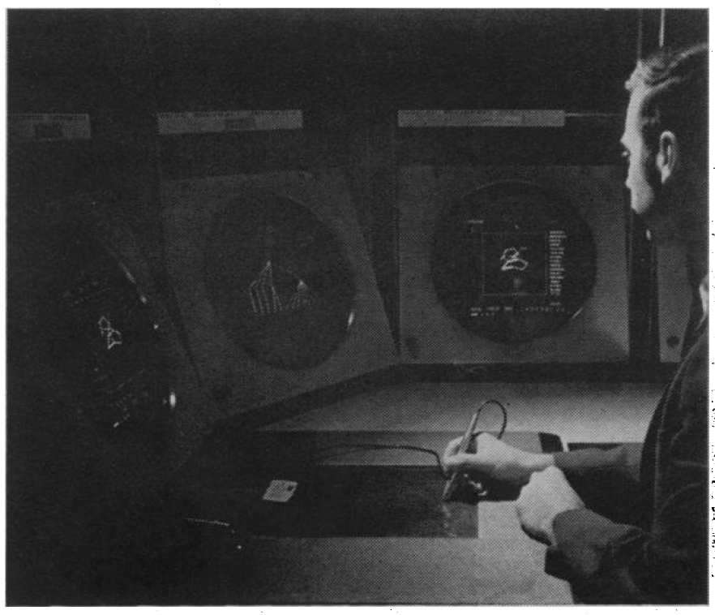
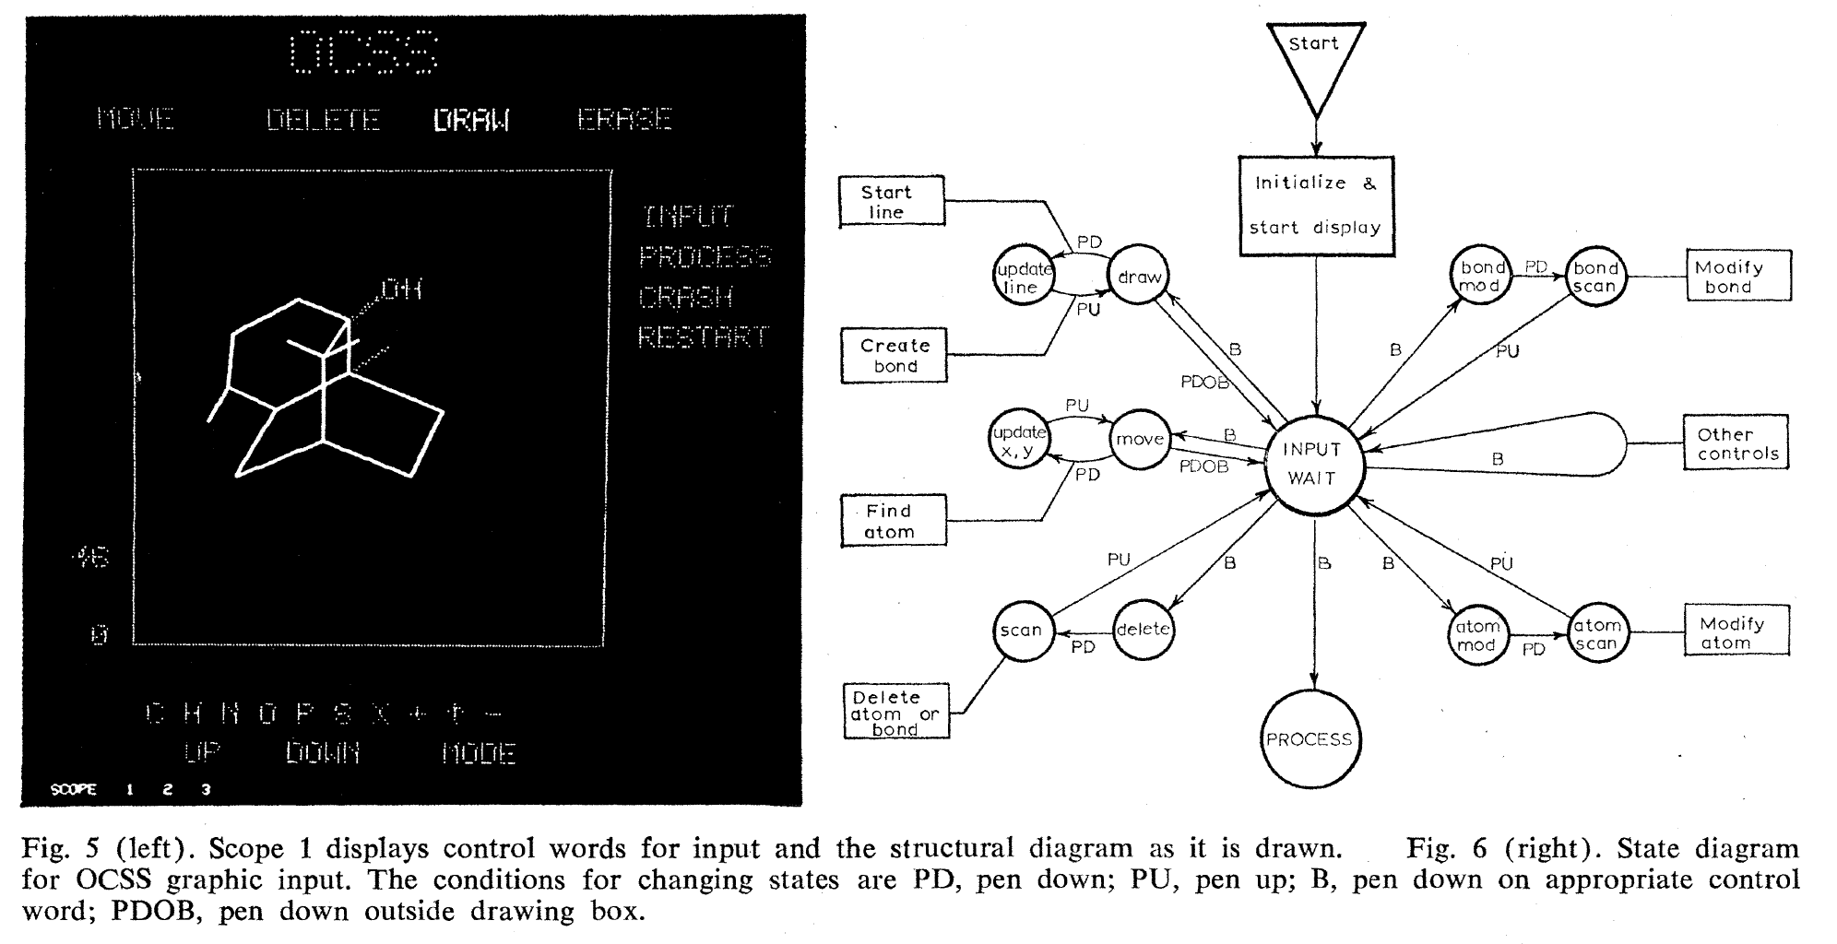
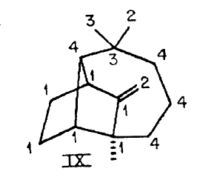
SMILES
SMILES strings are one way to get a molecule “into” the computer.
Corey and Wipke, "Computer-assisted design of complex organic syntheses” Science. 1969, 166, 178–192.

Slide 3
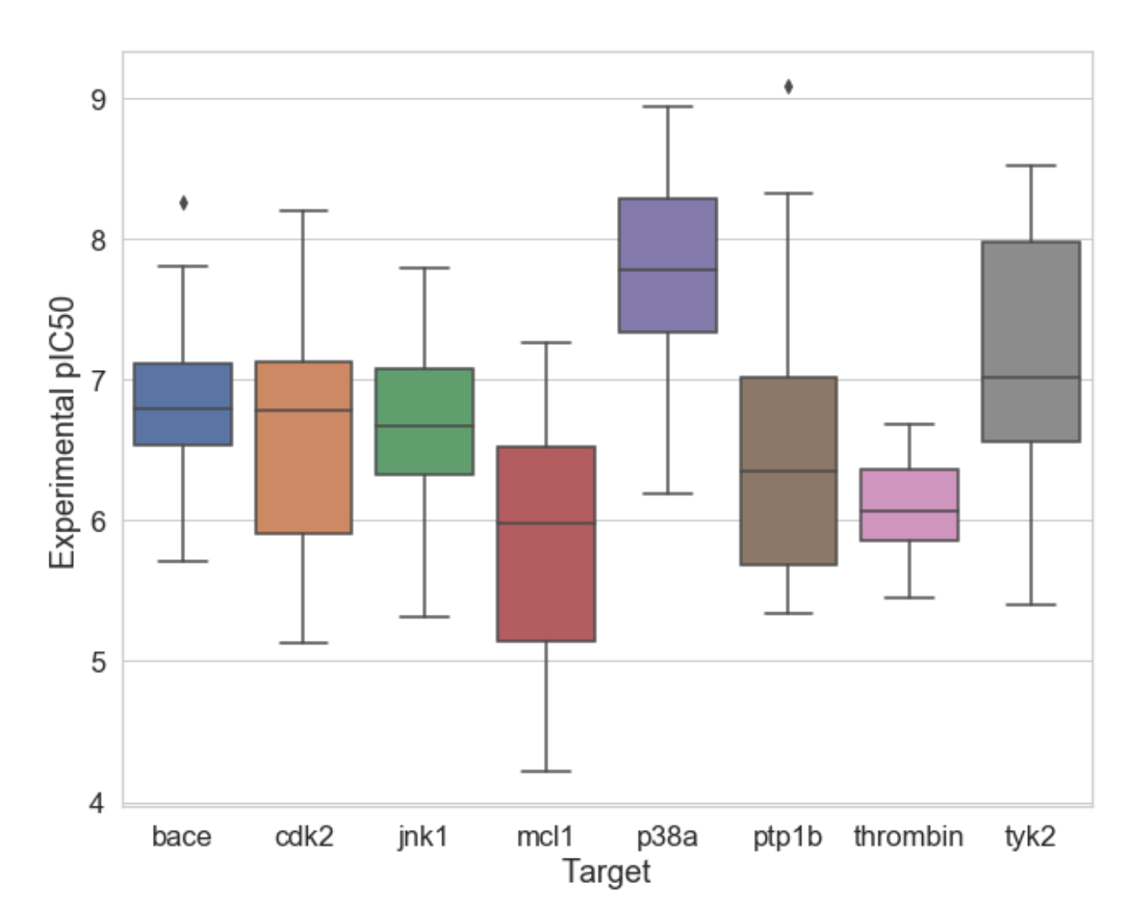
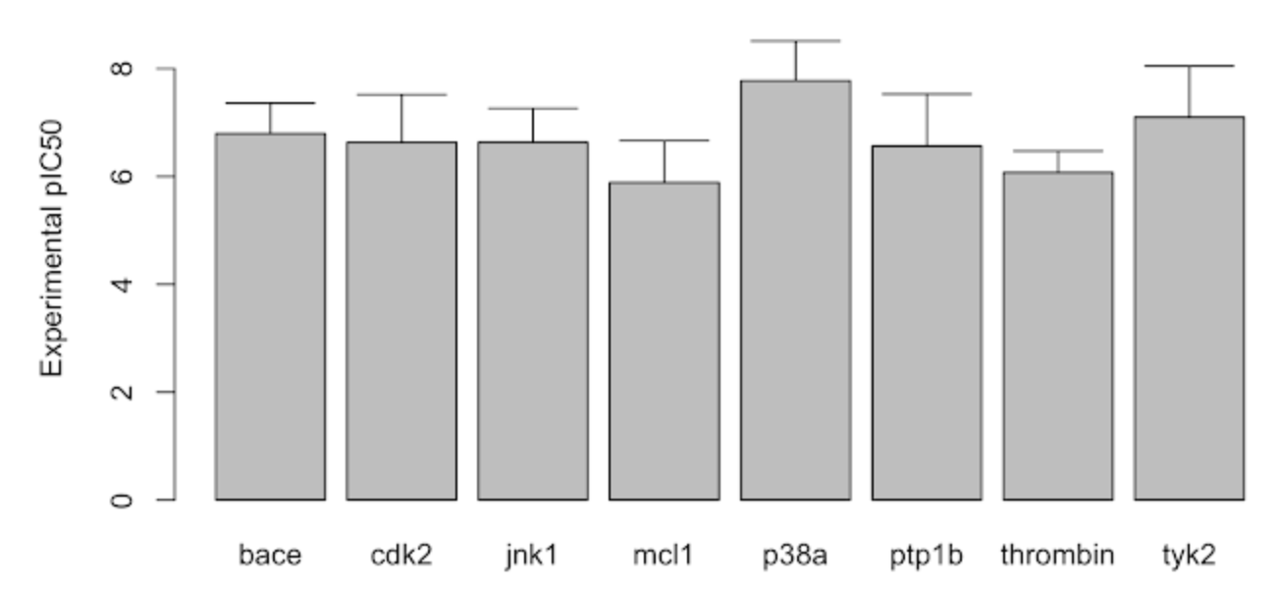
PLOTTING DATA
Dynamite Plots
(don’t use these)
Box Plots
(these show data distribution)
From http://practicalcheminformatics.blogspot.com/2019/03/plotting-distributions.html.

Slide 4
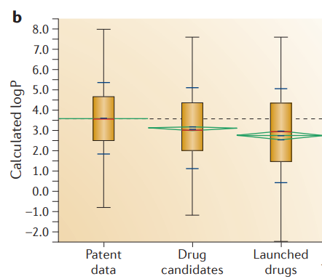


LIPINSKI
Chris Lipinski
Lipinski Rule of 5
LogP < 5; MW < 500; HBD < 5; HBA < 10
Lipinski et al. Adv. Drug Delivery Rev. 1997, 23(1), 3-25; Nat. Rev. Drug Disc. 2015, 14. 475.

Slide 5
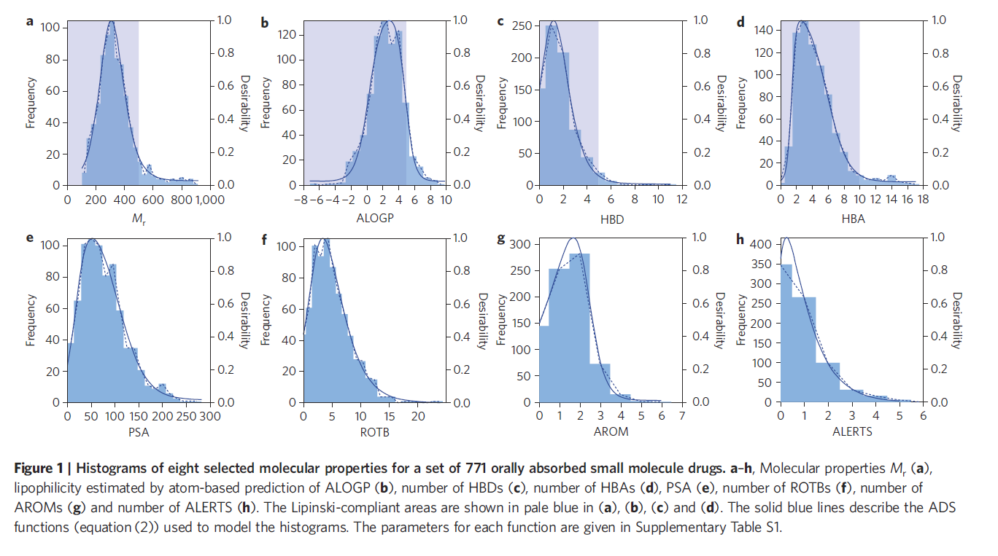
QUANTITATIVE ESTIMATE OF DRUG-LIKEDNESS (QED)
QED lets us condense 8 drug properties into a single number (~desirability)
Hopkins et al. Nat. Chem.. 2012, 4, 90-98.

Slide 6
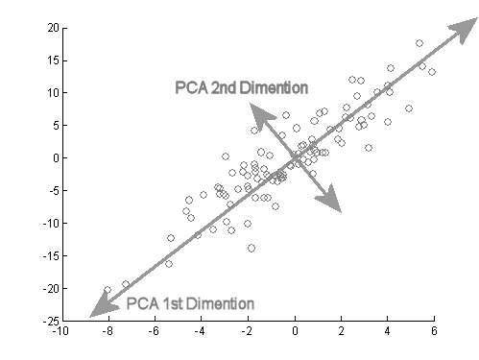
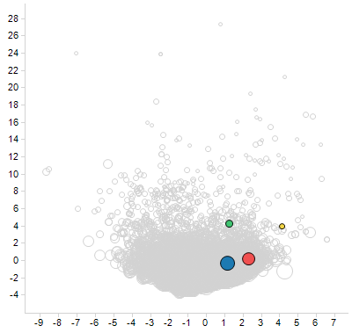
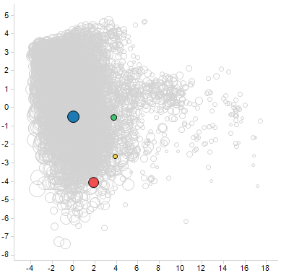
VISUALIZING CHEMICAL SPACE
Many tools exist to visualize multidimensional data in 2 or 3 dimensions
Principle Component
Analysis (PCA)
Januvia, Gefitinib, Rapamycin and Navitoclax shown on a PCA chemical space
of all drugs (grey). Note how “diversity” is relative to the method used.
PHYS PROP FP
STRUCTURAL FP (ECFP4)
PC1
PC1
PC2
PC2

