Slide 1


My Easy Cloud COP 5611 Chakib Cerny 04/31/2021

Slide 2
Motivate the problem
Have my own cloud
Accessible without internet
Full control of my data
Cost efficiency
2TB HDD < $60, unlimited users
Dropbox, 2TB, 6 users max $16.99/months

Slide 3
Goals
Ability to upload files on my private server
Upload file remotely without from main laptop
Keep a safety backup on original laptop
Simplicity to use
Avoid the logging process
Automation maximal

Slide 4


Raspberry pi
Easy to install
Light Debian OS
Open source client-server software

Slide 5
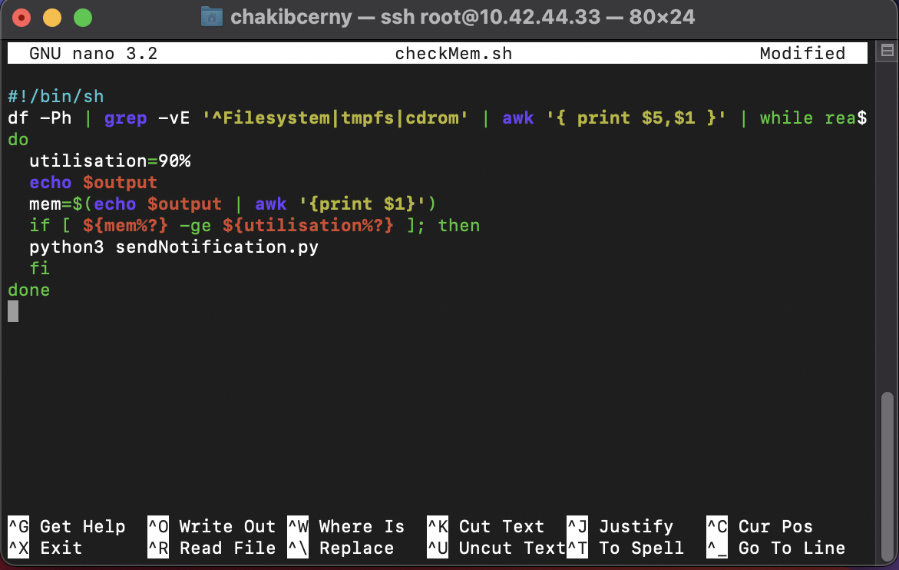
Server Side
Cronjob to run every 5 minutes
*/5 * * * * /opt/checkMem.sh
Memory check
Df | grep
Notification
Python / SMTP

Slide 6
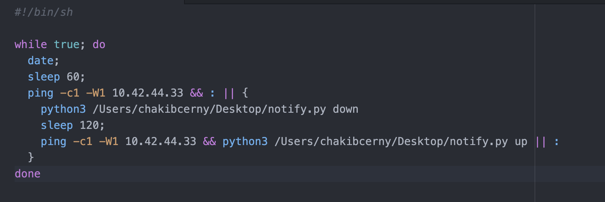
Client Side
Server status
*/5 * * * * /opt/checkNet.sh
Notification
Python / SMTP
Storage optimization
0 8 * * * / cleanup.sh

Slide 7
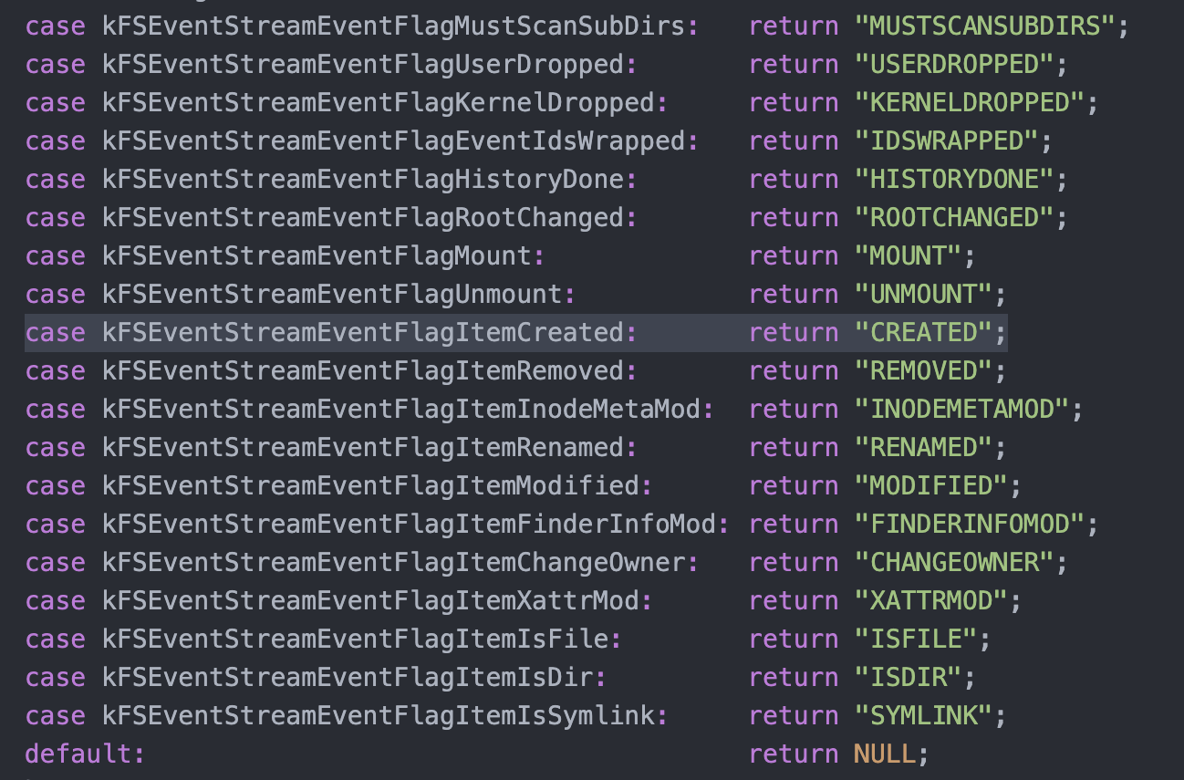
FSwatcher
File System Event API
#include <CoreServices/CoreServices.h>
System call
CURL / mv

Slide 8
The demo was too large to upload to github so I put it on my google drive
https://drive.google.com/file/d/10T-SAUXf_A7PEyX_xYXfeSKrZhLp76GU/view?usp=sharing

Slide 9
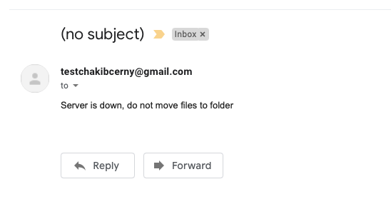
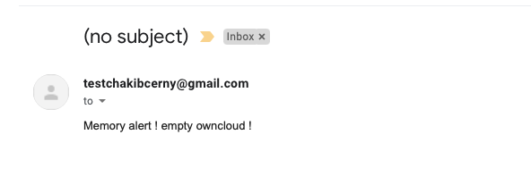
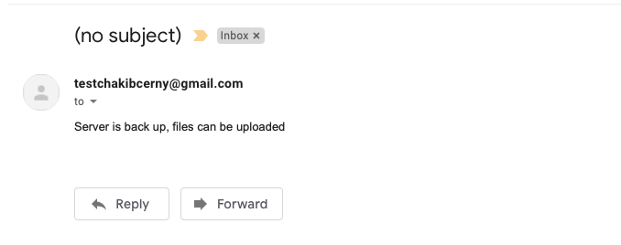
Email Notifications

Slide 10
References
https://central.owncloud.org
https://dietpi.com
https://github.com/paulgazz/fsevent-tools

Slide 11

Thank you

