Slide 1


CAP5415 - Computer Vision Object Tracking in Videos Fall 2020

Slide 2

How to track an object ?
Fully automated: Open CV tracker - Easy to implement - No prework - ROI only

Slide 3
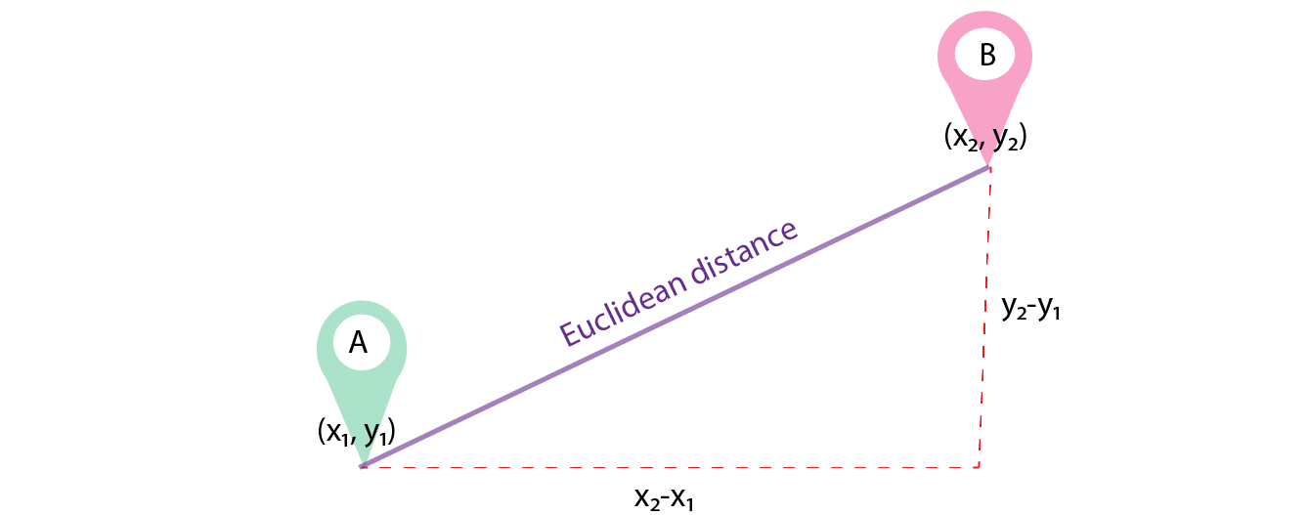
How to track an object ?
2 Steps process: Object Detection: YOLO V3 (80 classes) Object tracking: Euclidean Distance

Slide 4
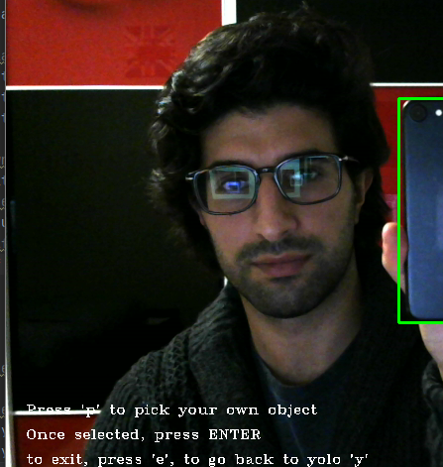
Fully automated vs 2 steps
Open-cv:
Implementation simplicity
Processing power
2 steps:
Reliability
Evolution
Performance improvement

Slide 5
References: https://medium.com/analytics-vidhya/role-of-distance-metrics-in-machine-learning-e43391a6bf2e https://pjreddie.com/media/files/papers/YOLOv3.pdf https://docs.opencv.org/3.4/d2/d0a/tutorial_introduction_to_tracker.html

