Slide 1
Embedded Learning Multi-Domain Convolutional Neural Networks for Visual Tracking
CSED499I
Detailed Design
20080650 CSE
Jeongbin Choe
Advisor: Prof. Bohyung Han (CV Lab)

Slide 2
Introduction
Multi-Domain Network (MDNet)
Consists of shared CNN layers and multiple branches of domain-specific layers
MATLAB based framework
The winner of The VOT2015 Challenge
Performed 1 fps with 8 cores Intel Xeon CPU + NVIDIA Tesla
Project Goal
Port MDNet to iPhone 6+ and optimize its performances
Implement MDNet based real-time learning and object tracking application

Slide 3
Requirements Summary
Embedded MDNet
Performs visual tracking on iPhone 6+ with targets used in VOT2015 challenges
Keeps at least 1 fps
YouTube
Real-time Application
Requires user to teach the neural networks with objects detected by scanning around with a camera
After training, performs real-time visual tracking through the camera

Slide 4
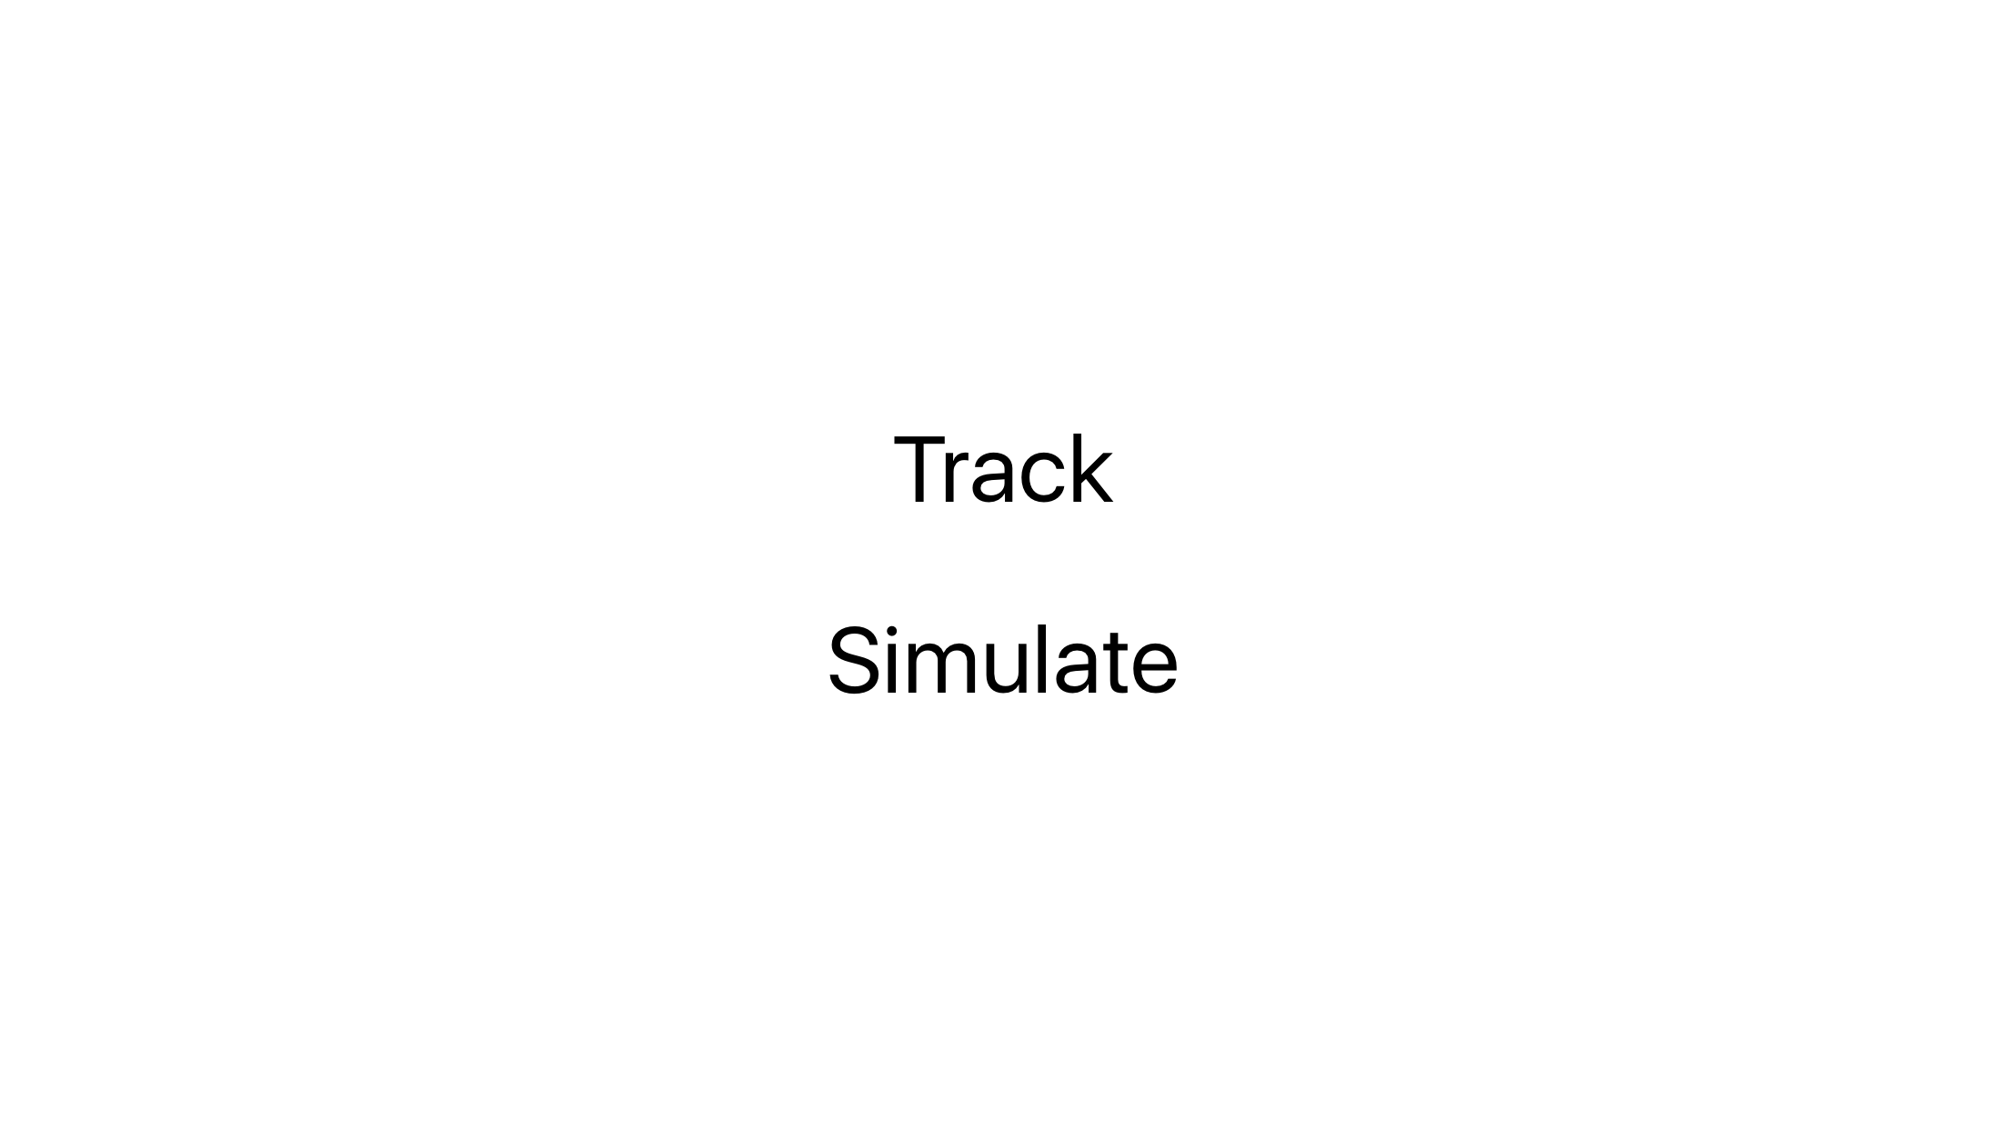
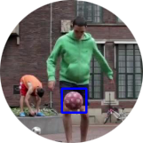
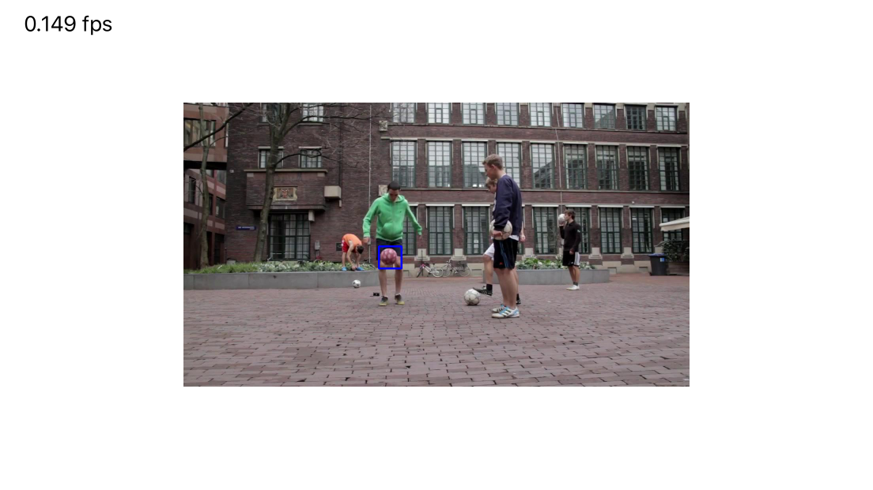

Interface - Embedded MDNet
Simulate MDNet
Display FPS here
VOT2015 images

Slide 5
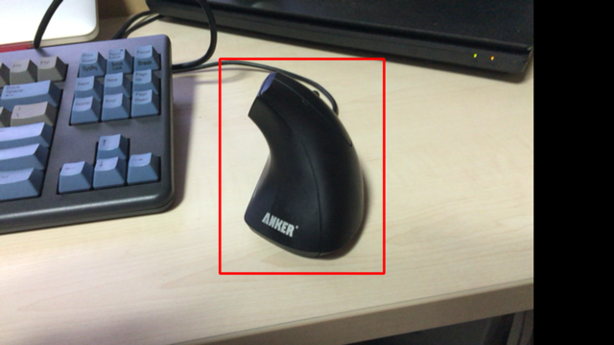
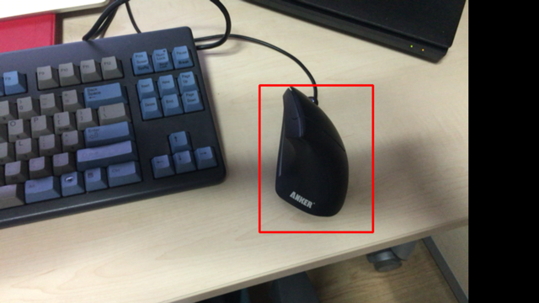
Interface – Real-time Application
Tracking selected object while camera is moving

Slide 6
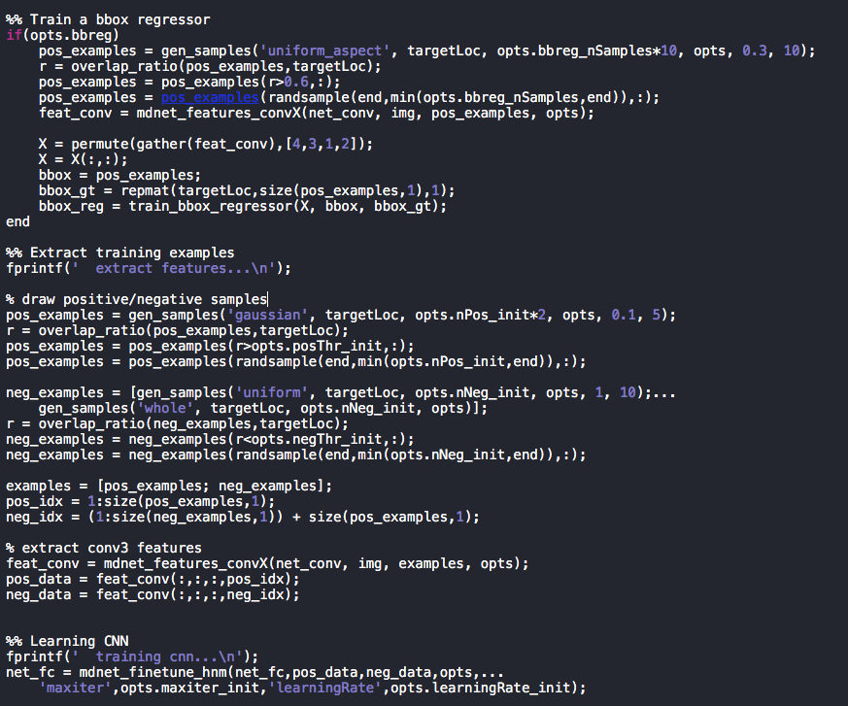
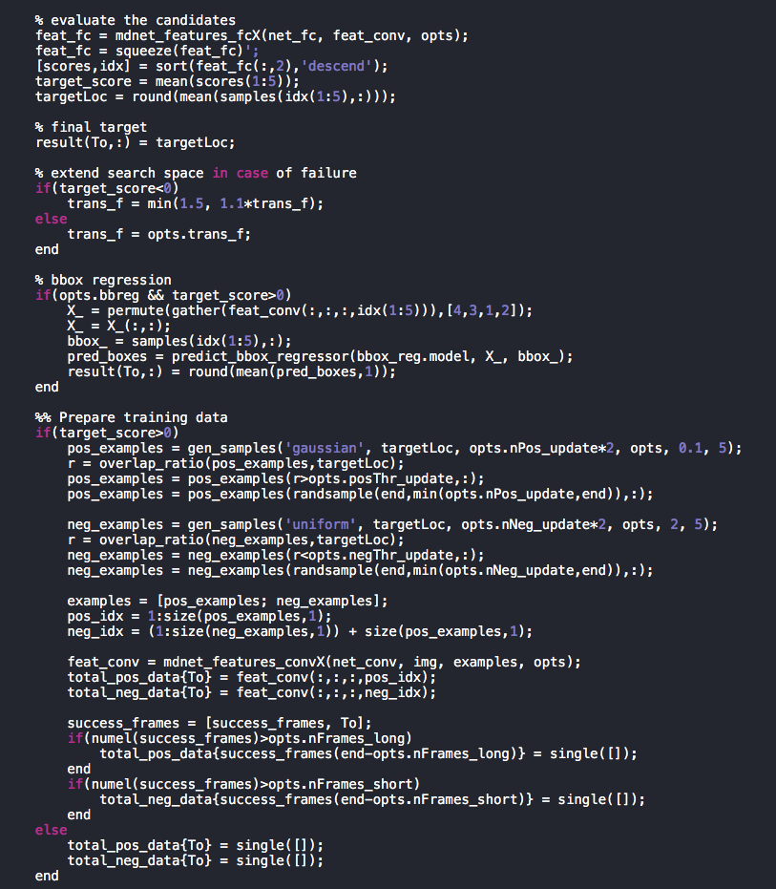
Architecture - Embedded MDNet
tracking/mdnet_run.m (MATLAB)

Slide 7
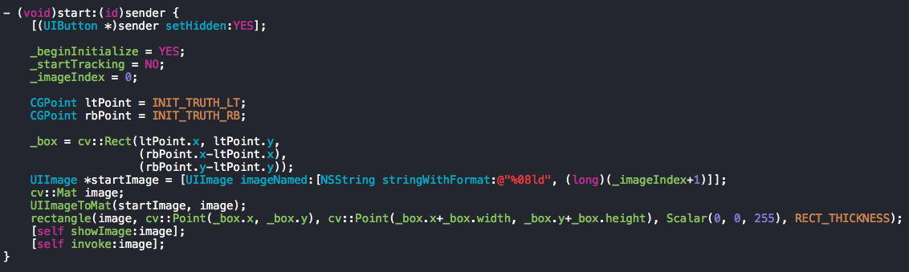
Architecture - Embedded MDNet
SimulationViewController – ‘start’ method

Slide 8
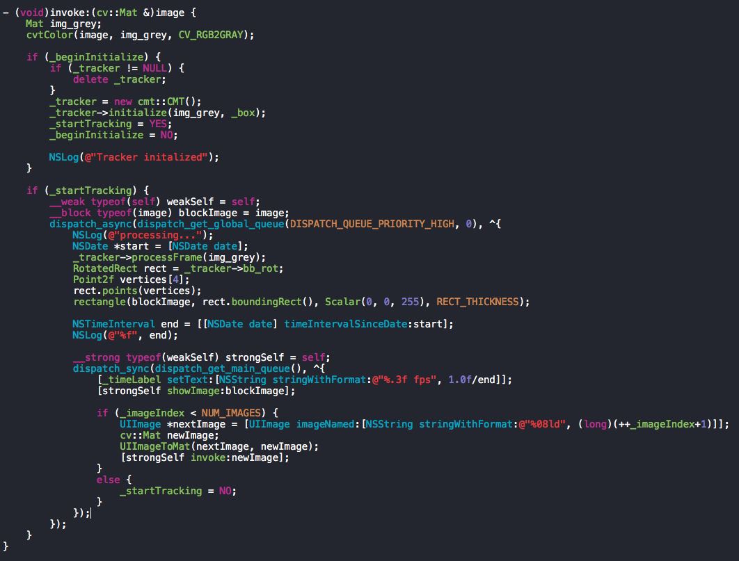
Architecture - Embedded MDNet
SimulationViewController – ’invoke’ method

Slide 9
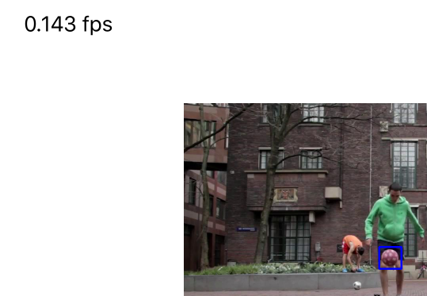
Current Status
Embedded MDNet
Initial Input Size: 51 by 51 px
3 Convolution Layers, 3 Pooling Layers
Disable online tracking process
FPS: around 0.150

Slide 10
Remaining Schedules
Mar. 23 | Understanding the Topic
Apr. 10 | Requirements Analysis
May. 03 | High-level Design & Implementation
May. 15 | Detailed Design
May. 24 | Optimization Implementation
May. 29 | Real-time Application Optimization
Jun. 03 | Poster presentation
Jun. 05 | Submitting final report

Slide 11
References
Hyeonseob Nam and Bohyung Han, Learning Multi-Domain Convolutional Neural Networks for Visual Tracking, arXiv, 2015.
Y. Wu, J. Lim, and M. Yang. Object tracking benchmark. TPAMI, 2015.
http://acsweb.ucsd.edu/~yuw176/report/ECE273.pdf
http://www.votchallenge.net/vot2015
https://github.com/TernaK/DeepLearningKit
https://github.com/clementfarabet/torch-ios
https://github.com/HyeonseobNam/MDNet

