Slide 1

https://github.com/ceronGithub/PDF-Extractor/tree/develop/PdfRenameApplication/bin/Debug
Copy and paste this to the browser.
Once you see the files, look for file named: PdfRenameApplication.exe
Install that application
After installing, run the application, then a message will pop-out and will say
Where user can get the output(this folder can be found in the desktop\PDF-OUTPUT)
Below is the design of the application.

Slide 2
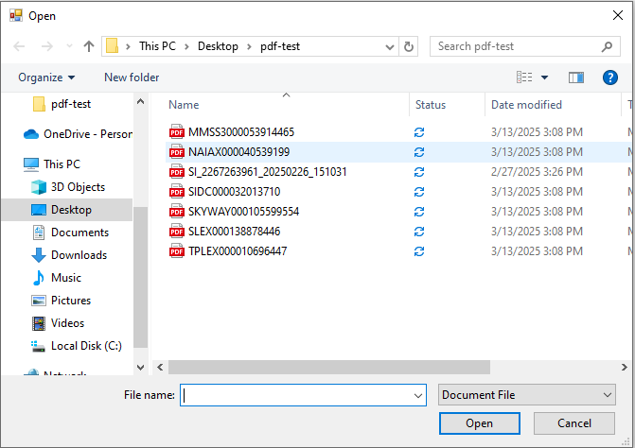
Click to locate-file
Then locate the pdf file you want to rename

Slide 3
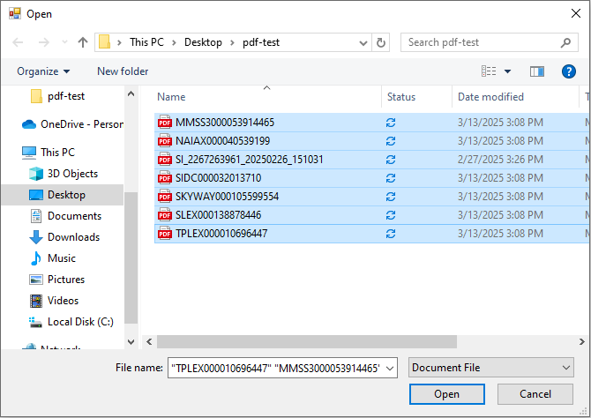
Few notes to remember
This application will crop the text according to coordinates of x-axis, y-axis, width, height
You can upload 1 or more than 1 pdf file.
Then once you have selected the pdf-file/s you want to import click open

Slide 4
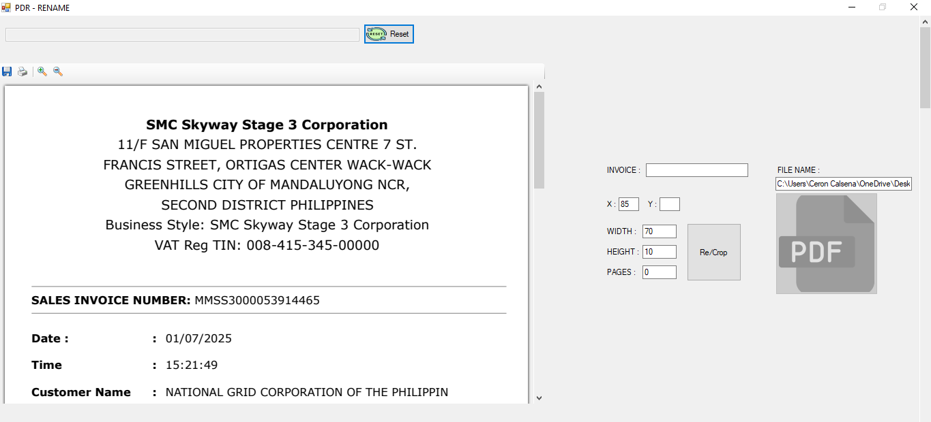
Now after clicking the open button. You can view the pdf-file inside the application
This will be abit tricky at first, but once you got the hang on how to use it. It will greatly
Helped you
Always edit the first pdf coordinates. And you will find the reason why, as we go along.

Slide 5
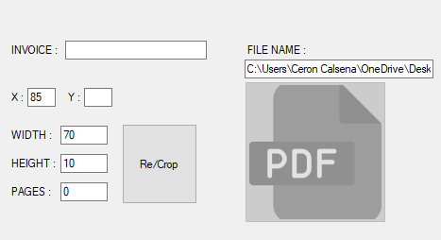
As you can see, on the center right side, you will see the file path.
And you will see Invoice, and x-axis, y-axis, width, height.
So I set this up already for you, babi… but you can adjust it to your desired coordinates
So what you are going todo is put a y-axis value.

Slide 6
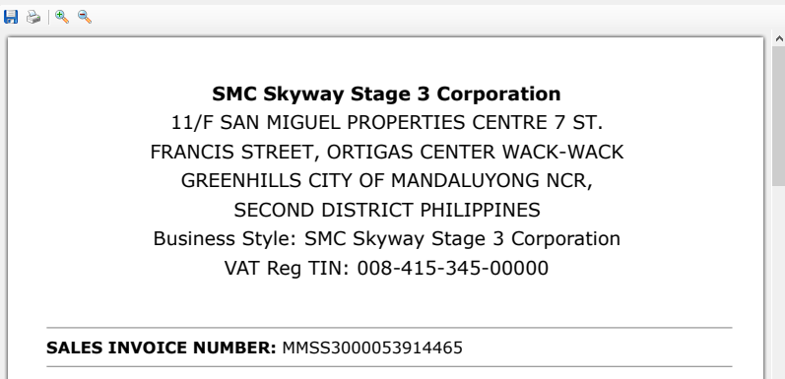
1
2
3
4
5
6
7
8
9
So heres the tricky part, to help you on get the invoice number
First you have to count how many lines are their before the invoice number
After counting how many lines.

Slide 7
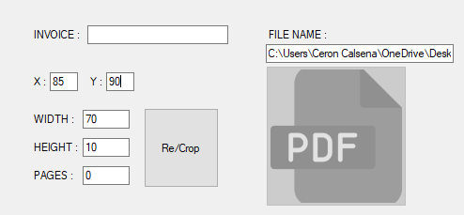
Type 90. because there are 9 lines in total.

Slide 8
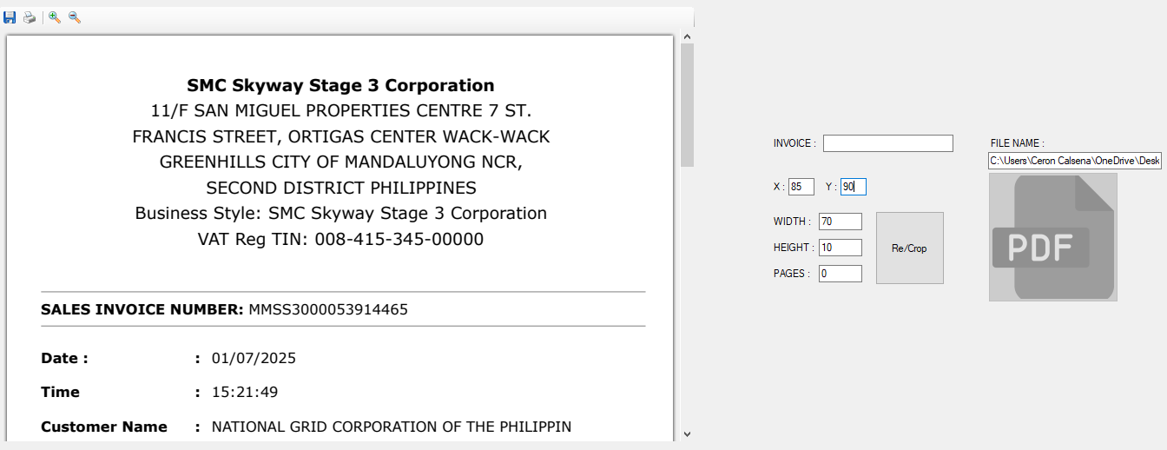
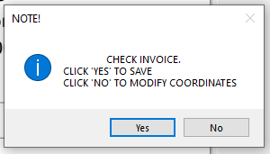
After inputing a value on y-axis. Click re/crop button
Read carefully!
Type ‘yes’ if you are sure
Type ‘no’ if you still want to modify the coordinates

Slide 9
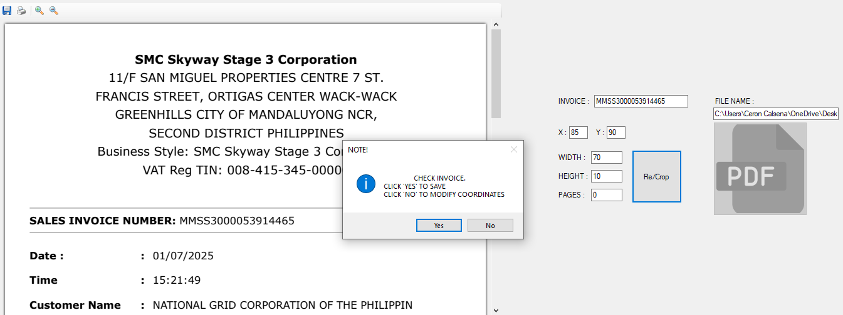

Slide 10
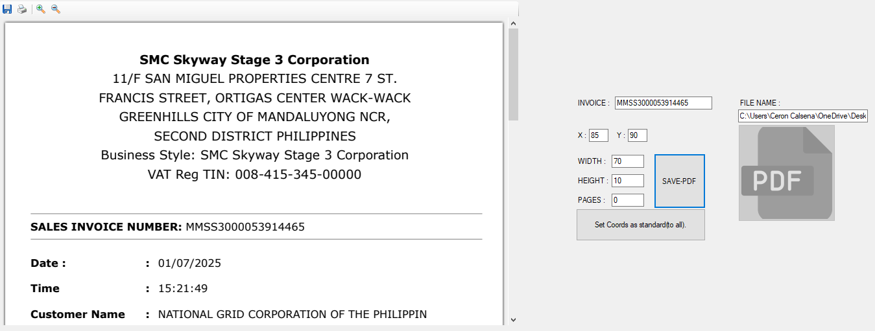
So after clicking the ‘yes’ another button will pop-out.
Take note this pop-out button only pops to first pdf, lets just say the first pdf- is were you
Adjust the coordinates according to your desire.
Now I will show you what the other pdf look-like

Slide 11
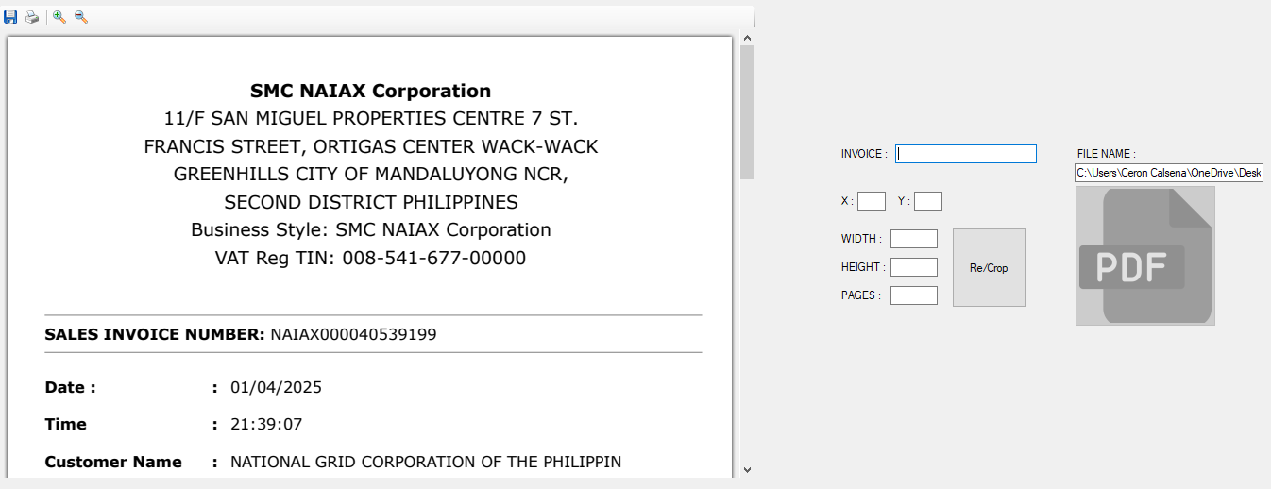
This is what the other pdf looks-like, no coordinates.
Again, the first pdf, is were you are going to adjust the coordinates. For the app to crop it for
You.

Slide 12
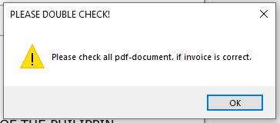
Now once you click this button.
A message will pop.
Click ok. And next pages are the
Result.

Slide 13
BEFORE

Slide 14
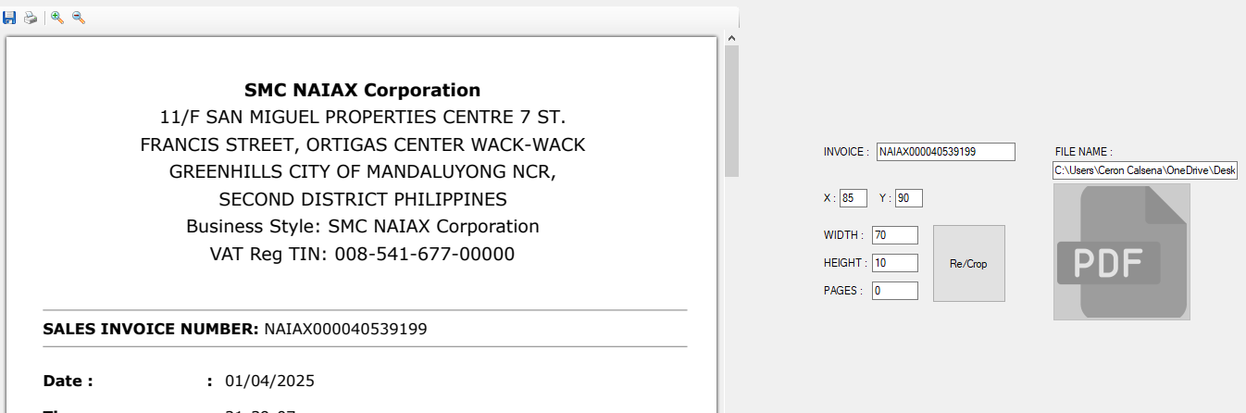
After

Slide 15
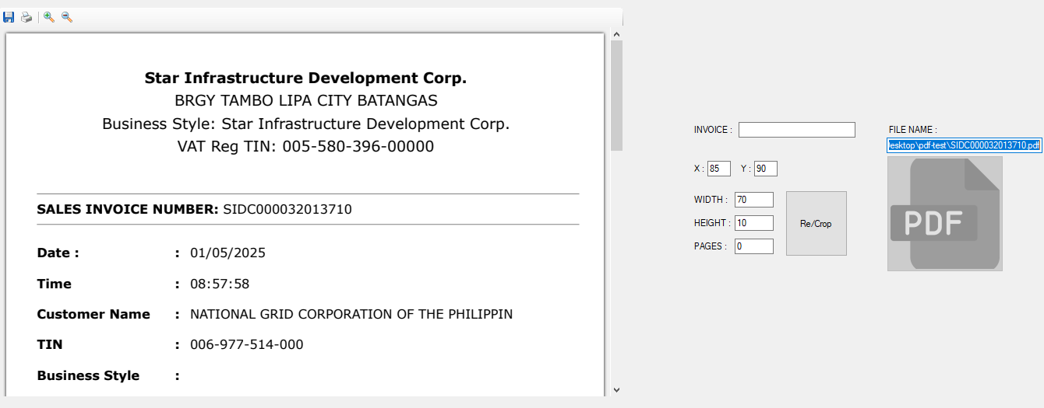
Note, please do mind check all pdf-documents if invoice are the same.
If somehow, I didn’t cropped the invoice, just adjust the y-axis. To higher 90, or lower 90

Slide 17
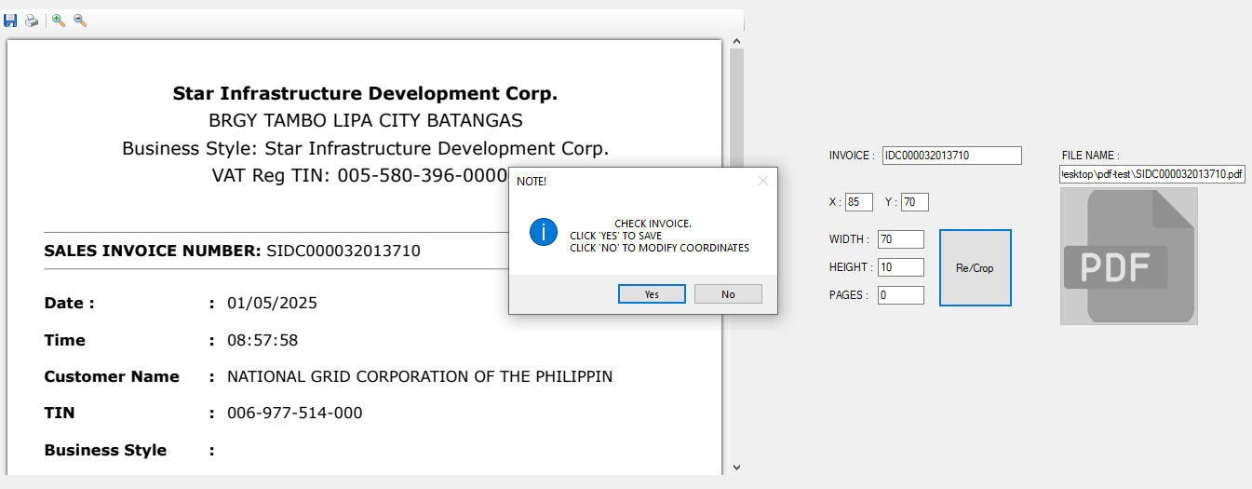
So here, I adjust the y-axis to 70, from 90. and it did cropped the invoice.

Slide 18
this
After checking, all the pdf-document/s, and if its correct click this button.

Slide 19
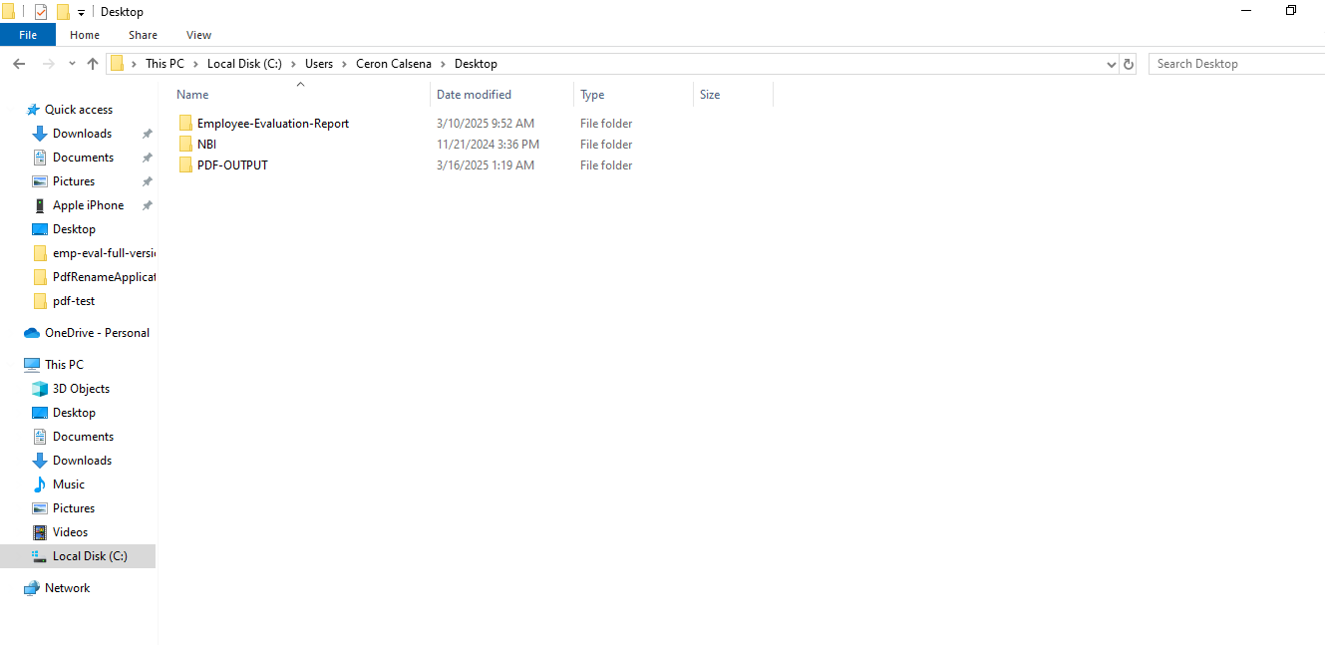
So sample, this is your desktop. Click the PDF-OUT folder.

Slide 20
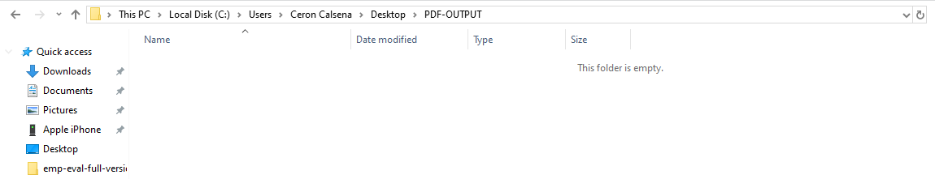
As you expect this is empty. Now lets go back to the application.

Slide 21
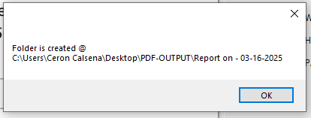
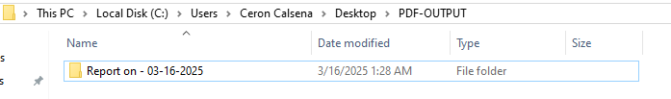
this
Now click the button. To save all pdf-file/s
A folder is created inside the PDF-OUTPUT
Folder.

Slide 22
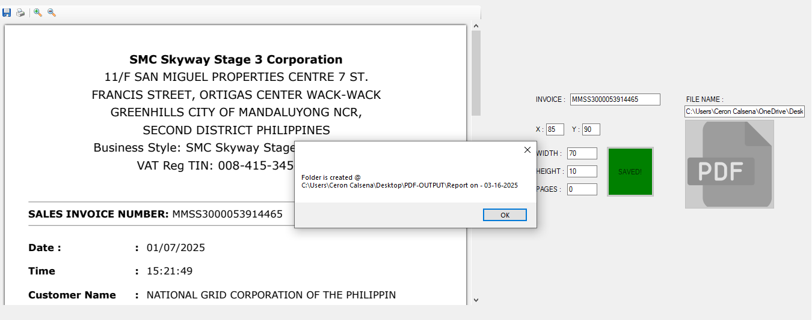
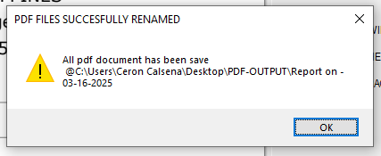
After you click SAVE-ALL-PDF button. This will happened. Then click OK
Now all pdf-file/s has been renamed
According to invoice number.
Check the PDF-OUTPUT folder. And
Click the folder inside.

Slide 23
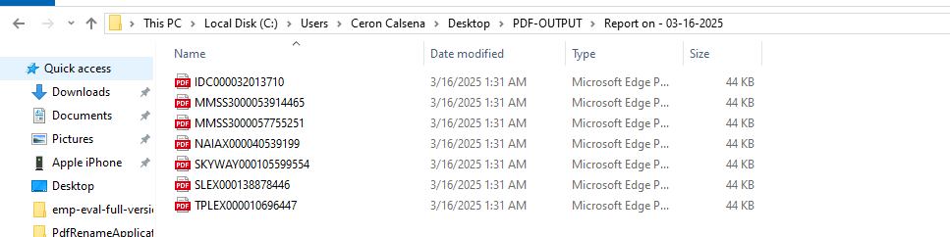

This is what you will see.
All pdf-file/s has been renamed according to its pdf-content. ☺
If you want to reset it, and import a different, pdf file. Click reset

