Slide 1
Discussion session: “Community Building”
Community of Edinburgh Research Software Engineers
26 September 2018

Slide 2
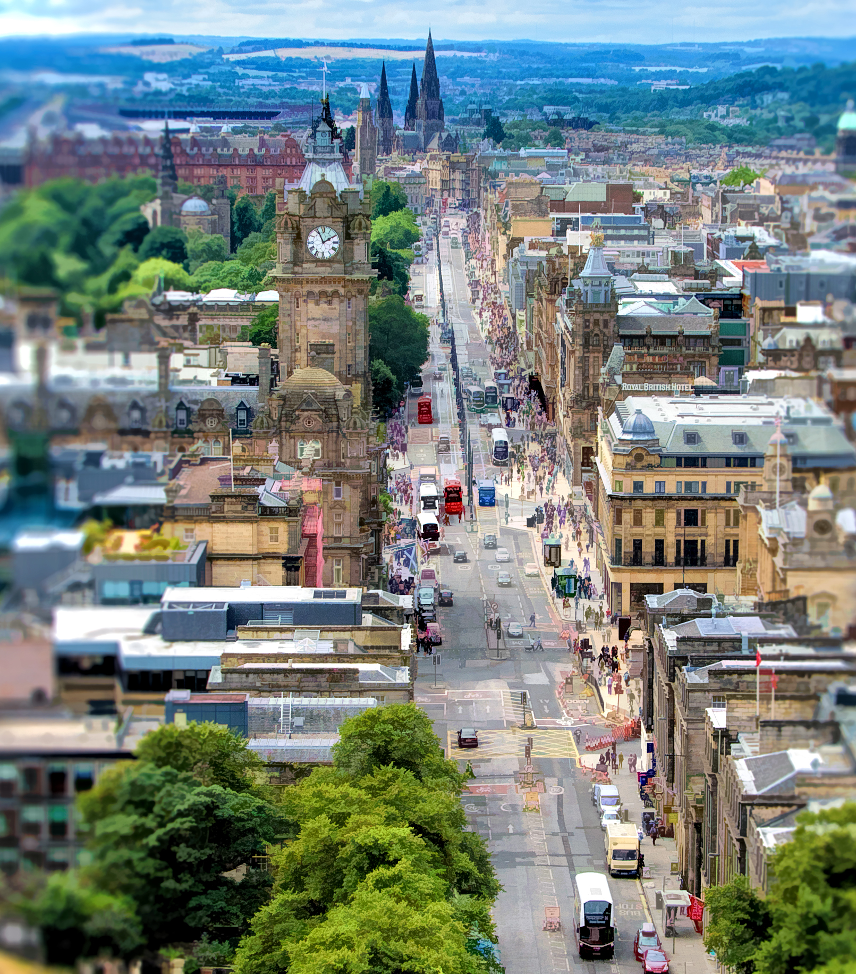
“It takes a village to raise a child”
Origin unknown – similar to various African proverbs
https://www.npr.org/sections/goatsandsoda/2016/07/30/487925796/it-takes-a-village-to-determine-the-origins-of-an-african-proverb
Photo credit: Princes Street by Hamish Irvine (CC-BY-NC)

Slide 3
Communities of Practice
Group of people (us!) who share a particular craft or shared purpose
Sharing ideas and tools with each other can accelerate and improve capabilities and research outcomes for you, your group, your department and your organisation
Each community is different and works in different ways, but there are common patterns to creating vibrant and successful communities
These discussion sessions will explore how we want to build and grow our community

Slide 4
Discussion session practicalities
Only 30 minutes!
Introductions (5 minutes)
Name, group / department, organization
Discuss the topic, noting ideas and barriers
Highlight (15 minutes)
Potential activities and events that might address the theme
Roles and Responsibilities: how might you organize these activities?
Available resources that could be contributed to make things happen
Missing skills / experience / resources that are needed
Prioritise (5 minutes)
What’s the most exciting thing? What’s the easiest thing to do now?
Wrapup – anything you’ve missed? (5 minutes)

Slide 5
Discussion themes
Learning, improving and sharing skills (Moderator: Toni)
Finding out what others are doing / presenting what I’m doing (Victoria)
Cross-campus and cross-discipline network building (Mario)
Growing our community / inclusion and support (Neil)
Recognition, reward and recruitment (Sean)
Making a difference (Andy)

Slide 6
Role of moderators
Coordinate and assist group discussions
Impartial: not dominating conversation nor evaluating ideas, but encouraging input from participants in their group
Keep discussions on time and on topic
Noting down ideas

Slide 7
Carpentries Cookbook
An open resource with examples of what different communities have done and acheived
https://cookbook.carpentries.org/

