Slide 1

Community of Edinburgh Research Software Engineers
Research-council recognized and funded role
Increasingly essential to large %age of research
Many RSEs working across Edinburgh, but are often isolated
Community of Edinburgh RSEs being bootstrapped now!
Github repos, slack channels, mailing lists, meetups – join us!
https://github.com/cerse/2018-09-26-bootstrap
Notes:
Many of our day jobs involve Research Software Engineering and Research Data Support roles
We Consult, Develop, Support ‘Software- and Data- dependent Research’, in partnership with research groups
We are often isolated – hence need to build community of practitioners – including to share knowledge, techniques, resources
Initial meetup at the 3rd RSE conference in Birmingham early September; Edinburgh bootstrap today at the Bayes Institute

Slide 2





Core Team
Andy Turner
https://rse.ac.uk/the-committee/
Mario Antonioletti
https://www.software.ac.uk/about/staff
Neil Chue Hong
https://www.software.ac.uk/about/staff
Giacomo Peru
https://www.software.ac.uk/about/staff
Notes:
Core Team provide much of the effort to organize Carpentries workshops, provide Instructors & Helpers, recruit researcher trainees, support them as RSEs

Slide 3
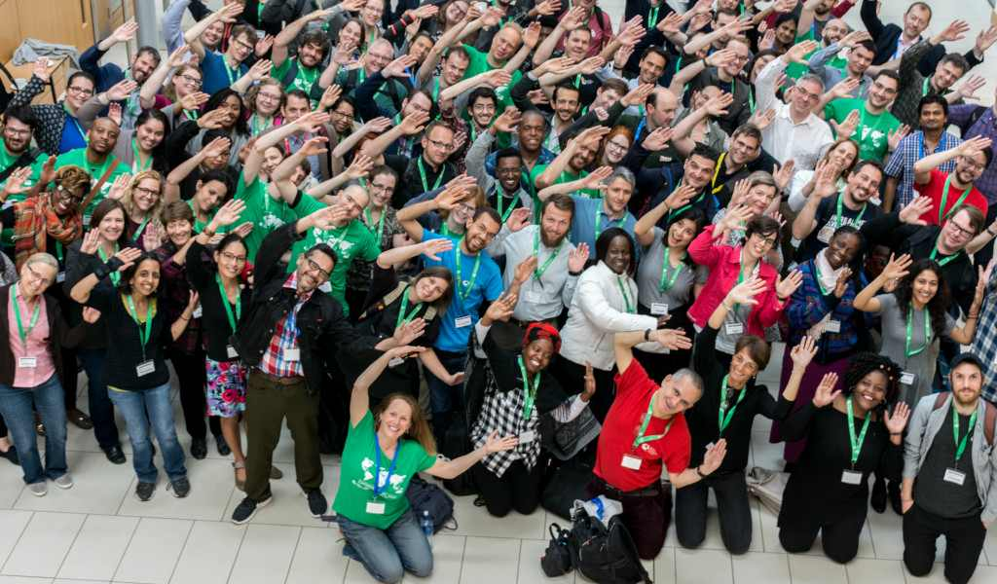
Inclusion & Diversity
Notes:
We aim to emulate the Carpentries’ level of inclusion, diversity and support – ’building locally, connecting globally’

Slide 4
Workshop Outline
13:10: Andy Turner: UK RSE Association
Research Software Engineers
– Who / What / Why
- Icebreaker / Introductions
13:30 Neil Chue Hong: Software Sustainability Institute
Community Bootstrap
– Moderated Discussion / Group Tasks
14:00 Coffee / Cake / Networking
14:15 Bootstrap Outputs & Actions
14:45 Wrap up, thanks & tidy up
Notes:
Core Group provide much of the effort to organize Carpentries workshops, provide Instructors & Helpers, recruit researcher trainees, support them as RSEs

Slide 5




Community Resources
https://ukrse.slack.com/ #edinburgh
Ed-rse-community@jiscmail.ac.uk
https://github.com/cerse
https://twitter.com/cerse7

