Slide 1
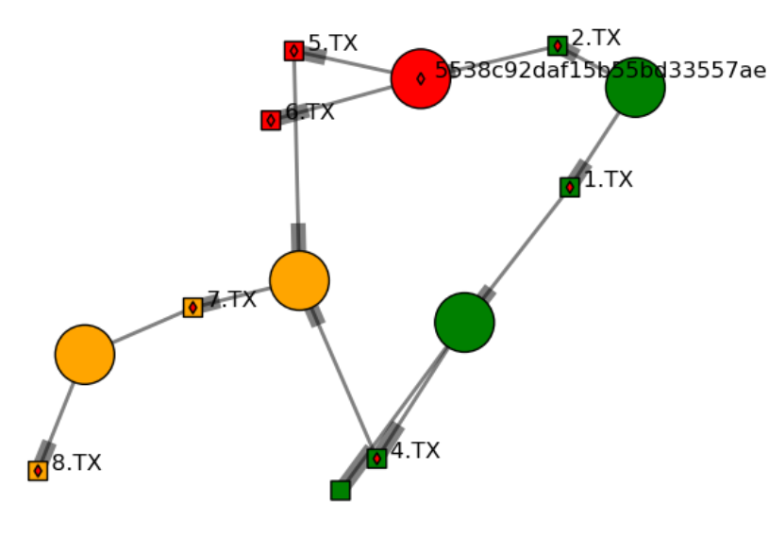
Geosmeta: prototype service for provenance & (meta)data
How was file a.dat made?
Where was code b.py used?
What do I need to archive for this research paper?
+ noSQL database
Current
Error
DownstreamOfError
mike.mineter@ed.ac.uk School of magnus.hagdorn@ed.ac.uk GeoSciences

