Slide 1
RSE: Why are we doing this?
IS Research Services - 2019

Slide 2
Ask any two RSEs what a RSE is
“do you work with research software in any way?”
Does not mean “do you create applications from scratch?”
Often answer is “no” even though you do
“do you support research computing?”
Does not mean “can you write a massively parallellised model?”
Often answer is “no” even when you sit in a lab
“Do you do anything that creates data/code?”
Does not mean “have you made 1000 commits to github?”
Often answer is “no” even though you have (eg) an excel spreadsheet that creates diet plans
Check your prejudices/privileges

Slide 3
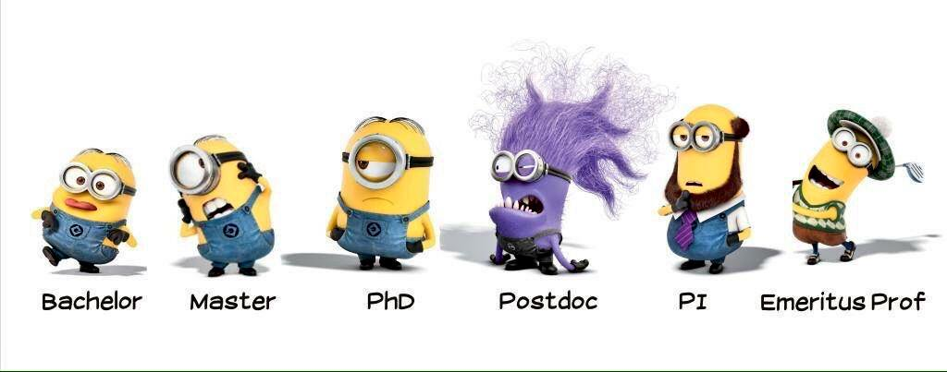
Clearly defined career pathway

Slide 4

This is not a forlorn hope
I’ve seen it happen
Leeds as a case study (next year)
Two RSE fellows
Two centrally funded staff employed as RSEs
Further staff planned
Actual job titles and defined roles
Sheffield/Manchester
Research consultancy

Slide 5
Consistency between institutions
There’s a (sort-of) agreed national scale for academic careers
There needs to be one for computational support roles
…that is at least relatable to the private sector
We need local champions to do this

Slide 6
What comes next?
Data
Discussion
Being taken seriously
Consultation
???
mike.wallis@ed.ac.uk

