Slide 1

Virtual
Welcome to the Sixth CERSE Meeting at the Bayes
❌

Slide 2

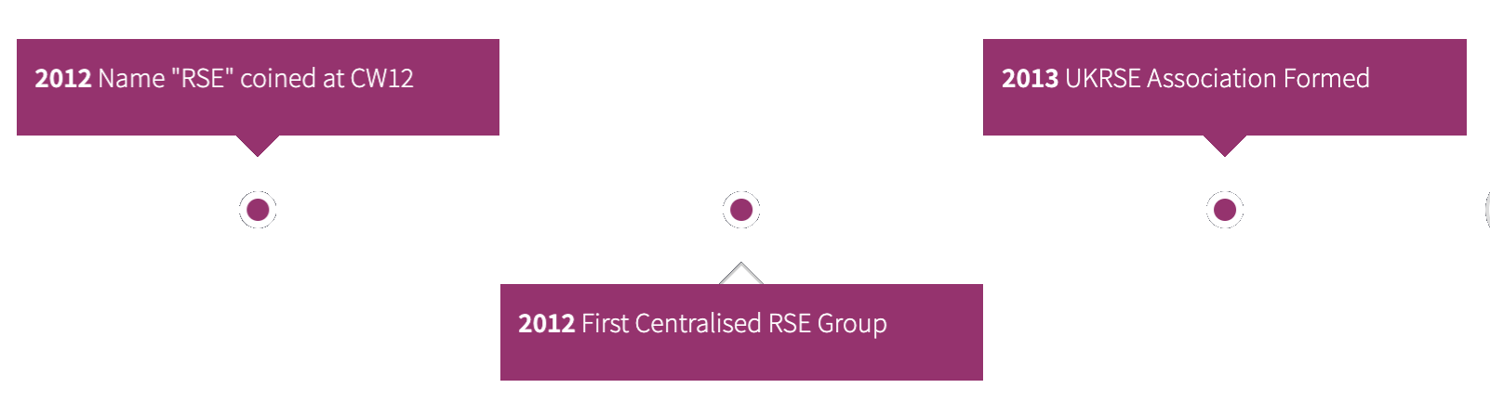
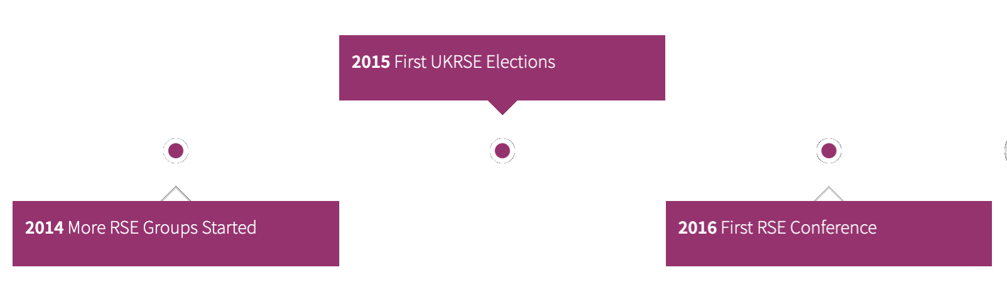

What are Research Software Engineers (RSEs)?
People who:
Develop software as part of their research or
Develop software for others to do research
It is a spectrum
Part of a bigger national movement
https://www.society-rse.org/
Help develop career paths in academia
SSI pivotal in establishing & gaining international traction
Timeline from the RSE web site.

Slide 3
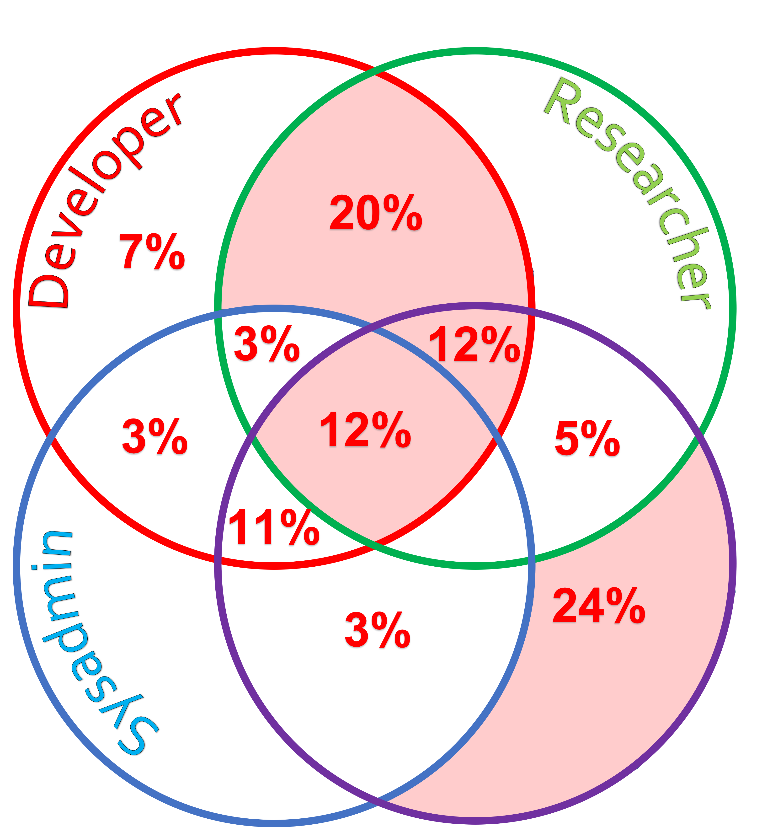
What are we doing in Edinburgh?
Establishing a Community of Edinburgh RSEs (CERSE)
https://cerse.github.io/
Hosted a number of meetings:
Bayes Centre –26/09/18
Edinburgh College of Art – 21/11/18
Argyle House – 25/01/19
BioQuarter – 08/10/19
Grant Institute, King’s Buildings – 18/02/20
This virtual meeting – 13/05/20
First phase:
Awareness raising exercise
Have meetings at different locations
Second phase:
Franchise meetings to local campuses
Have a number of bigger meetings less often
EPCC RSEs - Sample of 75 Out of 91 (as listed on the EPCC Web Site).

Slide 4

Why are we doing this?
Establish a grassroots led self-sustainable community
Act as a network for RSEs in Edinburgh
Many RSEs work in isolated silos, get to meet other RSEs
Inform RSEs what is happening Edinburgh/nationally/internationally
Develop best practice
Can also act as:
Lobbying point
Talent pool (for PIs, for EdCarp, etc.)
Still working out the best way to serve the community
If you have ideas on this, please get in touch

Slide 5
Finding out more
GitHub io pages:
https://cerse.github.io/
Jisc mailing list:
http://www.jiscmail.ac.uk/ed-rse-community
Twitter:
https://twitter.com/cerse7

Slide 6
Schedule
Time | Who | Activity
14:30 | Mario Antonioletti, EPCC | Welcome
14:35 |  | Ice breaking session (get to know some of your fellow attendees)
14:50 |  | Reporting back
15:00 | Simon Hetrick, Soton | Society of RSEs
15:30 | James Stix, EDINA | Noteable service
16:00 | Pedro Jacobetty | Music generation from a blockchain discourse on Twitter (Soundchain project) & RSEs and social scientists
16:30 | David Fergusson | Digital Research Services
16:45 | Mario Antonioletti | Edinburgh Carpentries
17:00 |  | Close

Slide 7
Breakout session (get to know fellow attendees)
Going to break out into rooms of 5-6 people. (15 mins)
Nominate a chair-person
Introduce yourself to everyone in your group:
Name, where you work, what you do and one unusual non-work thing about yourself.
Task:
What are the top 3 (max 1/person) work challenges that you have faced under lockdown AND
What support do you need to overcome the above to allow you to continue your research software engineering or research work?
E.g. a problem with a possible solution.
When we reconvene chair reports back your group’s problem/solutions (10 mins)
Report back verbally or use the chat facility to report back (depending on time)

