Slide 1
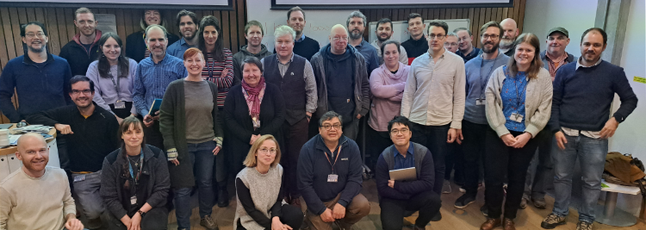
Welcome to the Eighth CERSE Meeting (2nd Virtual) CERSE aims and objectives
Mario Antonioletti, EPCC/SSI, UoE
Virtual Meeting, 26/04/23

Slide 2

What are Research Software Engineers (RSEs)?
RSEs are people who:
Part of a bigger national movement
https://www.society-rse.org/
Help develop career paths in academia
Network/training/support/build a community
Lobby on behalf of members
Software Sustainability Institute (SSI) pivotal in establishing
Gained international traction
Develop software as
part of their research
Develop software
for others to do research

Slide 3
Why have CERSE?
Aim build a Community of Edinburgh RSEs (CERSE)
Objectives:
Provide a mechanism to build a network
Website (virtual org in GitHub)
Mailing list (JISC list)
Knowledge and information exchange
Resources
Tooling
Best practice
Training opportunities (sister project: Edinburgh Carpentries)
Dynamic community – it is what you make of it
More information at:
https://cerse.github.io/

Slide 4
Past meetings
Meeting 8: virtual meeting – 25/04/23
Meeting 7: Bayes, restart meeting – 15/03/23 (strike day)
… COVID desert …..
Meeting 6: Bayes –Covid→ Virtual meeting – 13/05/20
Meeting 5: Grant Institute, King’s Buildings – 18/02/20
Meeting 4: BioQuarter – 08/10/19
Meeting 3: Argyle House – 25/01/19
Meeting 2: Edinburgh College of Art – 21/11/18
Meeting 1: Bayes Centre – 26/09/18
Continue alternating between face-to-face and virtual monthly meetings
Next meeting will be a face-to-face meeting on 31st May at Roslin
Meeting after will be a virtual meeting in late June, date and time TBC

Slide 5
Schedule
Time | Who | Activity
15:00 | Mario Antonioletti (EPCC/SSI, UoE) | CERSE aim and objectives
15:10 | Mike Spencer (Smart Data Foundry) | Smart Data Foundry
15:20 | Kirsty Pringle, (EPCC/SSI, UoE) | An Introduction to the RSE movement (and why you want to join!)
15:30 | Eleni Kotoula (Digital Research Services, UoE) | Digital Research Facilitation at UoE
15:40 | James Stix (EDINA, UoE) | Noteable for research use
15:50 | Peter McCallum (Institute for Energy Systems, UoE) | Cloud Platforms for Energy Research
16:00 |  | Close

Slide 6
Finding out more …
GitHub io pages:
https://cerse.github.io/
Jisc mailing list:
http://www.jiscmail.ac.uk/ed-rse-community
Twitter:
https://twitter.com/cerse7
Joining the RSE (there are various ways of interacting)
https://society-rse.org/join-us/

Slide 7
Thanks to …
Current organisers
Eleni Kotoula, Digital Research Services, UoE
Ed MacKenzie, Centre for Data Culture and Society, UoE
Felicity Anderson, EPCC, UoE
Kirsty Pringle, EPCC/SSI, UoE
Your name could be here!!
Digital Research Services for sponsoring the refreshments
It would be good to get a group pic (optional) at the end before we go out …

