Slide 1


An Introduction to the RSE movement (and why you want to join!)
Kirsty Pringle,
Software Sustainability Institute &
Edinburgh Parallel Computing Center

Slide 2

SSI Collaborations Workshop
Notes:
why is there no career for software developers in academia?

Slide 3
Timeline..
2014 UK Research Software Association is formed
2016 First RSE conference (with attendees from 16 countries)
2017 The movement grows with RSE associations forming in other countries
2019 The Society of Research Software Engineering charity was formed
2020 SORSE – Series of Online RSE events
2021 International Council of RSE Associations formed
Notes:
why is there no career for software developers in academia?

Slide 4
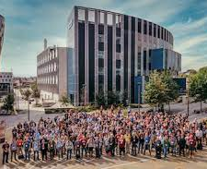

The Society for Research Software Engineering
Registered charity with 10-12 trustees from across the RSE community, voted in at each AGM
Membership is £20 per year
Access the Events & Initiatives fund
Contribute to special interest groups.
Apply for the Society’s mentorship scheme.

Slide 5

ScotRSE – a Network for RSEs in Scotland
Scotland channel on UKRSE Slack
Mailing list: scotrse@jiscmail
Proposal:
Online meetings every other month with rotating hosts
Showcase RSE groups / work
Annual in-person meeting (?)

Slide 6
Thanks
Any questions / comments please let me know:
K.pringle@epcc.ed.ac.uk

