Slide 1
Welcome to the 9th CERSE Meeting CERSE and DRS collaboration
Meeting at Roslin, 31/05/23
Notes:
9th meeting at CERSe
1st one at Roslin – welcome!

Slide 2

What are Research Software Engineers (RSEs)?
RSEs are people who:
Part of a bigger national movement
https://www.society-rse.org/
Community of Edinburgh Research Software Engineers (CERSE)
Open to everyone (within and outwith UoE)
Objectives: network/knowledge and information exchange
https://cerse.github.io/
Alternating between virtual and face-to-face meetings
Develop software as
part of their research
Develop software
for others to do research
Notes:
CERSE stands for Community of Edinburgh Research Software Engineers

Slide 3






Collaboration with Digital Research Services
We support researchers with computational, data-intensive and digital aspects of their projects.
Notes:
Digital Research Services aims: promote best research practices, further digital research skills, encourage uptake of digital tools and services
Similar values to RSE movement: Value interdisciplinary collaboration, outreach & engagement, community building

Slide 4
Schedule
Time | Who | Activity
15:00 | Sarah Janac (Research Facilitator, DRS) | CERSE and DRS collaboration
15:10 | Mario Antonioletti (Software Architect, EPCC) | RSEs and resources at EPCC
15:20 | Anthony Wood (Postdoc, Roslin) | Covid-19 data modelling at Roslin
15:30 | Aja Murray (Reader, Psychology) | Wellcome Data Prize for digital tool development
15:40 | Stefano Bordoni (Research Data Support) | DataVault for data preservation
15:50 | Andre Vieira (Research Facilitator, DRS) | Ice breaking session (opportunity to get to know your fellow attendees)
16:00 | Networking Opportunity – coffee and biscuits
16:45 | Close

Slide 5
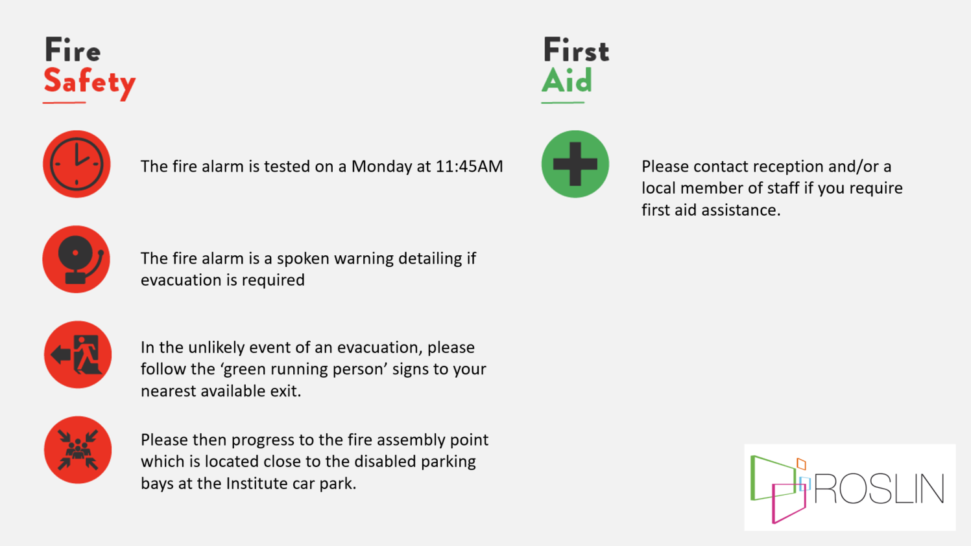

Slide 6
Finding out more …
GitHub io pages:
https://cerse.github.io/
Jisc mailing list:
http://www.jiscmail.ac.uk/ed-rse-community
Twitter:
https://twitter.com/cerse7
Joining the RSE (there are various ways of interacting)
https://society-rse.org/join-us/

