Slide 1

CRACKING
Stefano Bordoni
Research Data Support Assistant

Slide 2


What’s DataVault and what’s it used for?
UoE restricted access repository
It’s used to
- safely store personal and sensitive data (full encryption).
- long-term retention at project’s end.
- big deposits (above 100 GB).
Wanna go “open access” instead?

Slide 3


Who can use DataVault?
DataVault is available to University staff members, usually Principal Investigators (PIs) of a certain project.
I am a PGR… can I use DataVault?
PGRs at Roslin are allowed to use DataVault thanks to an agreement between the Institute and Research Data Support.

Slide 4




How long will my data be kept?
The retention period varies depending on the nature of the data, funding available and funder’s requirements.
Your funder may ask you to deposit your data for a number of years.
Our minimum retention period is 3 years (up to 30 years!).
At the end of the retention period, your vault will go through a review process.
What happens at the review?
You will be notified that the review is approaching and asked if your data is worth being kept or deleted.

Slide 5


Is there any cost charged?
Free up to 100 GB
> 100 GB - £50/year per TB pro rata
E.g. You must deposit 0.65 TB for 3 years=
0.65*3*50= £ 97.50

Slide 6


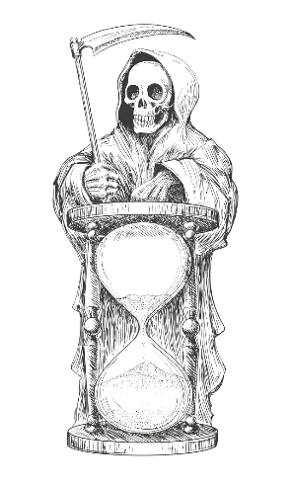
What happens if I don’t deposit straight away?
Nothing really! Time starts from your first deposit...
Short, happy story…
In January 2024, you pay for reserved storage for 3 years, but then time passes by and you don’t deposit anything until June 2026. No worries! We will consider June 2026 as the beginning of the three-years period. Hence, the vault will be reviewed in June 2029.
…but make sure to pay before your grant expires!

Slide 7





Depositing…
Deposit
MAX load: 10 TB
Deposit
Deposit
MAX load: 10 TB
MAX load: 10 TB
Contains:
Lots of stuff…
from a cool project
FRAGILE
SENSITIVE
My Vault
Best before: 2027-01-30
1 year time from the first deposit

Slide 8




How can my vault be cited?
Owner/Creators
Title
Year
Repository
Agarwal, D. (Creator), Pinnock, H. (Owner), Gonzalez Rienda, L. (Data Manager) (2022). Formulating and testing a strategy for introducing Pulmonary Rehabilitation (PR) for Chronic Obstructive Pulmonary Disease management in a rural Indian setting. Edinburgh DataVault.
https://doi.org/10.7488/9613095a-674e-41f7-9e86-e68c6e3570e7
DOI

Slide 9



What happens to my data when I leave the University?
UoE
At the time of the vault creation, you have the option to nominate Data Managers (NDM), so you can decide who will inherit your data when you leave.
School-level roles may intervene whenever a vault is “orphan”.
You can also assign depositor roles to
other project members.

Slide 10
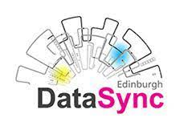


Do you need to share with someone else?
…and what if the user is outside the University?
We are experimenting DataVault Outward Staging Area (DOSA)

Slide 11

Stay in touch!
Research Data Support team
data-support@ed.ac.uk
…or through IS Helpline / EdHelp
…or through your local support team

