Slide 1

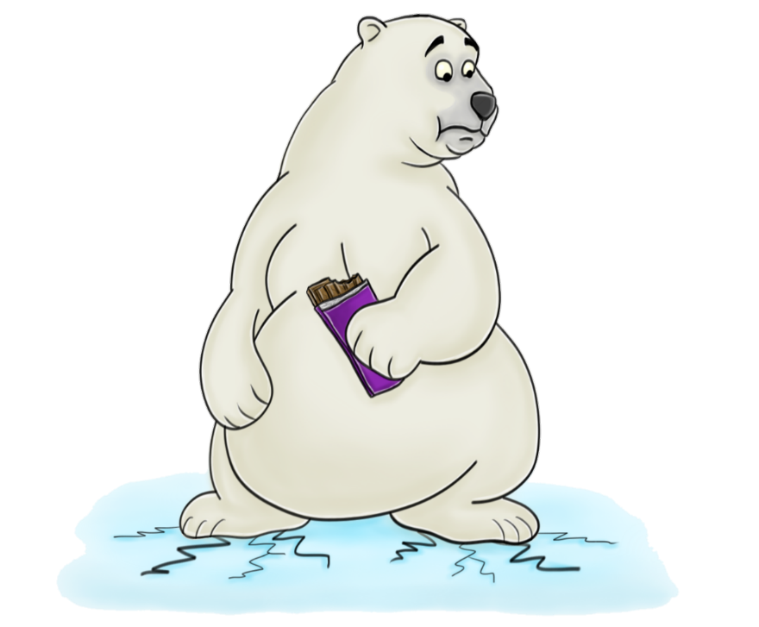
VERY IMPORTANT QUESTIONS
What’s one thing on your bucket list?
If you could be any animal in the world, what would you be and why?
Teleportation or flying?
What’s one thing you’re looking forward to this week?
If you could be on a TV show, which one would you choose?
Would you rather be invisible or be able to read minds?
What’s one word to describe your work style?
If humans established a colony on Mars, would you sign up to go?
Are you summer, fall, spring, or winter?
What’s one word that summarizes your weekend?
One dessert for the rest of your life, what would it be?
Coffee or tea?
What’s one thing you did last week that you’re proud of?
If you could live anywhere in the world, where would you live?
Where would you time-travel, if it were possible?

Slide 2
VERY IMPORTANT QUESTIONS
What movie do you wish you could watch again for the first time?
Pick your favourite decade. Tell us why.
Imagine you can instantly learn any language. Which would you choose?
What is your favourite knock-knock joke?
Who is your favourite author?
What is your #1 recommendation in this city?
What is your go-to TV show to watch at night?
How would you describe your job to a five year old?
What do your family and friends think you do all day?
What is your “when I was your age…” story?
Would you like aliens to beam you up if they came to Earth?
What is your New Years resolution?
What is something you like?
What was your best class in school?
What weird fashion trend would you bring back?

