Slide 1
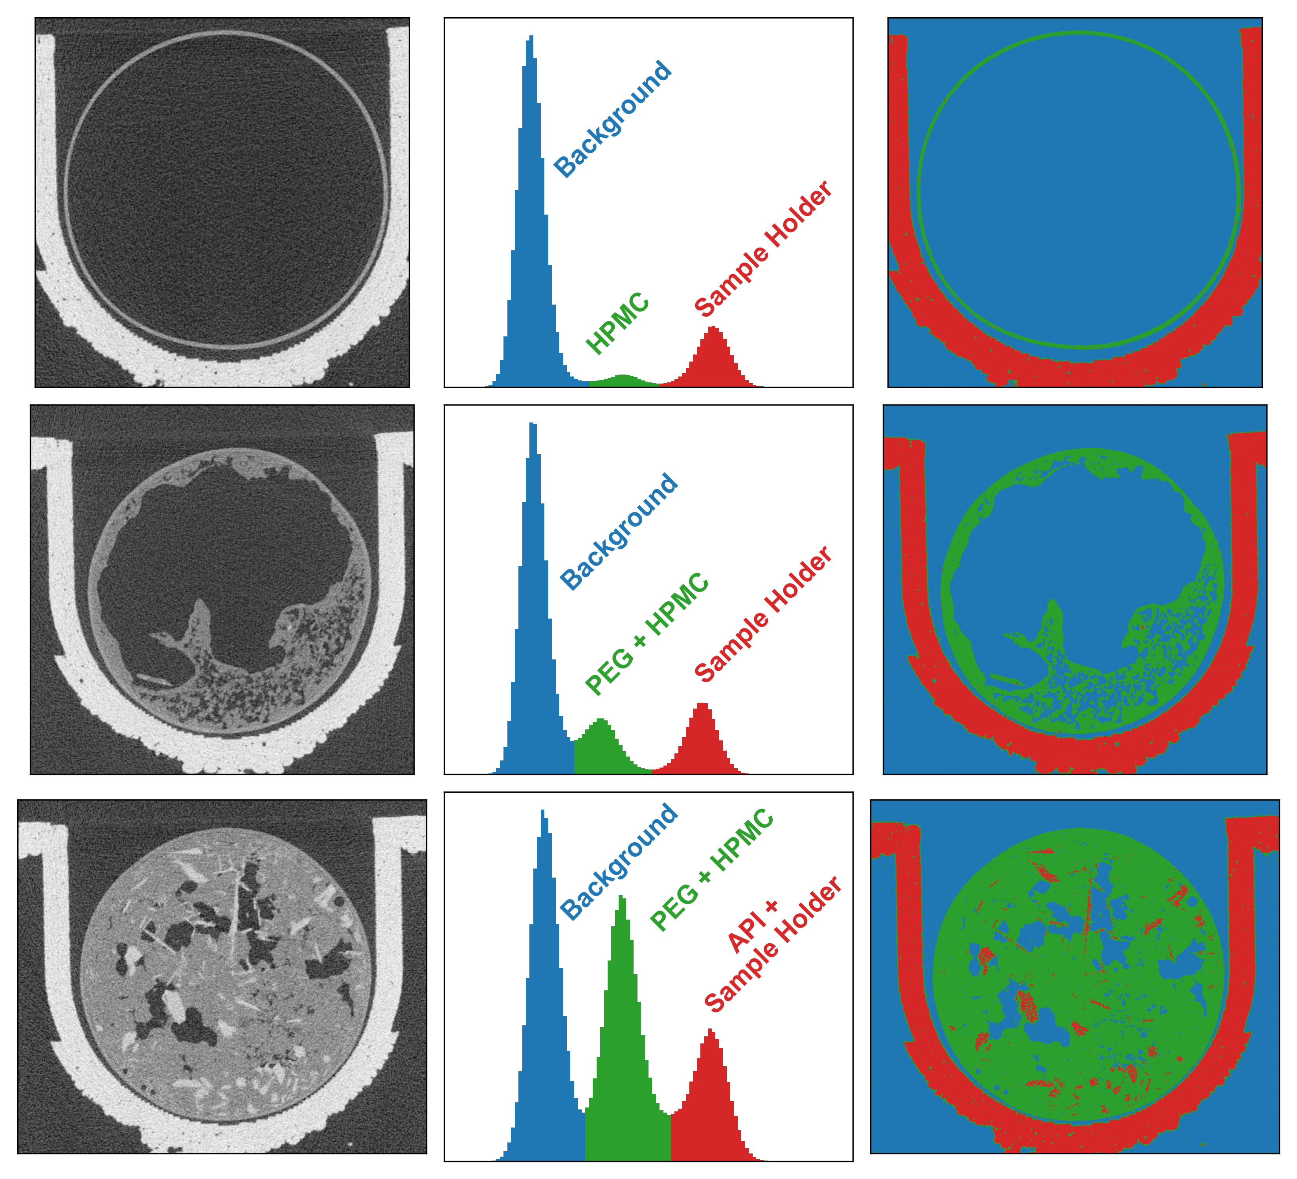
Raw Scans
Labeled Intensities
Colored Voxels
Empty Capsule
PEG Capsule
MOD+PEG Capsule

