Slide 1
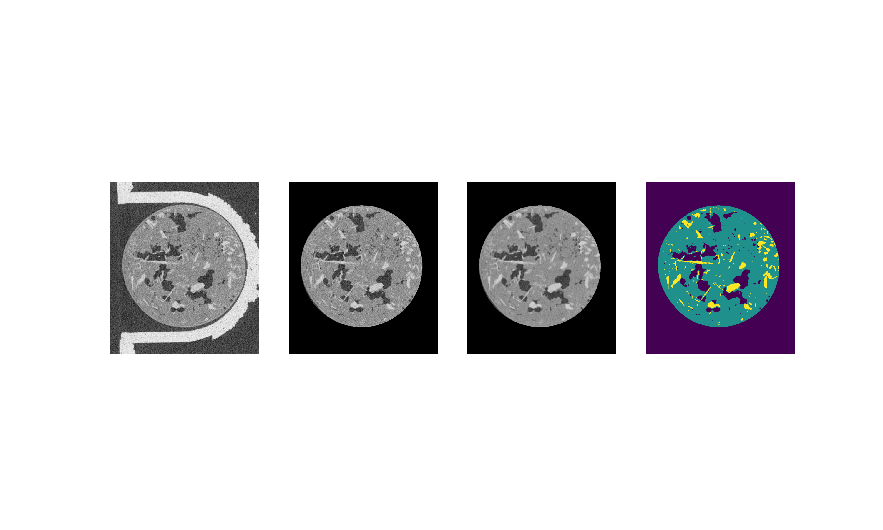
A
B
Radial Filter
Median Filter
C
D
Greyscale Thresholding

