Slide 1
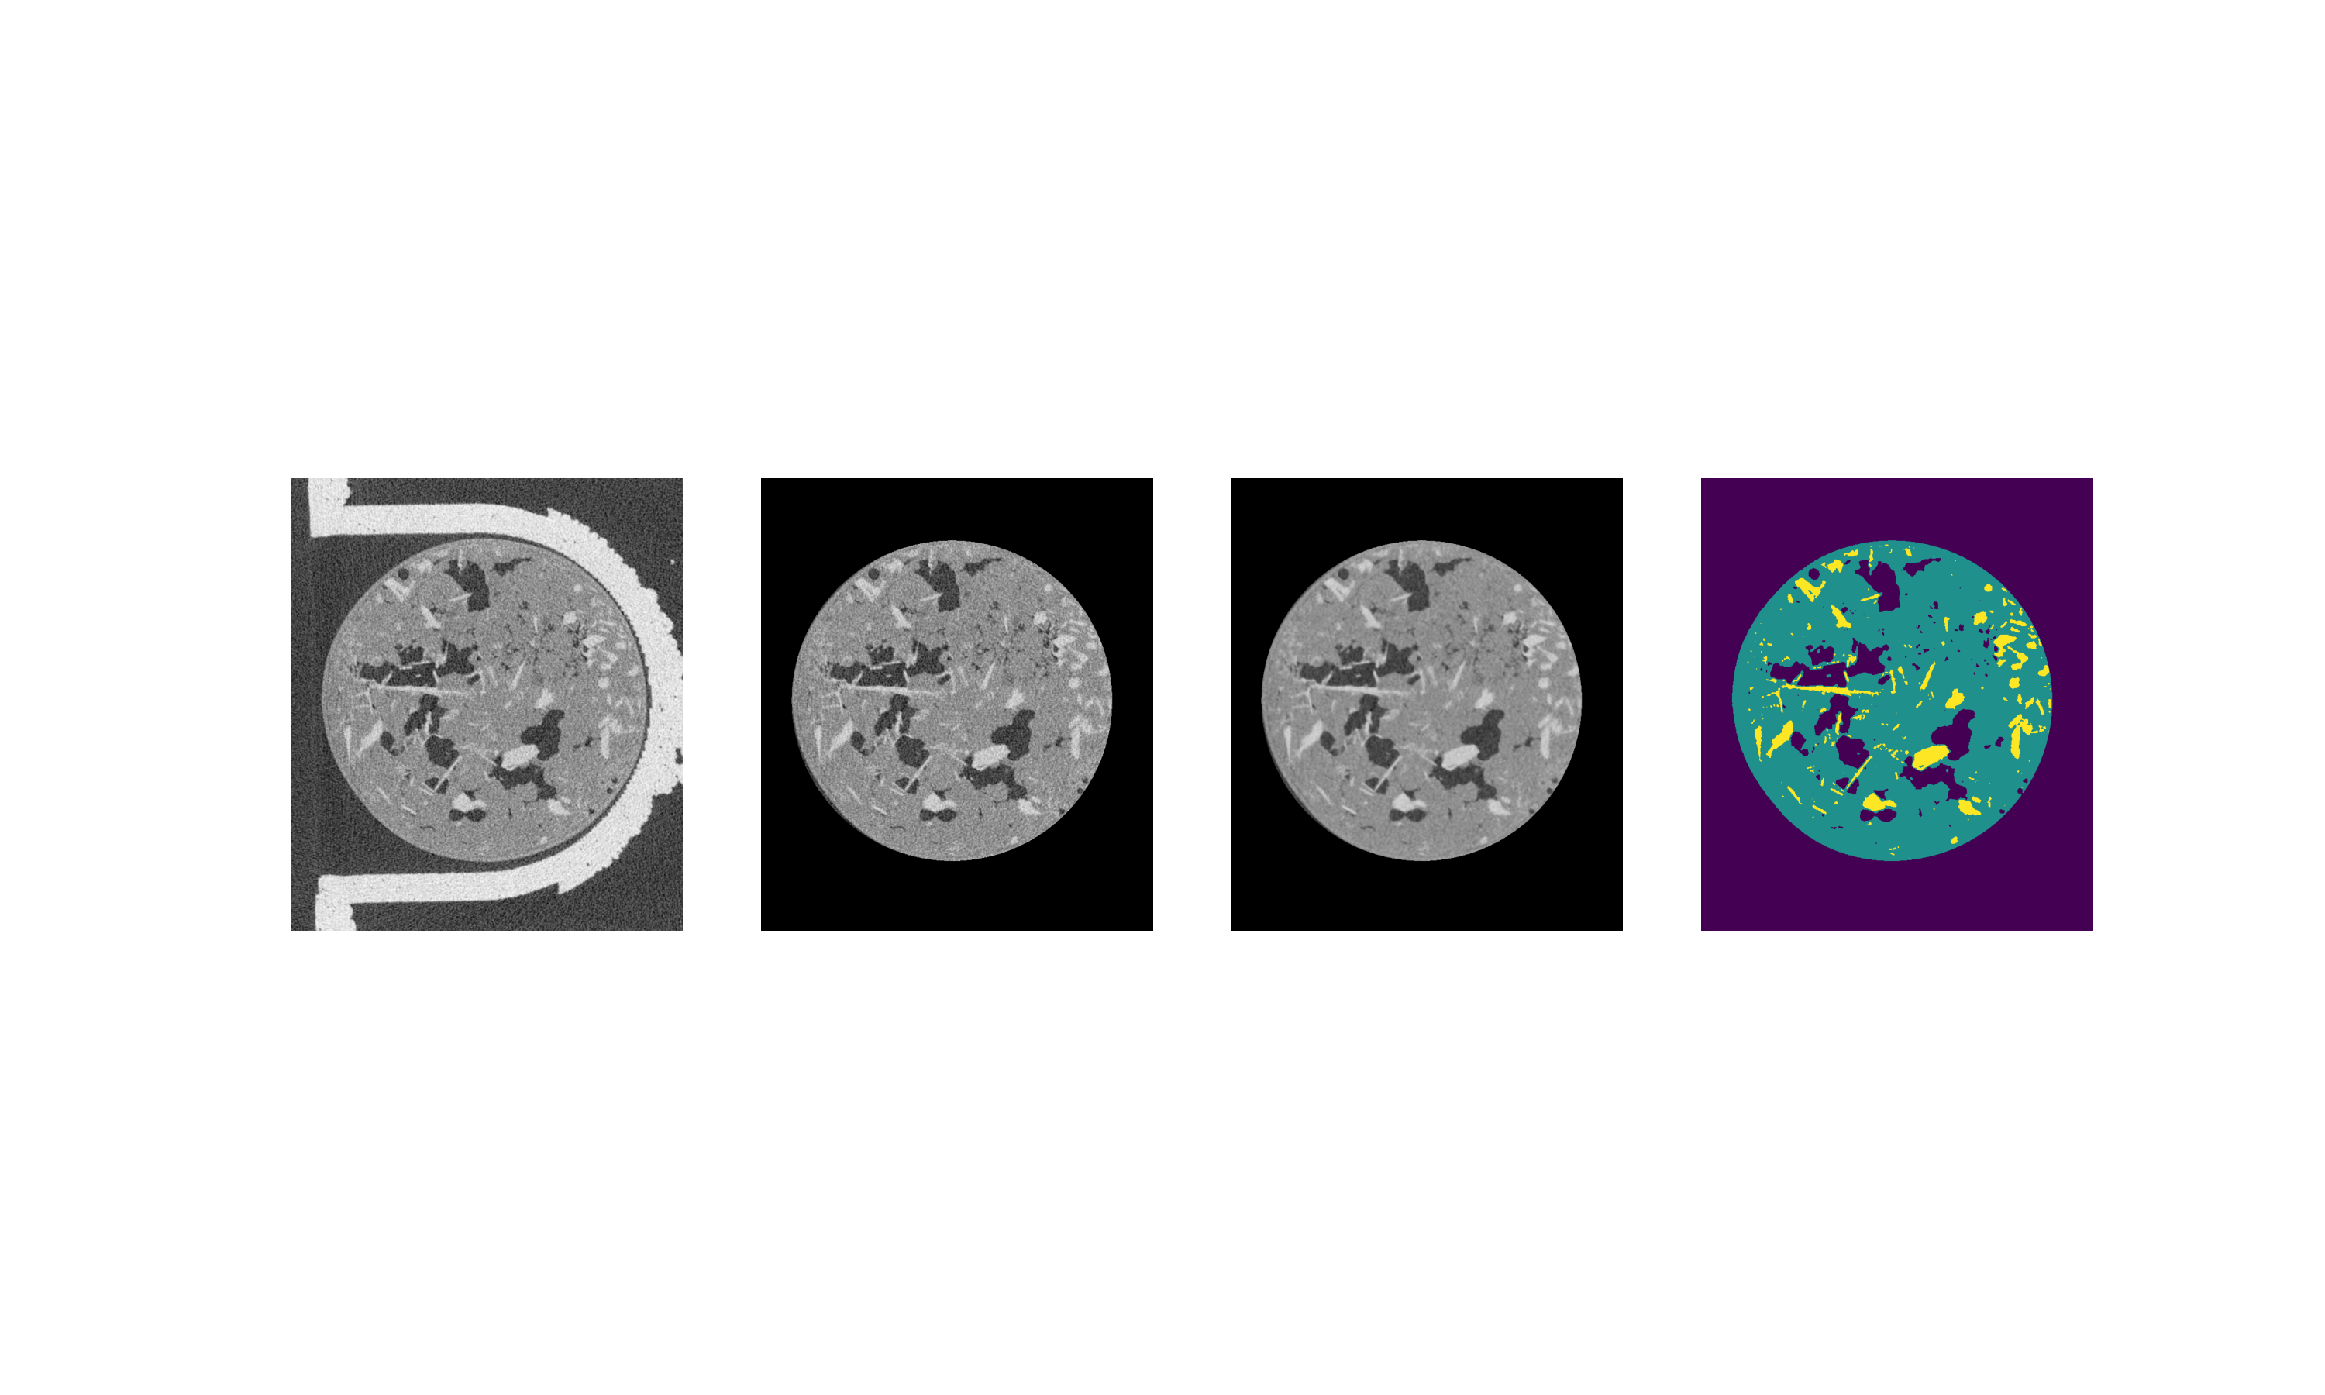
(a)
(b)
Radial Filter
Median Filter
Greyscale Thresholding
(c)
(d)

