Slide 1
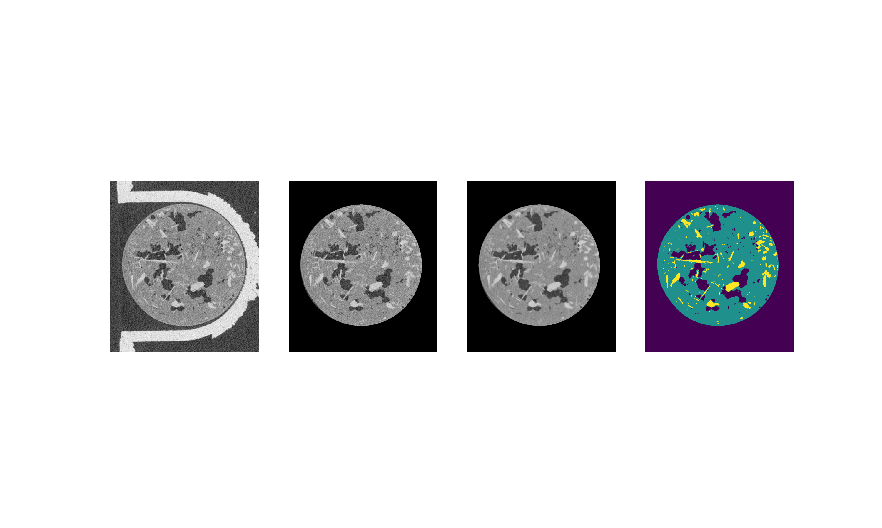
Radial Filter
Median Filter
Greyscale Thresholding

