Slide 1
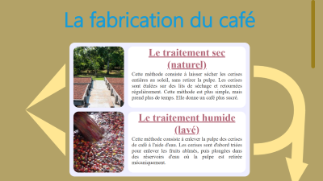

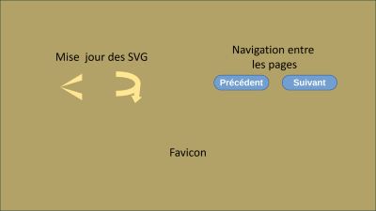
Structure générale
Scripts
Galerie d’art

Slide 2
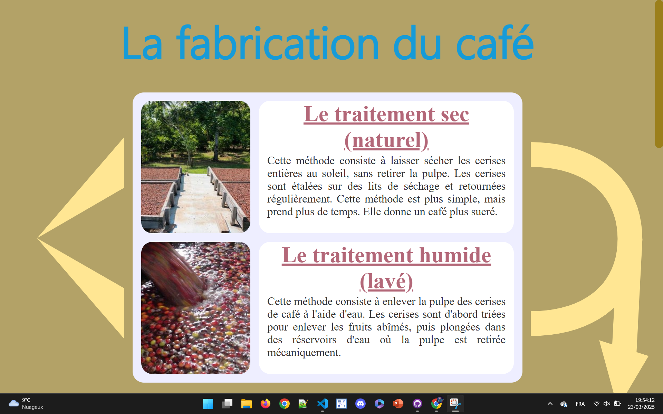

Slide 6
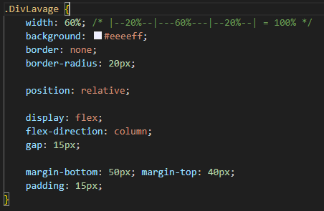


Slide 7
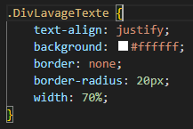


Slide 8
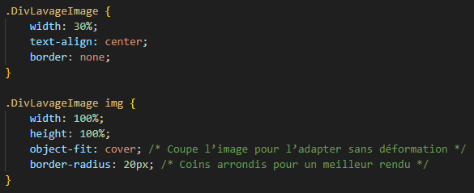
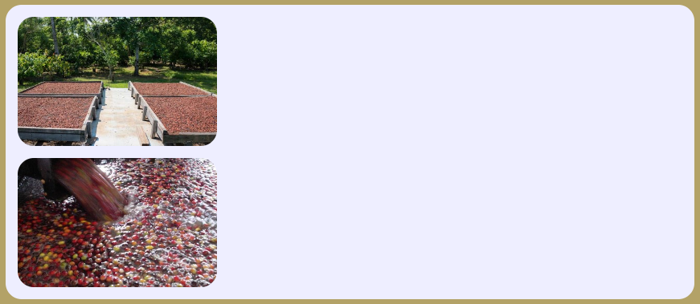

Slide 9
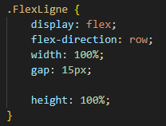

Slide 10



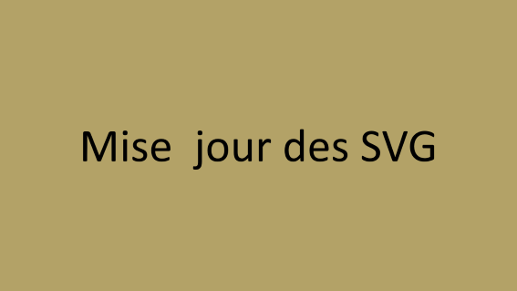



Slide 11
Mise jour des SVG

Slide 12
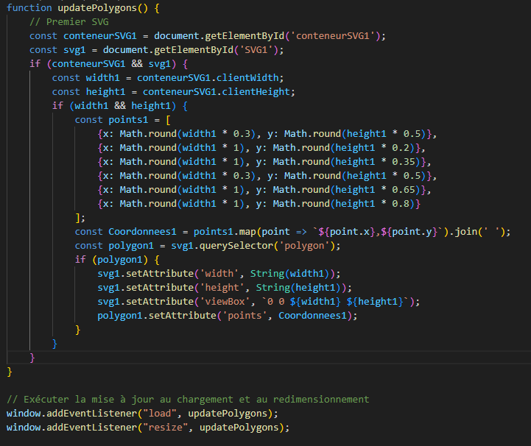

Slide 13
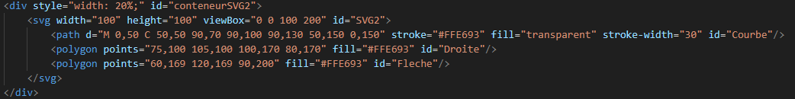

Slide 15
Navigation entre
les pages

Slide 16
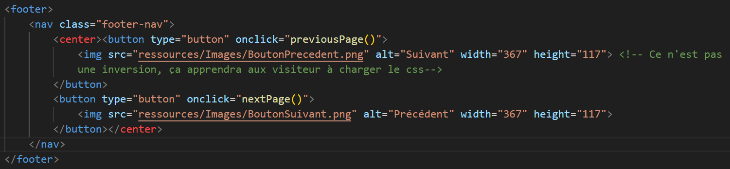

Slide 17
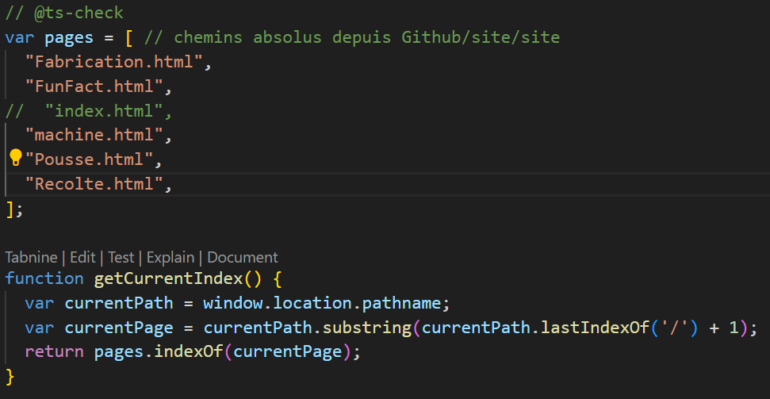
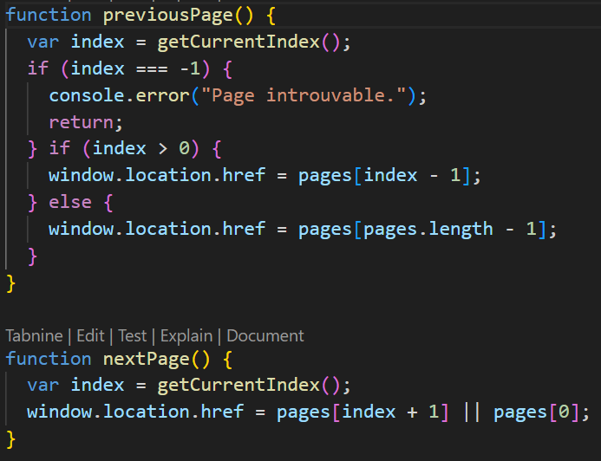

Slide 18
Favicon

Slide 19
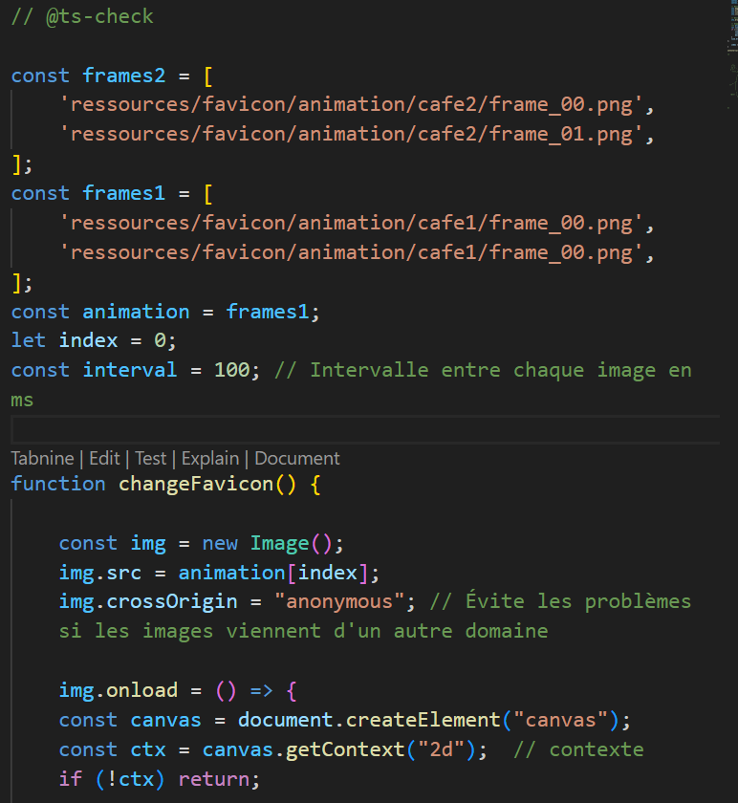
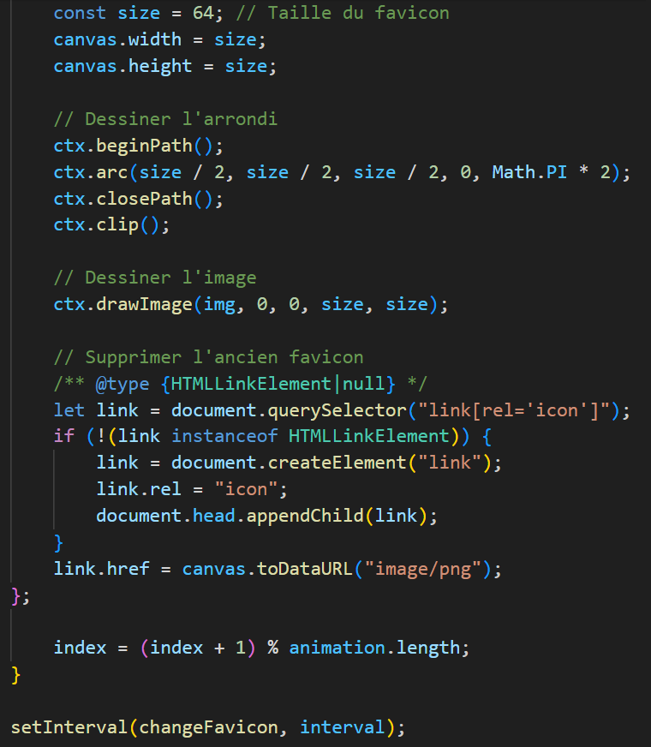

Slide 20


Slide 21
Galerie d’art

Slide 22
,_-=(!7(7/zs_.
.=' ' .`/,/!(=)Zm.
.._,,._.. ,-`- `,\ ` -` -`\\7//WW.
,v=~/.-,-\- -!|V-s.)iT-|s|\-.' `///mK%.
v!`i!-.e]-g`bT/i(/[=.Z/m)K(YNYi.. /-]i44M.
v`/,`|v]-DvLcfZ/eV/iDLN\D/ZK@%8W[Z.. `/d!Z8m
//,c\(2(X/NYNY8]ZZ/bZd\()/\7WY%WKKW) -'|(][%4.
,\\i\c(e)WX@WKKZKDKWMZ8(b5/ZK8]Z7%ffVM, -.Y!bNMi
/-iit5N)KWG%%8%%%%W8%ZWM(8YZvD)XN(@. [ \]!/GXW[
/ ))G8\NMN%W%%%%%%%%%%8KK@WZKYK*ZG5KMi,- vi[NZGM[
i\!(44Y8K%8%%%**~YZYZ@%%%%%4KWZ/PKN)ZDZ7 c=//WZK%!
,\v\YtMZW8W%%f`,`.t/bNZZK%%W%%ZXb*K(K5DZ -c\\/KM48
-|c5PbM4DDW%f v./c\[tMY8W%PMW%D@KW)Gbf -/(=ZZKM8[
2(N8YXWK85@K -'c|K4/KKK%@ V%@@WD8e~ .//ct)8ZK%8`
=)b%]Nd)@KM[ !'\cG!iWYK%%| !M@KZf -c\))ZDKW%`
YYKWZGNM4/Pb '-VscP4]b@W% 'Mf` -L\///KM(%W!
!KKW4ZK/W7)Z. '/cttbY)DKW% -` .',\v)K(5KW%%f
'W)KWKZZg)Z2/,!/L(-DYYb54% ,,`, -\-/v(((KK5WW%f
\M4NDDKZZ(e!/\7vNTtZd)8\Mi!\-,-/i-v((tKNGN%W%%
'M8M88(Zd))///((|D\tDY\\KK-`/-i(=)KtNNN@W%%%@%[
!8%@KW5KKN4///s(\Pd!ROBY8/=2(/4ZdzKD%K%%%M8@%%
'%%%W%dGNtPK(c\/2\[Z(ttNYZ2NZW8W8K%%%%YKM%M%%.
*%%W%GW5@/%!e]_tZdY()v)ZXMZW%W%%%*5Y]K%ZK%8[
'*%%%%8%8WK\)[/ZmZ/Zi]!/M%%%%@f\ \Y/NNMK%%!
'VM%%%%W%WN5Z/Gt5/b)((cV@f` - |cZbMKW%%|
'V*M%%%WZ/ZG\t5((+)L\'-,,/ -)X(NWW%%
`~`MZ/DZGNZG5(((\, ,t\\Z)KW%@
'M8K%8GN8\5(5///]i!v\K)85W%%f
YWWKKKKWZ8G54X/GGMeK@WM8%@
!M8%8%48WG@KWYbW%WWW%%%@
VM%WKWK%8K%%8WWWW%%%@`
~*%%%%%%W%%%%%%%@~
~*MM%%%%%%@f`
'''''

Slide 23
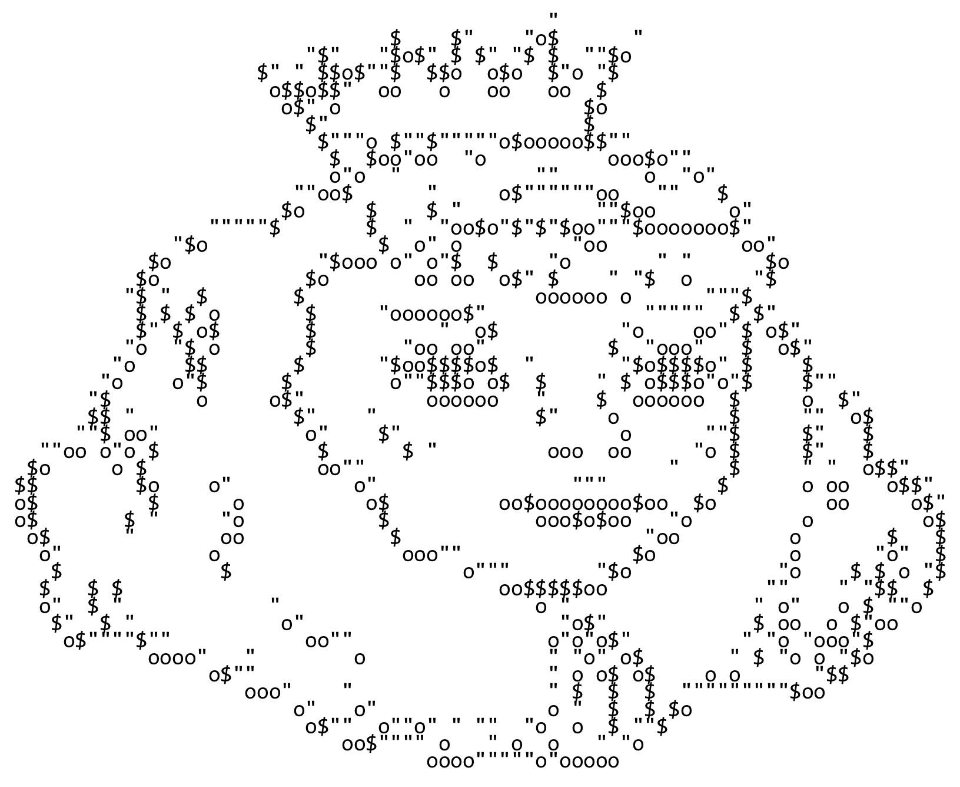

Slide 24
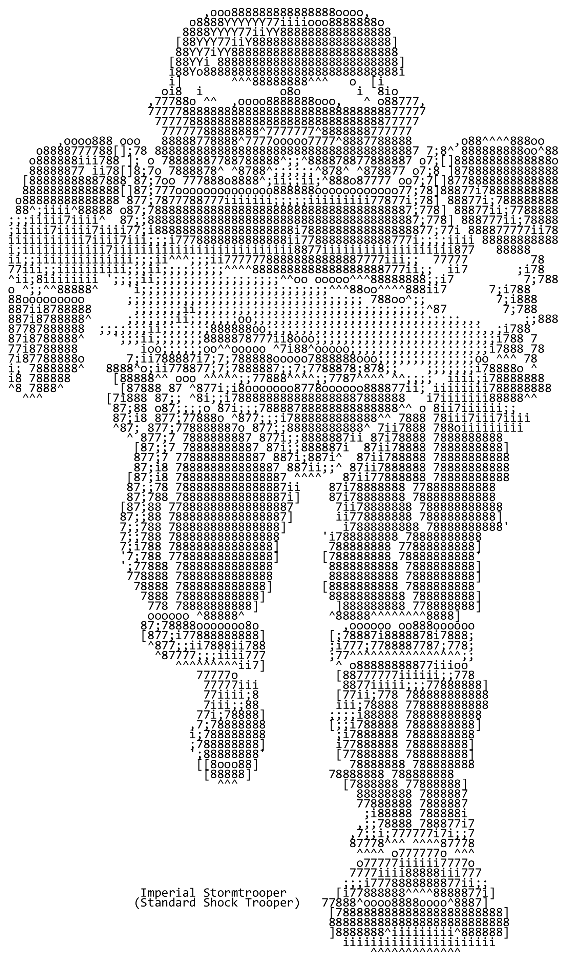

Slide 25
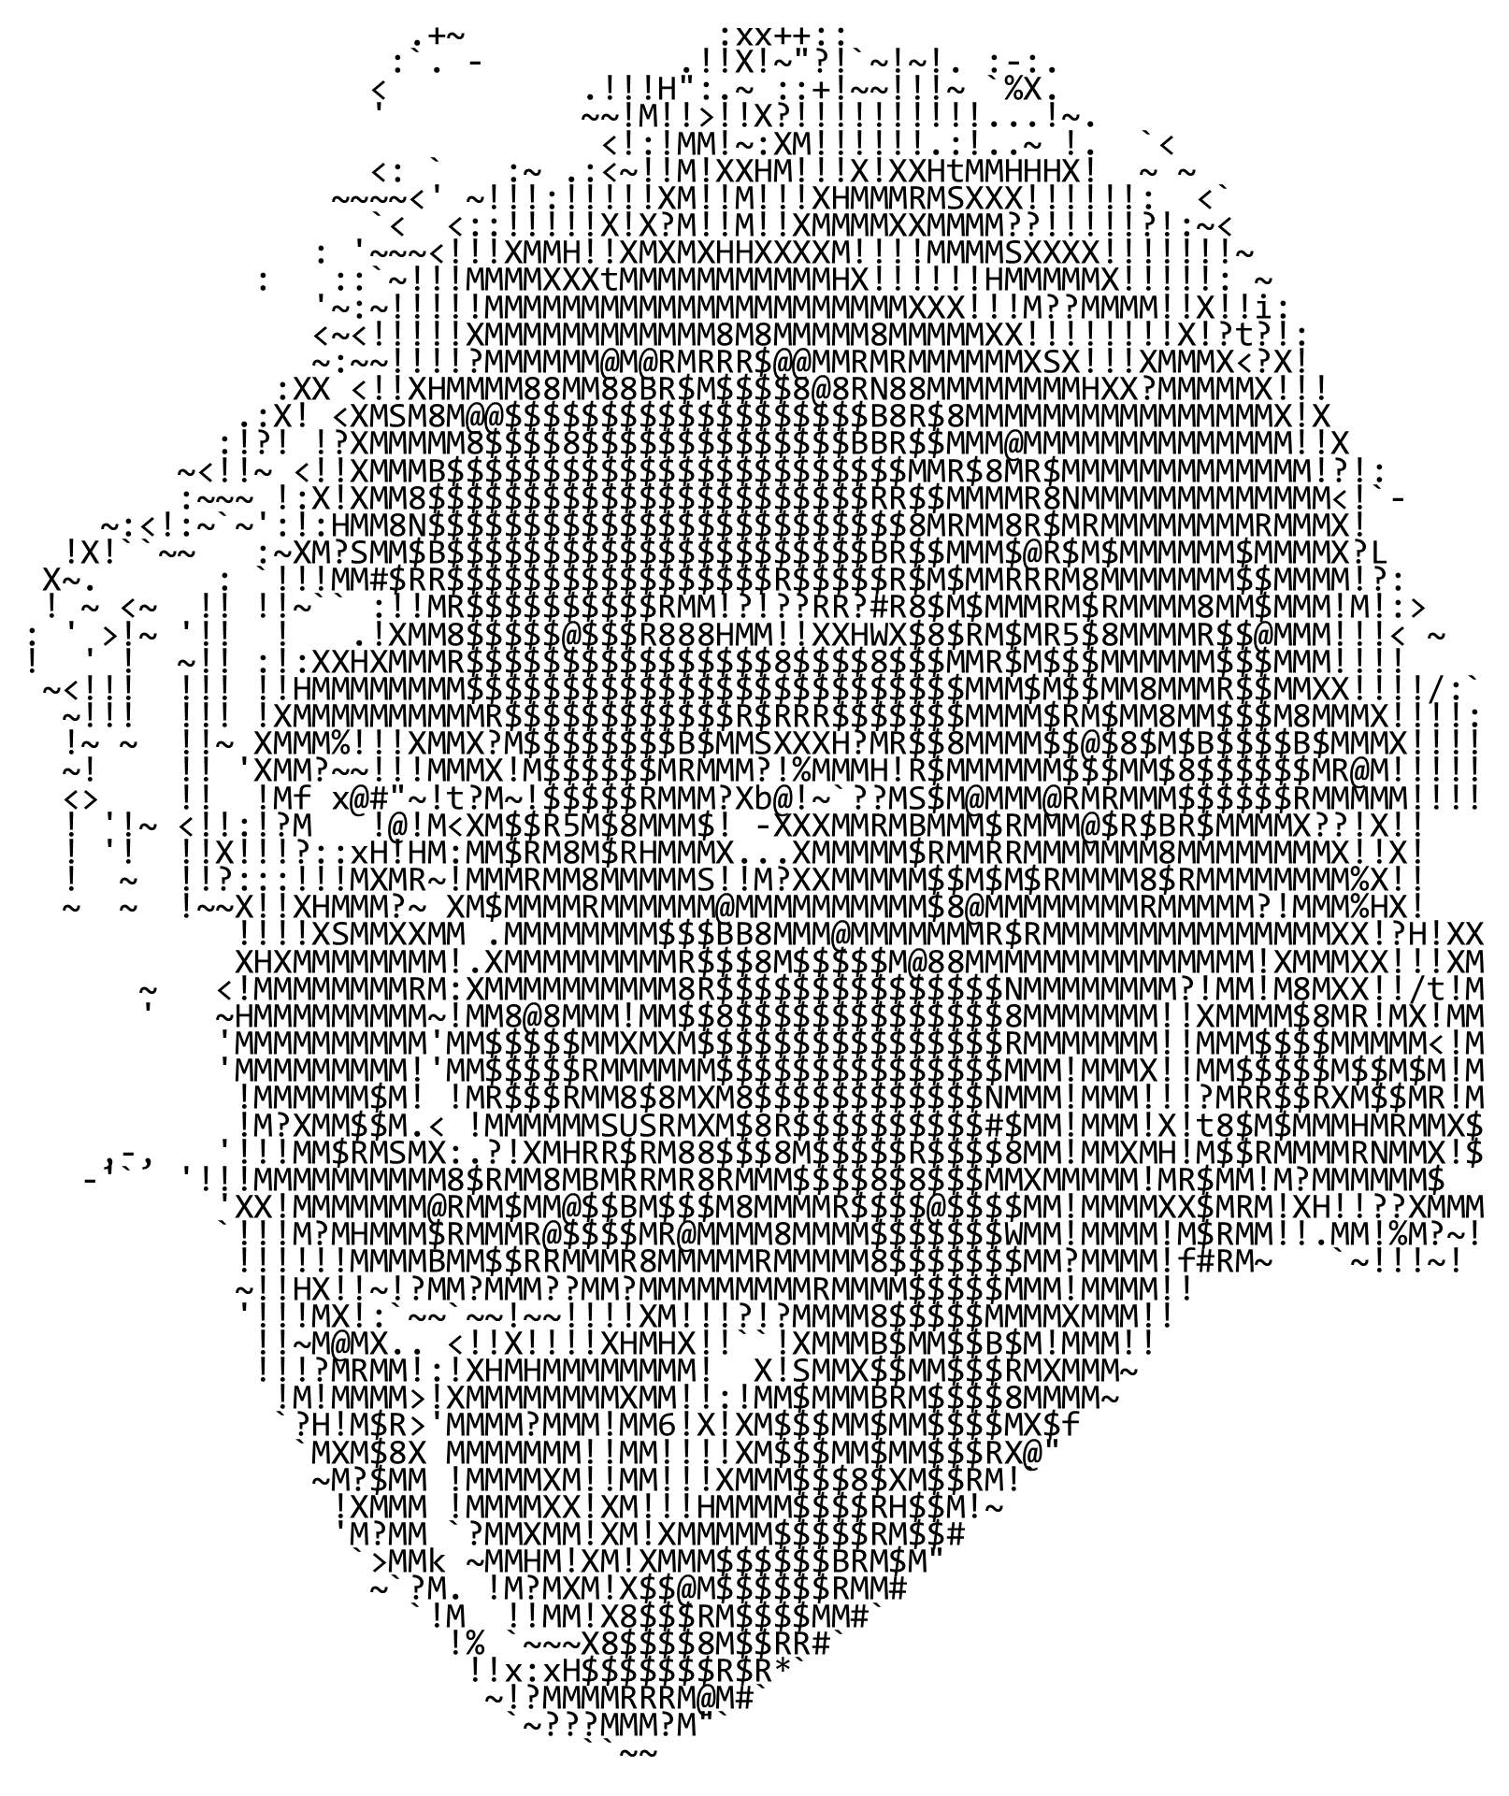

Slide 26
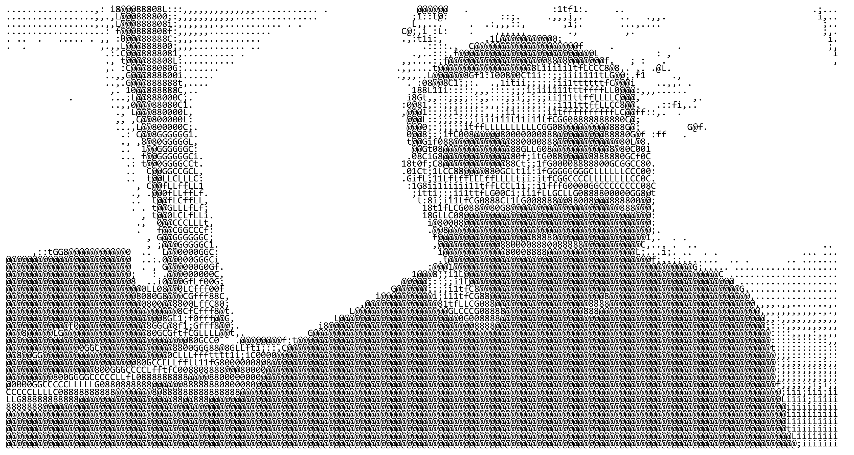

Slide 27

Fin

