Slide 1
DVC for ML: Cats vs Dogs Project
Project-specific walkthrough, pipeline run, and tracked outputs
DVC Example Repo

Slide 2
Purpose
Show how this repository uses DVC for ML reproducibility.
Focus on the local cats-vs-dogs classifier project.
Remove broad, unrelated DVC theory from the original deck.
Keep the final deck below 20 slides.

Slide 3
Project at a Glance
Task: binary image classification for cats vs dogs.
Data: 1,800 local images tracked by DVC.
Training: VGG16 bottleneck features plus a small dense classifier.
Reproducibility: data, parameters, metrics, and artifacts are connected through dvc.yaml.

Slide 4
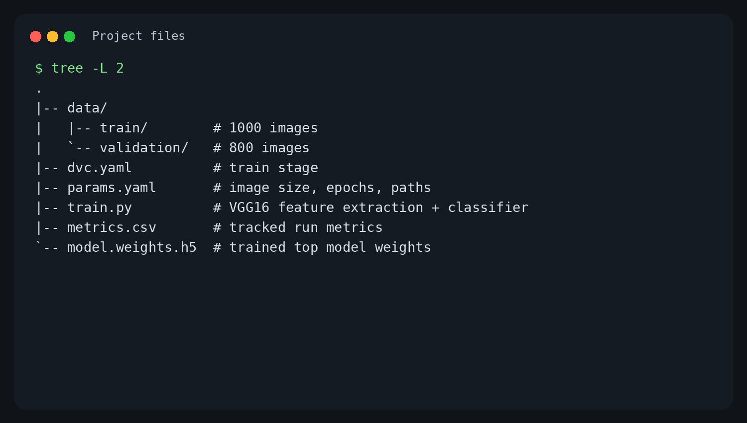
Repository Structure

Slide 5
DVC Role in This Project
Git tracks code and lightweight metadata.
DVC tracks the dataset and generated ML artifacts.
data.dvc records the dataset version.
dvc.yaml defines the train stage.
dvc.lock captures the exact pipeline state after reproduction.

Slide 6
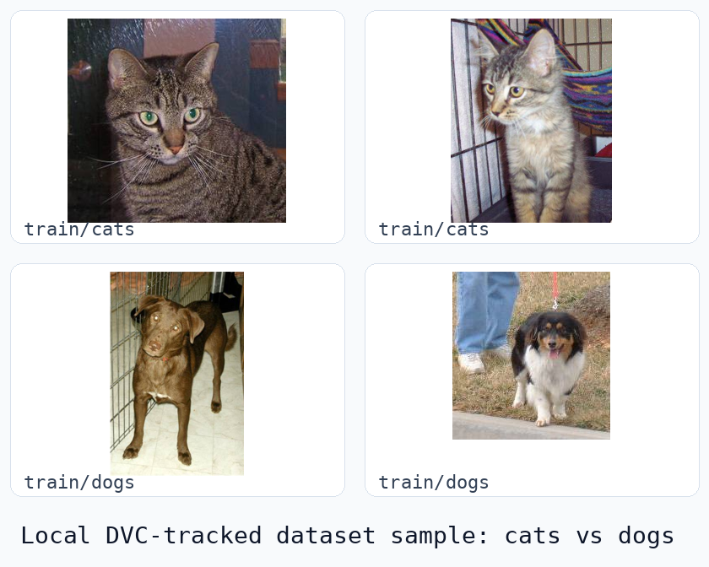
Local Dataset

Slide 7
Dataset Split
data/train: 1,000 images.
data/validation: 800 images.
Classes are inferred from folder names:
  cats
  dogs
Total local dataset size: 1,800 image files.

Slide 8
Training Pipeline
dvc.yaml defines one stage:
train:
cmd: python train.py --config params.yaml
deps:
- train.py
- data
outs:
- model.weights.h5
- bottleneck_features_train.npy
- bottleneck_features_validation.npy
metrics:
- metrics.csv

Slide 9
Parameters
params.yaml controls the training configuration:
Image size: 150 x 150.
Epochs: 10.
Batch size: 10.
Training data: data/train.
Validation data: data/validation.
Metrics output: metrics.csv.

Slide 10
Model Flow
Load images with Keras ImageDataGenerator.
Rescale pixels by 1 / 255.
Use VGG16 without the top layer to extract bottleneck features.
Train a dense classifier:
  Flatten
  Dense(256, relu)
  Dropout(0.5)
  Dense(1, sigmoid)

Slide 11
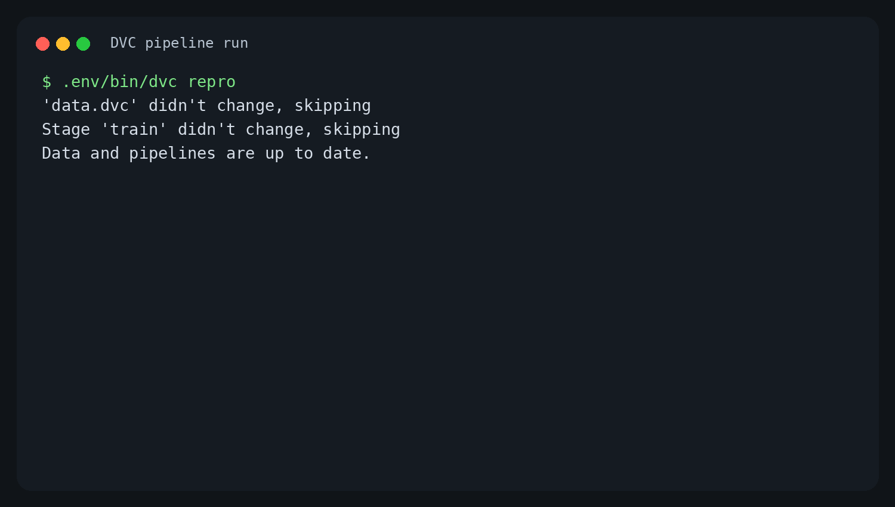
Run Evidence: Reproduce

Slide 12
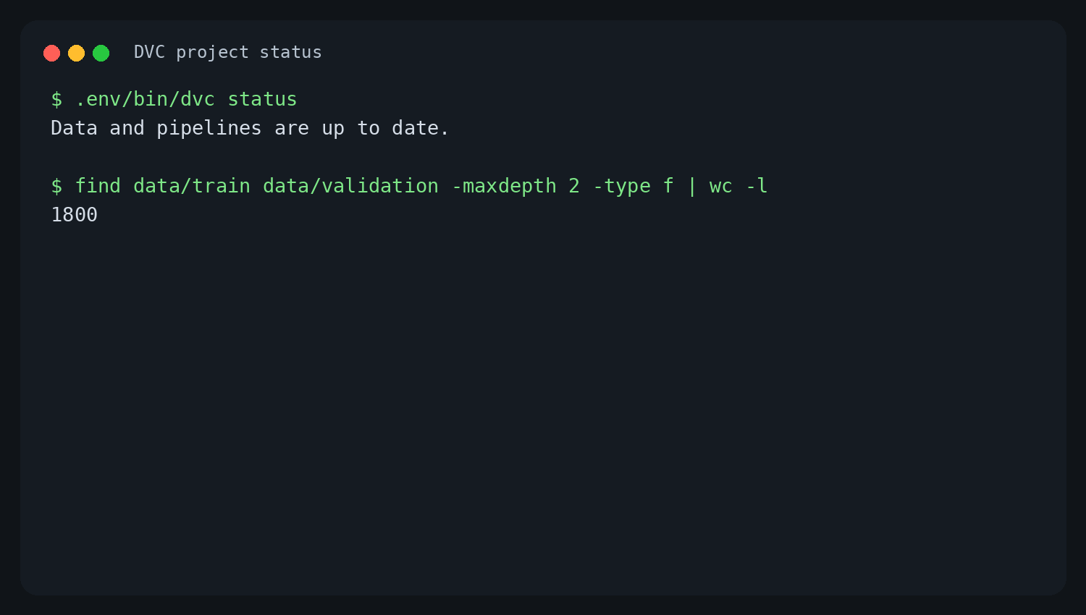
Run Evidence: Status

Slide 13
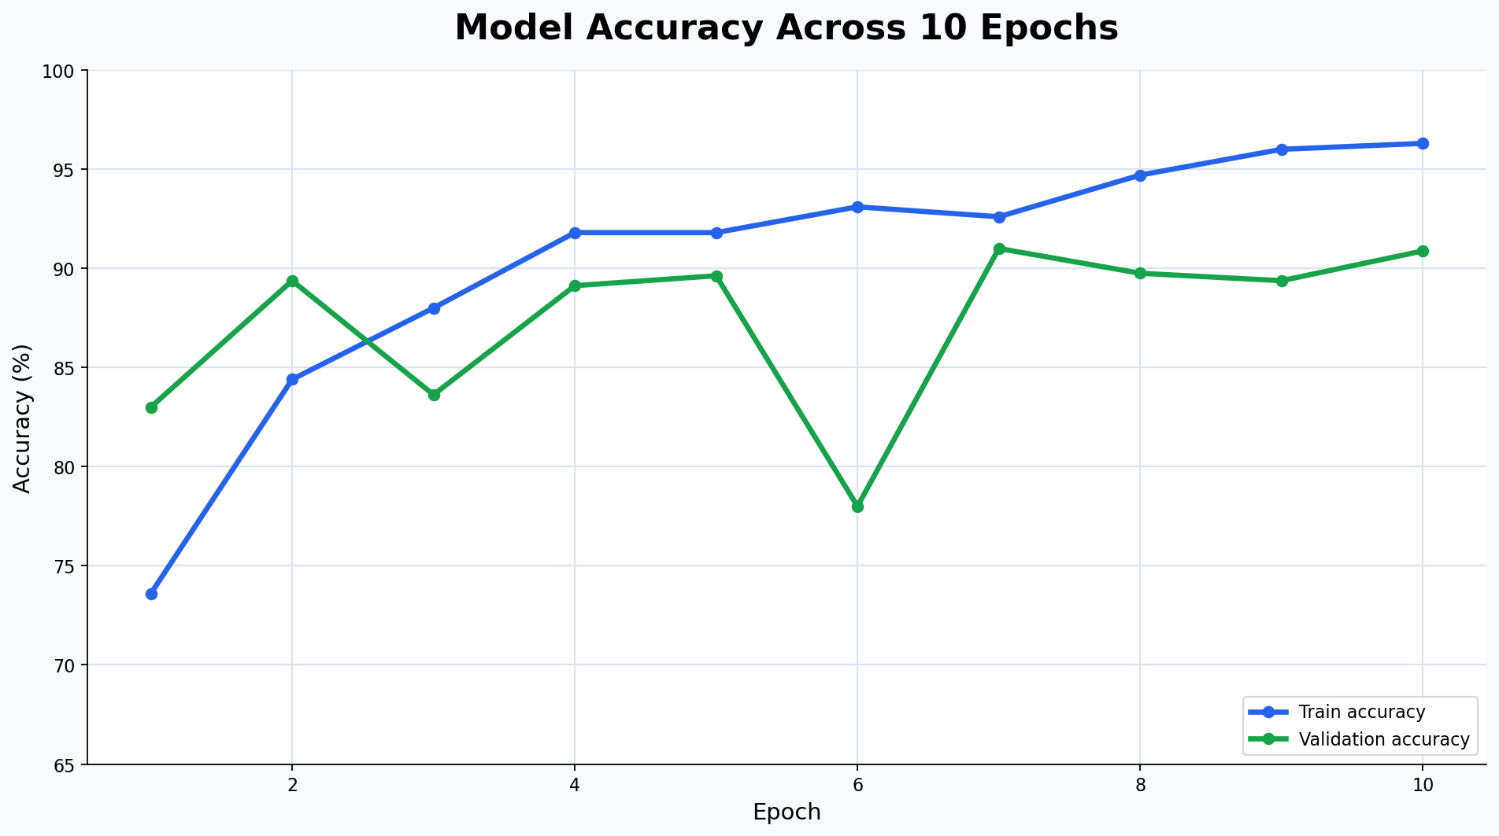
Metrics

Slide 14
Latest Result
Final training accuracy: 96.30%.
Final validation accuracy: 90.87%.
Best validation accuracy: 91.00% at epoch 7.
Tracked metrics file: metrics.csv.
Tracked model artifact: model.weights.h5.

Slide 15
Versioning Workflow
Common project commands:
dvc add data
dvc repro
git add dvc.yaml dvc.lock params.yaml metrics.csv
git commit -m "Train cats-vs-dogs model"
git tag -a v1.0 -m "model version"

Slide 16
Sharing and Recovery
Configure a DVC remote for data and artifact storage.
Use dvc push to upload DVC-tracked files.
Use git push --follow-tags for code, metadata, and model version labels.
On another machine, run:
git clone <repo>
dvc pull
dvc repro

Slide 17
Takeaways
The repo is a reproducible ML training project, not just a DVC concept demo.
DVC connects the dataset, parameters, training code, metrics, and artifacts.
Current pipeline state is up to date after running dvc repro.
The revised deck is project-specific and stays under the 20-slide limit.

