Slide 1
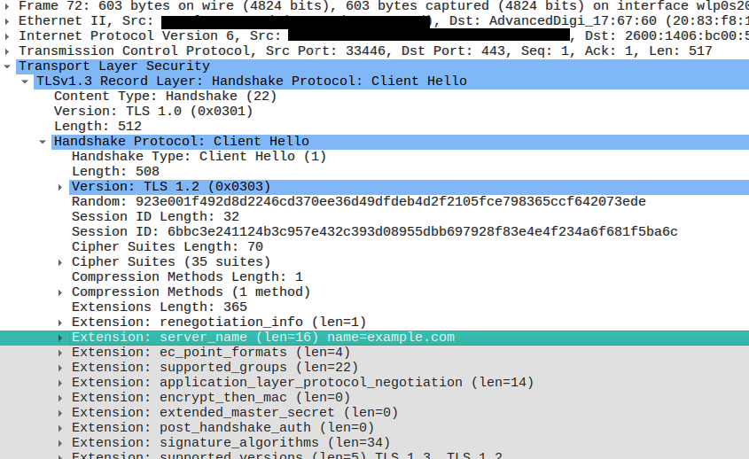

Slide 2
2003: SNI (Server Name Indication) standardised
2018: Experimental Encrypted SNI
2020: First ECH Encrypted Client Hello draft
  (draft-ietf-tls-esni-24)

Slide 3
2003: SNI (Server Name Indication) standardised
2018: Experimental Encrypted SNI
2020: First ECH Encrypted Client Hello draft
  (draft-ietf-tls-esni-24)

Slide 4
ECH Requirements
TLSv1.3+
public key before starting TLS
Key is in DNS
  Clients require DoH

Slide 5
ECHConfig
ECHConfig
Version
Length
ECHConfigContents
HpkeKeyConfig
Config ID
KEM ID
Public Key
HPKE symmetric cipher suite
Maximum Name Length
Public Name
ECHConfigExtension […]

Slide 6
Deployment

Slide 7
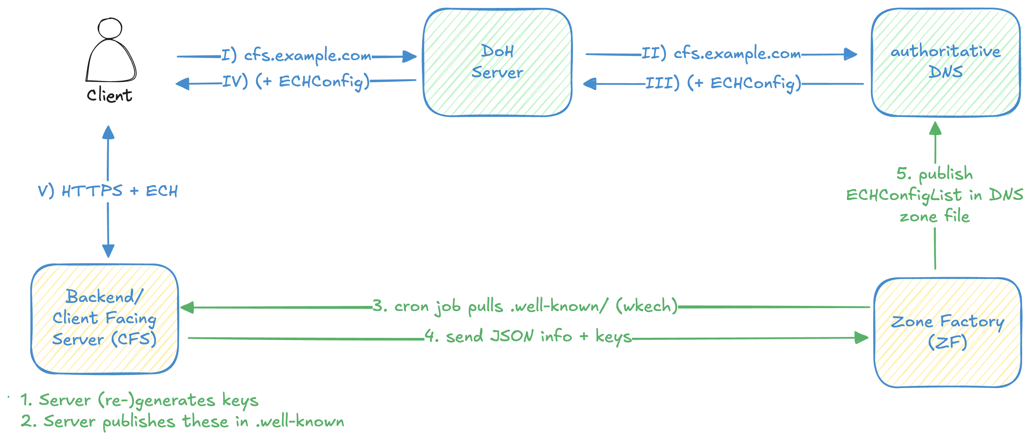

Slide 8
Incentives

Slide 9
Separation issues

Slide 10
Weaknesses

Slide 11
Complexity

Slide 12
WKECH

Slide 13
DoH/DoT

Slide 14
Clients

Slide 15
Browsers

Slide 16
IoT & Libraries

Slide 17
Tor Network

Slide 18
Censorship and Blocking

Slide 19
De-Anonymization

Slide 20
Via metadata

Slide 21
Via Correlations

Slide 22
Via legal means

