Slide 1
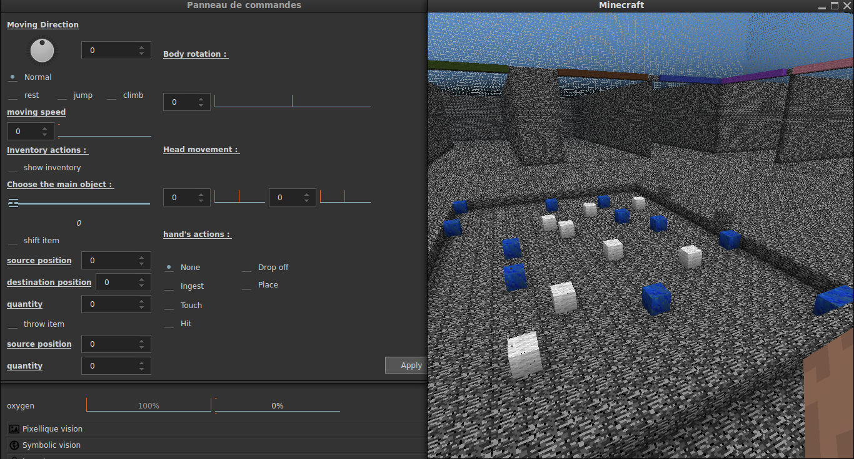
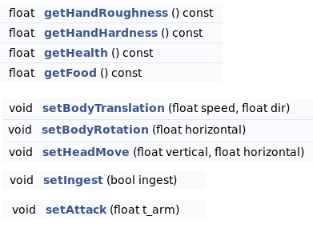
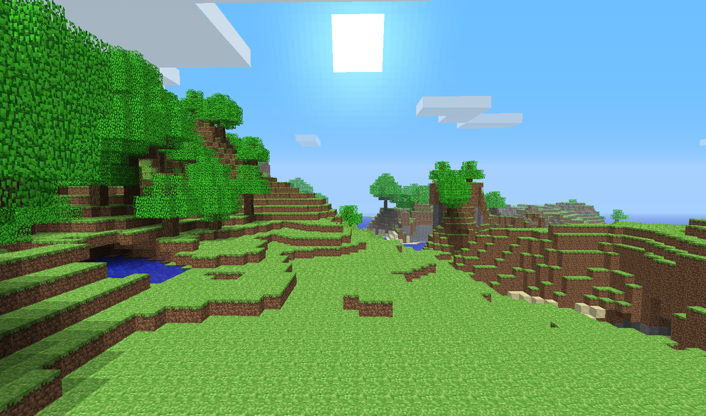
Symbolic systemic models using cognitive function ersatz
http://virtualenaction.gforge.inria.fr

Slide 2
Problem position
Given a simulated survival environment to
experiment with brainy-bot systemic models,
We need a toolbox of basic cognitive functions
      Memory modules, motor-reflexes, …
in order to :
  Easily design complete experiments,
  Compare algorithmic/bio-realistic modules

Slide 3
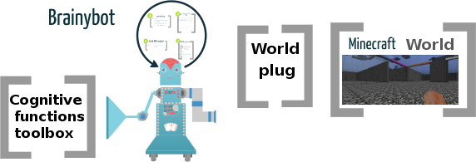
Problem position
Experimental
setup
Provides basic
cognitive symbolic
functionality
Provides bot in/output
- adaptation (e.g. noise)
- observation

Slide 4
Sensor/Actuator data.
In/out data are symbolic iterative structures
  T-uples of { name = value : @type … }
  Sets of [ value … ]
  Bounded finite precision numerics
    Small amount of data (≈ 1Kb / time-step)
    Easily mapped on a (huge) discrete set
    Not related to any neural coding
    Suitable to use
      Machine-learning algorithm
      Graph related algorithms

Slide 5
Sensor/Actuator data.
@action : {
body : { translation : { speed : @real, direction : @real }, orientation : @real, rest : @bool },
head : { vertical : @real, horizontal : @real },
attack : { strongness : @real },
jump : { height : @real },
gesture : { touch : @bool, ingest : @bool, throw : @bool, climb : @bool },
hand : { put : { slot : @int } , get : { slot : @int } }
},
@sensation : {
location : { position : @position, orientation : @real },
vital : { health : @real, food : @real, water : @real, oxygen : @real, energy : @real},
vision : { blocks: [ @block* ], entities: [ @block* ] },
touch : { blocks: [ @block* ], entities: [ @block* ] },
hand : { roughness : @real, hardness : @real, item : @item },
olfaction : { intensity : @real, toxicity : @real, friendlyness : @real, edibleness : @real },
inventory : [ @item* ]
},
@block : {
id : @int, position : @position,
roughness : @real, hardness : @real, temperature : @real, color : @color
},
@item : { id : @int, count : @int, slot : @int },
@position : { x : @real, y : @real, z : @real },

Slide 6
Hyperthymesia function.
Simply remember all past events
The history is a backward sequence of
time-step, i.e., sensation/action
Bot {
// Gets the current sensation/planned action
@step : get()
}
@step { s : @sensation, a : @action, now : @int}
@episode : { time : @int, e : [ @step* ] }
Hmem {
// Adds on time-step event (called at each step)
add(@step);
// Gets the last added time-step.
@int : getNow()
// Clears the memory, beyond a given time-step
delSteps(when : @int)
// Gets an episode (a sub-sequence of steps)
@episode : getSteps(when : @int, count : @int)
}
// Implements an iterative structure
Struct {
// Sets a parameter value
set(name : @string, value : @data)
// Gets a parameter value
@data : get(name : @string)
}

Slide 7
Data categorization.
To “label” a data set (e.g., good/bad data)
  With an (internal) supervised learning tool
  With unsupervised data structuration
    Dimensional reduction
      Representing data with a minimal parameterization
    Data clustering
      Grouping data closed together in cluster
Categorize {
// Adds a learning sampling
add(value : @data, name : @string)
// Gets a sample label
@string getName(value : @data)
// Gets the sample cluster
@int : getCluster(value : @data)
// Gets the sample projection
@data : getProjection(value : @data)
}

Slide 8
Trajectory interpolation.
To go from an initial to a final state avoiding obstacles
  It generates a step by step trajectory
    Towards a given goal
    Given constraints to avoid
A constraint is a cost
    > 0 if it is verified
    = 0 if the border is attained
    < 0 in case it is “too late”
A goal is a cost
  > 0 if not yet reached
  <= if done
e.g. the distance to a goal state
Trajectorize {
// Sets final state
setFinal(value: @data)
// Adds a contraint
addObstacle(c:@cost)
// Gets the next data given the previous one
getNext(value: @data, epsilon: @double)
}
  A cost is a real function of the state:
  @state -> @real
// Defines a real function on a data
Cost {
// Returns the cost value
@real: get(value: @data)
}

Slide 9
The ground tool: divergence.
In order, e.g., to remember / recognize etc.
  We must compare a data to a reference
  div(data, reference)
    Embedding the notion of equality :
    data == reference <═> div(data, reference) = 0
    Defined as a positive “cost”
    div(data, reference) ≥ 0
Yields the notion of projection on a reference set
(points of minimal divergence)
  thus of dimension reduction.
No need to be symmetric
No need to be a distance (i.e. triangular inequality)

Slide 10
How to define divergence ?
Default definition of divergence:
  For 2 t-uples: The weigthed sum of the named values.
  For 2 sequences: A weigthed editing (i.e. alignment) distance.
  For entities/block lists: A location invariant matching distance.
  For 3D position/orientation: The related Euclidean/Spherical dist.

Slide 11
What's next ?

