Slide 1

ICG Retreat 2022
Identification of genetic risk variants for atherosclerosis
using oxidative stress assay in vascular smooth muscle cells and bioinformatic approaches
Torben Falk
INSTITUTE FOR
CARDIOGENETICS
University of Lübeck
Notes:
Hi, welcome!
I hope you had a refreshing break. Now it is my time to present to you. Again. As most of you probably remember, I last presented exactly one month ago in the lab meeting. So, this is just going to be a short reminder and update. So, lay back an enjoy.

Slide 2
Me and my project
“Identification of genetic risk variants for atherosclerosis using bioinformatic approaches and oxidative stress assay in vascular smooth muscle cells”
Notes:
You might also remember this slide.
The working title of my thesis is still “Identification of genetic risk variants for atherosclerosis using bioinformatic approaches and oxidative stress assay in vascular smooth muscle cells”. And I’d like to start with an update on the lab work.

Slide 3
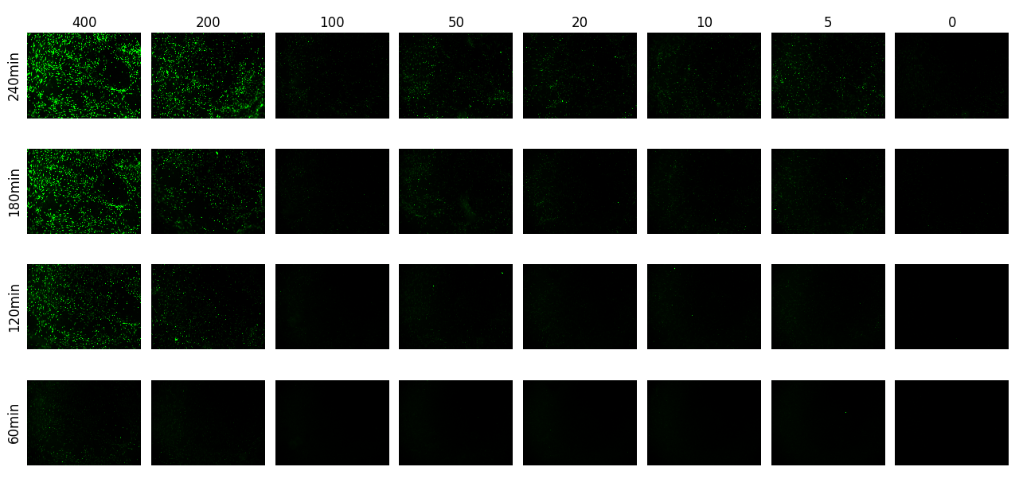
CellROX titration: Characterizing the CellROX assay
PDGFBB concentraton (ng/mL)
CellROX titration:
  2 days 5 ng/mL TGFb
  4 days 10 ng/mLIL-1b + 10ng/mL PDGFBB
  Boost with 8 different PDGF concentrations (between 0 and 400 ng/mL)
  Detection at 4 time points
time
Notes:
We are still trying to evaluate if ROS production be triggered by PDGF Stimulation of HAoSMCs of the synthetic phenotype.
For this Cells are treated for 2 days with TGFb and further for two additional days with IL1b and PDGF-BB.
As seen in this slide, we can detect ROS after ~3 hours of boost with at least 200 ng/mL PDGF in HBSS.

Slide 4
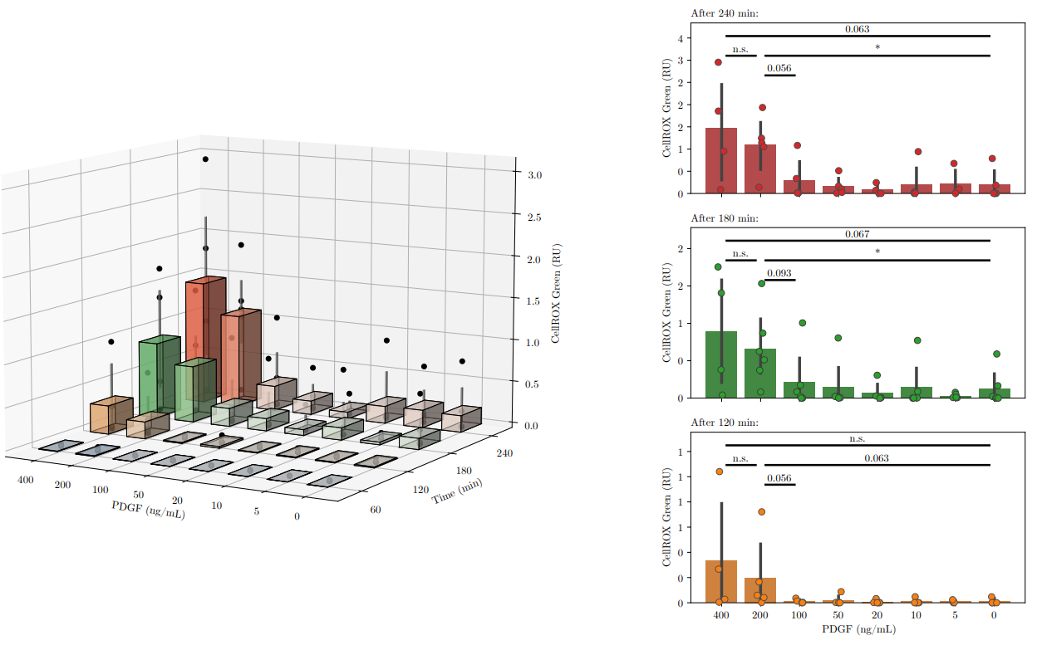
CellROX titration: another biological replicate
CellROX titration:
  2 days TGFb
  4 days IL-1b + PDGFBB
  Boost with 8 different PDGF concentrations
  Detection at 4 time points
7 repeats, one not used because signal way to high
Normalization via DAPI
Significance via Mann-Whitney U test
Notes:
To better understand the limits of this Assay, testing different PDGF concentrations and time dependency of the boost. Now with my final biological repeat, we can final see these little astrixes, indicating that we have a significant difference between signal at 0 ng/mL and 200 ng/mL.

Slide 5
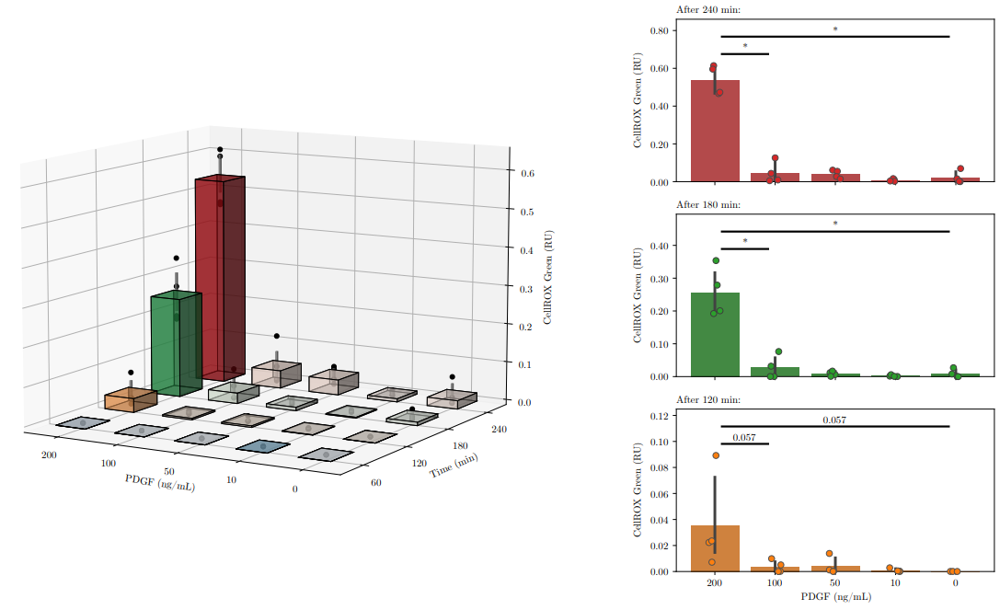
CellROX titration: An attempt at normalization
Only use datapoints that are found in all repeats
Normalization via DAPI
Second normalization between repeats via cumulative signal of the repeat
Significance via Mann-Whitney U test
Notes:
And the same stays true when we try to normalize our biological repeats with the total signal of the repeat to account for factors that are out of our control, like the age of the CellROX Green used in the Assay.

Slide 6
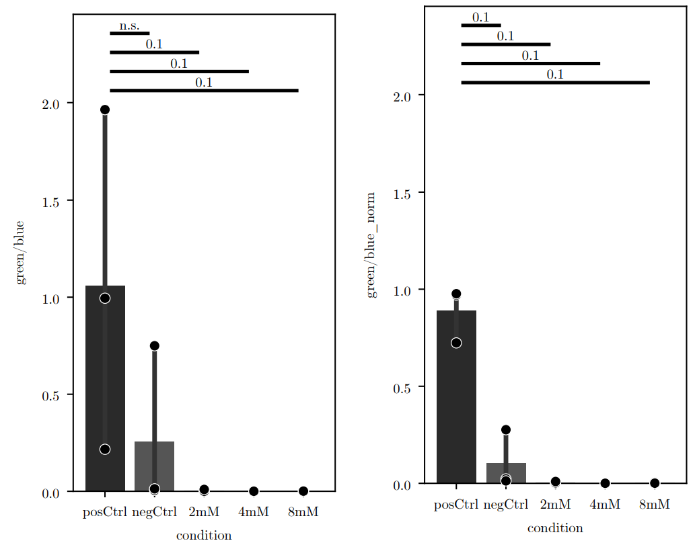
CellROX quench: ROS generation be rescued with the antioxidant NAC?
CellROX 5 conditions:
  2 days TGFb &
  4 days IL-1b + PDGFBB
  2 h treatment with NAC
  Boost 200 ng/mL PDGFBB and NAC
Normalization via DAPI (left)
normalization between repeats via total signal (right)
Significance via Mann-Whitney U test
Notes:
I further did another repeat for our proposed rescue experiment, quenching the generation of ROS with the antioxidant NAC. And indeed, while not yet significant, the trend seems to be pretty clear. No signal can be detected if cells are treated with NAC, stringly supporting the claim, that observd signal is due to generation of ROS.

Slide 7
Me and my project
“Identification of genetic risk variants for atherosclerosis using bioinformatic approaches and oxidative stress assay in vascular smooth muscle cells”
Notes:
The second part of the thesis was the use of bioinformatic approaches.

Slide 8
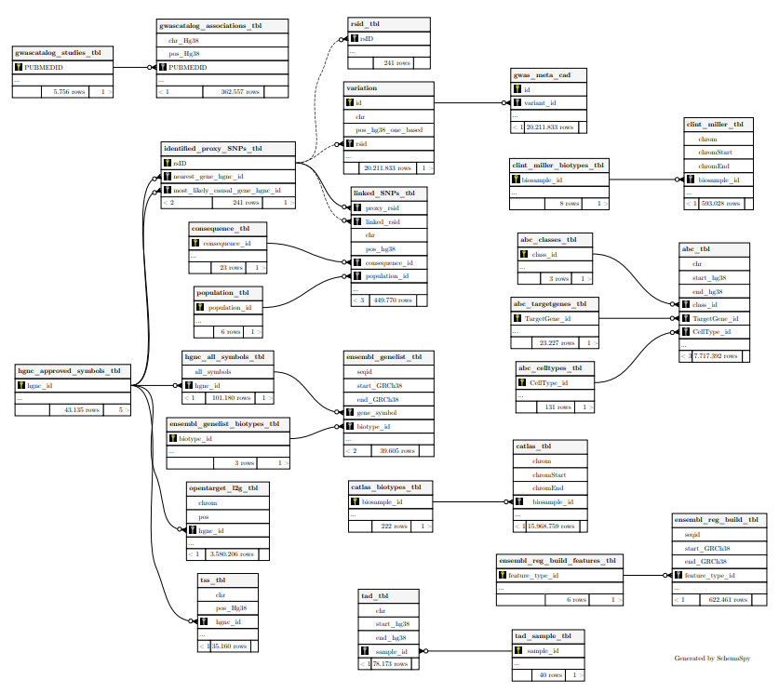
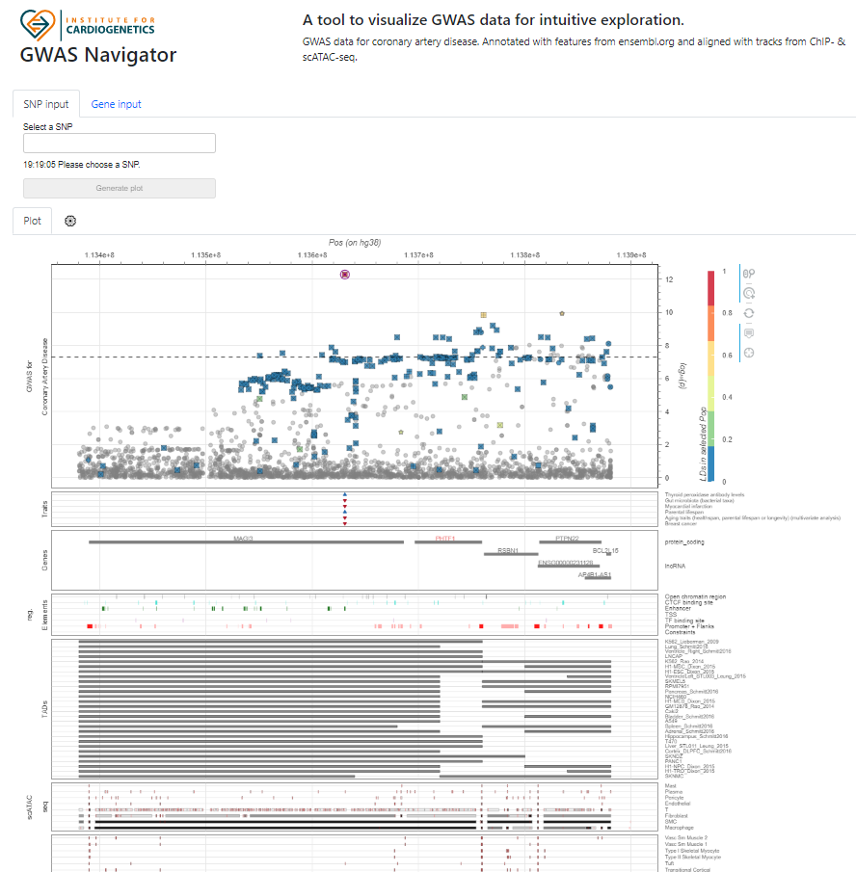
GWAS Navigator
Notes:
One main goal was to build an application, that renders GWAS summary statistics to the browser and co-visualizes it with other high through put data to allow intuitive and visual exploration.
Last time I gave you a short tech demo and mentioned that all the data displayed was currently coming from literally dozens of different csv files or even APIs living on my system.
What we now did, was to funnel all this data into a sql database that serves as the datasource for the tool.
This might not be super noticeable for the user, other then slightly increasing the speed, because databases are extremely fast in retrieving the required data.
But it more importantly really cleaned up the code and really, really, improved maintainability!

Slide 9
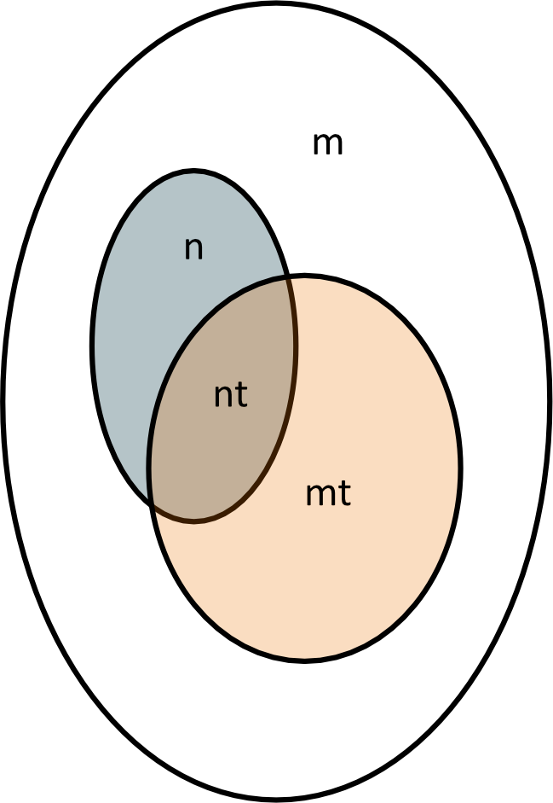
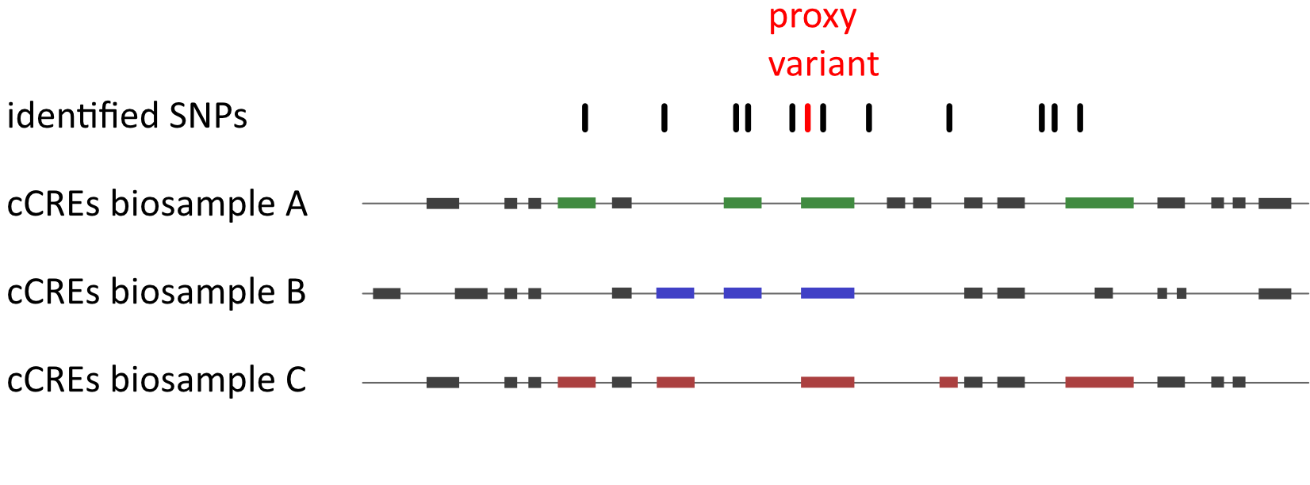
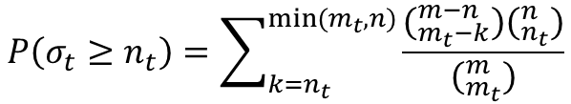
Enrichment analysis on cCRE elements
m = number of cCREs
mt = cCREs within one biosample
n = cCREs overlapping with proxy SNPs
nt = number of overlapping cCREs within one biosample
nt | mt-nt | mt
n-nt | m-n-mt+nt | m-mt
n | m-n | m
$$P\left(σ_{t}≥n_{t}\right)=\sum_{k=n_{t}}^{min⁡(m_{t}, n)}{\frac{(_{m_{t}−k}^{m−n})(_{n_{t}}^{n})}{(_{m_{t}}^{m})}}$$
doi encode cCREs: https://doi.org/10.1038/s41586-021-04226-3
doi million hearts study: https://doi.org/10.1101/2021.05.24.21257377
Notes:
Additionally I promised that I would use all this collected data to run a postGWAS analysis, to demonstrate an additional use case for all the data we collected and so I have a result to show in my thesis.
And we decided to do an enrichment analysis.
Which is quite a mouth full but actually not that hard to understand if you give me a minute.

Slide 10
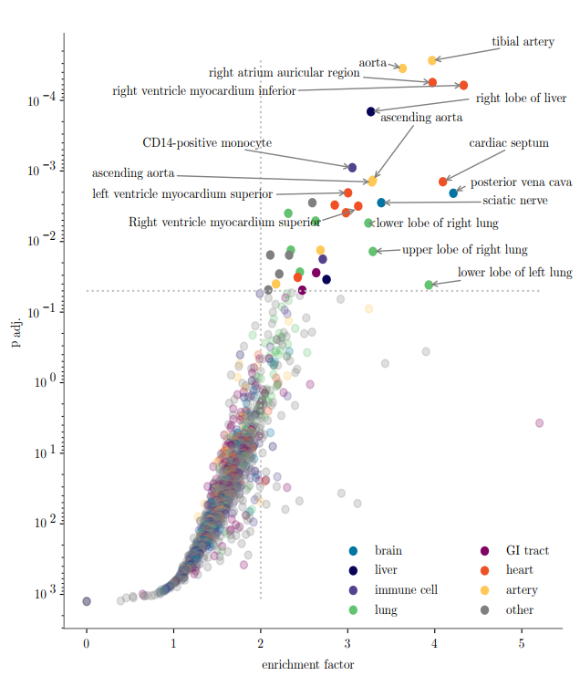
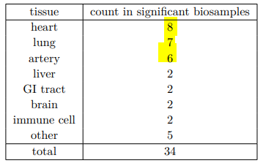
Enrichment analysis on cCRE elements
Notes:
And the result looks pretty much as expected. We indeed do find enrichment in 34 out of I think 1200 biosamples. And half of these tissues are annoted to be biosamples from heart tissue, lung tissue or artery tissue. Which makes a lot of sense, when you consider that we were looking at SNPs that are associated with coronary artery disease. This now verifies that risk variants for CAD show overlap with regulatory features that are active in affected tissues.
Liver, intestines and brain are also among tissues that well perfused.
Immune cell -> CD14 positive cell -> often found in injured or inflamed tissue.

Slide 11
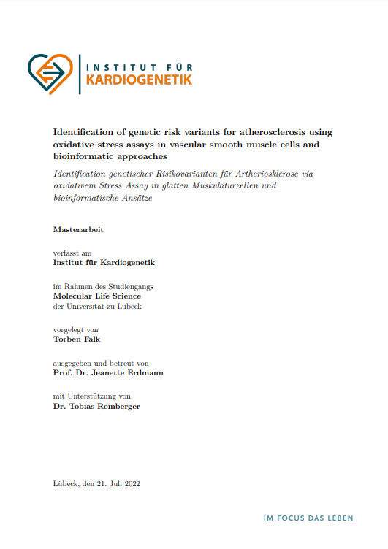
Outlook
Notes:
This is it. Other than that I finally starting writing my thesis and I’m constantly alternating between procrastinating, because I still have a little over a month and bing super stressed, because I only have a month left.

Slide 12
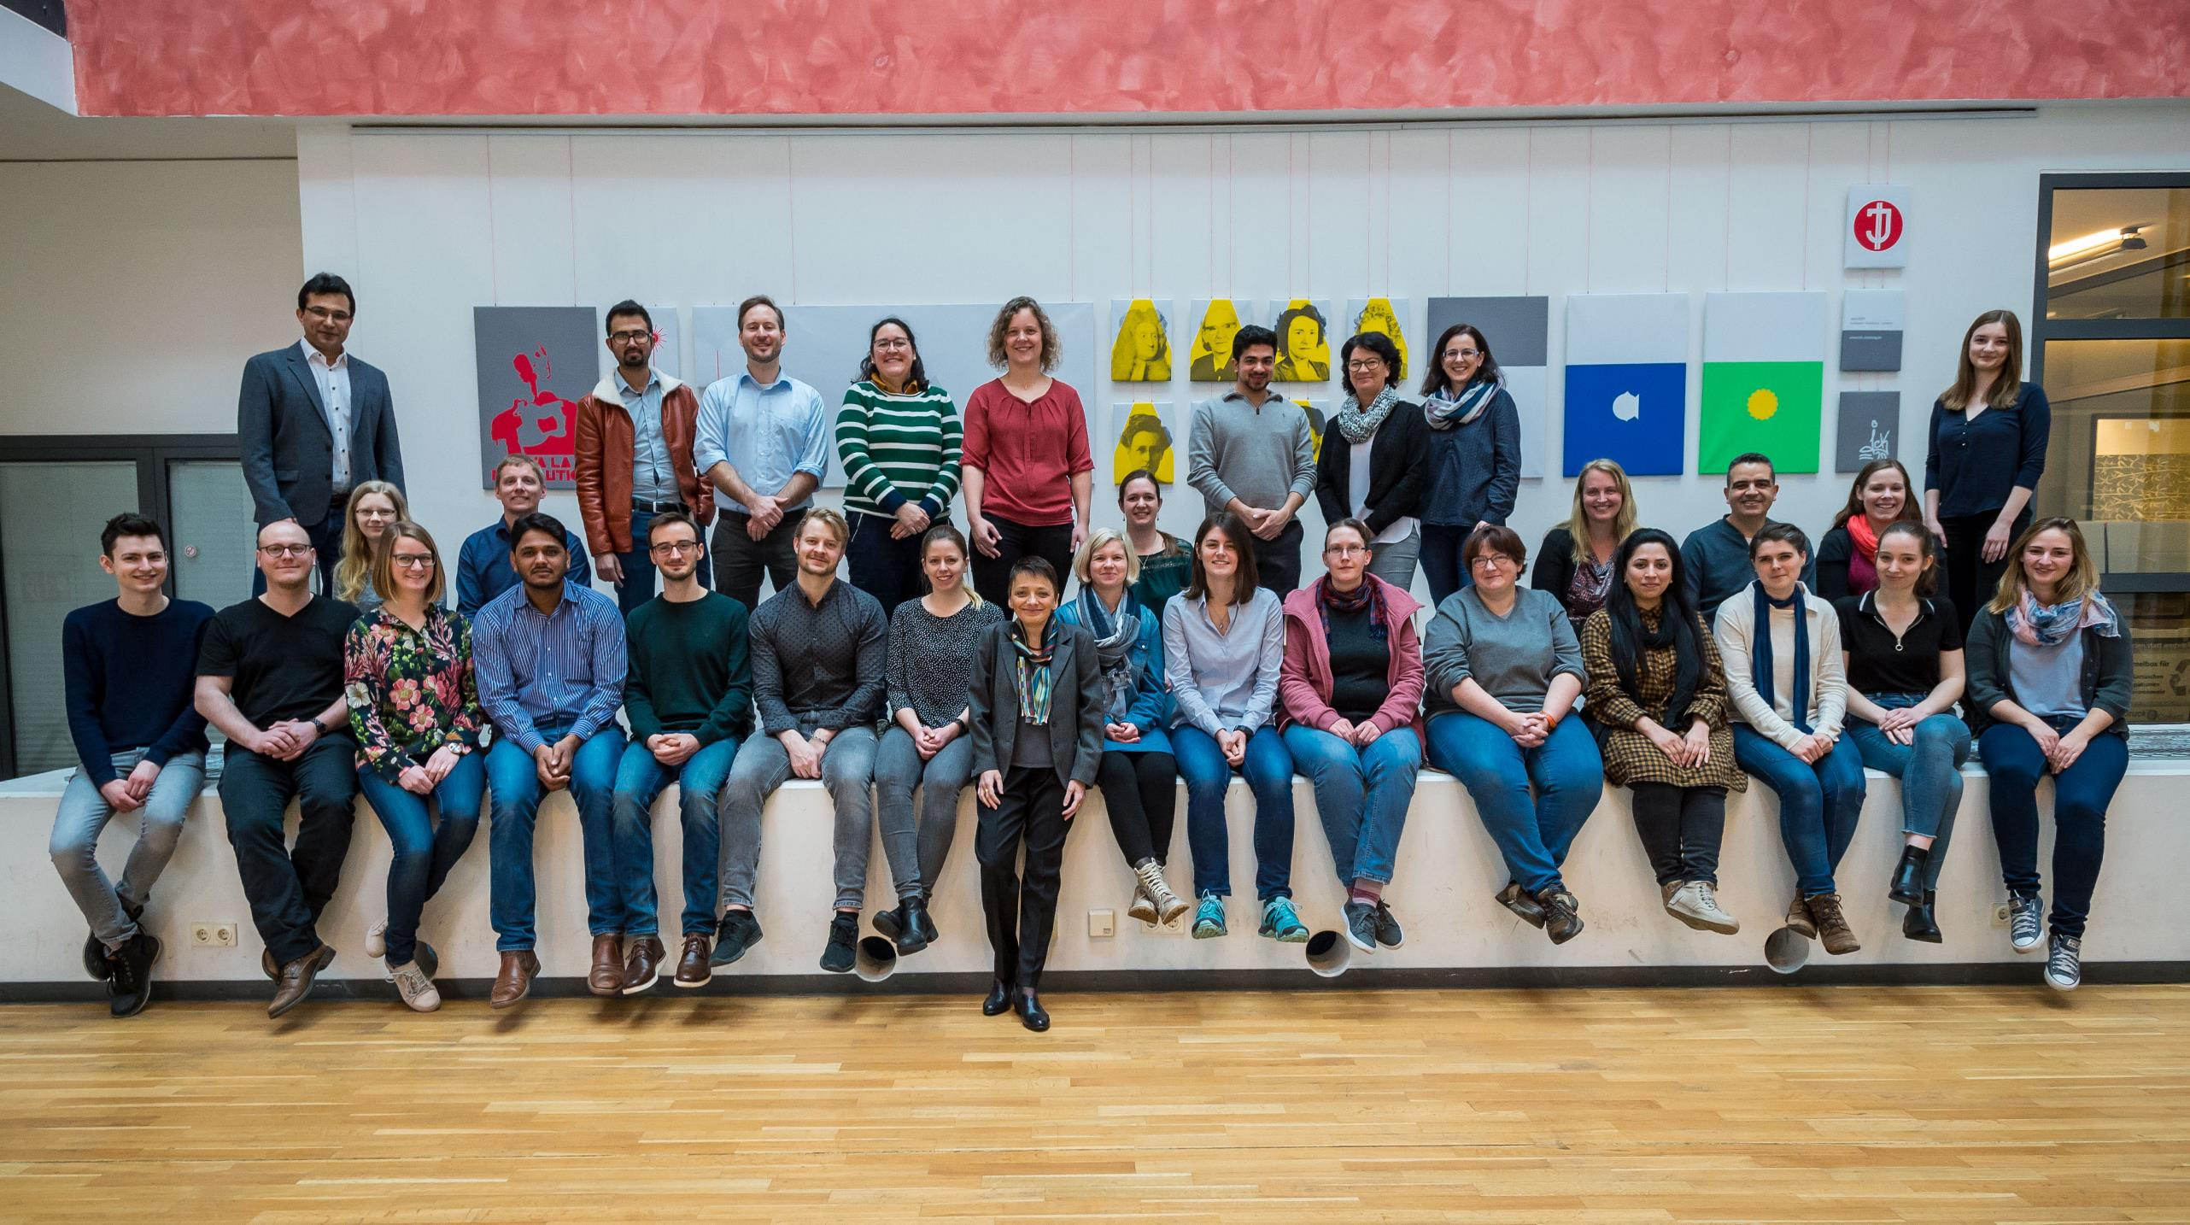

Many thanks for your attention
Tobias Reinberger – NCCR 02.12.2019
12
Notes:
Thank you very much for your attention!

