Slide 1
CS4210: F1 Race Prediction
Members: Darren Banhthai, Cesar Henry de Paula, Marian Remoroza

Slide 2
INTRODUCTION

Slide 3
What is Formula 1?
Formula 1, often abbreviated as F1, is the highest class of single-seater auto racing sanctioned by the Fédération Internationale de l'Automobile (FIA). It's characterized by high-speed racing cars, advanced technology, and a global series of races known as Grand Prix. The term "formula" in the name refers to a set of rules that all participants' cars must comply with. These rules govern everything from the design of the cars to the specifications of the engines and other components.
CONTENT: The kaggle dataset consists of all information on the Formula 1 championships from 1950 until the latest 2023 season.
OUR GOAL: The business goal is to accurately predict the outcome of a Formula 1 Championship race. We want to predict:
Which drivers are likely to finish in the podium?
WHY F1? We thought this would be relevant since a lot of people are invested into watching the F1 Championship every year and are interested in seeing how various drivers will perform in such a high profile race.

Slide 4
BACKGROUND

Slide 5
Background Information & Related Work
Our Formula 1 project is similar to other sports-related prediction models. Using machine learning for our prediction model involves utilizing various algorithms and techniques to analyze data and make predictions about the outcomes of F1 events
Sports prediction is nothing new, so there are existing solutions online specifically for whichever sports you’re following.

Slide 6
OBJECTIVES

Slide 7
Objectives
Data Collection - Gather comprehensive data on various factors that can influence race outcomes.
Feature Engineering - Identify relevant features from the collected data that can serve as inputs to the ML model.
Model Selection - Explore and evaluate two ML algorithms suitable for the prediction task.
Training & Validation - Split the dataset into training and validation sets to train the ML model and assess its performance.
Evaluation Metrics - Define appropriate evaluation metrics to assess the performance of the ML model.

Slide 8
ML Algorithm: Random Forest
Random forest is an algorithm used for both classification and regression tasks. There are several advantages random forest have that we want to utilize for our model:
They can handle both numerical and categorical features without requiring extensive preprocessing
They provide estimates of feature importance, providing us insights into the underlying relationships in the data
Relatively easy to interpret

Slide 9
ML Algorithm: Logistic Regression
ML Algorithm: ANN
Linear and logistic regression involves modeling the relationship between predictor variables (features) and the target variable (race outcomes).
Artificial Neural Networks have been used in various sports prediction domains. We chose to work with ANN because it offers several advantages for prediction tasks:
Ability to capture complex nonlinear relationships in the data and their capability to learn from large datasets
Allows for flexibility in model design and customization

Slide 10
DATA COLLECTION & PROCESSING

Slide 11
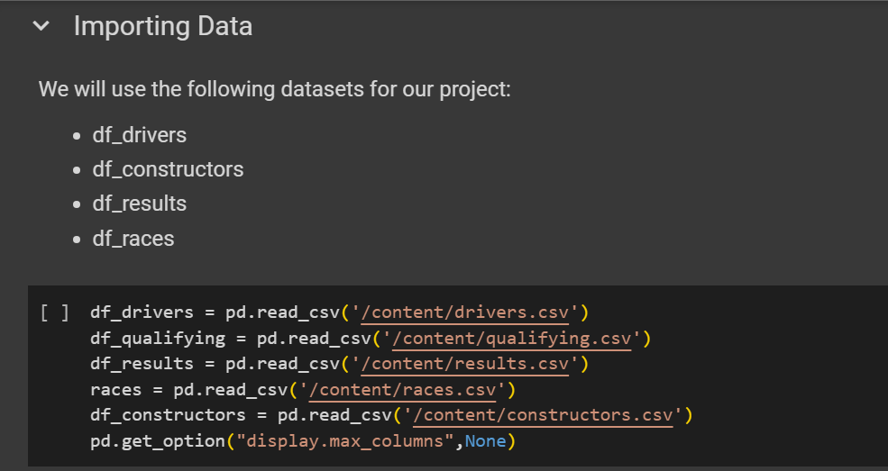
Data Collection
Data Source: https://www.kaggle.com/datasets/rohanrao/formula-1-world-championship-1950-2020?select=results.csv
The dataset consists of all information on the Formula 1 races, drivers, constructors, qualifying, circuits, lap times, pit stops, championships from 1950 till the latest 2023 season.

Slide 12
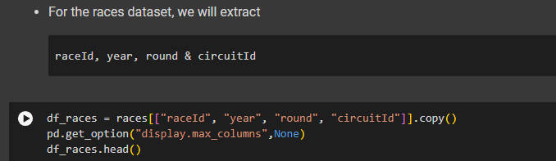
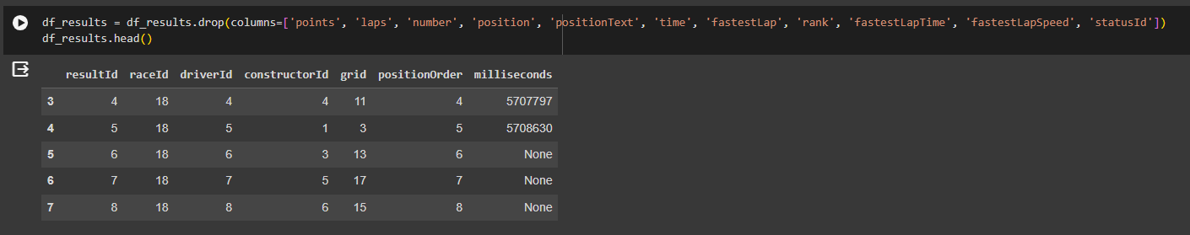
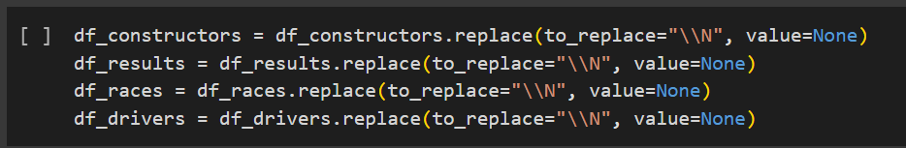
Ensuring Data Quality
Consolidated the data into a single data frame
Dropping unnecessary columns
Handling null values
Converting to appropriate data types

Slide 13
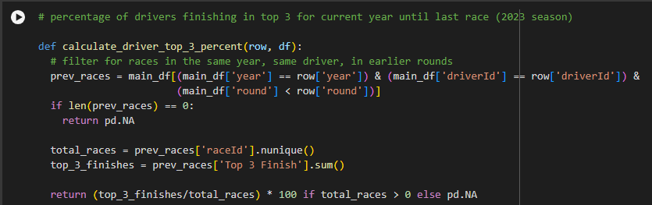
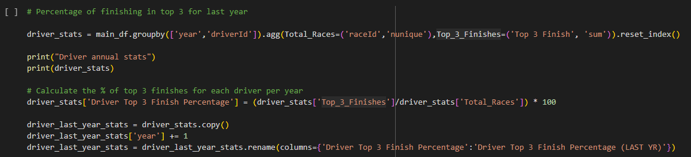
Feature Engineering
Experimented with adding an extra feature: Top 3 Finish
The idea is to get an average of who were the top 3 finishes for drivers and constructors and use that feature to train our ML models

Slide 14
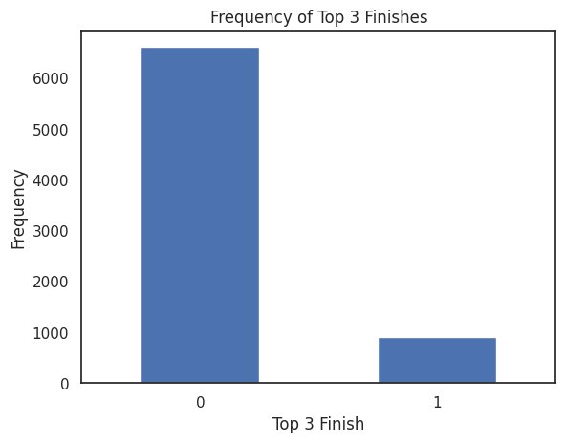
Feature Engineering
The data suggests that the likelihood of a driver to finish in the top 3 is much less likely than finishing otherwise
It makes sense that finishing in the top 3 out of 20 drivers would be a rare thing to do
Because of this, we want the data distribution to remain this way to capture this dynamic

Slide 15
Feature Engineering
We also experimented with adding features that would give more context to each row in terms of the driver and their constructor’s rankings around the time that they’re supposed to rank.
These are the following features:
Driver Top 3 Finish Percentage (Last Year)
Constructor Top 3 Finish Percentage (Last Year)
Driver Top 3 Finish Percentage (This Year)
Constructor Top 3 Finish Percentage (This Year)
Driver Average Position (Last Year)
Constructor Average Position (Last Year)

Slide 16
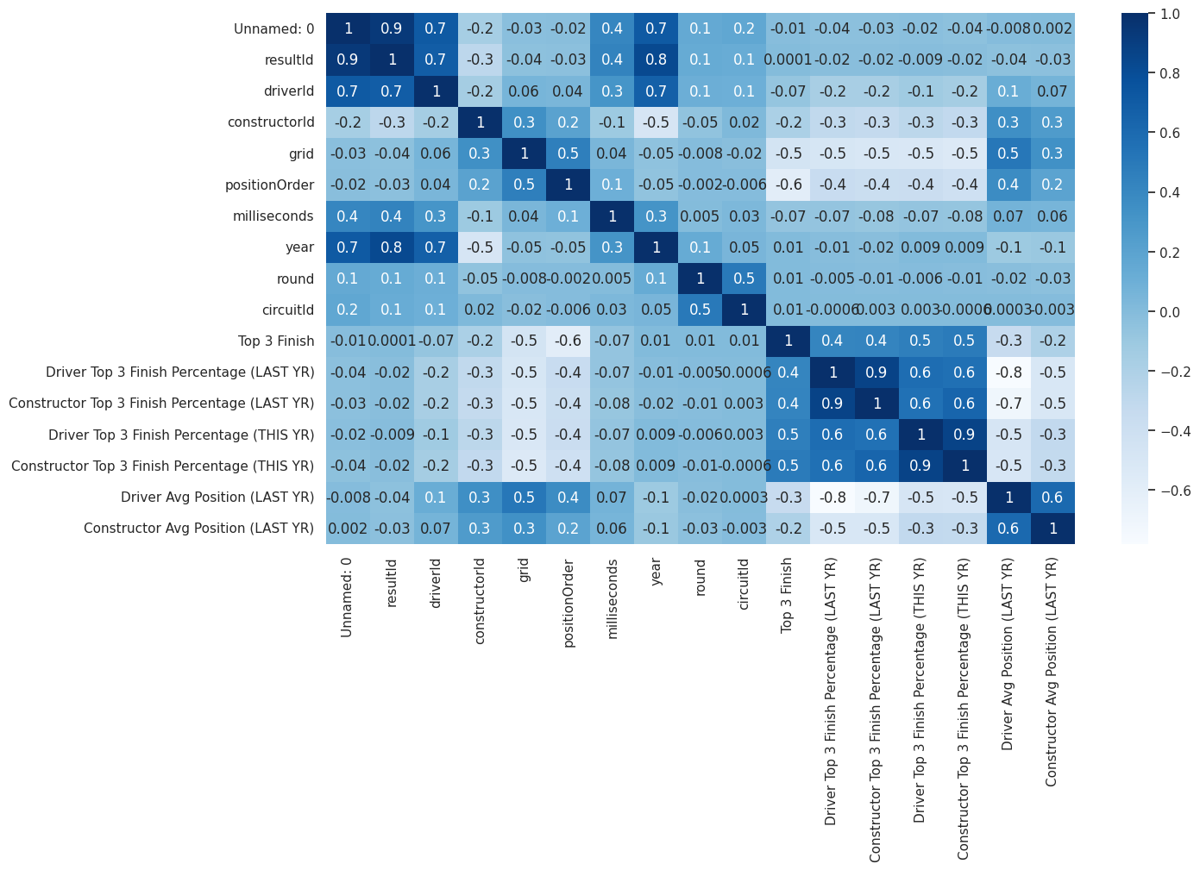
Feature Engineering: Correlation
We see there’s a good correlation between the features we have added. We will be using these to train our ML model
Notes:
We can see that the top 3 finish percentage for both drivers and constructors(teams) in the current and past year have strong positive correlations with the target variable `Top 3 Finish', which is whether the driver finishes in top 3 for this race. The values of these correlations are between 0.46 and 0.53.
In addition, grid (driver's starting position for this race) and average finishing positions for drivers and teams in the past and current year have negative correlations with the target variable `Top 3 Finish'. This is expected as when the starting position or average finishing position has a higher value, it's less likely for the car to finish in top 3.
Furthermore, several engineered features have some degree of correlations. For example, the correlation between 'Driver Top 3 Finish Percentage (Last Year)' and `Driver Top 3 Finish Percentage (This Year till last race)' is 0.65. But since they are not close to a perfect correlation, having an additional feature still has the potential to improve our classification model.

Slide 17
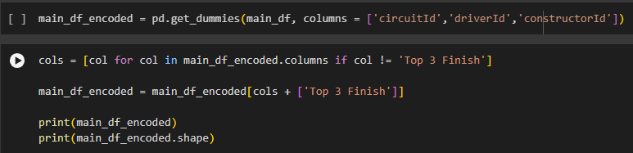
Feature Engineering: One Hot Encoding
We applied one hot encoding to the ID columns: circuitId, driverId & constructorId
We do this to ensure that the numerical representation of categories is independent of each other.

Slide 18
METHODOLOGY

Slide 19
Methodology
We are comparing logistic regression, random forest, and ANN
The criteria we are using for comparison is the accuracy of the ML model
As explained earlier, we added a new feature to include in our ML training for our logistic, random forest, and ANN models.
Libraries used:
sklearn
tensorflow keras
pandas
numpy
matplotlib

Slide 20
Methodology
Our strategy was to go through steps in which we would make various changes in the features fed to the models and see which variations would produce the best models.
Step 1: Year, round, Top 3 Finish, Prev year’s driver’s top 3 finish % and Constructor avg position, circuit and driver ids
Step 2: add Prev year’s Constructor top 3 finish % and driver’s avg position, this year’s driver top 3 finish % and Constructor top 3 finish %
Step 3: Add starting grid position
For each step we would be also be performing hyperparameter tuning as it is possible that the optimal set of hyperparameters would change in response to the added features.

Slide 21
Methodology
For each model, we decided on the following parameters to tune:
Logistic Regression:
C (used to control regularization technique, used to prevent overfitting by penalizing large coefficient; the higher C is, the lower regularization strength is)
Random Forest:
Number of estimators (decision trees)
Max Depth (of each estimator)
ANN:
Number of epochs (iterations our algorithm will work through the training dataset)
Number of neurons in hidden layer

Slide 22
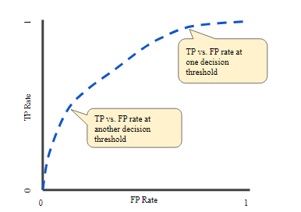
Methodology
For evaluation we are using the accuracy score of the models, as well as the ROC AUC score, which is the area under a ROC curve, a graph that plots the True Positive rate and False Positive Rate of a model. The closer to 1, the better the performance.
We also want to balance the tradeoff between TPR and FPR, so we will also compute the precision-recall curve to determine the best threshold through optimizing the F1 score.

Slide 23
IMPLEMENTATION

Slide 24
Implementation
Logistic Regression
Libraries used: sklearn.linear_model: LogisticRegression
Random Forest
Libraries used: sklearn.ensemble: RandomForestClassifier
Artificial Neural Network
Libraries used: tensorflow, tensorflow: keras, tensorflow.keras.models: Sequential, tensorflow.keras.layers : Dense
Splitting, Scoring, Hyperparameter tuning
Libraries used: sklearn.metrics: accuracy_score, roc_curve, auc

Slide 25
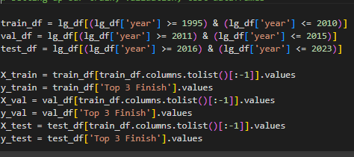
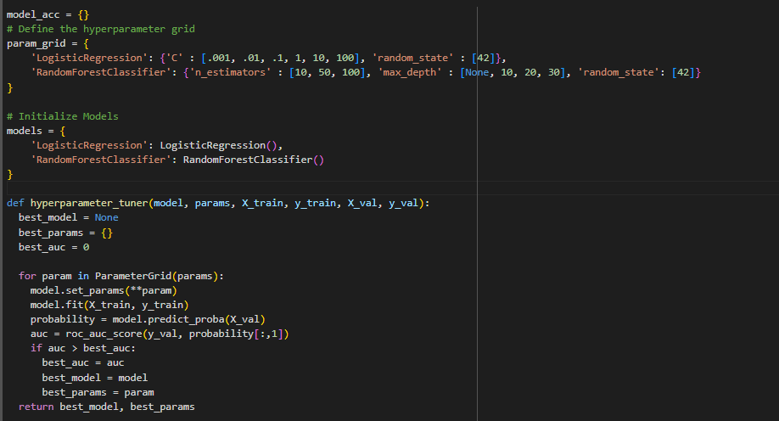
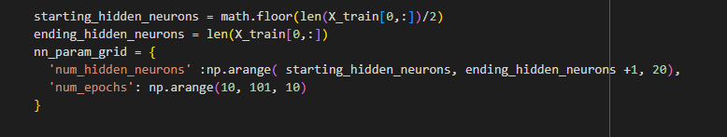
Implementation
We split the data into training, validation, and test datasets based on time period.
Then we defined a set of hyperparameters for each model and tested each model using the AUC ROC scores to determine the best possible options to tune our models with.

Slide 26
Implementation: Resulting Model Implementations
Step 1:
Logistic: C = .01
Random Forest: max depth = 10, # estimators : 50
ANN: Input Layer w/ 157 neurons, Hidden Layer w/ 90 neurons, Output Layer w/ 1 neuron, 20 epochs
Step 2:
Logistic: C = 0.01
Random Forest: max depth = 10, # estimators : 50
ANN: Input Layer w/ 161 neurons, Hidden Layer w/ 160 neurons, Output Layer w/ 1 neuron, 80 epochs
Step 3:
Logistic: C = 10
Random Forest: max depth = 30, # estimators : 100
ANN: Input Layer w/ 162 neurons, Hidden Layer w/ 141 neurons, Output Layer w/ 1 neuron, 80 epochs

Slide 27
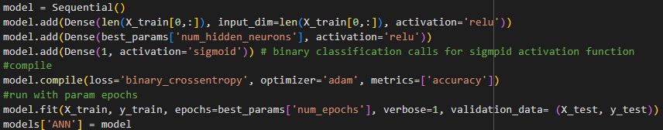
Implementation
ANN:
Loss Function: Binary Cross-Entropy
Activation Function for Hidden Layer: ReLU
Activation Function for Output Layer: Sigmoid

Slide 28
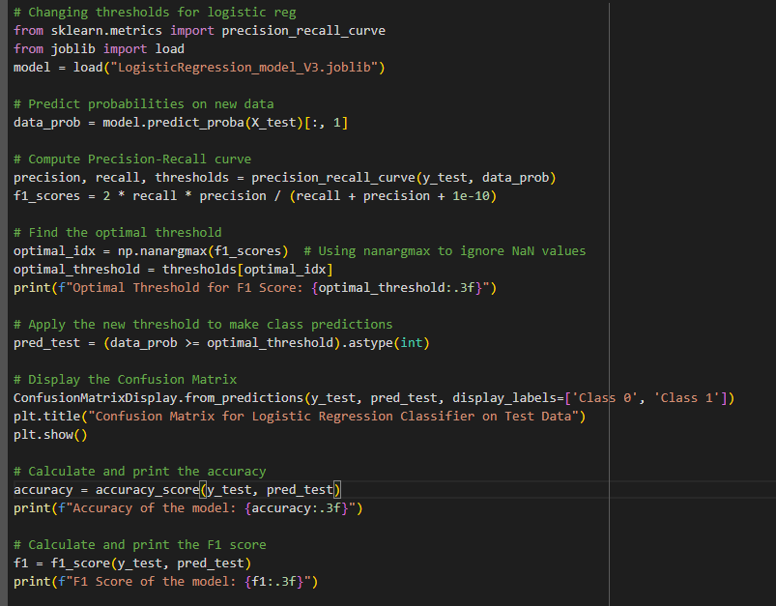
Implementation
After going through each step and finding out which of the models were the best, we we calculated the precision recall curve and its f1_scores, took the highest of those to find its corresponding threshold, and inserted that threshold into the corresponding model to create the final iteration of our model.
To do this, we utilized precision_recall_curve and f1_score from sklearn.metrics.

Slide 29
RESULTS

Slide 30
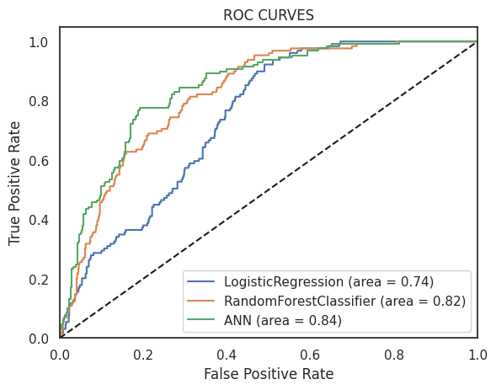
Results: Model 1
Logistic Regression
Test Accuracy: 83.60%
AUC-ROC: 0.7425
Random Forest Classifier
Test Accuracy: 85.23%
AUC-ROC: 0.8211
ANN
Test Accuracy: 84.91%
AUC-ROC: 0.8443
Notes:
Step 1: Year, round, Top 3 Finish, Prev year’s driver’s top 3 finish % and Constructor avg position, circuit and driver ids
Driver Top 3 finish % last year, Constructor top 3 finish % last yr

Slide 31
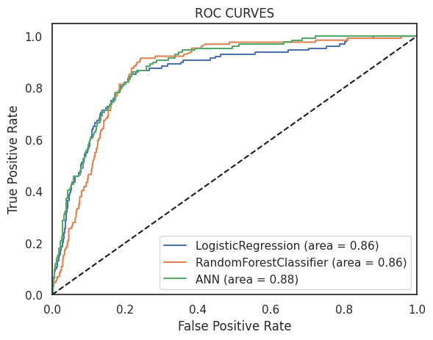
Results: Model 2
Logistic Regression
Test Accuracy: 86.43%
AUC-ROC: 0.8540
Random Forest Classifier
Test Accuracy: 85.34%
AUC-ROC: 0.8626
ANN
Test Accuracy: 86.68%
AUC-ROC: 0.8773
Notes:
Step 2: add Prev year’s Constructor top 3 finish % and driver’s avg position, this year’s driver top 3 finish % and Constructor top 3 finish %

Slide 32
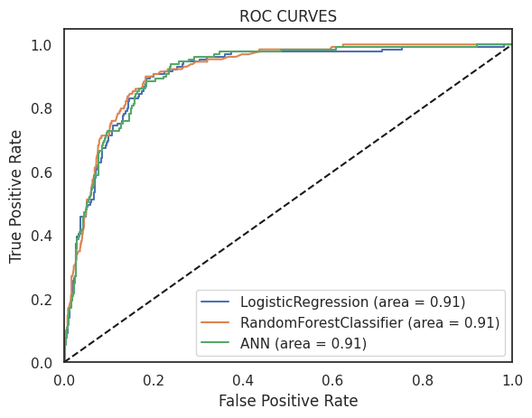
Results: Model 3
Logistic Regression
Test Accuracy: 88.93%
AUC-ROC: 0.9052
Random Forest Classifier
Test Accuracy: 87.95%
AUC-ROC: 0.9137
ANN
Test Accuracy: 86.86%
AUC-ROC: 0.9088
Notes:
AUC-ROC Score:
The AUC-ROC score is the area under the ROC curve, ranging from 0 to 1. A higher AUC-ROC score indicates better discrimination ability of the model.
An AUC-ROC score of 0.5 indicates that the model's performance is no better than random guessing, while a score of 1 indicates perfect discrimination between the positive and negative classes.
AUC-ROC is a threshold-independent metric, meaning it evaluates the overall performance of the model across all possible classification thresholds.
Interpretation of AUC-ROC:
AUC-ROC values closer to 1 indicate better model performance, with the model effectively distinguishing between positive and negative instances.
AUC-ROC values around 0.5 suggest that the model's performance is no better than random guessing.
AUC-ROC values below 0.5 indicate that the model's performance is worse than random guessing and may be making incorrect predictions.
In summary, AUC-ROC provides a comprehensive measure of the discriminative ability of a binary classification model, making it a valuable metric for evaluating and comparing different models' performances, particularly in scenarios where the class distribution is imbalanced or when choosing an optimal classification threshold is important.

Slide 33
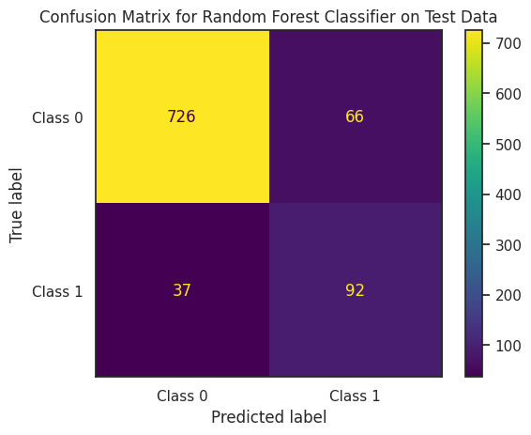
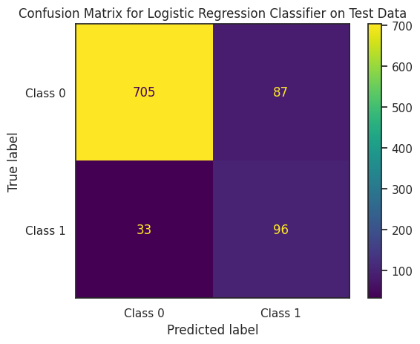
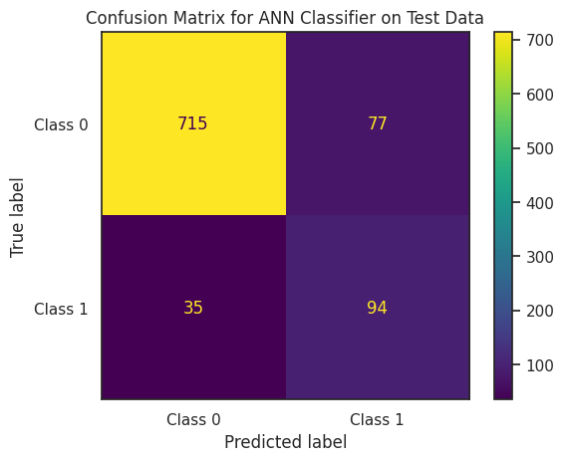
Confusion Matrix on Model 3
Accuracy: 88.8%
F1 Score: 0.641
Accuracy: 87.0%
F1 Score: 0.615
Accuracy: 87.8%
F1 Score: 0.627
Notes:
The F1 score ranges between 0 and 1, where a higher score indicates better performance. It reaches its best value at 1 (perfect precision and recall) and its worst at 0.
In summary, the F1 score provides a single metric that balances both precision and recall, making it a useful measure for evaluating the overall performance of a classification model, especially in scenarios with imbalanced classes or when you want to prioritize both precision and recall equally.

Slide 34
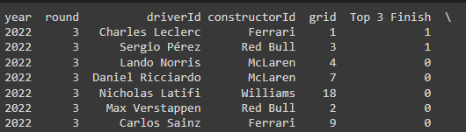
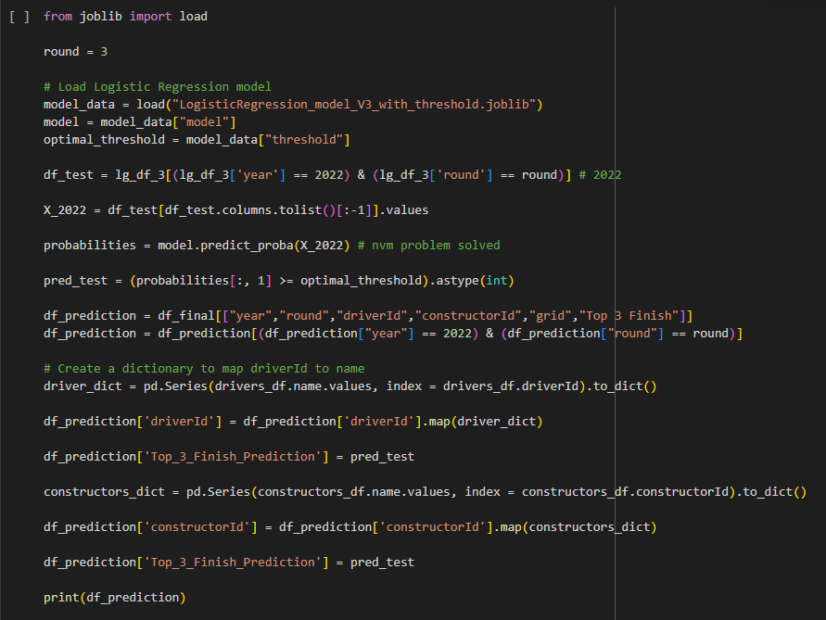
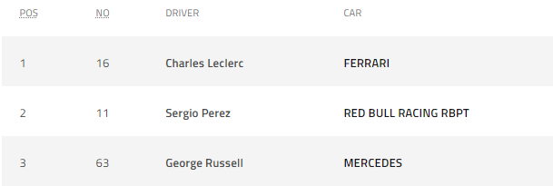
F1 Podium Prediction Example: 2022 Australia Grand Prix (Rnd 3)
Logistic Regression, Random Forest Classifier & ANN had the same prediction result. Compared to the actual 2022 Australia GP result, our models accurately predicted the top 1 and top 2.

Slide 35
DISCUSSION

Slide 36
Discussion
We initially thought these three models would perform differently; perhaps if we increased the test size of our dataset we would have seen a difference.
If given more time, we would try to utilize the other data sets and train them as well.
It’s interesting to see how the ANN did not yield a higher accuracy than the other two models.
The implications this project has in the real world is its usability towards other sports.
Fans can use these predictions for fantasy leagues, betting, or simply to enhance their viewing experience by understanding the factors influencing race outcomes.

Slide 37
CONCLUSION & FUTURE WORK

Slide 38
Conclusion
Overall our logistic regression, random forest classifier and ANN models ran similarly, though the logistic regression model has a higher accuracy of 88.93% compared to random forest’s 87.95% and ANN’s 86.86%.
Based on the accuracy of our models, we conclude that the logistic regression model would be more appropriate to use for our dataset. Of course, if we are planning on adding other datasets, this might change.

Slide 39
Limitations and Future Work
Neither of us were familiar with F1 racing at all, and while we have gained a better understanding there are still many variables to racing that our datasets did not capture (such as the weather, accident rate, etc) or variables that we did not understand that may have a significant impact on our results.
For future improvements, we would incorporate more datasets that capture those variables into the development and training of our model.

Slide 40
THANK YOU

