Slide 1

Genetic Algorithms for Quantum Circuits
By Arturo, Badr, Cesar, Lukas and Tim

Slide 2
Outline
Introduction of the problem
Physical problem
Quantum circuits and VQE
Genetic algorithms
Code implementation
Tensor and circuit generations
Tournament and selection
Crossover
Mutations
Hyperparameter Optimisation
Results
Energies
Phase transition with Z magnetisation
Conclusions
AI for Physicists (AP3751)
GA for Quantum Circuits
27 June 2025
2
2

Slide 3

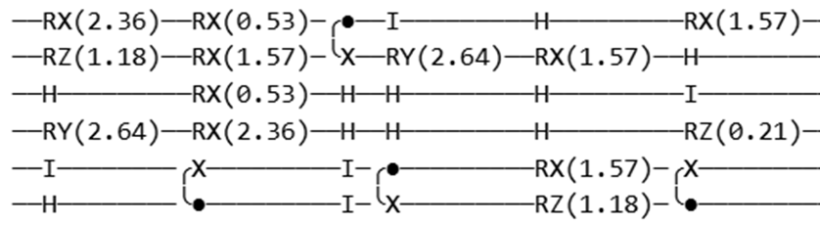
Introduction Physics Problem At Hand
Transverse-Field Ising model
Maps computational problems
AI for Physicists (AP3751)
GA for Quantum Circuits
27 June 2025
3

Slide 4
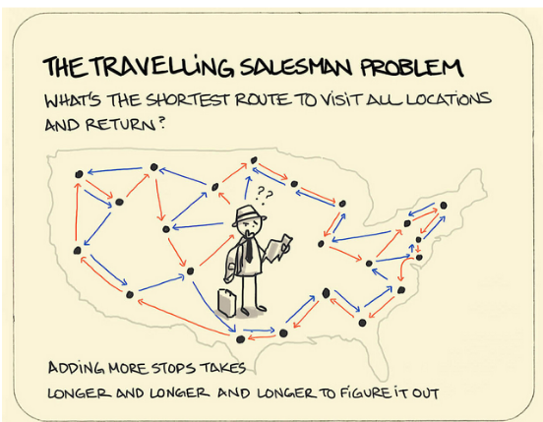
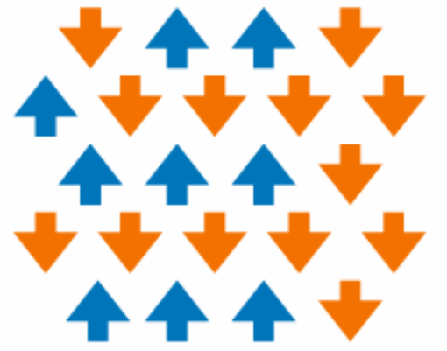
Introduction Physics Problem At Hand
https://sketchplanations.com/the-travelling-salesman-problem
E. Greplova: AP3751 Lecture 1
Solution found by minimizing loss function
Solution found by calculating lowest eigenvalue
AI for Physicists (AP3751)
GA for Quantum Circuits
27 June 2025
4

Slide 5
Introduction Physics Problem At Hand
Transverse-Field Ising model
Maps computational problems
Solution: Finding lowest eigenvalue
Exponential scaling with system size
AI for Physicists (AP3751)
GA for Quantum Circuits
27 June 2025
5

Slide 6
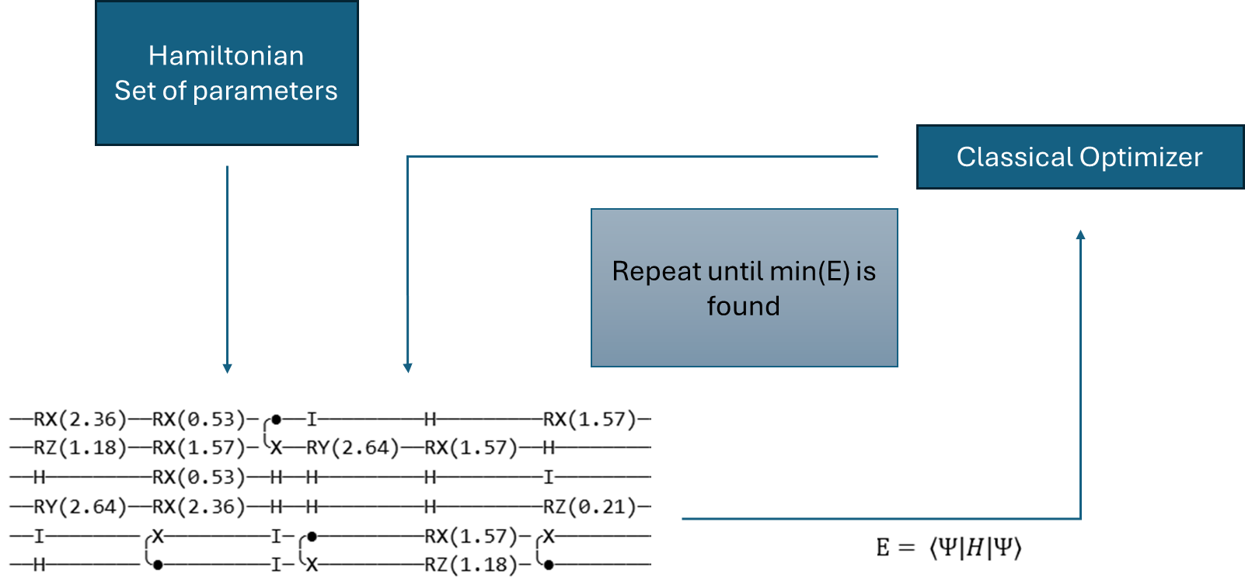
Introduction Existing Solutions: VQE
Update Gates
Need for automated circuit optimization
AI for Physicists (AP3751)
GA for Quantum Circuits
27 June 2025
6

Slide 7
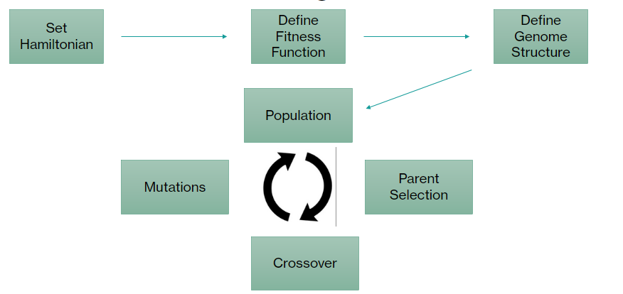
Introduction Genetic Algorithms
Evolution theory
Survival of the fittest
Crossover/Mutations
General Advantages
No gradient information
Naturally handles discrete problems
AI for Physicists (AP3751)
GA for Quantum Circuits
27 June 2025
7

Slide 8

Introduction Genetic Algorithm
Set Hamiltonian
Define Fitness Function
Define Genome Structure
Population
Mutations
Parent Selection
Crossover
AI for Physicists (AP3751)
GA for Quantum Circuits
27 June 2025
9

Slide 9
Introduction Genetic Algorithm
Set Hamiltonian
Define Fitness Function
Define Genome Structure
Population
Mutations
Parent Selection
Crossover
AI for Physicists (AP3751)
GA for Quantum Circuits
27 June 2025
10

Slide 10
Code Implementation Structure
Set Hamiltonian
Define Fitness Function
Define Genome Structure
Population
Mutations
Parent Selection
Crossover
AI for Physicists (AP3751)
GA for Quantum Circuits
27 June 2025
11

Slide 11
Code Implementation Structure
Genetic Algorithm file
Main file
First class defines the circuits and methods (Hamiltonian, mutation, crossover, etc)
Second class performs the evolution by selecting the parents and generating the offsprings
Calls GA file to execute the evolutionary algorithm
Plots the energies and magnetisation
AI for Physicists (AP3751)
GA for Quantum Circuits
27 June 2025
12

Slide 12
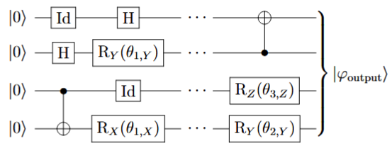
Code Implementation Tensor and circuit generation
Fixed number of qubits
Implemented gates:
Identity (Id)
Hadamard (Hd)
CNOT
X, Y, Z rotations:
Three predetermined angles
Depth
AI for Physicists (AP3751)
GA for Quantum Circuits
27 June 2025
13

Slide 13
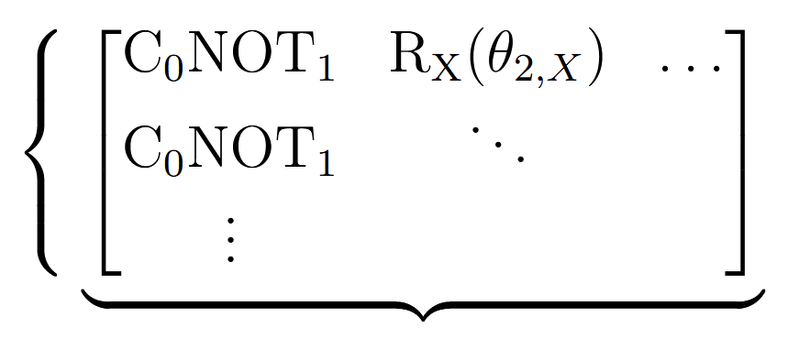
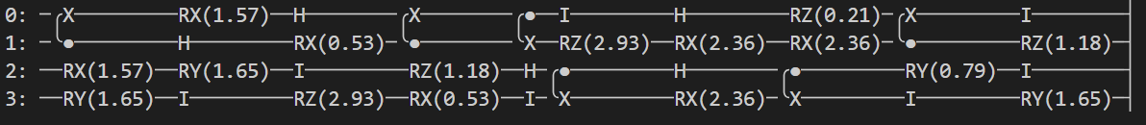
Code Implementation Tensor and circuit generation
Circuits saved as (num_qubits × depth) tensor
Number
of
qubits
Converted to PennyLane quantum circuits for evaluating their energies (fitness)
Depth
Initialisation: generate num_circuits random circuits
AI for Physicists (AP3751)
GA for Quantum Circuits
27 June 2025
14

Slide 14
Code Implementation
Set Hamiltonian
Define Fitness Function
Define Genome Structure
Population
Mutations
Parent Selection
Crossover
AI for Physicists (AP3751)
GA for Quantum Circuits
27 June 2025
15

Slide 15

Code Implementation Parent Selection
Population (size=100)
Sample 5 from Population
Select Winner
Parents
(size=0)
AI for Physicists (AP3751)
GA for Quantum Circuits
27 June 2025
16

Slide 16
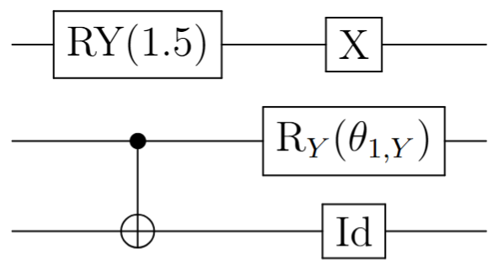
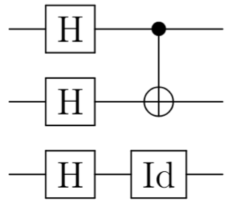
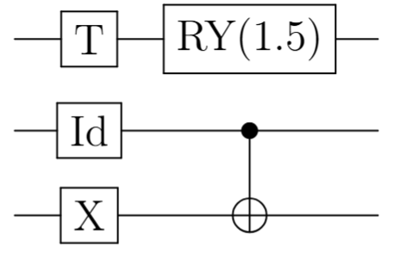
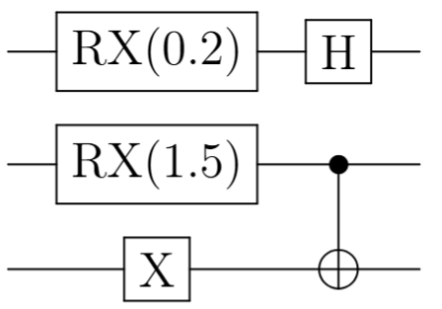
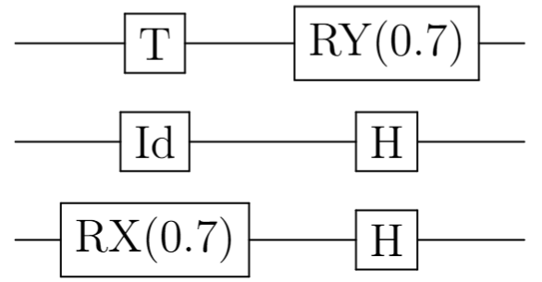
Code Implementation Parent Selection
Population (size=100)
Sample 5 from Population
Select Winner
Parents
(size=0)
AI for Physicists (AP3751)
GA for Quantum Circuits
27 June 2025
17

Slide 17
Code Implementation Parent Selection
Population (size=100)
Sample 5 from Population
Lowest
Energy?
Select Winner
Parents
(size=0)
AI for Physicists (AP3751)
GA for Quantum Circuits
27 June 2025
18

Slide 18
Code Implementation Parent Selection
Population (size=100)
Sample 5 from Population
Select Winner
Parents
(size=0)
AI for Physicists (AP3751)
GA for Quantum Circuits
27 June 2025
19

Slide 19
Code Implementation Parent Selection
Population (size=99)
Winner is removed to avoid reselection
Sample 5 from Population
Select Winner
Parents
(size=1)
AI for Physicists (AP3751)
GA for Quantum Circuits
27 June 2025
20

Slide 20
Code Implementation Parent Selection
Population (size=98)
Sample 5 from Population
Select Winner
Parents
(size=2)
AI for Physicists (AP3751)
GA for Quantum Circuits
27 June 2025
21

Slide 21
Code Implementation Parent Selection
Population (size=97)
Sample 5 from Population
Select Winner
Parents
(size=3)
AI for Physicists (AP3751)
GA for Quantum Circuits
27 June 2025
22

Slide 22
Code Implementation Parent Selection
Population (size=60)
Sample 5 from Population
Select Winner
Parents
(size=40)
AI for Physicists (AP3751)
GA for Quantum Circuits
27 June 2025
23

Slide 23
Code Implementation
Set Hamiltonian
Define Fitness Function
Define Genome Structure
Population
Mutations
Parent Selection
Crossover
AI for Physicists (AP3751)
GA for Quantum Circuits
27 June 2025
24

Slide 24
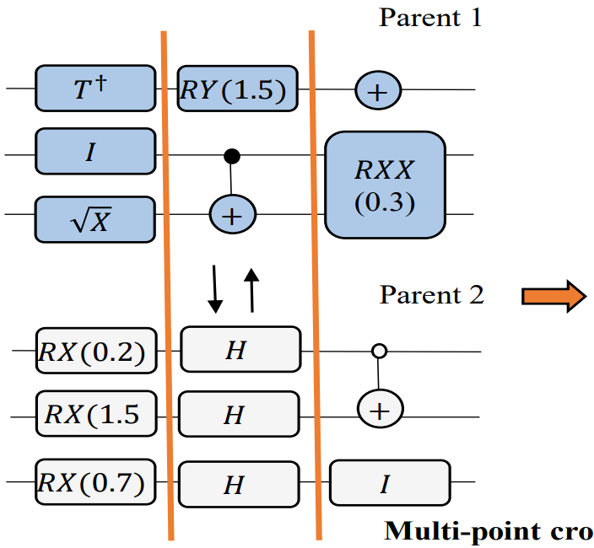


Code Implementation Crossover – Two Strategies
?
Sünkel, L., Martyniuk, D., Mattern, D., Jung, J., & Paschke, A. (2023). GA4QCO: genetic algorithm for quantum circuit optimization.
AI for Physicists (AP3751)
GA for Quantum Circuits
27 June 2025
25

Slide 25
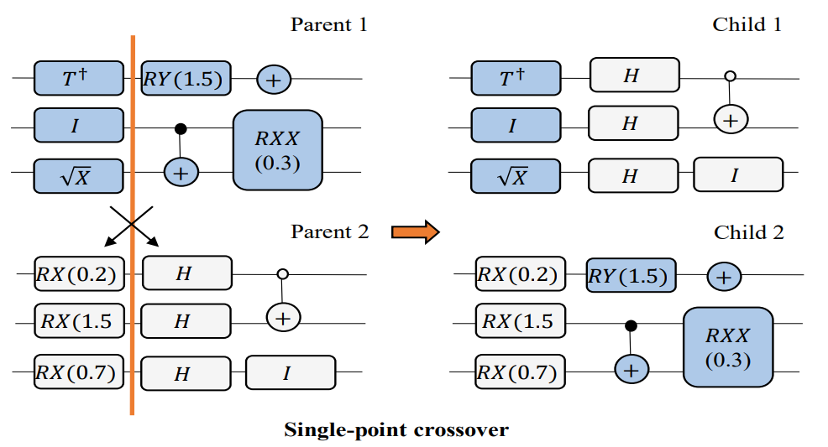
Code Implementation Strategy 1 – Blind Crossover
Step 1: Select Random Crossover Layer
Step 2: Split and Recombine
Sünkel, L., Martyniuk, D., Mattern, D., Jung, J., & Paschke, A. (2023). GA4QCO: genetic algorithm for quantum circuit optimization.
AI for Physicists (AP3751)
GA for Quantum Circuits
27 June 2025
26

Slide 26

Code Implementation Strategy 2: Entanglement-aware Crossover
EAQGA: A Quantum-Enhanced Genetic Algorithm with Novel Entanglement-Aware Crossovers, Haghighi et al., 2025
AI for Physicists (AP3751)
GA for Quantum Circuits
27 June 2025
27

Slide 27
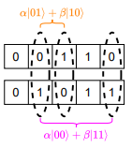
Code Implementation Strategy 2: Entanglement-aware Crossover
Consider a five-qubit problem with the following two parent solutions:
Ensure highly correlated qubits remain entangled across generations
EAQGA: A Quantum-Enhanced Genetic Algorithm with Novel Entanglement-Aware Crossovers, Haghighi et al., 2025
AI for Physicists (AP3751)
GA for Quantum Circuits
27 June 2025
28

Slide 28
Code Implementation Strategy 2 – Entanglement-aware Crossover
Step 1: Find Compatible Blocks – i.e. blocks with equal entanglement generation
Step 2: Select Compatible Crossover Layer
Step 3: Split and Recombine
Sünkel, L., Martyniuk, D., Mattern, D., Jung, J., & Paschke, A. (2023). GA4QCO: genetic algorithm for quantum circuit optimization.
AI for Physicists (AP3751)
GA for Quantum Circuits
27 June 2025
29

Slide 29
Code Implementation
Set Hamiltonian
Define Fitness Function
Define Genome Structure
Population
Mutations
Parent Selection
Crossover
AI for Physicists (AP3751)
GA for Quantum Circuits
27 June 2025
30

Slide 30
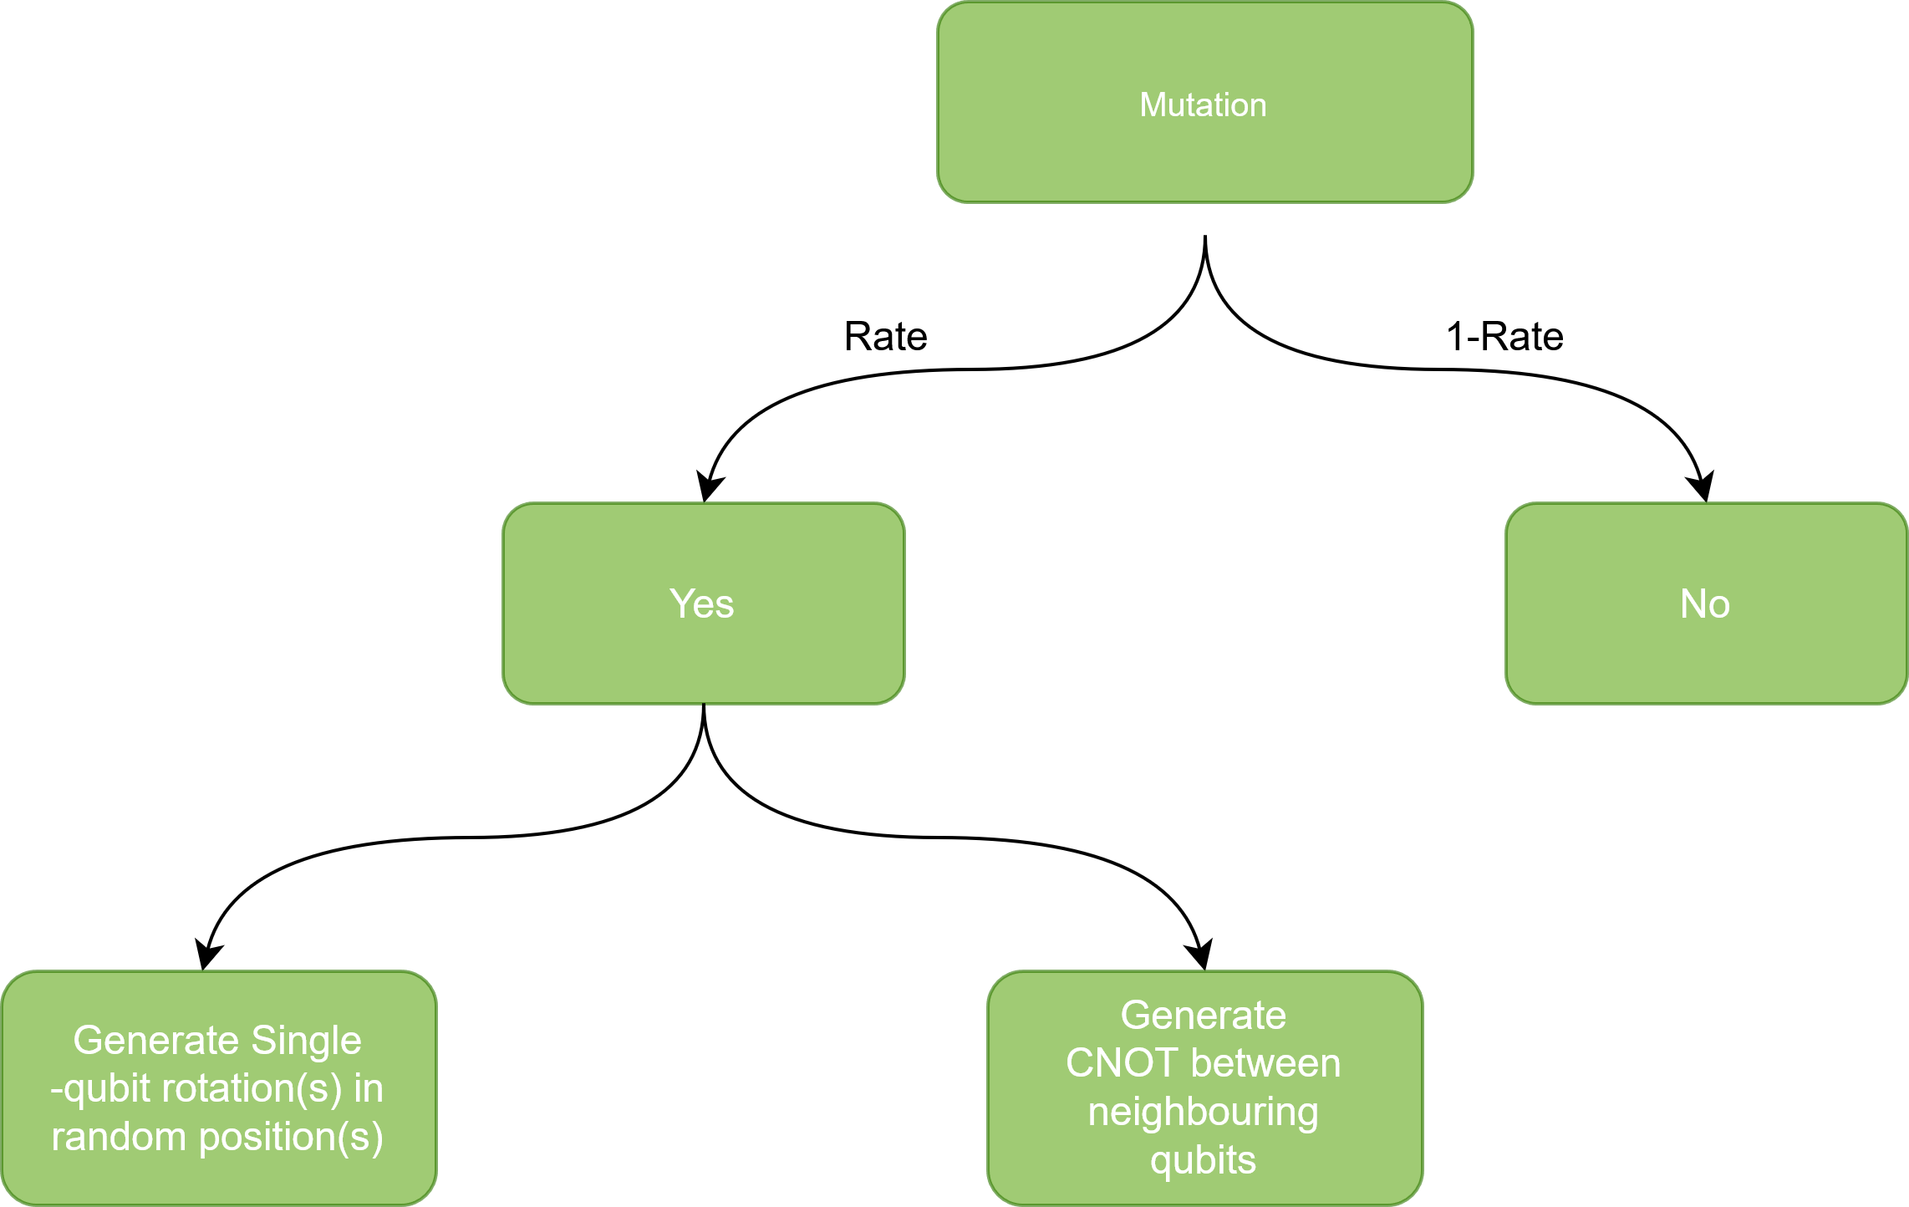
Code Implementation Mutations
AI for Physicists (AP3751)
GA for Quantum Circuits
27 June 2025
31

Slide 31
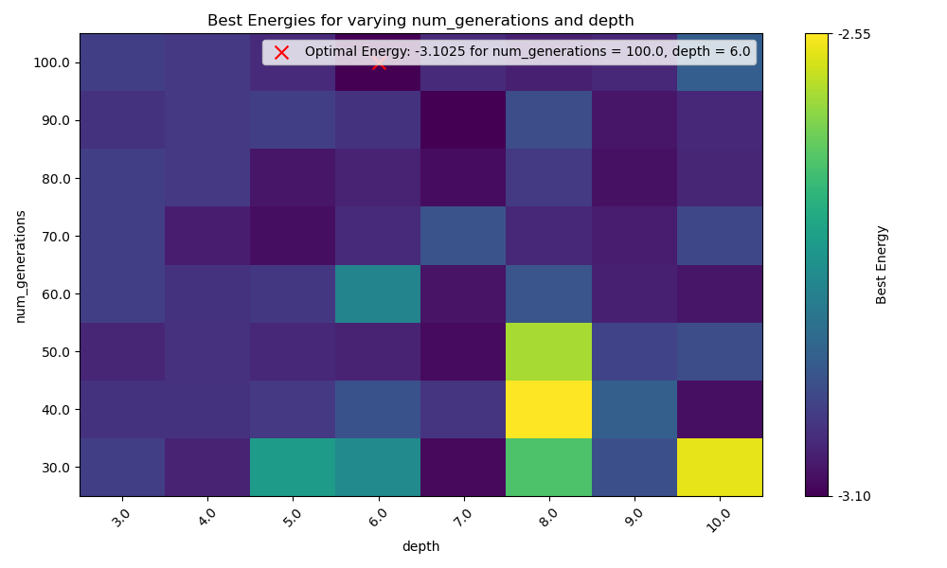
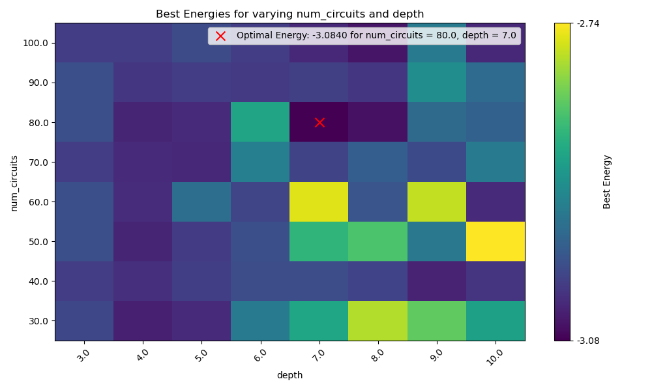
Code Implementation Hyperparameter optimisation
h=0.32
AI for Physicists (AP3751)
GA for Quantum Circuits
27 June 2025
32

Slide 32
Results
Can Evolutionary Algorithms be used to find ground state energies?
Can we replicate the phase transition of the transverse-field Ising Hamiltonian?
AI for Physicists (AP3751)
GA for Quantum Circuits
27 June 2025
33

Slide 33

Results
Can Evolutionary Algorithms be used to find ground state energies?
Recall:
$$H=−J\sum_{(i,j)∈E}{Z_{i}Z_{j}+h\sum_{i}{X_{i}}}$$
We measure (and optimise) energy $E= \left\langle Ψ|H|Ψ\right\rangle$ by changing gates rather than angles
AI for Physicists (AP3751)
GA for Quantum Circuits
27 June 2025
34

Slide 34
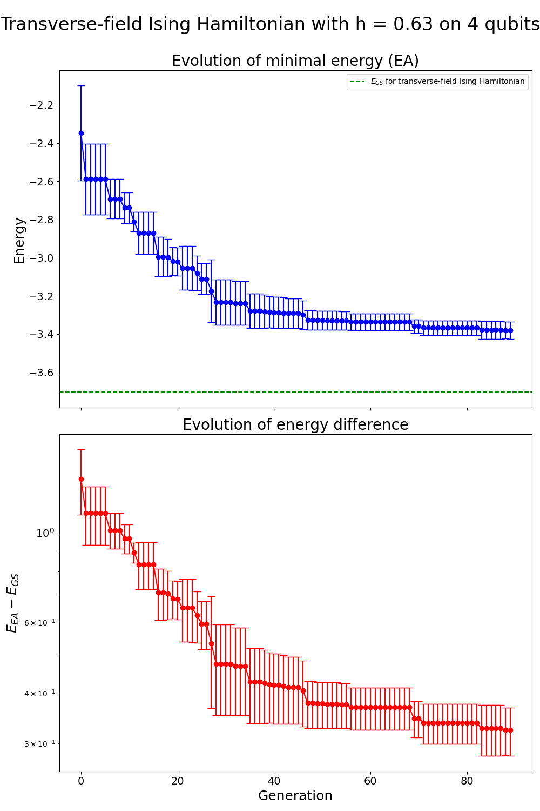
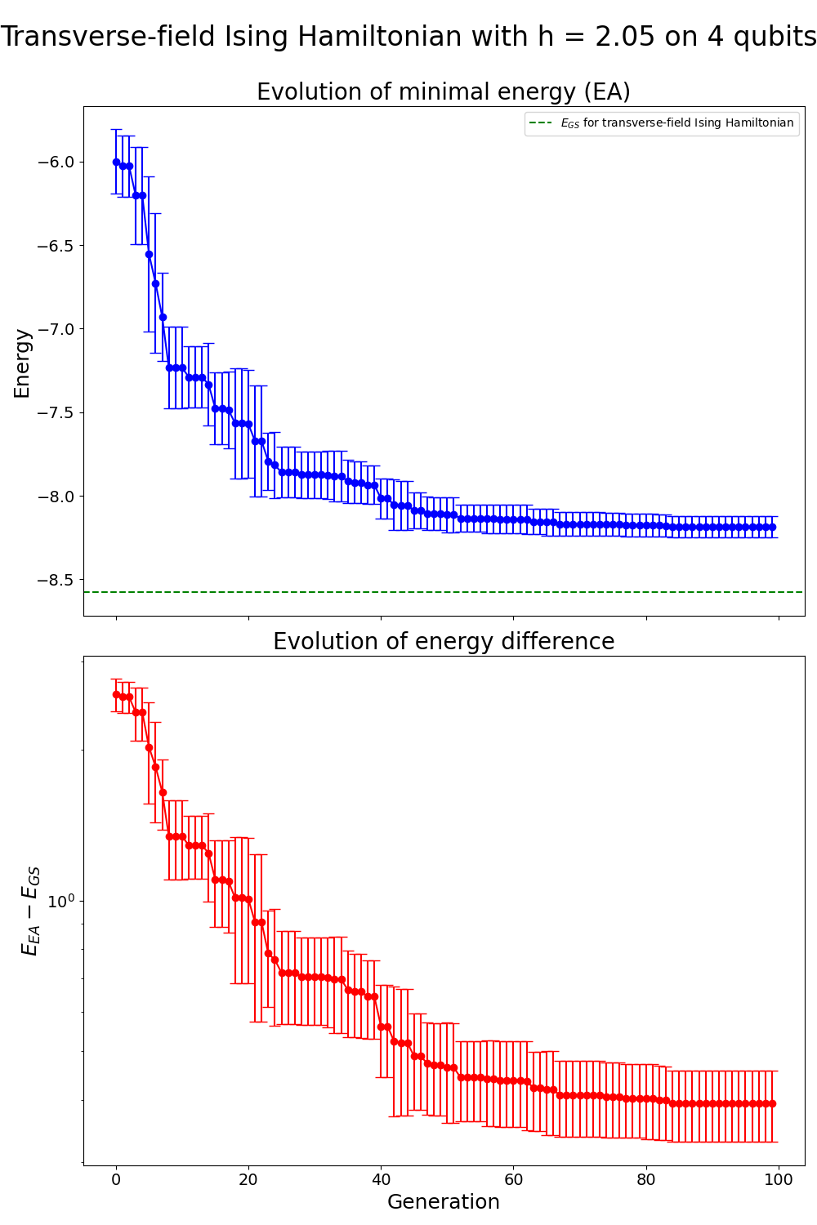
Can Evolutionary Algorithms be used to find ground state energies?
Results
Energy optimisation over GA generations for four qubits, averaged over five runs.
Left: result for $h=0.63$, Right: result for $h=2.05$
AI for Physicists (AP3751)
GA for Quantum Circuits
27 June 2025
35

Slide 35
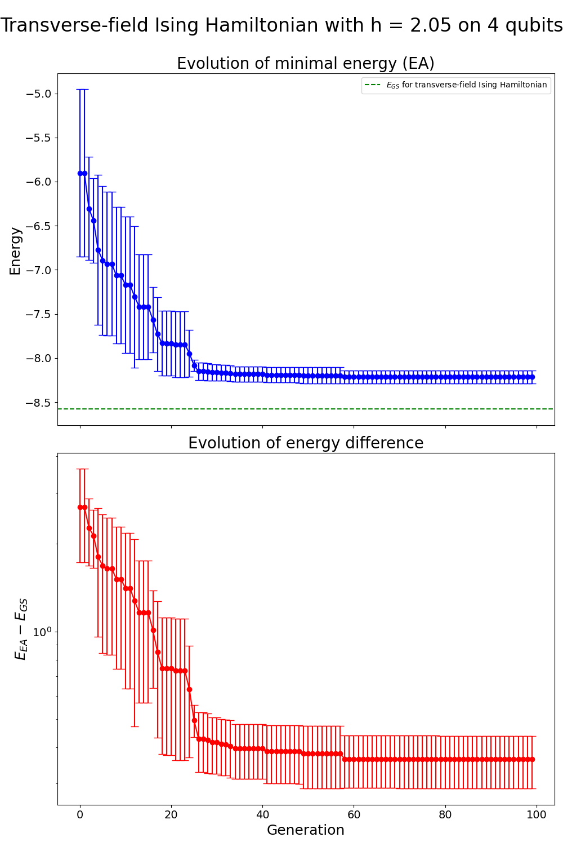

Results
Can Evolutionary Algorithms be used to find ground state energies?
Energy optimisation over GA generations (+VQE) for four qubits, averaged over five runs.
Right: result for $h=2.05$.
AI for Physicists (AP3751)
GA for Quantum Circuits
27 June 2025
36

Slide 36
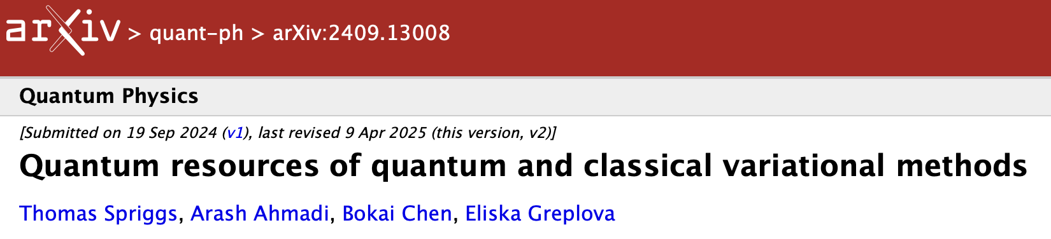
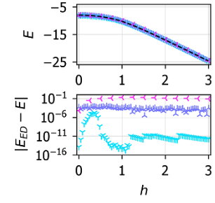
Can Evolutionary Algorithms be used to find ground state energies?
Results
Quantum resources of quantum and classical variational methods, Spriggs et al., 2024
AI for Physicists (AP3751)
GA for Quantum Circuits
27 June 2025
37

Slide 37
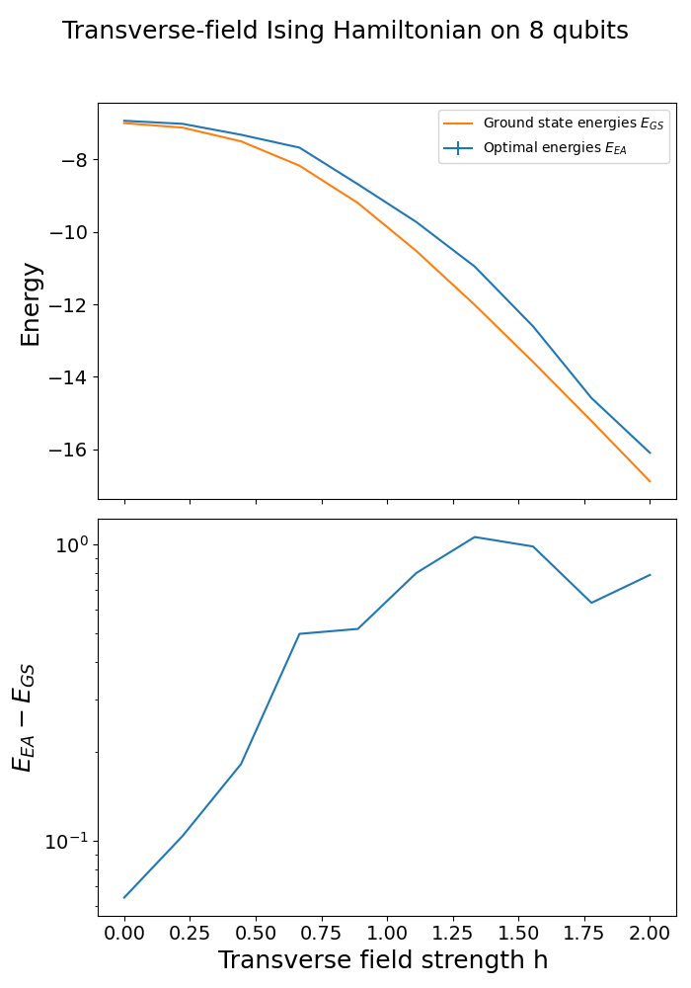
Results
Can Evolutionary Algorithms be used to find ground state energies?
Energy and energy difference to GS vs. transverse-field strength $h$.
Left: VQE result on eight qubits, Right: EA (+VQE) result on eight qubits.
AI for Physicists (AP3751)
GA for Quantum Circuits
27 June 2025
38

Slide 38

Results
Can Evolutionary Algorithms be used to find ground state energies?
Yes, either as a stand-alone approach or as ansatz for VQE optimisation.
Can we replicate the phase transition of the transverse-field Ising Hamiltonian?
AI for Physicists (AP3751)
GA for Quantum Circuits
27 June 2025
39

Slide 39
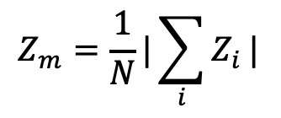
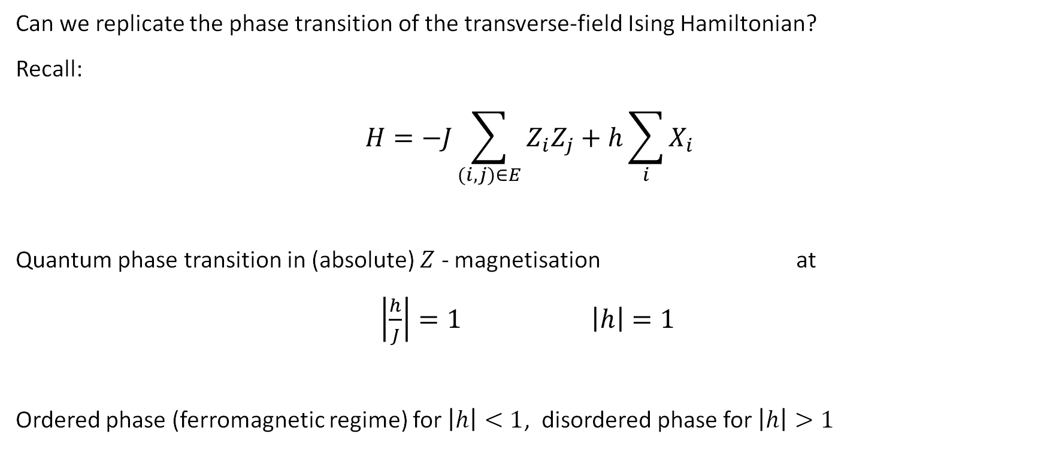
Results
Can we replicate the phase transition of the transverse-field Ising Hamiltonian?
Recall:
$$H=−J\sum_{(i,j)∈E}{Z_{i}Z_{j}+h\sum_{i}{X_{i}}}$$
Quantum phase transition in (absolute) $Z$ - magnetisation at
$\left|\frac{h}{J}\right|=1$ $\left|h\right|=1$
Ordered phase (ferromagnetic regime) for $\left|h\right|<1$, disordered phase for$\left|h\right|>1$
AI for Physicists (AP3751)
GA for Quantum Circuits
27 June 2025
40

Slide 40
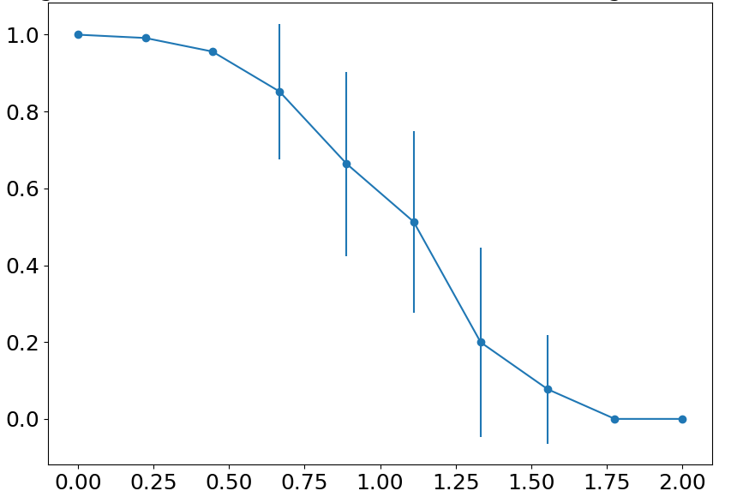
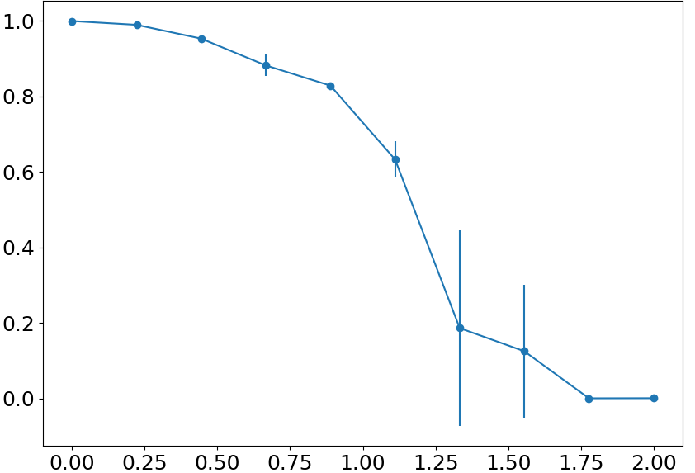
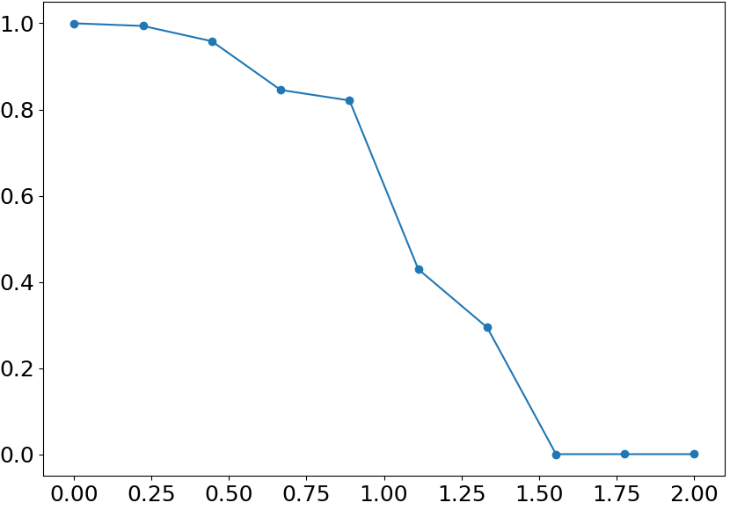










Results – Phase Transition
Can we replicate the phase transition of the transverse-field Ising Hamiltonian?
Quantum phase transition in $Z_{m}$at $\left|h\right|=1$:
$Z_{m}$ vs. $h,$five qubits
$Z_{m}$ vs. $h,$six qubits
$Z_{m}$ vs. $h,$eight qubits
$$Z_{m}$$
$$Z_{m}$$
$$Z_{m}$$
$$h$$
$$h$$
$$h$$
Absolute $Z$-magnetisation vs. transverse-field strength $h$ for various system sizes.
All results incl. VQE optimisation, and are averaged over 25, three and one run, respectively.
AI for Physicists (AP3751)
GA for Quantum Circuits
27 June 2025
41

Slide 41
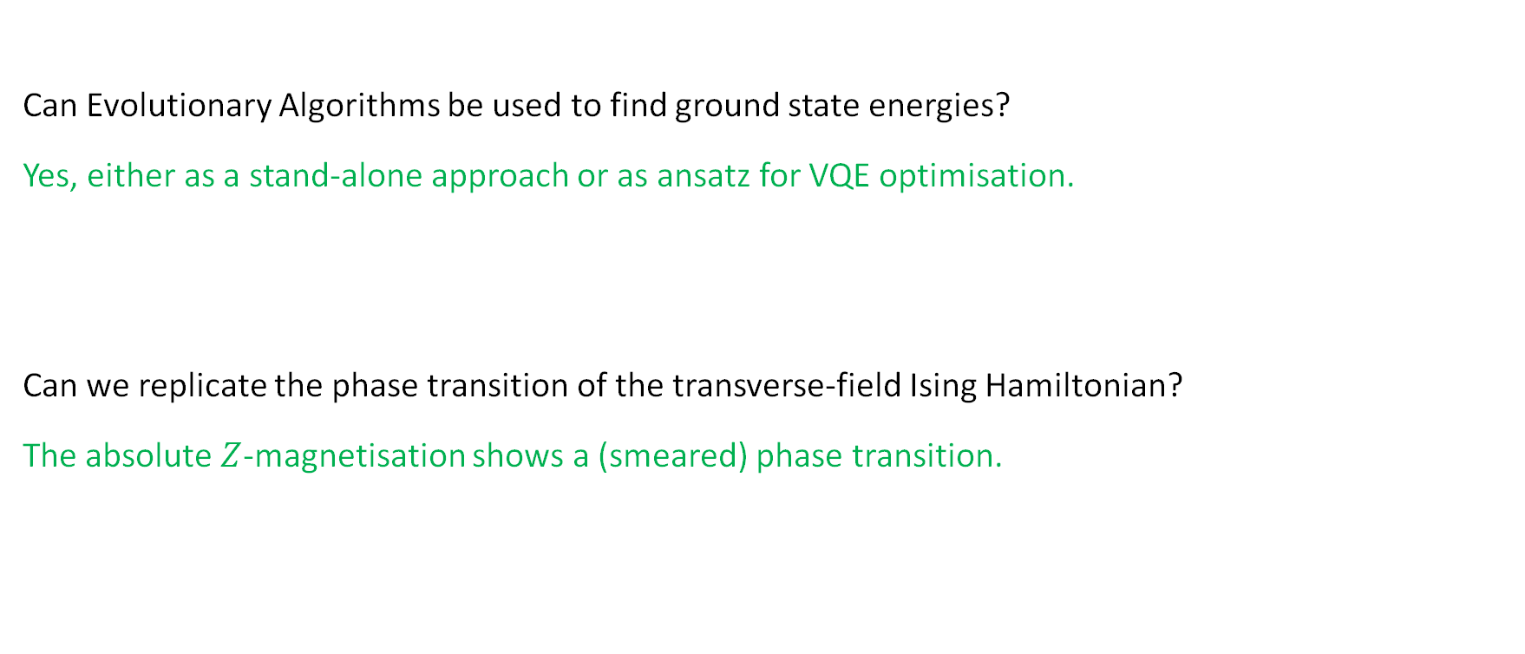
Results
Can Evolutionary Algorithms be used to find ground state energies?
Yes, either as a stand-alone approach or as ansatz for VQE optimisation.
Can we replicate the phase transition of the transverse-field Ising Hamiltonian?
The absolute $Z$-magnetisation shows a (smeared) phase transition.
AI for Physicists (AP3751)
GA for Quantum Circuits
27 June 2025
42

Slide 42
Conclusion
Evolution-inspired principles of selection, crossover and mutation are applicable finding ground state energies and identifying phase transitions
Genetic Algorithms rely on Exploration (mutation) vs. Exploitation (selection) trade-off to optimize gates rather than angles
GAs can act as an ansatz for VQE optimisation
AI for Physicists (AP3751)
GA for Quantum Circuits
27 June 2025
43

Slide 43
Limitations & Future Work
Inherently probabilistic approach, no convergence guarantees
Noise-free setting (but handling of sampling uncertainty)
(Over-)Reliance on fixed set of angles; could be alleviated by weight-agnostic* models
Abundance of hyperparameters to investigate (also with respect to scaling)
Scalable approach due to gradient-free design (?)
* cf. Weight Agnostic Neural Networks, Gaier and Ha, 2019
AI for Physicists (AP3751)
GA for Quantum Circuits
27 June 2025
44

Slide 44
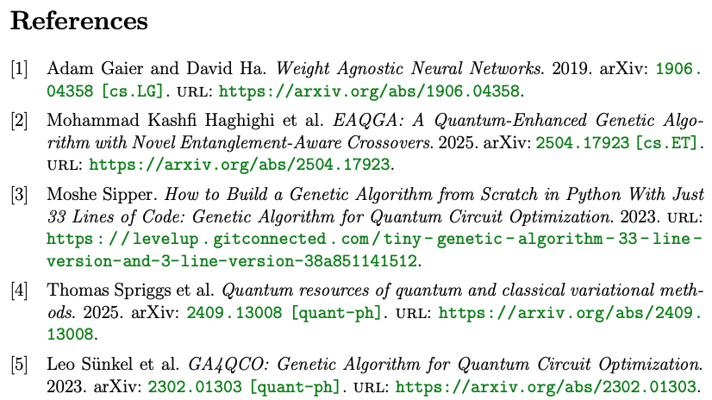
AI for Physicists (AP3751)
GA for Quantum Circuits
27 June 2025
45

Slide 45
Genetic Algorithms for Quantum Circuits
By Arturo, Badr, Cesar, Lukas and Tim

Slide 46
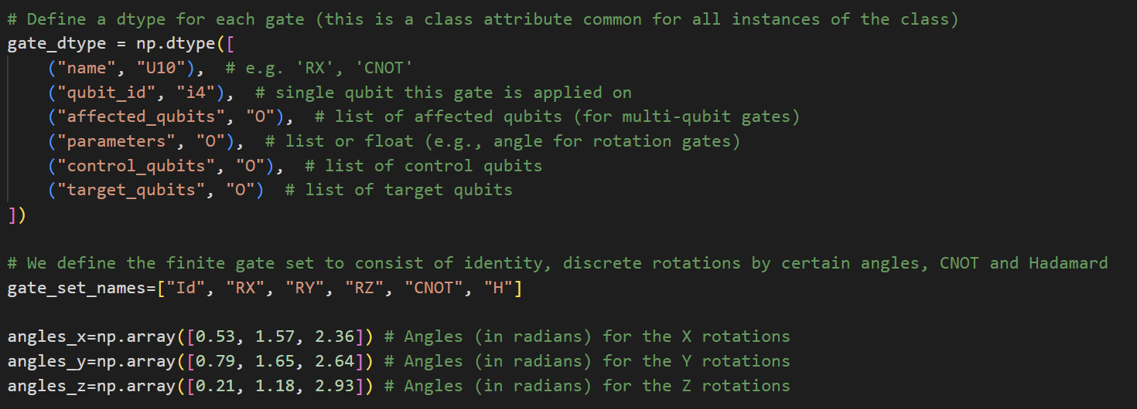
Appendix: Code Implementation Gate encoding

Slide 47
Appendix: Code Implementation Mutations
With a certain probability (rate) a mutation is performed in each quantum circuit
A portion of them are made to mutate to a single-qubit gate:
If a CNOT is detected for the mutation, then the two qubits involved will be mutated to two (different) single-qubit gates
The other portion of these mutations will be to generate CNOTs
Take a random qubit and a random neighbour to generate a CNOT between them

Slide 48
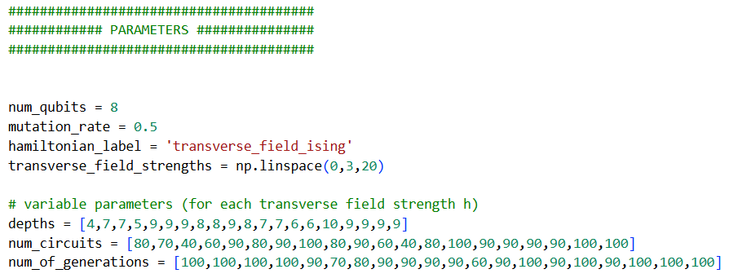
Appendix: Hyperparameters

Slide 49
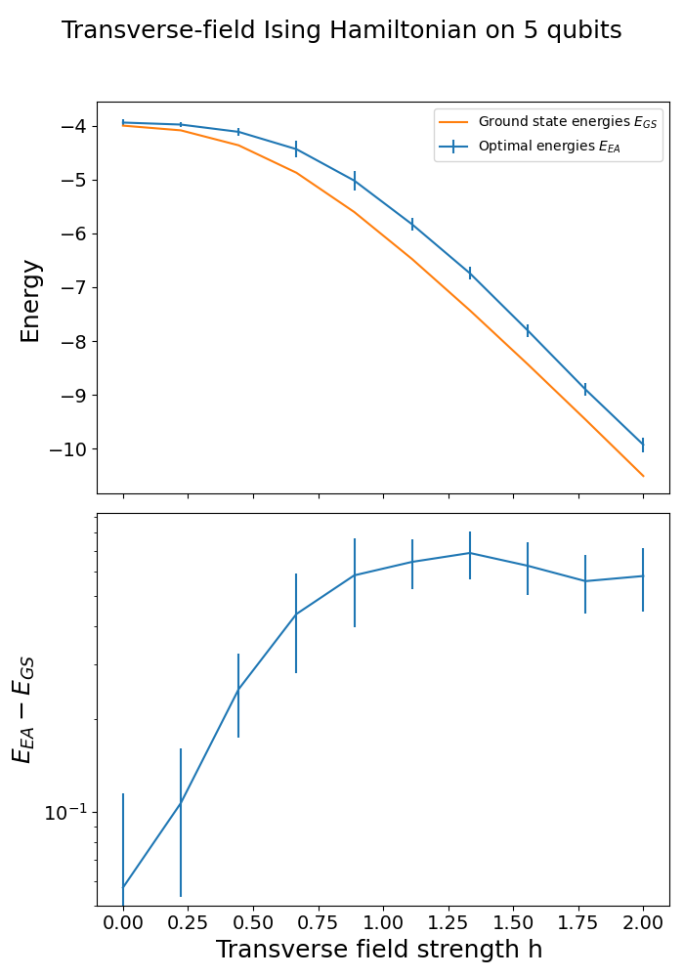

Results
Energy and energy difference to GS vs. transverse-field strength $h$.
EA + VQE result on five qubits over 25 iterations.

