Slide 1


Slide 2
What is Cyber Attack?
Cyber attacks are malicious Internet operations launched mostly by criminal organizations looking to steal money, financial data, intellectual property or simply disrupt the operations of a certain company, individual or organization.
Countries also get involved in so-called state-sponsored cyber attacks, where they seek to learn classified information on a geopolitical rival, or simply to “send a message”.
The global cost of cyber crime for 2015 was $500 billion (BOLD NUMBER).
Notes:
You must have heard it on the news: “Country X accuses country Y for launching a cyber attack against its infrastructure” or “Huge leak at Corporation X, account information of millions of users leak”. Sometimes, you don’t even need to hear it on the news, but instead it is right there, plastered all over your computer screen: “Your information has been encrypted, and the only way to recover it is to pay us”.
Countries also get involved in so-called state-sponsored cyber attacks, where they seek to learn classified information on a geopolitical rival, or simply to “send a message”.
That’s 5 times Google’s yearly cashflow of 90$ billion dollars.
And that number is set to grow tremendously, to around 2 trillion dollars by 2019.
I want to explore the types of attacks used by cybercriminals to drive up such a huge figure, and also help you understand how they work and affect you.

Slide 3
Scraped the Hack out of me
Website: www.hackmageddon.com
Tools: Scrapy
Scraped almost entire website!

Slide 4
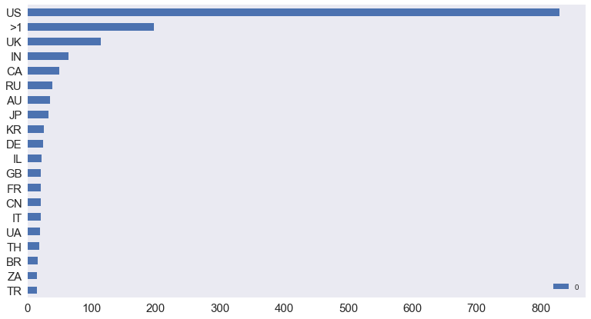
Attack Targets: Distribution By Country
US is the most attacked country.

Slide 5
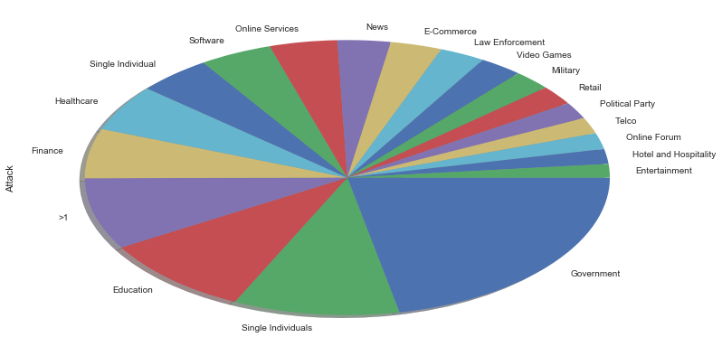
Attack Targets: Distribution by Organization Types
Government and single individuals are on top of the attackers’ preferences.
Notes:
Government: I leaked this information, pay us.
Single individual: its easy to target individual instead of organisation.

Slide 6
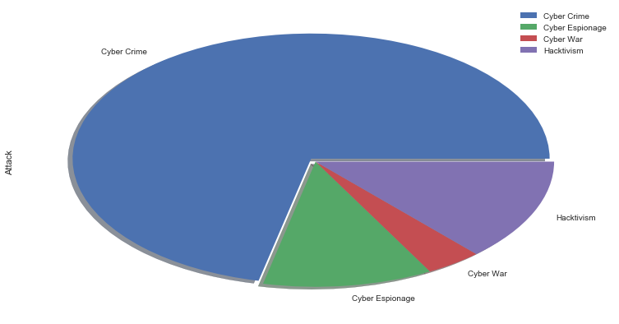
Motivation Behind Attacks
Cyber Crime leads the Motivations chart.
Notes:
Cyber crime: Crimes that use computer networks or devices
Cyber espionage: gain illicit access to confidential information, typically that held by a government or other organization.
Cyber war: use of computer technology to disrupt the activities of a state or organization
Hacktivism: the act of hacking, or breaking into a computer system, for a politically or socially motivated purpose.

Slide 7
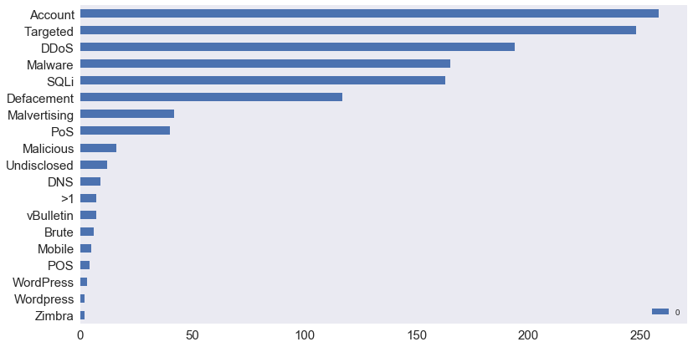
Attack Techniques
Account Hijackings and Targeted attacks rank on top of the Attack Vectors.

Slide 8
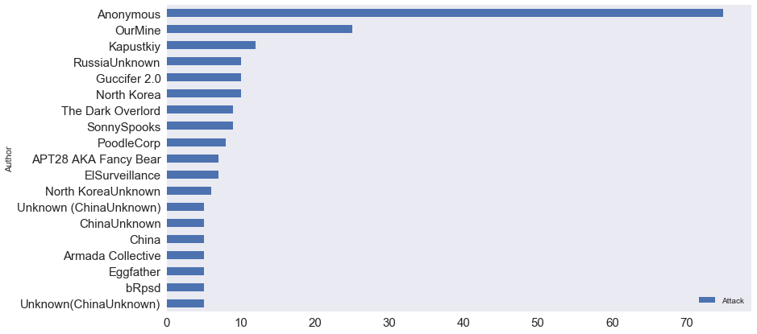
Notorious Hackers
Anonymous leads the hacking race with more then 75 attacks followed by OurMine.
Notes:
Anonymous: they also called digital robin hood. In 2012, Time called Anonymous one of the "100 most influential people" in the world.
Ourmine: hacking group mostly target celebrity. they hacked the Twitter accounts of Wikipedia co-founder Jimmy Wales,^{[5]} Pokémon Go creator John Hanke,^{[6][7]}Twitter co-founder Jack Dorsey,^{[8]} Google CEO Sundar Pichai,^{[9]} and Facebook co-founder Mark Zuckerberg.

Slide 9
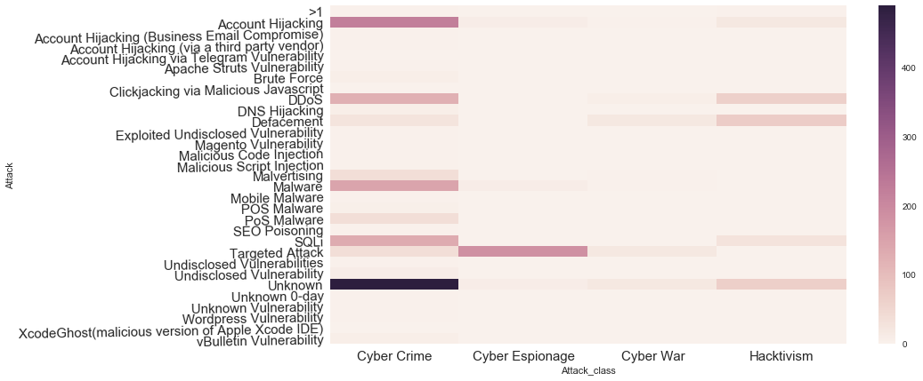
Attacks: Motivation and Techniques
According to the heat map, cyber crime class using Unknown technique has maximum number of attacks followed by Account Hijacking technique with Cyber Crime.

Slide 10
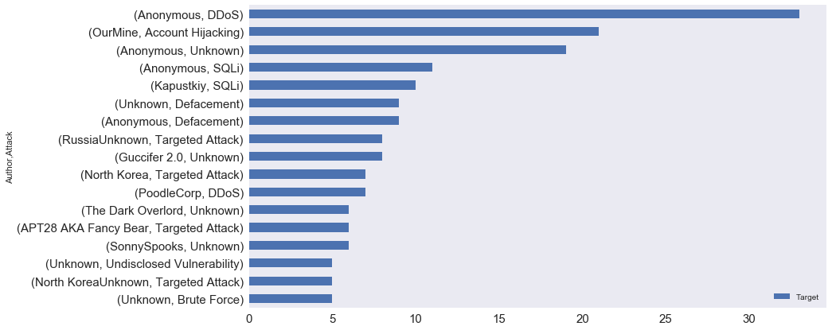
Cyber Attacks by Hackers and Techniques
Anonymous did more then 30 attacks with DDoS.

Slide 11
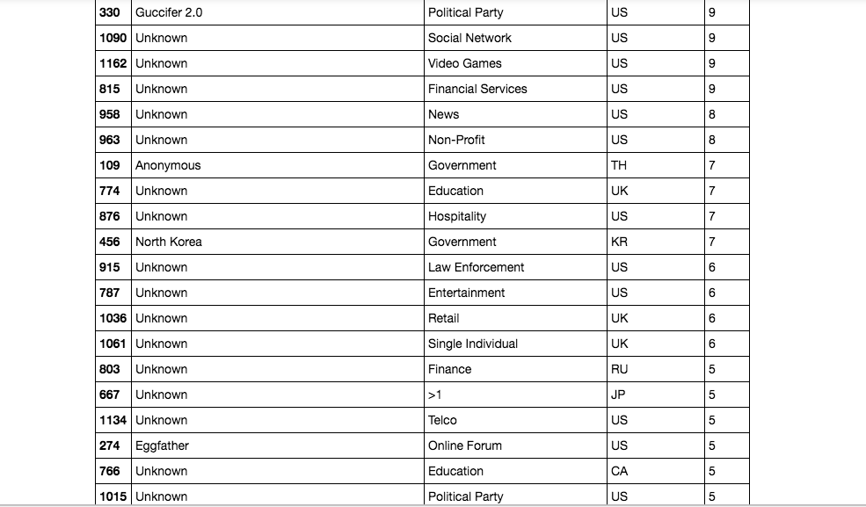
Cyber Attacks by Hackers, Organization and Country
Notes:
North korea mostly attacks south korea.
Eggfather targets online forums and dumps username and passwords.

Slide 12
Natural Language Processing
Tokenizing
TF-IDF Vectorizer
Cosine Similarity
Multidimensional Scaling
K-means Clustering

Slide 13
Summary
Most attacked organization: Government
Guccifer 2.0 was involved with 2016 United States presidential election.
“Anonymous” performed most number of attacks.
Account Hijacking is most common technique used by hackers.

Slide 14
Reference
www.hackmageddon.com
https://en.wikipedia.org/wiki/Anonymous_(group)
https://datasciencelab.wordpress.com/2013/12/12/clustering-with-k-means-in-python/
http://blog.christianperone.com/2011/09/machine-learning-text-feature-extraction-tf-idf-part-i/

