Slide 1

An Open Source Graphing Library

Slide 2
Agenda
What is Plotly ?
What is Plotly used for?
Features
Demo
Things to consider

Slide 3
What is Plotly
Advanced data visulization
Features interactive elements
Web based visulization

Slide 4

What is it used for ?
Data Visulization in different Fields
Data Analysis
Maschine Learing
Bussines Intelligence

Slide 5
Little Introduction
Numpy
Better array implementation
More functions for arrays
Pandas
- New datastructure known as Dataframes
- Esay data manipulation

Slide 6
Framework Structure
Express
Graph Objects
Traces
Figures
Notes:
Manually with below three
Automatic with top one

Slide 7
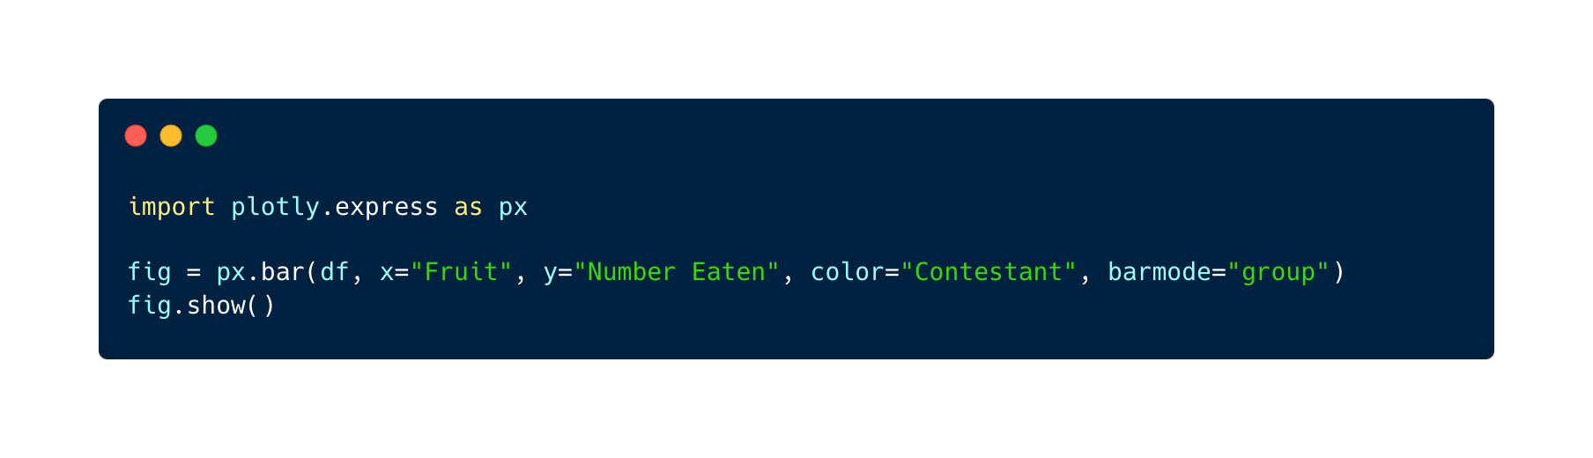
Figures
The most basic component
It contains all information on the layout, data and styling instrcutions
Notes:
Always some interactive options
Get shown on a localhost server created by plotly
High customizablitly

Slide 8
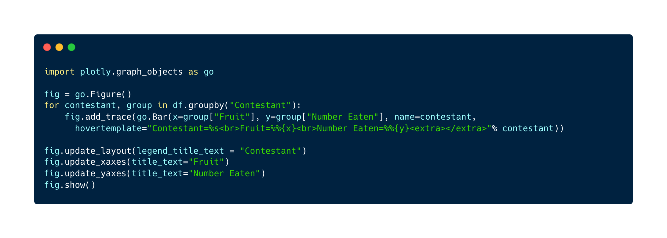
Trace
Single dataset that gets visulazied
Only used for very specific use cases
Notes:
Is the bare bone and a bit more customizable (generally not needed)
You put traces in a figure (like paper)

Slide 9
Interactive Elements
Very tideous to implement
Better alternative: Dash
Notes:
For more interactive controlls
Provides a nicer user interface because of bootstrap
Provides feauters such as url paths and other web based necessitiys

Slide 10
Dash
Bootstrap Components
Multi-Page Applications
Callbacks
Declerative Syntax
Notes:
Esay to work with
Through bootstrap makes it esair for create good looking uis

Slide 11
Subplots
Put multiple traces in one figure
Define size of each trace individually
Notes:
- You can put ultiple traces into one figure
- It is similar structure to the grid component in bootstrap

Slide 12
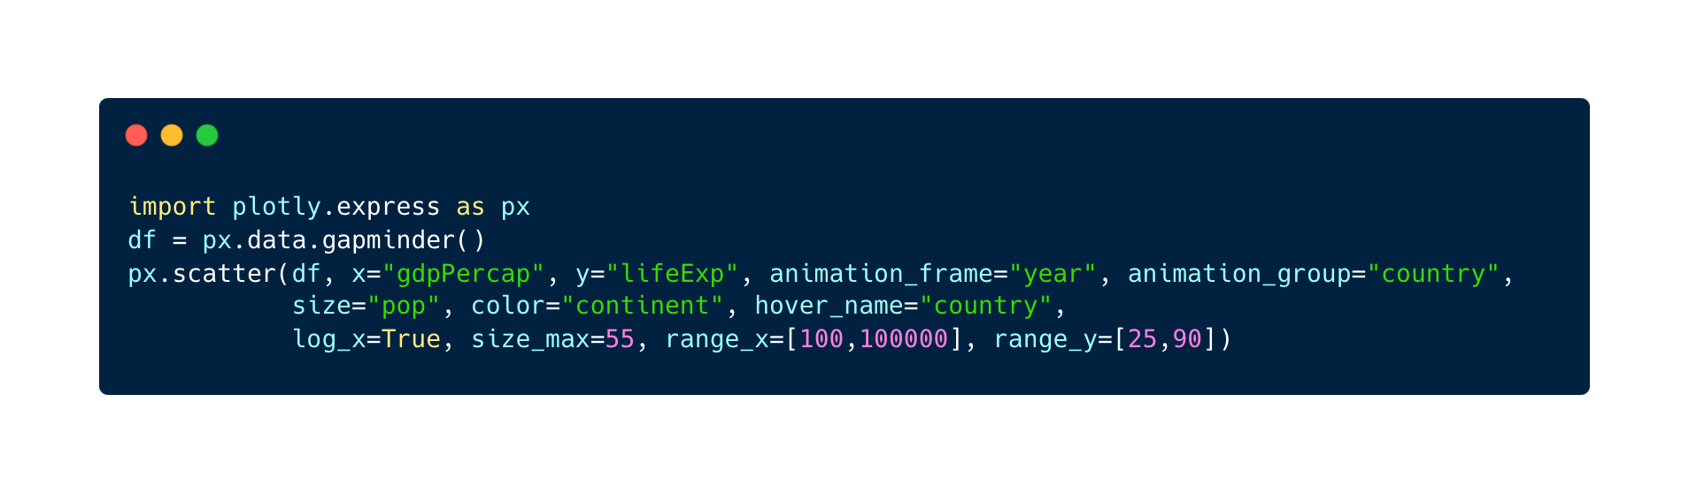
Animations
Esay to use animations
Very simple no advanced features
Notes:
Really simple !!!
-> Next: Demo

Slide 13
Demo Time

Slide 14
Things to consider
Performance is not the best espacially for large scale applications
Intergrates flawlessly with numpy and pandas
There are a to many graph and settings options
A lot of dependencys
Notes:
Performance: takes a lot of ressources espacially when interactive, render speed can be a problem with large datasets

