Slide 1

Clean Code
Weekly Meeting
September 2th, 2020

Slide 2

Work Plan | Requirements Elicitation & Data Gathering | Next Steps

Slide 3
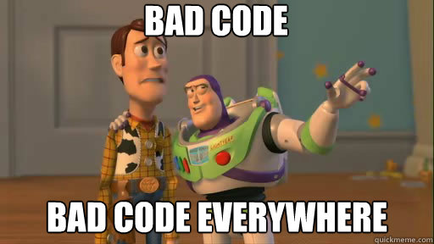
Clean Code
Constructing the simplest possible code that would solve your problem resulting in an increase in productivity by producing higher quality in less time.
Work Plan | Requirements Elicitation & Data Gathering | Next Steps

Slide 4
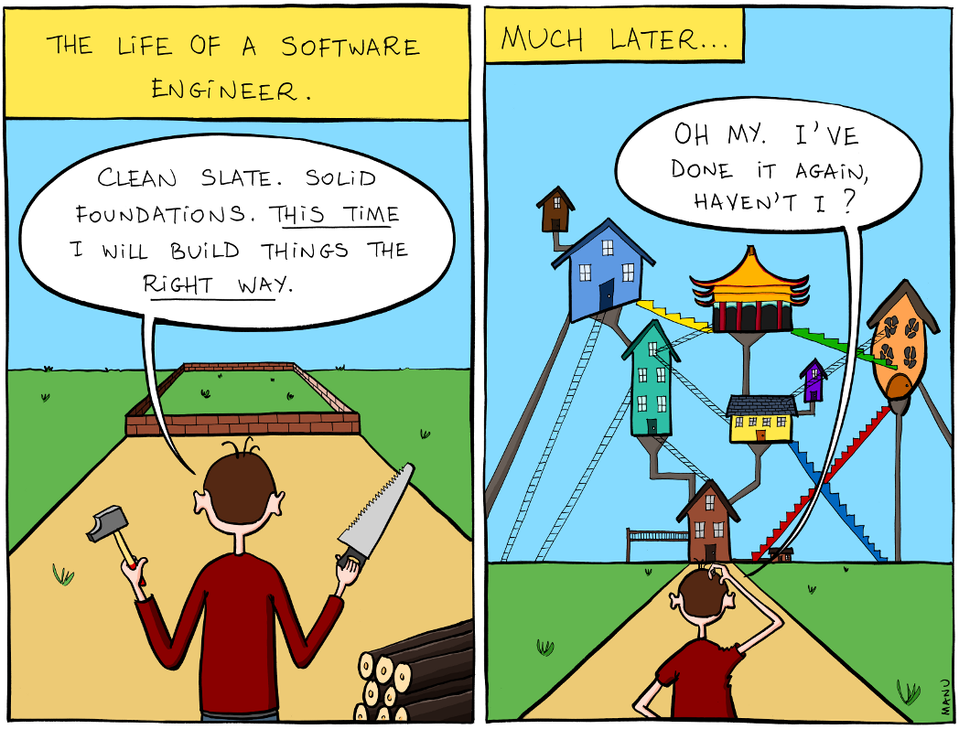
Usually building a software looks like this
Work Plan | Requirements Elicitation & Data Gathering | Next Steps

Slide 5
Why do we write bad code?
Work needed to be done fast
Tired of the same project/work
Requirements changed
Pushing managers
Work, for now, will clean up later
Work Plan | Requirements Elicitation & Data Gathering | Next Steps

Slide 6
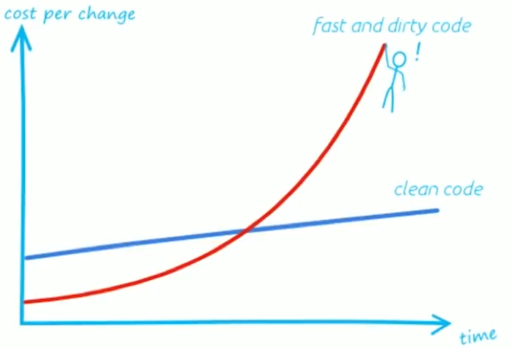
What are we actually doing
Work Plan | Requirements Elicitation & Data Gathering | Next Steps

Slide 7
Benefits in clean code
Problems become easier to solve since code is modular.
Less time is wasted on maintenance since lines of code are less.
Ideas are more clearly communicated.
Unit Test cases are much smaller and easier to write.
Making changes is much faster.
Pleasing to your eyes 👀.
Work Plan | Requirements Elicitation & Data Gathering | Next Steps

Slide 8
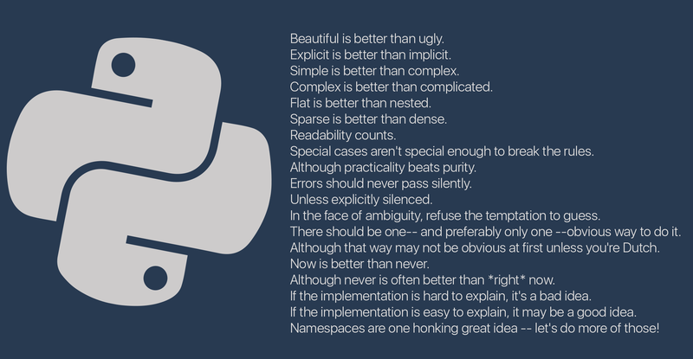
The Zen of Python
19 guiding principles for Python design
Work Plan | Requirements Elicitation & Data Gathering | Next Steps

Slide 9
1. Cohesion
It is the degree to which the elements of a certain module belong together.
It is a measure of how strongly related each piece of functionality expressed by the source code of a software module.
A good software has High Cohesion
Work Plan | Requirements Elicitation & Data Gathering | Next Steps

Slide 10
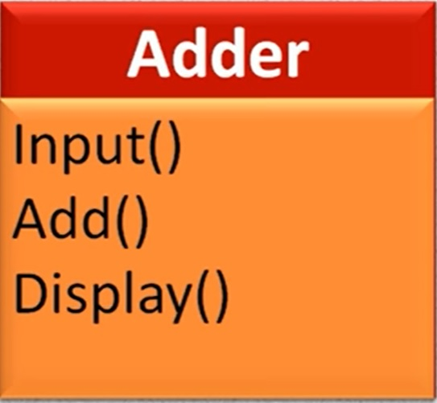
Low Cohesion
Complex system.
Hard to understand to other developers
Low maintainability
Low reusability
Wrong Approach
Work Plan | Requirements Elicitation & Data Gathering | Next Steps

Slide 11
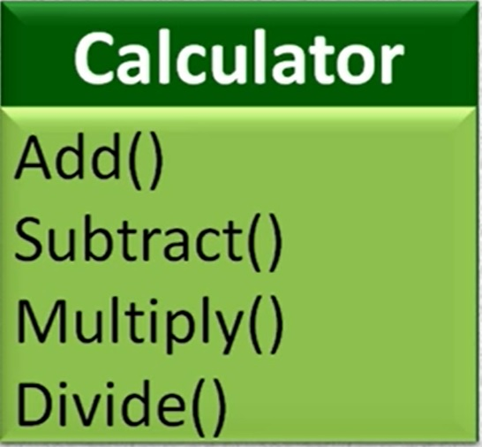
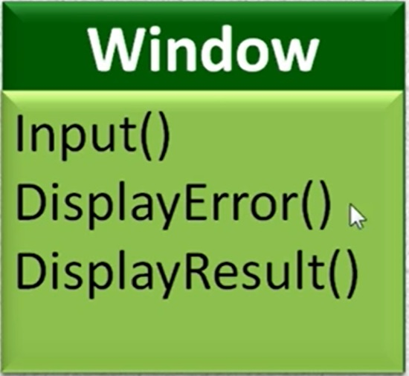
Good Cohesion
A good software has high cohesion
High cohesion means more robustness and reliability
Smaller and simpler modules
Higher reusability
More readability
Work Plan | Requirements Elicitation & Data Gathering | Next Steps

Slide 12
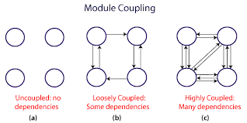
2. Coupling
It is the degree of interdependence between the modules.
If the dependencies are more then it is considered as tightly coupled and if the dependencies are less then it is considered as loosely coupled.
Work Plan | Requirements Elicitation & Data Gathering | Next Steps

Slide 13
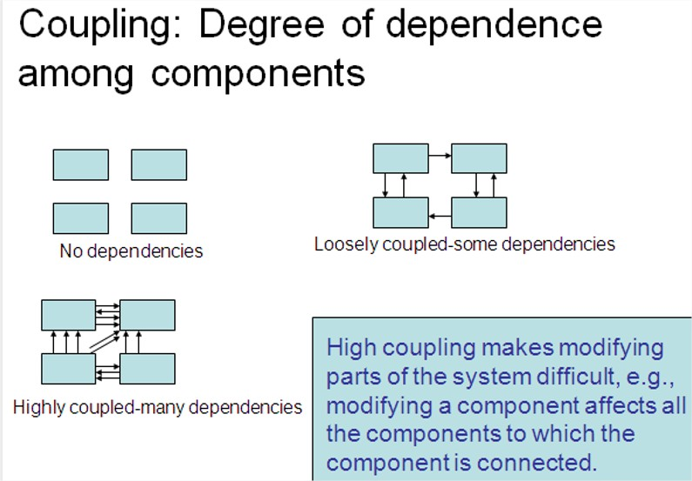
Work Plan | Requirements Elicitation & Data Gathering | Next Steps

Slide 14
Coupling Problems
Software programs with low cohesion typically have high coupling.
Tightly coupled modules suppresses reusability
Bad coupling reduces maintainability of the application
Is considered bad practice to write tightly coupled applications and modules.
Good software has low coupling.
Work Plan | Requirements Elicitation & Data Gathering | Next Steps

Slide 15
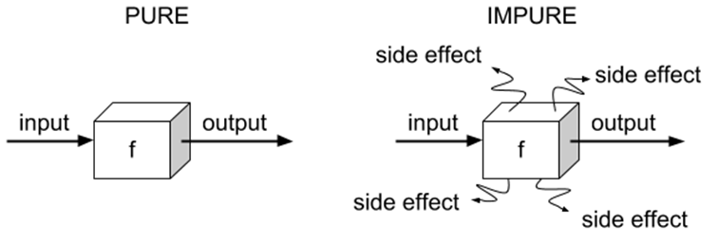
3. Pure vs Impure Functions
Work Plan | Requirements Elicitation & Data Gathering | Next Steps

Slide 16
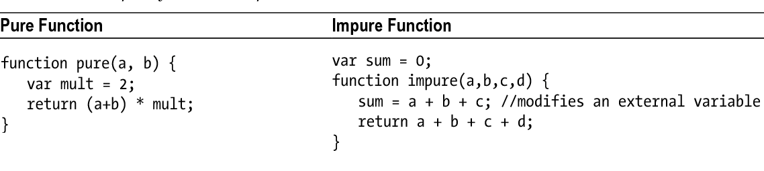
Pure vs Impure Functions example
Work Plan | Requirements Elicitation & Data Gathering | Next Steps

Slide 17
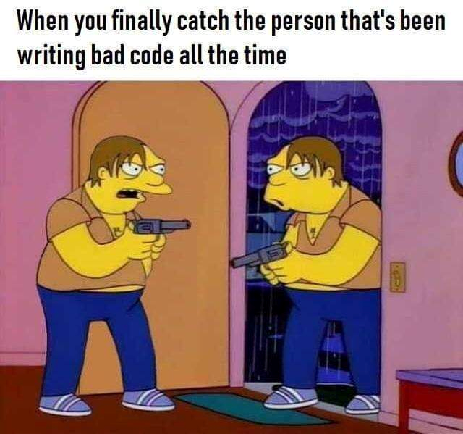
Work Plan | Requirements Elicitation & Data Gathering | Next Steps

