Slide 1


Building a data warehouse with Pentaho and Docker
OPEN DATA CASE STUDY: CENIPA - AERONAUTICAL ACCIDENT INVESTIGATION AND PREVENTION CENTER
http://dados.gov.br/dataset/ocorrencias-aeronauticas-da-aviacao-civil-brasileira
Sources
https://github.com/wmarinho/edw_cenipa
Wellington Marinho
wpmarinho@globo.com

Slide 2














Architecture
Data Sources
GitHub
Docker Hub
BI SERVER / PDI
BI SERVER
docker-pentaho
( Dockerfile / scripts )
pentaho-biserver:5.4
( imagem)
ETL
Amazon EC2
PDI
PROJETO EDW
PDI
Amazon RDS
Postgresql / Redshift
edw-cenipa
( Dockerfile / scripts )
pentaho-kettle:5.4
( imagem)
Jenkins + Docker Compose
Amazon EC2
BI SERVER

Slide 3
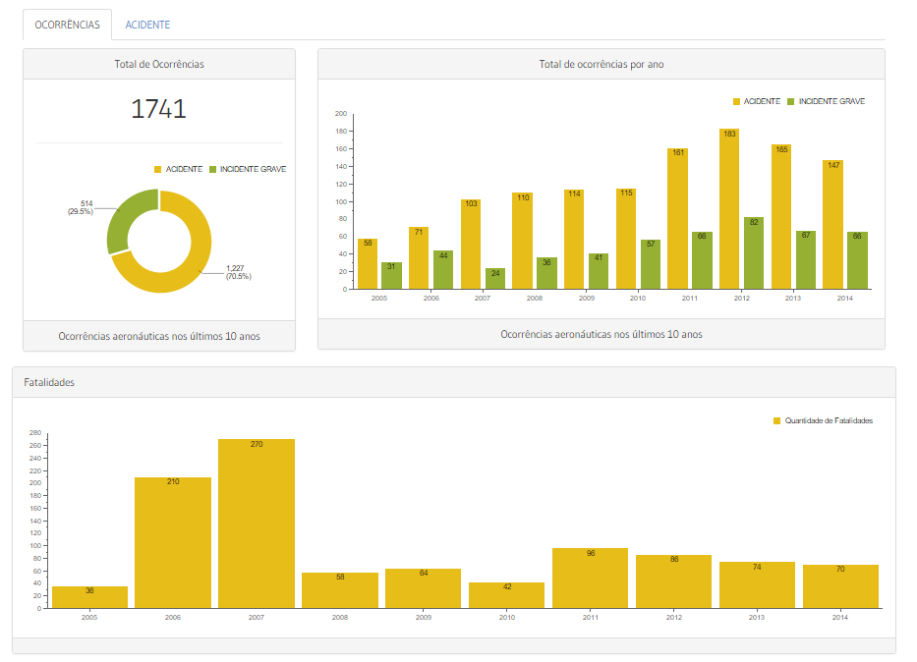
Dashboards – Aeronautical Accident & Incident
http://localhost/pentaho/plugin/cenipa/api/ocorrencias

Slide 4
Business Analytics
User
Development
Dimensional Modeling
OLAP
Visualization
Requirements Analysis
Business Requirements
Knowledge
Data
Information

Slide 5
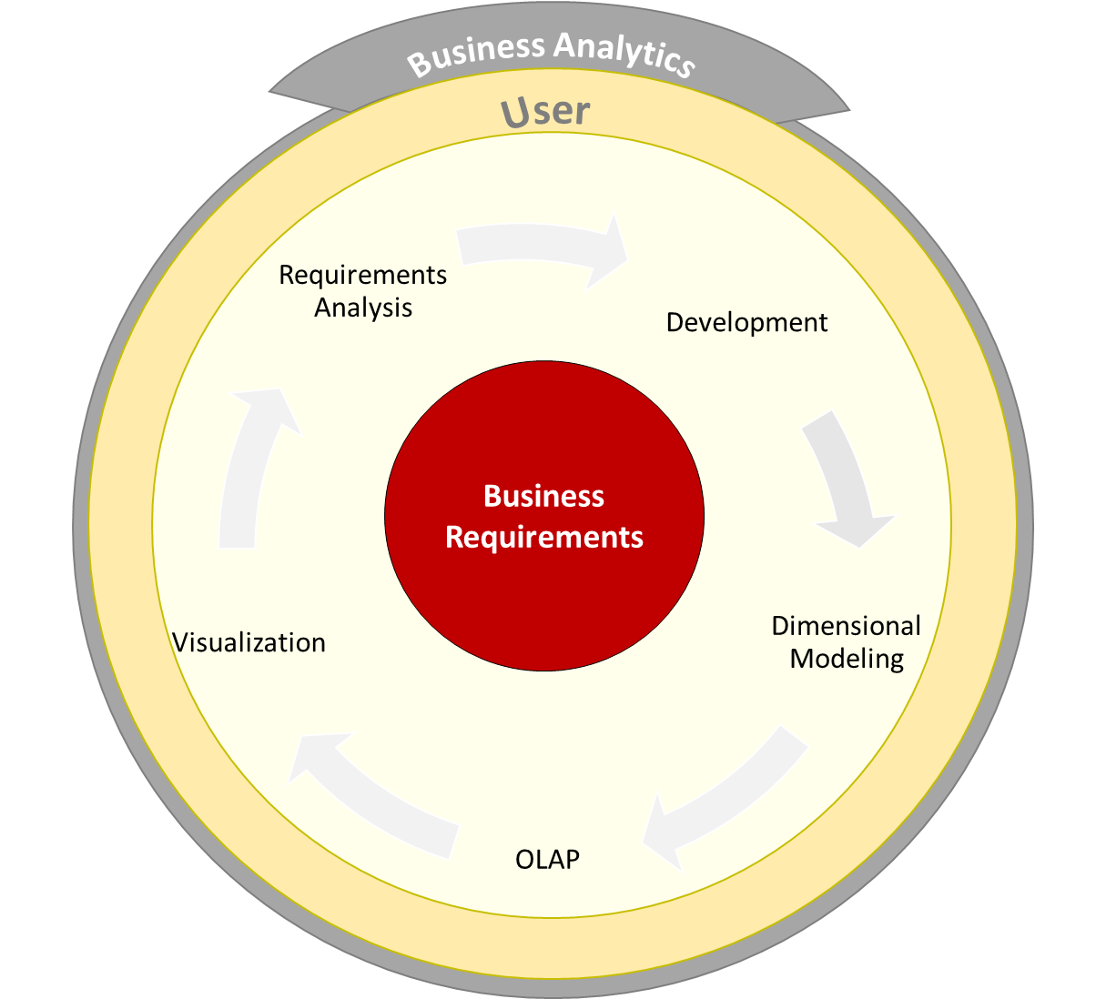
Business Analytics

Slide 6

CASE STUDY- EDW CENIPA
EDW CENIPA is a opensource project designed to enable analysis of aeronautical incidentes that occured in the brazilian civil aviation. The project uses techniques and BI tools that explore innovative low-cost technologies. Historically, Business Intelligence platforms are expensive and impracticable for small projects. BI projects require specialized skills and high development costs. This work aims to break this barrier.
All analyzes are based on open data provided by CENIPA with historical events of the last 10 years :
http://dados.gov.br/dataset/ocorrencias-aeronauticas-da-aviacao-civil-brasileira
The graphics were inspired by the report available on the link:
http://www.cenipa.aer.mil.br/cenipa/index.php/estatisticas/estatisticas/panorama.

Slide 7



Tools
Here are some resources, tools and platforms that were used to develop and deploy the project
Amazon Web Services - https://aws.amazon.com/
Linux Operating System - CentOS 6 / Ubuntu 14
GitHub - https://github.com/ - Powerful collaboration, code review, and code management for open source and private projects
Docker - https://www.docker.com/ - An open platform for distributed applications for developers and sysadmins.
Pentaho - http://www.pentaho.com/ e http://community.pentaho.com/ - Big data integration and analytics solutions.

Slide 8
Requirements
Linux Operating System 4GB RAM and 10GB available hard disk space
Docker v1.7.1
CentOS: https://docs.docker.com/installation/centos/
Ubuntu: https://docs.docker.com/installation/ubuntulinux/
Mac : https://docs.docker.com/installation/mac/
Docker Compose v1.4.2 - https://docs.docker.com/compose/install/
Fast deployment on Amazon Linux AMI
$ yum update -y
$ yum install -y docker
$ service docker start
$ usermod -a -G docker ec2-user
$ yum install -y git
$ pip install -U docker-compose
$ PATH=$PATH:/usr/local/bin

Slide 9
Comandos básicos
$ docker info
$ docker --help
$ docker COMMAND --help
$ docker run --rm -it busybox echo "Olá, esse é meu primeiro container“
$ docker ps
$ docker images
$ docker build –t repositorio/imagem:tag .
Criar um arquivo Dockerfile
FROM busybox
CMD ["echo", "Olá, esse é meu primeiro container"]
Construir umaa imagem
$ docker build -t teste/myimage .
Criar um container
$ docker run --rm teste/myimage

Slide 10
Pentaho + Docker – Building an image from a Dockerfile
FROM java:7
MAINTAINER Wellington Marinho wpmarinho@globo.com
# Init ENV
ENV BISERVER_VERSION 5.4
ENV BISERVER_TAG 5.4.0.1-130
ENV PENTAHO_HOME /opt/pentaho
# Apply JAVA_HOME
RUN . /etc/environment
ENV PENTAHO_JAVA_HOME $JAVA_HOME
ENV PENTAHO_JAVA_HOME /usr/lib/jvm/java-1.7.0-openjdk-amd64
ENV JAVA_HOME /usr/lib/jvm/java-1.7.0-openjdk-amd64
# Install Dependences
RUN apt-get update; apt-get install zip -y; \
apt-get install wget unzip git -y; \
apt-get clean && rm -rf /var/lib/apt/lists/* /tmp/* /var/tmp/*;
RUN mkdir ${PENTAHO_HOME};
# Download Pentaho BI Server
RUN /usr/bin/wget --progress=dot:giga http://downloads.sourceforge.net/project/pentaho/Business%20Intelligence%20Server/${BISERVER_VERSION}/biserver-ce-${BISERVER_TAG}.zip -O /tmp/biserver-ce-${BISERVER_TAG}.zip; \
/usr/bin/unzip -q /tmp/biserver-ce-${BISERVER_TAG}.zip -d $PENTAHO_HOME; \
rm -f /tmp/biserver-ce-${BISERVER_TAG}.zip $PENTAHO_HOME/biserver-ce/promptuser.sh; \
sed -i -e 's/\(exec ".*"\) start/\1 run/' $PENTAHO_HOME/biserver-ce/tomcat/bin/startup.sh; \
chmod +x $PENTAHO_HOME/biserver-ce/start-pentaho.sh
RUN useradd -s /bin/bash -d ${PENTAHO_HOME} pentaho; chown -R pentaho:pentaho ${PENTAHO_HOME};
#Always non-root user
USER pentaho
WORKDIR /opt/pentaho
EXPOSE 8080
CMD ["sh", "/opt/pentaho/biserver-ce/start-pentaho.sh"]

Slide 11
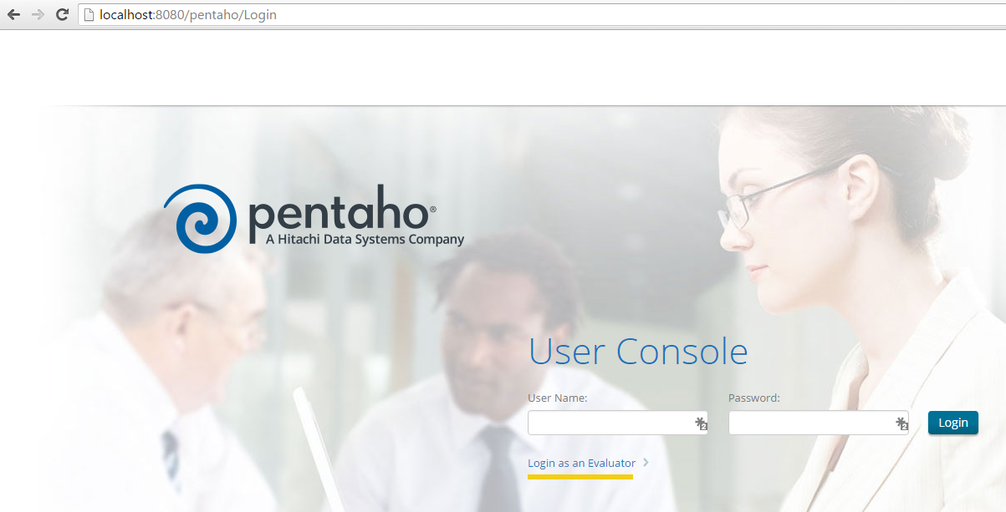
Pentaho BI Server
Building an image and runing docker container
$ docker build -t pentaho/biserver:5.4 .
$ docker run --rm -p 8080:8080 -it pentaho/biserver:5.4
Open Pentaho BI Server

Slide 12
Deploying Project
Deploying EDW CENIPA project
$ wget -O - https://raw.githubusercontent.com/wmarinho/edw_cenipa/master/easy_install | sh
Installation can take over 30 minutes , depending of server configuration and Internet bandwidth .
Check if containers are running
$ docker ps
The project has 3 containers :
edwcenipa_db_1 – PostgreSQL database container
edwcenipa_pdi_1 – Pentaho Data Integration container
edwcenipa_biserver_1 – Pentaho BI Server container
Check logs
$ docker logs -f edwcenipa_pdi_1
$ docker logs -f edwcenipa_biserver_1

Slide 13
Docker Compose
docker-composse.yml – Define and run all docker applications
pdi:
image: image_cenipa/pdi
links:
- biserver:edw_biserver
volumes:
- /data/stage:/tmp/stage
environment:
- PGHOST=172.17.42.1
- PGUSER=pgadmin
- PGPASSWORD=pgadmin.
- PENTAHO_DI_JAVA_OPTIONS=-Xmx2014m -XX:MaxPermSize=256m
biserver:
image: image_cenipa/biserver
ports:
- "80:8080"
links:
- db:edw_db
environment:
- PGUSER=pgadmin
- PGPASSWORD=pgadmin.
- INSTALL_PLUGIN=saiku
- CUSTOM_LAYOUT=y
db:
image: wmarinho/postgresql:9.3
ports:
- "5432:5432"

Slide 14
Pentaho + Docker + Amazon
With the following command and the appropriate credentials , you can run the project on Amazon Web Services. REMEMBER to replace the variables before running the command (check the parameters in the AWS console) .
$ SUBNET_ID=
$ SGROUP_IDS=
$ KEY_NAME=
$ aws ec2 run-instances \
--image-id ami-e3106686 \
--instance-type c4.large \
--subnet-id ${SUBNET_ID} \
--security-group-ids ${SGROUP_IDS} \
--key-name ${KEY_NAME} \
--associate-public-ip-address \
--user-data "https://raw.githubusercontent.com/wmarinho/edw_cenipa/master/aws/user-data.sh" \
--count 1

Slide 15
Thank you!
Thanks:
Marcelo Módolo – Globosat
Caio Moreno – IT4Biz
Fernando Maia – IT4Biz
Sources:
https://github.com/wmarinho/edw_cenipa
https://github.com/wmarinho/docker-pentaho
https://hub.docker.com/r/wmarinho/pentaho/

