Slide 1
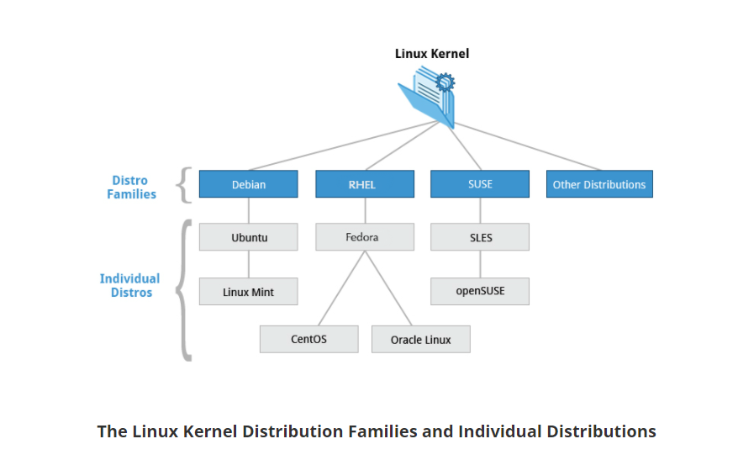

Slide 2
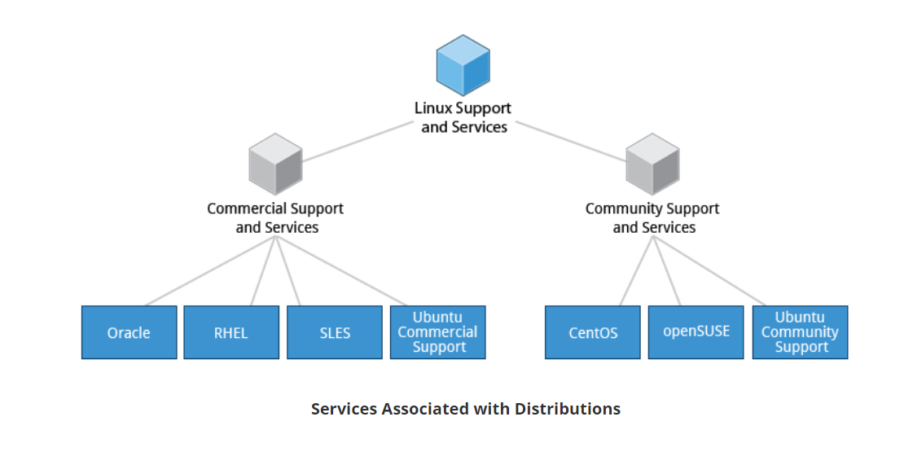

Slide 3
OpenSUSE
Linux Mint
PRO Extremely reliable
The packaging team is dependable resulting in system updates that come in a timely fashion and systems which rarely, if ever, break due to packaging. The versions of software that are selected and the configuration of them is typically extremely high quality.
PRO Easy installation and administration
openSUSE makes use of a GUI tool called YaST to install and setup an openSUSE system.
YaST is very easy to use and makes the process of installing and maintaining an openSUSE installation a breeze.
PRO One-Click install
Much better system then other distros for installing any package. It is as simple as clicking on one button and typing in your password. Adds a repo to your system keeping everything updated at the same time.
PRO Easily get packages from other sources
SUSE Build Service offers packages from the same sources as Fedora, Debian, Ubuntu, SUSE Linux Enterprise and other distributions. This is the most underused package tool in Linux today.
PRO Probably the best KDE desktop experience
Both Gnome and KDE desktop options are well polished to fit with the opensuse theme and environement, so either desktop is a great choice.
PRO Convenient package management with Zypper
Fast, reliable, powerful and almost impossible to leave a broken system.
The Yast interface will also give you access to a Zypper GUI if you are uncomfortable with the command line.
PRO Compatibility with Debian and Ubuntu software builds and repositories
Mint gains a very strong package ecosystem and software manager of Debian, including more than 30,000 packages available from the Debian repositories.
PRO Familiar user interface
Mint is highly recommended for both users coming from Windows, as well as users coming from Ubuntu, but unhappy with Ubuntu's recent, rather dramatic interface changes. Mint provides an updated interface with a look and feel similar to Gnome 2, with an application menu reminiscent of the Windows 7 Start Menu, with categorization and search.
PRO Already functional out-of-the-box
Mint comes bundled with software for browsing the web, editing pictures, browsing files, watching videos and even a full office suite (LibreOffice). An average user can use Mint right away after a fresh install, using all the software that comes with the distribution to complete most of their daily tasks.
PRO Complete and stable
It's based upon Ubuntu LTS or Debian.
It depends on which one you select - Linux Mint or Linux Mint Debian Edition.
The Debian Edition is even more stable.
PRO Easy installation and configuration
Linux Mint uses the same installer as Ubuntu. It is very easy to use for beginners, and also allows more advanced users to choose their own partitions. Linux Mint's Cinnamon desktop is highly customizable and can be made to look however preferred.
PRO Provides LTS (long term support) versions
Long Term Support versions are versions of software that are continuously updated for an extended period of time, even after newer versions are launched. LTS versions will typically get feature additions and enhancements for an extended period of time, then security updates up until its End of Life. An LTS release should typically be considered good for at least 5 years.

Slide 4
PRO Very stable
Stable, reliable, rock solid.
PRO "Tumbleweed" Rolling Release
Regular and easy upgrades to stable and well tested software.
PRO Supports RPM packages
Popular format shared with distros like Fedora, RHEL, Scientific Linux, Mageia etc.
PRO Amazing choice for both newbies and power users
OpenSUSE is very easy in terms of installing packages, administration and customization, yet very powerful in the same. Every user should find his own piece of cake in this OS.
PRO Dedicated professional community
Directions on other desktop Linux's often force you to use GUI packages or have steps that introduce security issues.
OpenSUSE has a professional community and directions are usually geared toward GUI and CLI with similar steps.
PRO Built-in drivers
Does the job needed and has the hardware drivers for the application built-in by the H/W supplier.
PRO Outstanding community support
OpenSUSE has a VERY active user community. Questions on forums are generally answered in minutes.
PRO Good community support
There are several different ways to get support for this distribution, including the forums, their IRC channel, or their github repositories if you think their software isn't behaving as it should.
PRO Dedicated upgrade process
The Linux Mint team is very dedicated to upgrading and improving Mint, to the point where the releases are fairly predictable. They are also dedicated to their users, meaning that they are responsive to critiques, suggestions, etc.
PRO Popular
Linux Mint is currently the most hit page on DistroWatch. Because of its popularity, long-term support is pretty guaranteed.
PRO Supports proprietary software
Linux Mint does maintain a free software environment, however, it does offer full support to proprietary software (Chrome, Skype, Teamviewer).
PRO Not from a big company
Linux Mint is not Canonical, while based upon Ubuntu.
PRO The OS is great for both beginners and advanced users
The OS has different update settings for different users and has easy manual within the OS.
PRO The easiest option ever
The distro is the easiest operating system to run ever.
PRO There is a "system restore" tool to restore the OS if something breaks
This tool backs up the core OS files to an external drive with an option for full encryption.
PRO Pretty desktop
Linux Mint has a quite pretty default desktop. Cinnamon is adopted by other distros also.
PRO Has more desktop options
You can choose between Cinnamon, MATE and XFCE.

Slide 5
PRO Mint 20 will actively avoid the Snap landmine planted by Canonical in Ubuntu 20.04.
PRO Low learning curve to go from installation to advanced configuration
Mint is extremely easy to install, and with community support, easy to move onto adjusting the OS to meet your specific needs. The vast majority of instructions for undertaking configuration work and are easy to understand.
PRO 2016 hack listed here as a Con, was very quickly dealt with and is a non-issue over 4 years later.
PRO MATE desktop (as an option)
MATE is a classic desktop as opposed to the newer "Unity" desktop. For people who prefer the classic style this is one of only few modern distributions with still active MATE desktop development.

Slide 6
CON Poor support for nVidia drivers in Tumbleweed
No native driver support and nouveau may be broken, especially for KDE, and not suitable for some GPUs.
CON Short lived distro
Every release lasts 18 months only before needing a major upgrade.
CON Old kernel by the Leap version
Kernel in Leap 42.3 is in version 4.4, that's pretty old.
CON Limited community support
The community is fairly small, and there is no indication on the forums regarding when a issues will be solved.
CON Some clear differences from other Linux distros
This might be a systemd issue or OpenSUSE specific, but changing certain text files does not update things. They must be edited in YaST, or in /etc/sysconfig/
CON Startup takes a long time
CON Packman repository has to be added to have good software support.
CON Bloated and slow
CON Complex permissions policy
CON Outdated software centers
Many of the offered options are older versions.
CON The Linux Mint website once provided spyware
The website for Linux Mint was hacked in 2016 and its download links led to a modified ISO, which contained spyware.
CON System updates can lead the system to being unstable
While a new installed system is stable, after an update, there is a slight chance of something not working.
CON Does not handle multiple languages well
Begs
CON Nothing new
Just another fork of Ubuntu. Produces nothing that can't be found in another Debian-based distros
CON Upgrade process between version can be painful
The Linux Mint team offers a method to upgrade the OS between versions but they tend to recommend clean installs, which isn't always suitable for everyone. However, following the upgrade process currently is less than straightforward and is easily capable of leaving your system in a confused state.
CON The Update doesn't work sometimes
Sometimes the update failed to configure a package.
CON Cheap Windows substitute
Mint tries to be like Windows when it could be different and provide options.
CON Looks ugly
The default theme and wallpaper looks outdated and bland. Luckily that is easy to change in the settings.
CON Mint 19 forces unwanted updates
Since version 19 Mint adopted Windows 10's policy to force the user to install unwanted updates and even if the user deselects them and marks them not to be installed, they're still being installed.

Slide 7
CON Political
Clement Lefebvre, the lead developer of Linux Mint said “I don’t want any money or help coming from people who support the actions of the Israeli government.”
CON Limits to the support of propriatary hardware drivers
Mint has limited support for older graphics cards beyond the generic nouveau driver, and some software (like Stremio) only works with official Nvidia drivers (for example).
CON Many proprietary (closed-source) packages
By default, Linux Mint includes almost all the proprietary packages just to improve the user experience.
CON Linux Mint tries to force people to use less powerful custom package management system
The custom package management system is slow, frustrating, and forces you to select and install one package at a time. Can't select a whole load of packages and then run the installations in one go.
CON Very boring to boring people
CON Too many kernel crashes
Linux Mint Xfce keeps crashing 5-6 times a day with no way to fix it. Endless rebooting. It is the most unstable distro.

Slide 8
Ubuntu
Linux Mint
PRO Lots of support
As the most popular Linux distribution, there's a wide range of sources for support online if you ever need help, including the Ubuntu Wiki, Ubuntu Forums and the Ask Ubuntu Stack Exchange site.
PRO Wide range of software out of the box
The default apps available in Ubuntu cover the gamut of most anyone's needs. From music, video or office applications Ubuntu has an app that will cover the users needs.
PRO Simplicity
Ubuntu is designed to be used by everyday people. Because of that, Ubuntu has tried hard to make a user interface that's intuitive and looks pleasant and clean.
PRO Great long term support release schedule (2 years)
This allows for users to always have a new supported release available without long unkown wait times in between.
PRO Use it on almost any device
Not just for laptops - Ubuntu was designed with tablets and touchscreen devices in mind, and with phone support on the way. Ubuntu also has Long Term Support releases, as well as a version oriented toward servers, so you can use the same OS at work or on mobile as you do on your desktop.
PRO Just works out of the box
Lots of support for hardware, lots of pre-installed software, and a smooth install process means less time downloading drivers, less time digging through configuration files, and less time deciding on software to use just to get up and running. It also means less time digging through forums looking for support.
PRO Compatibility with Debian and Ubuntu software builds and repositories
Mint gains a very strong package ecosystem and software manager of Debian, including more than 30,000 packages available from the Debian repositories.
PRO Familiar user interface
Mint is highly recommended for both users coming from Windows, as well as users coming from Ubuntu, but unhappy with Ubuntu's recent, rather dramatic interface changes. Mint provides an updated interface with a look and feel similar to Gnome 2, with an application menu reminiscent of the Windows 7 Start Menu, with categorization and search.
PRO Already functional out-of-the-box
Mint comes bundled with software for browsing the web, editing pictures, browsing files, watching videos and even a full office suite (LibreOffice). An average user can use Mint right away after a fresh install, using all the software that comes with the distribution to complete most of their daily tasks.
PRO Complete and stable
It's based upon Ubuntu LTS or Debian.
It depends on which one you select - Linux Mint or Linux Mint Debian Edition.
The Debian Edition is even more stable.
PRO Easy installation and configuration
Linux Mint uses the same installer as Ubuntu. It is very easy to use for beginners, and also allows more advanced users to choose their own partitions. Linux Mint's Cinnamon desktop is highly customizable and can be made to look however preferred.
PRO Provides LTS (long term support) versions
Long Term Support versions are versions of software that are continuously updated for an extended period of time, even after newer versions are launched. LTS versions will typically get feature additions and enhancements for an extended period of time, then security updates up until its End of Life. An LTS release should typically be considered good for at least 5 years.

Slide 9
PRO Good UI for small monitors
Because the menu usually is in the title bar and the launcher auto-hides, the whole screen can be used by an application.
PRO Perfect for collaboration on open source projects
This is probably the best option when collaborating on open source projects in hardware. This is mostly because packages and tools are readily available via software center.
PRO Flexible
The setup for personal use is simple enough for anyone to achieve, and can easily be modified to act as a server. Programs and all features are easy to find and use, and first-timers can easily pick up on how to use it.
PRO Good PPA repositories available
PPA repositories allow you to install the latest version of your preferred software while keeping the rest of the operating system "stable".
PRO Cares about stable drivers
PRO UTF-8 is the default character encoding
Beginning with Ubuntu 5.04, UTF-8 became the default character encoding, which allows for support of a variety of non-Roman scripts.
PRO Unified search
Type any query into the Dash Home, and search will look through files, stores and web-pages to find what you are looking for.
PRO Dedicated software center
The Ubuntu Software Center offers a GUI interface for installing new apps which is extremely easy and welcoming for beginners to Linux. But it should not be used by more advanced users since the method of installing through the terminal is much faster and easier after one is used to it.
PRO Company behind it
This means that the system must run well, otherwise they will lose money.
PRO Good community support
There are several different ways to get support for this distribution, including the forums, their IRC channel, or their github repositories if you think their software isn't behaving as it should.
PRO Dedicated upgrade process
The Linux Mint team is very dedicated to upgrading and improving Mint, to the point where the releases are fairly predictable. They are also dedicated to their users, meaning that they are responsive to critiques, suggestions, etc.
PRO Popular
Linux Mint is currently the most hit page on DistroWatch. Because of its popularity, long-term support is pretty guaranteed.
PRO Supports proprietary software
Linux Mint does maintain a free software environment, however, it does offer full support to proprietary software (Chrome, Skype, Teamviewer).
PRO Not from a big company
Linux Mint is not Canonical, while based upon Ubuntu.
PRO The OS is great for both beginners and advanced users
The OS has different update settings for different users and has easy manual within the OS.
PRO The easiest option ever
The distro is the easiest operating system to run ever.
PRO There is a "system restore" tool to restore the OS if something breaks
This tool backs up the core OS files to an external drive with an option for full encryption.
PRO Pretty desktop
Linux Mint has a quite pretty default desktop. Cinnamon is adopted by other distros also.
PRO Has more desktop options
You can choose between Cinnamon, MATE and XFCE.

Slide 10
PRO Stable
It‘s one of the most stable Linux Distros.
PRO Looks good
Ubuntu looks clean even when running from a LiveCD.
PRO Has a clean Gnome interface
Gnome has lot of extensions available and can be custmoized rather easily.
PRO Runs 95% out of the box
PRO Mint 20 will actively avoid the Snap landmine planted by Canonical in Ubuntu 20.04.
PRO Low learning curve to go from installation to advanced configuration
Mint is extremely easy to install, and with community support, easy to move onto adjusting the OS to meet your specific needs. The vast majority of instructions for undertaking configuration work and are easy to understand.
PRO 2016 hack listed here as a Con, was very quickly dealt with and is a non-issue over 4 years later.
PRO MATE desktop (as an option)
MATE is a classic desktop as opposed to the newer "Unity" desktop. For people who prefer the classic style this is one of only few modern distributions with still active MATE desktop development.

Slide 11
CON No rolling release
New Ubuntu versions are released two times a year, during this period almost all software receives only security updates and minor bug fixes.
CON Canonical does not respect Ubuntu users' preferences
In 2012 it became impossible in Ubuntu to move the close-window-button back to the upper-right corner of the window, where it always was before. To the questions of their users Canonical replied that they know better than users where it would be convenient for users to have the close-window-button.
CON Relatively high system requirements
The default GNOME desktop environment is a resource hog which requires hardware accelerated graphics rendering in order to run smoothly, making out of the box Ubuntu unsuitable for low end systems and older hardware. Even mildly aged hardware, you'll get far better performance out of a lighter desktop environment like LXDE or XFCE.
CON Custom PPAs required for most software
To get the most software available, user must add several PPAs to the system. That has major problems:
1) Terminal recommended for adding a PPA, which can scare away users
2) A PPA can potentially distribute malware by creating a "newer" version of a package than available in other PPAs, such as the Linux kernel.
3) PPAs must be recreated and re-added with every major system update
CON Includes adware
Advertisers pay to have their links or software preinstalled. Like the links to Amazon installed by default in the dock.
CON Canonical (author) is proprietary
Canonical is focused on making money so you can see many proprietary offers by them and the OS has built-in trackers (Amazon).
CON Binary incompatible to Debian
Ubuntu releases are based on Debian testing/unstable, however, unlike other Debian-based distributions they are not binary compatible due to different libc versions, so you can't install Debian packages in Ubuntu and vice versa.
CON Outdated software centers
Many of the offered options are older versions.
CON The Linux Mint website once provided spyware
The website for Linux Mint was hacked in 2016 and its download links led to a modified ISO, which contained spyware.
CON System updates can lead the system to being unstable
While a new installed system is stable, after an update, there is a slight chance of something not working.
Monikathibdb13
CON Does not handle multiple languages well
Begs
CON Nothing new
Just another fork of Ubuntu. Produces nothing that can't be found in another Debian-based distros
CON Upgrade process between version can be painful
The Linux Mint team offers a method to upgrade the OS between versions but they tend to recommend clean installs, which isn't always suitable for everyone. However, following the upgrade process currently is less than straightforward and is easily capable of leaving your system in a confused state.
CON The Update doesn't work sometimes
Sometimes the update failed to configure a package.
CON Cheap Windows substitute
Mint tries to be like Windows when it could be different and provide options.
CON Looks ugly
The default theme and wallpaper looks outdated and bland. Luckily that is easy to change in the settings.
CON Mint 19 forces unwanted updates
Since version 19 Mint adopted Windows 10's policy to force the user to install unwanted updates and even if the user deselects them and marks them not to be installed, they're still being installed.

Slide 12
CON Unstable
Some people pointed out that updating Arch is a high risk affair. And one should carefully read forums before doing it. The same is true about Ubuntu. Making system updates (like it was with 10.04 to 11.04) that screw so many things up became a routine. Even LTS releases should not give confidence that it will work.
CON Splits the Debian community
The most packages are imported from Debian but Ubuntu uses own bug trackers and develops its own patches.
CON Doesn't shutdown/standby properly on Lenovo laptops (b, e & g series) and desktops (Thinkcentre)
Ubuntu has some serious issue with some Lenovo laptops and desktops. Sometimes, it doesn't shutdown correctly.
CON Extremely un-customizable
CON Redundant
With the removal of Unity, there is no point in choosing Ubuntu over Debian anymore because everything else is imported from Debian to Ubuntu.
CON A tweaked Gnome version
Instead of original Gnome desktop with Ubuntu you get a tweaked Gnome and most of the tweaks makes user experience worse.
CON Problematic to integrate in Windows server environment (Active Directory)
CON Software can be outdated, if not severely outdated
If you try to download "unpopular" software, so you may find you're downloading a version that's several years old.
CON Random system errors may pop up
CON Not so strong at all
CON Company stays behind it
CON Systemd
CON Political
Clement Lefebvre, the lead developer of Linux Mint said “I don’t want any money or help coming from people who support the actions of the Israeli government.”
CON Limits to the support of propriatary hardware drivers
Mint has limited support for older graphics cards beyond the generic nouveau driver, and some software (like Stremio) only works with official Nvidia drivers (for example).
CON Many proprietary (closed-source) packages
By default, Linux Mint includes almost all the proprietary packages just to improve the user experience.
CON Linux Mint tries to force people to use less powerful custom package management system
The custom package management system is slow, frustrating, and forces you to select and install one package at a time. Can't select a whole load of packages and then run the installations in one go.
CON Very boring to boring people
CON Too many kernel crashes
Linux Mint Xfce keeps crashing 5-6 times a day with no way to fix it. Endless rebooting. It is the most unstable distro.

Slide 13
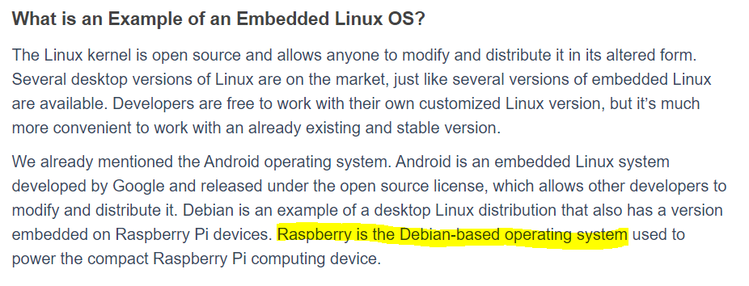

Slide 14
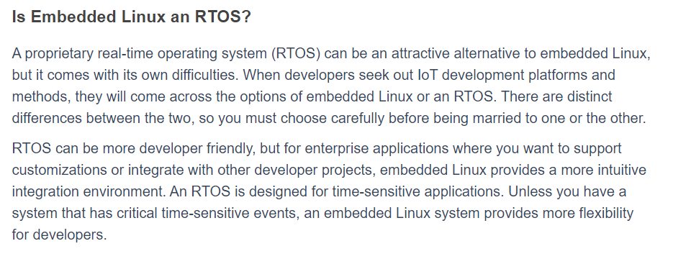

Slide 15
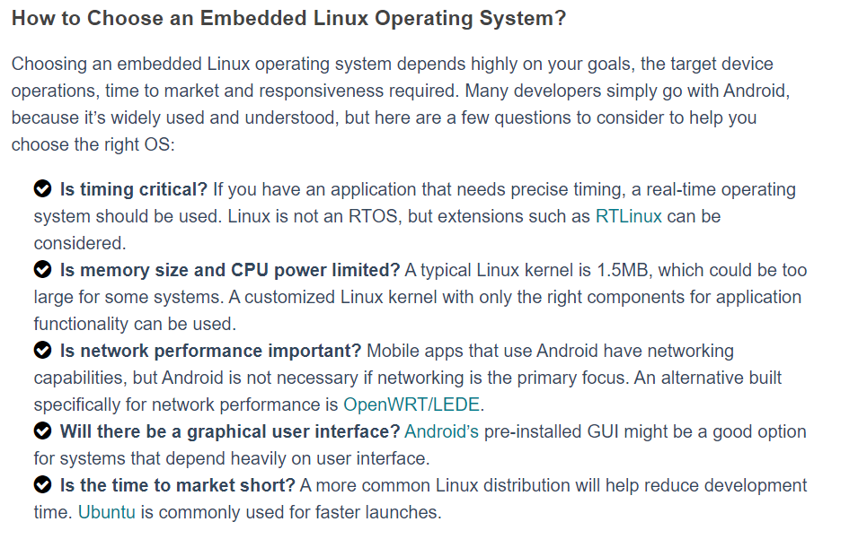

Slide 16
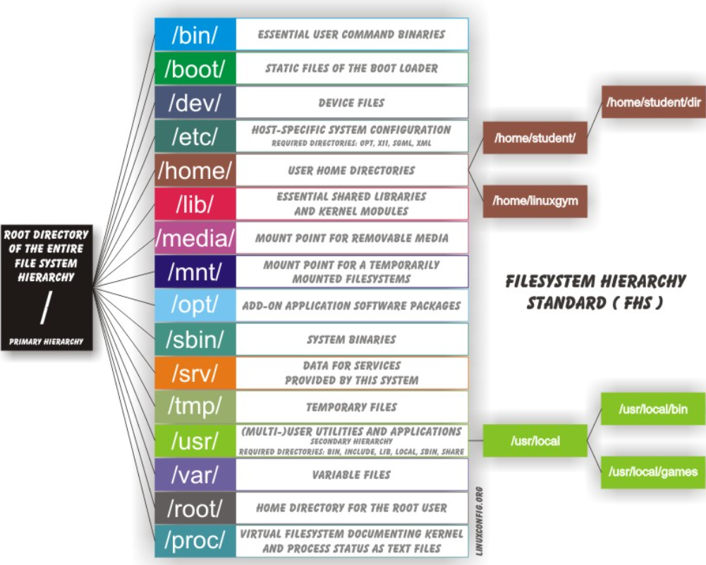

Slide 17
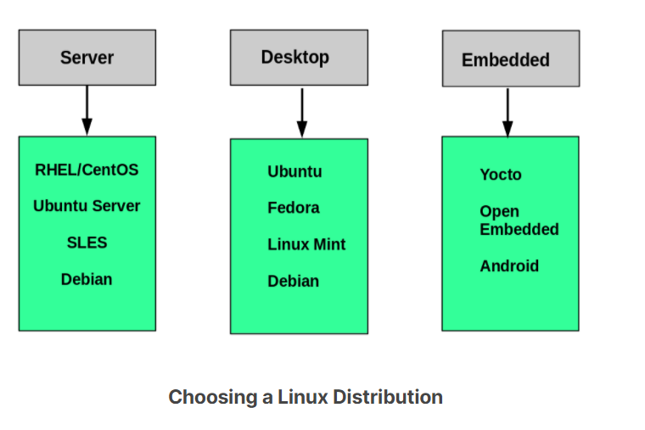

Slide 18
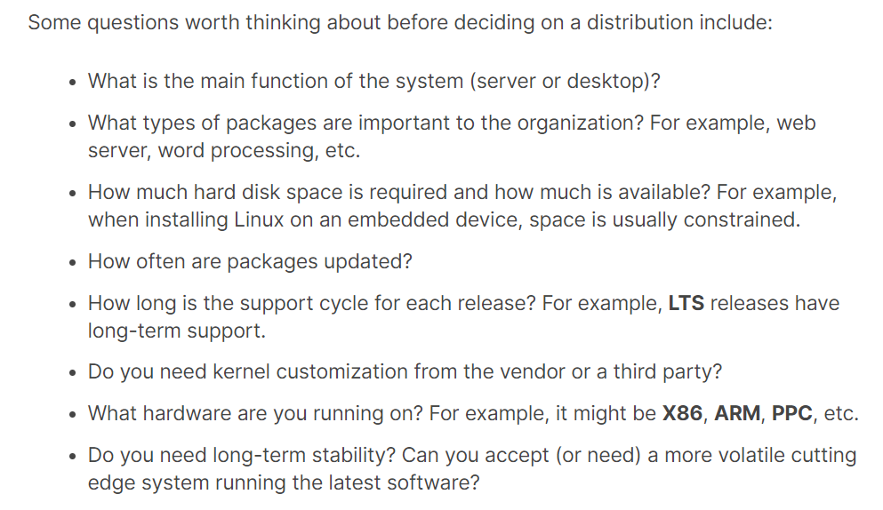

Slide 19
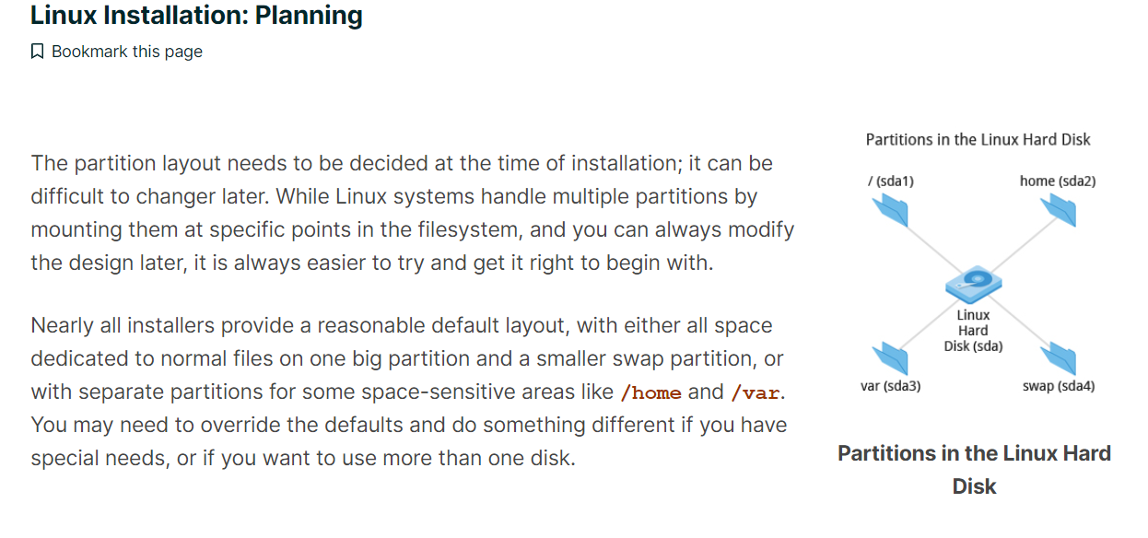

Slide 20
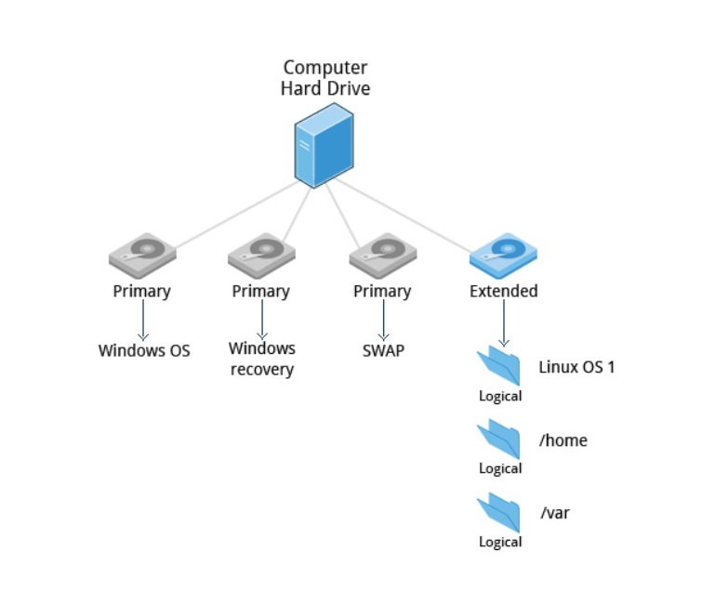
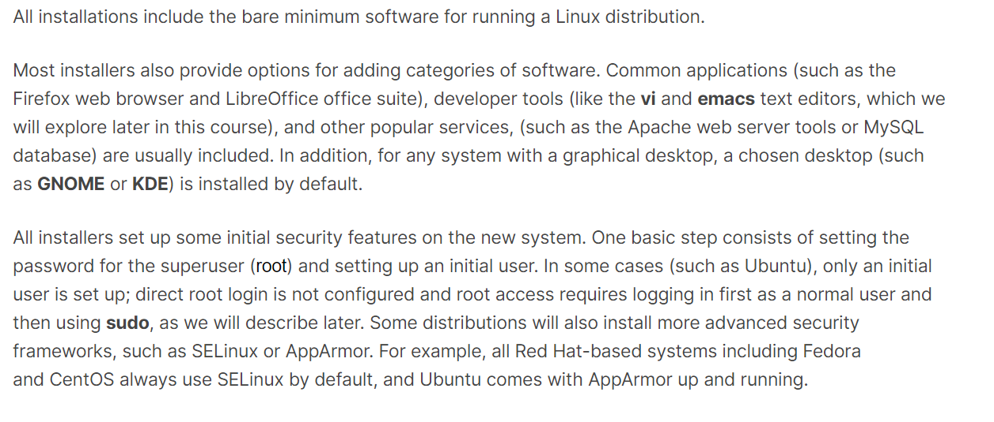

Slide 21
