Slide 1
JAVA ☺

Slide 2
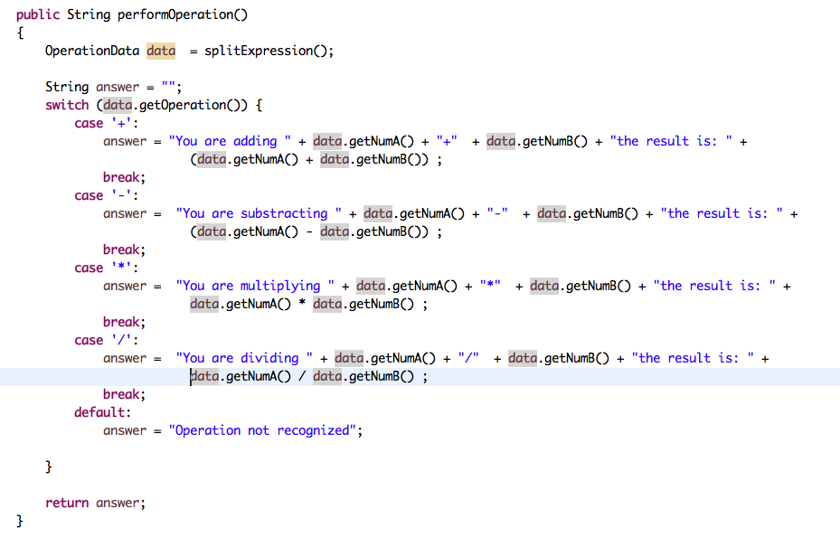
OperationHelper
Key Concepts:
Aritmetic Operators
+ operator (overloading)

Slide 3
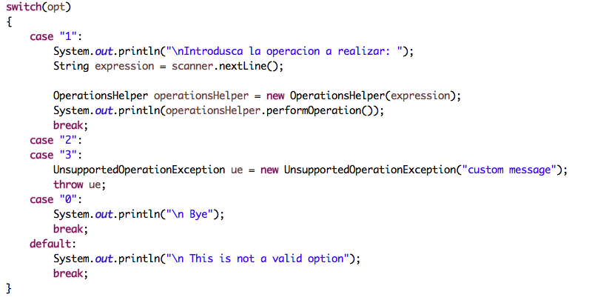
CalculatorMain
Quick Review:
Contructor overloading

Slide 4
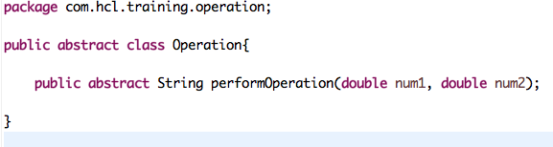
Create a Package com.hcl.training.operation
Create a Class Operation
Key Concepts:
Abstract Class
Abstract Method

Slide 5
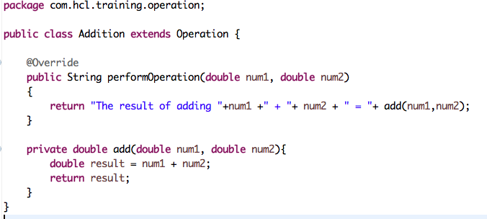
Addition
Key Concepts:
Annotations
Inheritance

Slide 6
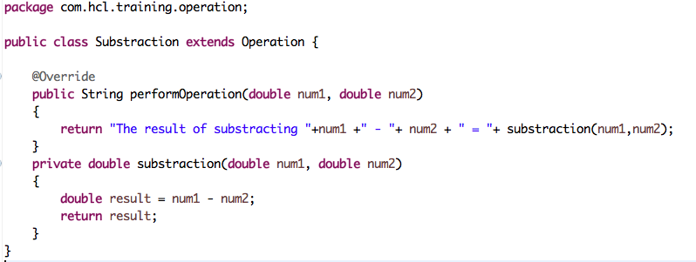
Substraction
Key Concept:
Polimorfisim
Key Concept:
pass per reference
Create and implement Divition and Multiplication Classes

Slide 7
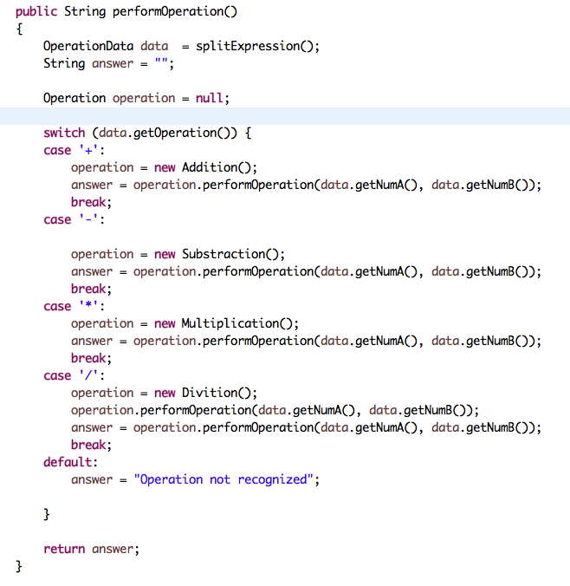
OperationHelper
Quick Review:
4 pilars of O.O.P.
Abstraction
Encapsulation
Inheritance
Polimorfisim

Slide 8
Add Junit to classpath
Create a Package com.hcl.training.operation
Create a Class OperationsTest
Dowload junit-4.10.jar to you computer
Add junit-4.10.jar to classpath
Right click in the project
Goes to "properties"
Goes to "Java Build Path"
Verify that "Libraries" Option is Selected
Click on Add External Jar
Searh for "junit-4.10.jar" file you just downloaded and click on "Open"
Click on Apply
Key Concepts:
JUnit
Classpath

Slide 9
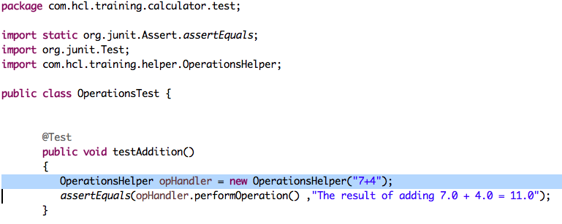
OperationsTest
Key Concepts:
Unit Testing
Asserts
assertEquals

Slide 10
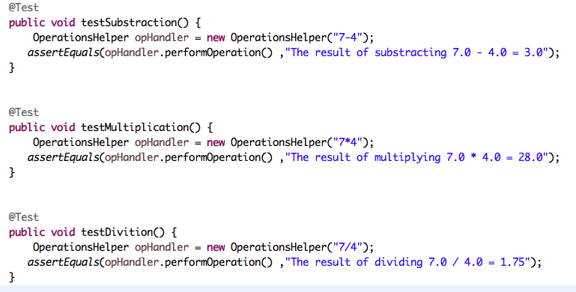
OperationsTest

Slide 11
¿Preguntas?

