Slide 1
Zisis, the witch
A character that I have started developing for a comic book
She was vectorized with Microsoft PowerPoint and animated with Unity Engine
This document contains the steps of her creation and her assets.

Slide 2
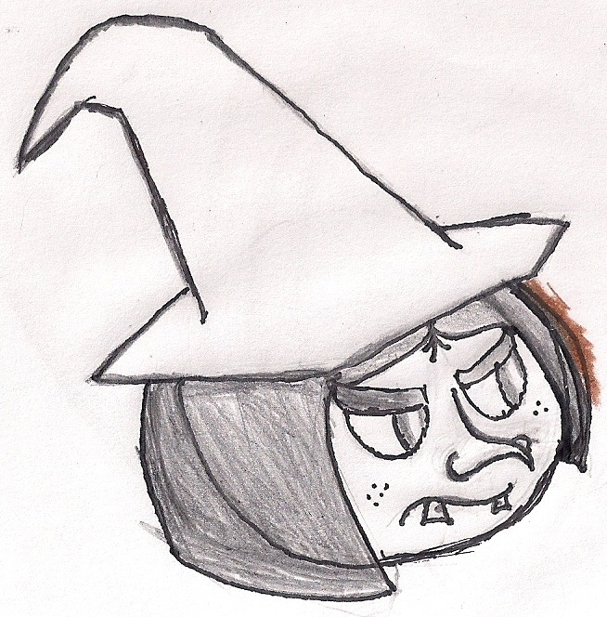
First step: hand drawing

Slide 3
Second step: digital drawing – dismissed

Slide 4
Third step: vectorizing

Slide 5
Vectorizing process

Slide 6
Assets

Slide 7
Zisis smiling

Slide 8
Zisis angry

Slide 9
Zisis animation demo is in GitHub:
https://github.com/cesargaspfer/Zisis

