Slide 1

Miniaturized Mobile Robot for Educational Applications in Logistics
CROS 2026 - Brazilian Conference on Robotics
João Pessoa, Brazil
April 27–30, 2026
César Grossl (UTFPR)
Dieisson Martinelli (UDESC)
Vivian Cremer Kalempa (UDESC)
André Schneider de Oliveira (UTFPR)

Slide 2
Motivation
Internal logistics still relies on human-operated forklifts.
Material handling is subject to errors, safety risks, and inefficiencies.
Autonomous mobile robots can improve repeatability and operational support.
A miniaturized prototype provides a practical platform for education and research.

Slide 3
Objective
Design and develop a miniaturized robotic platform for logistics.
Integrate LiDAR, ultrasonic sensors, and ROS 2 for perception and navigation.
Experimentally validate the system using SLAM.

Slide 4
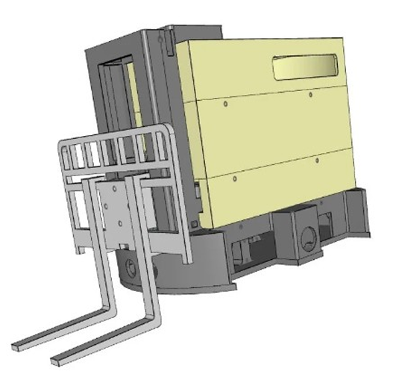
Prototype Design and Fabrication
The chassis was designed in CAD and 3D printed in PLA.
The miniaturized prototype uses four DC motors for differential drive and one motor for fork lifting.
Its compact dimensions of 24 cm in length, 22 cm in height, and 1.35 kg in mass make it suitable for reduced-scale experimental validation.
Robot design

Slide 5
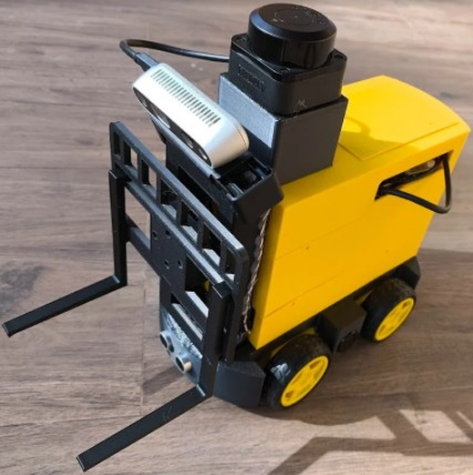
Hardware Components
Raspberry Pi 4 as central processing unit.
LiDAR (RPLiDAR C1) for mapping and navigation.
Ultrasonic sensors for obstacle detection.
Intel RealSense D435i for depth perception and pallet detection.
DC motors and encoders for movement and odometry.
Motor drivers (TB6612FNG and L298N) for motion and fork control.
Supporting components: power bank, limit switch, buzzer, and connector
Physical prototype of the mobile robot

Slide 6
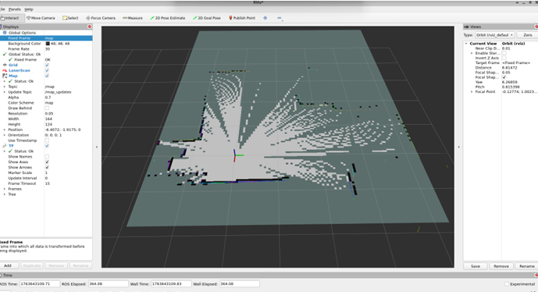
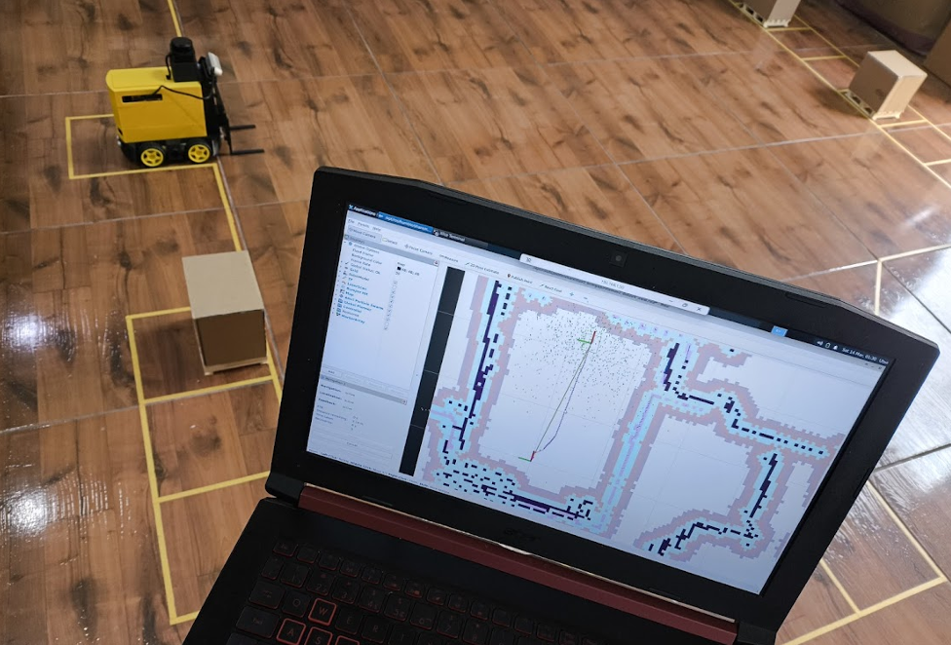
Mapping (SLAM)
LiDAR-based 2D environment mapping
Real-time data acquisition via ROS 2 (/scan topic)
Map generation and localization using RViz2
Integration with odometry for position estimation
RViz2 visualization of LiDAR-based SLAM
Experimental mapping environment

Slide 7
Tests and Validation
Assembly tests were performed to verify the correct positioning of mechanical and electronic components.
Individual validation of sensors, motors, and control modules was carried out before full integration.
Movement tests were conducted to adjust motor control and calibrate odometry.
Obstacle detection tests were performed using front, rear, and side ultrasonic sensors.
SLAM mapping and navigation were validated in RViz using 2D Pose Estimate and Nav2 Goal.

Slide 8
Prototype Demonstration Video
SLAM-Based Mapping Experiment
Obstacle Avoidance Experiment
YouTube: https://youtu.be/EFHZ58ks7_c

Slide 9
Conclusion
The proposed prototype demonstrated the feasibility of a miniaturized mobile robot for logistics applications.
The system successfully integrated sensors, embedded electronics, and ROS 2 architecture.
Initial experiments validated SLAM-based mapping, obstacle detection, and navigation.
The platform showed potential for educational and research applications in robotics and logistics.

Slide 10
Future Work
Improve odometry accuracy and navigation stability.
Enhance SLAM performance for more accurate environment mapping.
Implement pallet detection using the Intel RealSense D435i camera.

Slide 11
Thank You for Your Attention
Questions?

