Slide 1
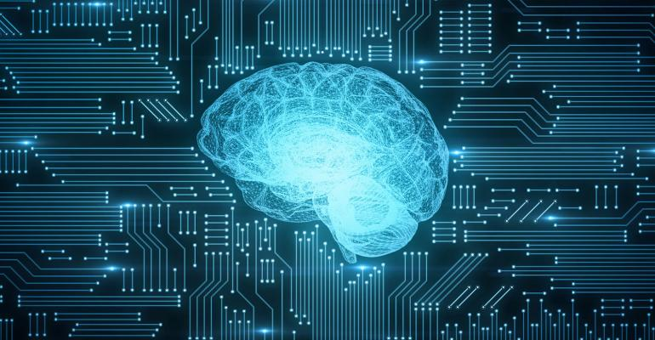
2020-2021
ADVANCED
MACHINE LEARNING
MERCARI PRICE SUGGESTION
Alessandro Pigato - 852482
Davide Banfi - 806539
Giacomo Cesareo - 805716

Slide 2
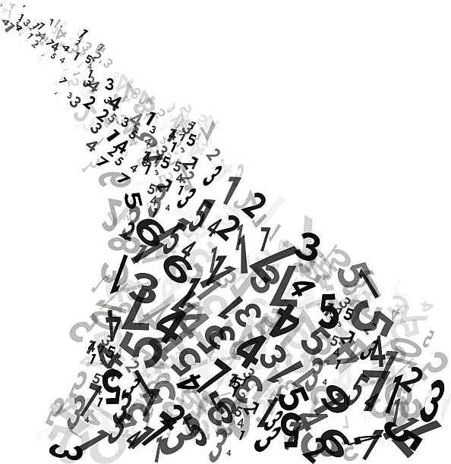





DATASET OVERVIEW
Data are made available by Mercari, a Japanese company which allows users to buy and sell items quickly from their smartphones.
The challenge consists in predicting the price of the listed items knowing desiderable properties such as a brief description, the brand, the physical condition and many others.
Data spaces in a variety of forms as numeric, binary and textual variables can be found, hence there is the necessity to properly handle these.

Slide 3
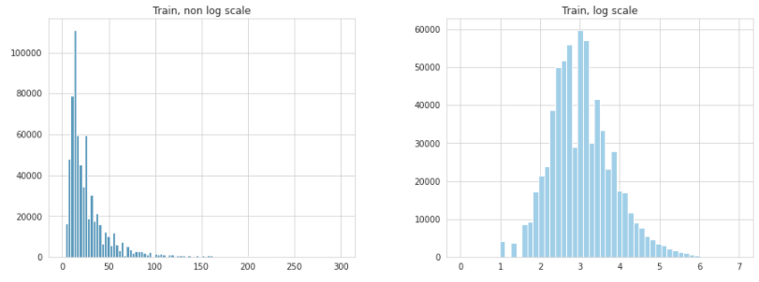
TARGET VARIABLE
DISTRIBUTION
It is useful to take a look at the distribution of the dependent variable as it may become handy when the model will output its predictions.
The vast majority of values is concentrated very closely to the smaller values. A logarithmic transformation stretches the whole into a better and clearer scale.

Slide 4

The original test dataset does not contain prices so it's impossible to verify the goodness of models. For this reason the dataset containing known values has been split in order to obtain a 20% "mini test set".
Database
80%
training
20%
test

Slide 5

PRE-PROCESSING
Textual variables: item name and description
Data cleaning
Text Normalization
NLP
Drop NaN values
Zero price removal
Contractions expansion
Stop words removal
Uniforming accents
Tokenization
Embedding

Slide 6

EXAMPLE
I'm selling all my pokémon cards. I'll ship the-cards-on-Monday.
Text Normalization
am selling all pokemon cards will ship cards monday
Tokenization & Indexing
[1, 2, 3, 4, 5, 6, 7, 5, 8]

Slide 7
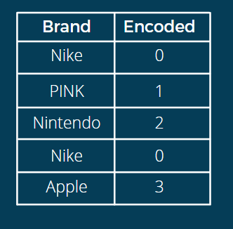
LABELS ENCODING
All the categorical variables are transformed into unique integers.
For instance, "brand" can be directly indexed with no other particular operation required.
Brand
Encoded
Nike
0
PINK
1
Instead, "category_name" is actually made up of three categories, hence it is handy to separate them before encoding.
Nintendo
2
Nike
0
Apple
3

Slide 8
WORDS EMBEDDINGS
Thanks to Gensim library every word is mapped into an array of numbers through Word2Vec.
The algorithm manages to capture semantic similarity, in fact...
[('pikachu', 0.5732),
('charizard', 0.5690),
('squirtle', 0.5652),
('pokeball', 0.5625),
('charmander', 0.5409),
('bulbasaur', 0.5305),
('heartgold', 0.5270),
('firered', 0.5251),
('leafgreen', 0.5091),
('jigglypuff', 0.5071)]
Top 10 words closest to "pokemon"

Slide 9
NEURAL NETWORKS
THREE DIFFERENT APPROACHES
Base model
LSTM architecture
CNN+GRU architecture

Slide 10
COMMON
PARAMETERS
The three models have been given the same parameters but unique layers in the architecture.
Some L1-L2 regularization factors.
Dropout layers inbetween denses.
Embedding layers to map name and item description in vectors.
ReLU activation function.
MSE loss.
ADAM optimizer with 0.01 learning rate.
EarlyStopping callback to stop the algorithm if validation MSE would not undergo a 5‰ decreasement in 5 epochs.
Train test split rate of 0.2%.

Slide 11
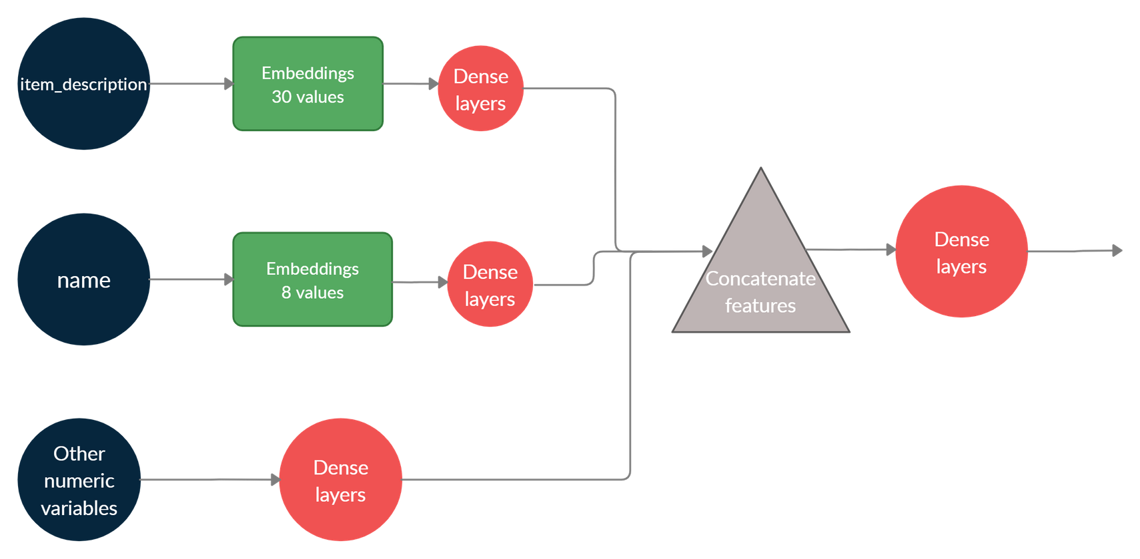
THE BASE MODEL

Slide 12
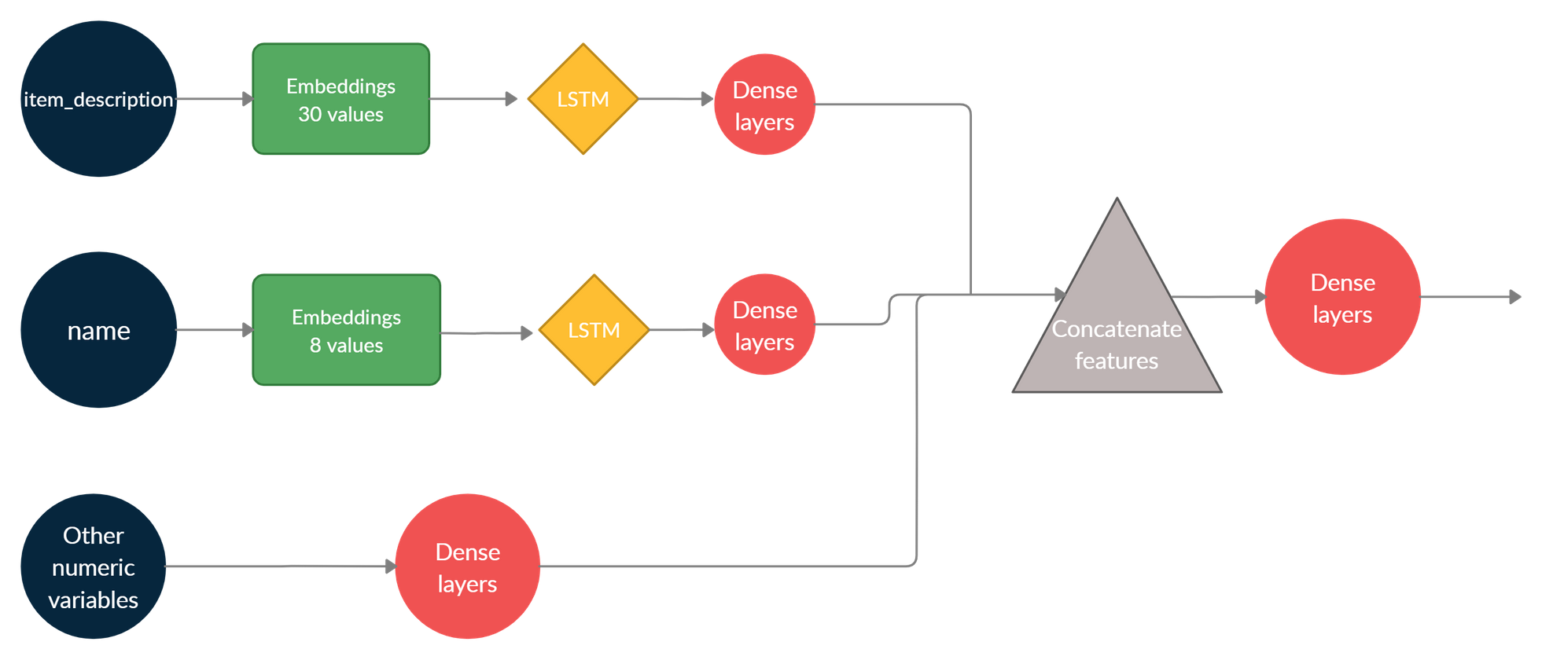
LSTM

Slide 13
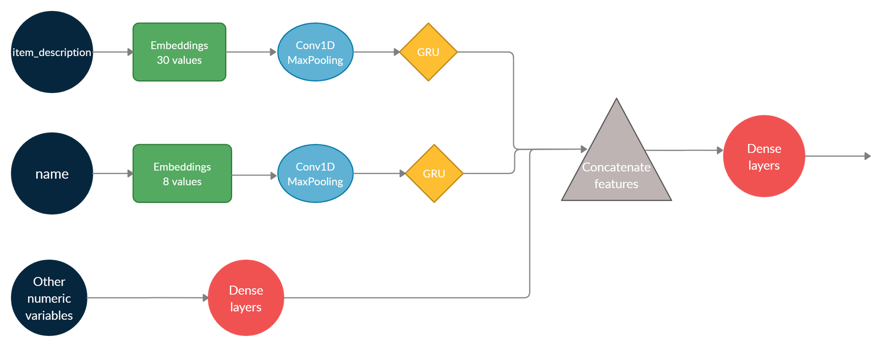
GRU & CNN

Slide 14
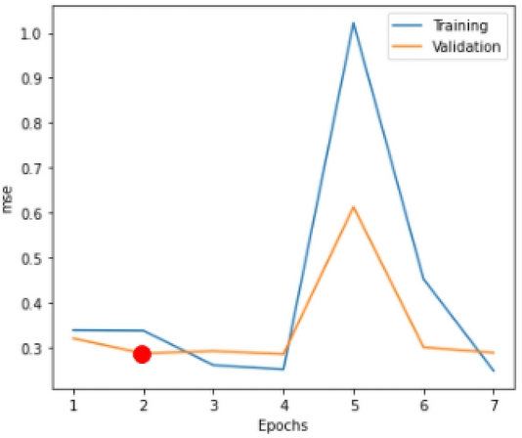
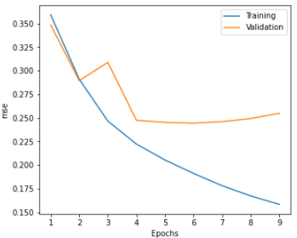
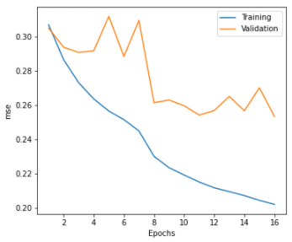

DIFFERENCES AND SIMILARITIES: MSE
Base model
LSTM
CNN + GRU
Using these
parameters
Using these
parameters
Using these
parameters
loss = 0.477
mse = 0.287
loss = 0.247
mse = 0.247
loss = 0.269
mse = 0.251

Slide 15
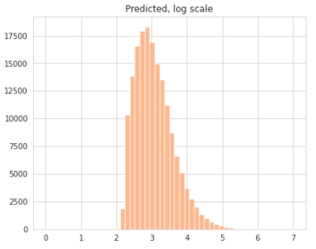
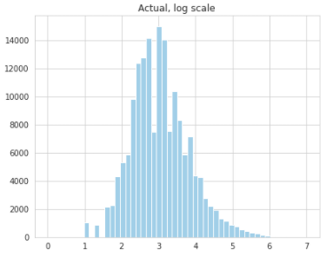

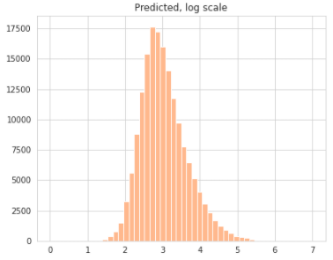

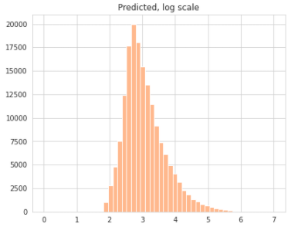
DIFFERENCES AND SIMILARITIES: THE OUTPUT DISTRIBUTION
BASE MODEL
range = (2.209, 6.859)
mean = 3.069
variance = 0.302
skewness = 0.942
kurtosis = 1 .238
TARGET DISTRIBUTION
LSTM MODEL
range = (1.394, 6.699)
mean = 3.036
variance = 0.377
skewness = 0.763
kurtosis = 0.879
CNN + GRU MODEL
range = (1.955, 5.967)
mean = 3.061
variance = 0.384
skewness = 0.982
kurtosis = 1.183

Slide 16
CONCLUSIONS
Results were satisfactory for all the presented architectures and allowed to predict the unknown prices in a very similar distribution.
Future enhancements concern the implementation of:
Advanced NLP techniques for more accurate text normalization such as stemming and lemmatization.
AutoML approach for hyperparameters optimization.
Deeper and more complex neural networks.

Slide 17
Thank you for the attention

