Slide 1
CLINICAL TRIALS’
BIG DATA PIPELINE
Presented by: Cesar N.

Slide 2

Outline:
Pipeline Benefit
Data source
Data ingestion
Data Processing
Database
Demo

Slide 3
CUSTOMER
Syneos Health
( A Pharmaceutical company)
Mission: “Develop state of the art medicine”

Slide 4
Pipeline Benefit
Business case:
Special case on cancer clinical trials
Purpose:
To monitor the cancer clinical trial in progress
Benefit: extraction of information related to medical, surgical or behavioral intervention currently being used to help cancer patient and their families

Slide 5
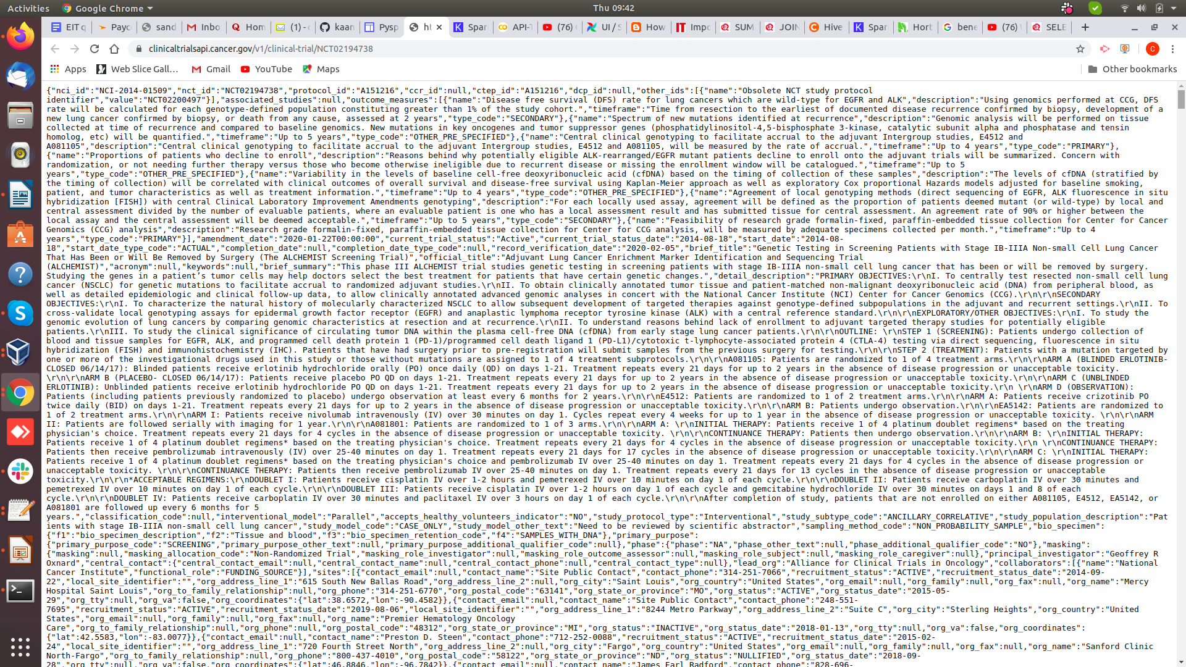

Slide 6
Data source
US Department of Health and Human Services
National Cancer Institute API
Goals and mission
NCI's mission is to lead, conduct, and support cancer research across the nation to advance scientific knowledge and help all people live longer, healthier lives.

Slide 7
Data source
Clinical trials
Clinical trials are research investigations in which people volunteer to test new treatments, interventions or tests as a means to prevent, detect, treat or manage various diseases or medical conditions.
The trial API get updated every day.

Slide 8
Data Ingestion tool
Kafka:
producer
Broker AND topic
consumer
Why kafka:High Throughput: Due to low latency, Kafka is able to handle more number of messages of high volume and high velocity

Slide 9
Data Processing
SPARK:
RDD
Action and transformation
Why Spark:
Fault tolerance capabilities due to immutable primary abstraction named RDD.
Provides highly reliable fast in memory computation.
Efficient in interactive queries and iterative algorithm.

Slide 10
Database
Hive
Why hive:
The main advantage of Apache Hive is for data querying, summarization, and analysis

Slide 11
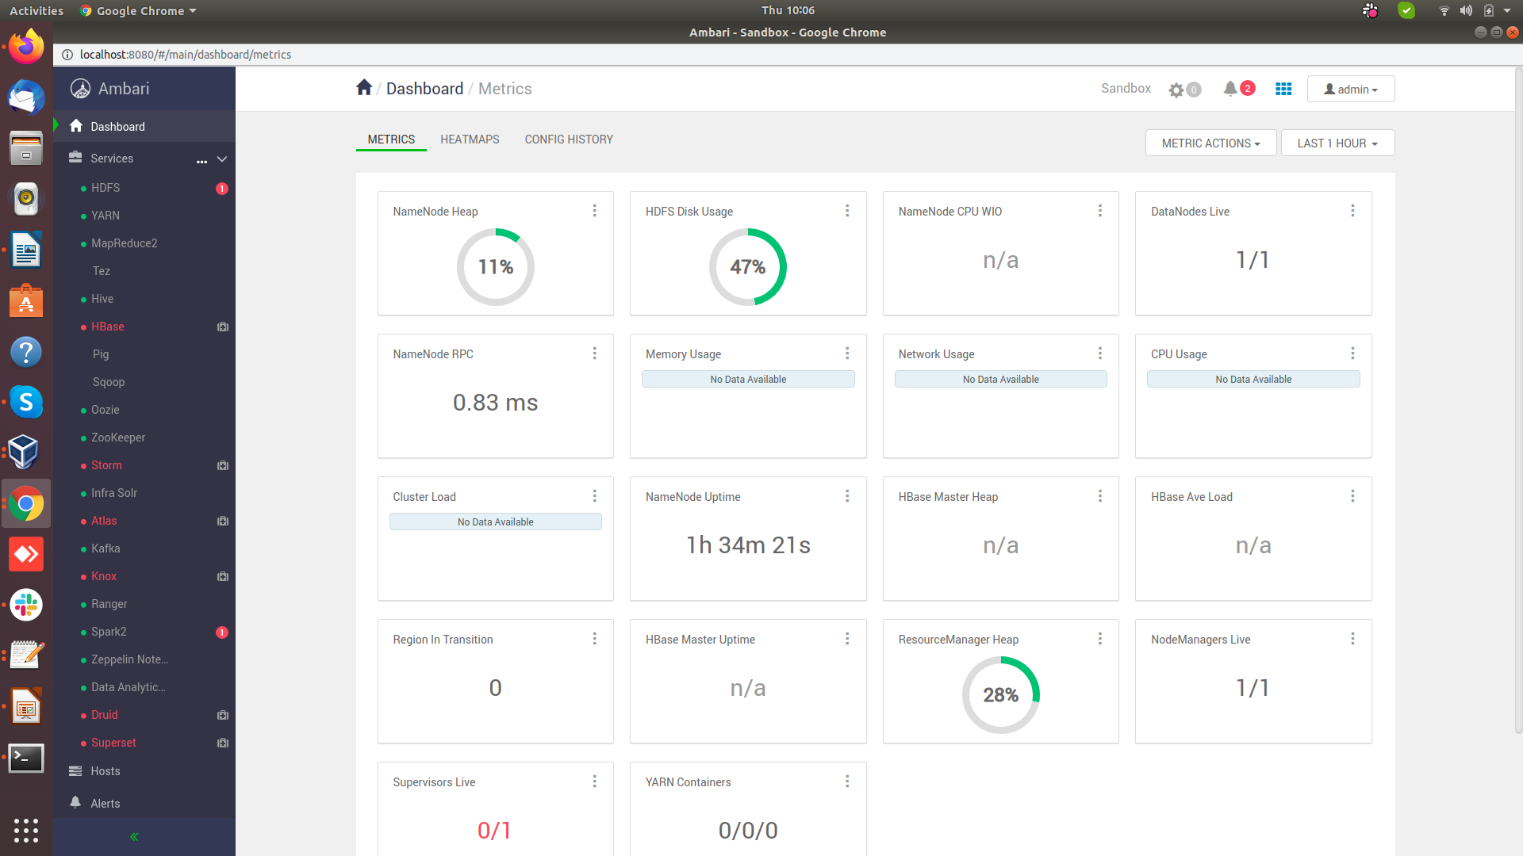

Slide 12
Demo

Slide 13

QnA
Thank you for your time

