Slide 1
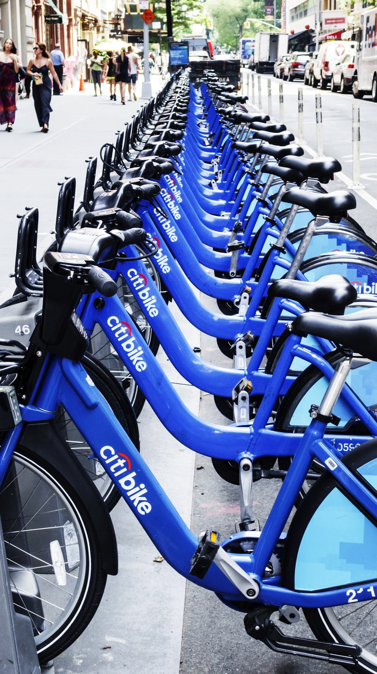
Time Series Analysis: Citibike NYC
Cesar Rene Pabon Bernal
Stat 715: Professor Dana Sylvan
May 13, 2019

Slide 2
OUTLINE
INTRODUCTION
History
Data
Plot Time Series/Transformations/Auto Correlation Structure
METHODS
Model Specification
Model Fitting
Model Diagnostics
Forecasting
CONCLUSION

Slide 3
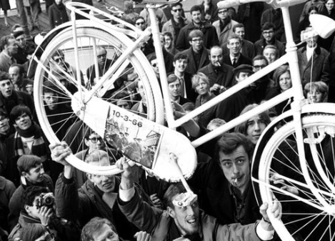
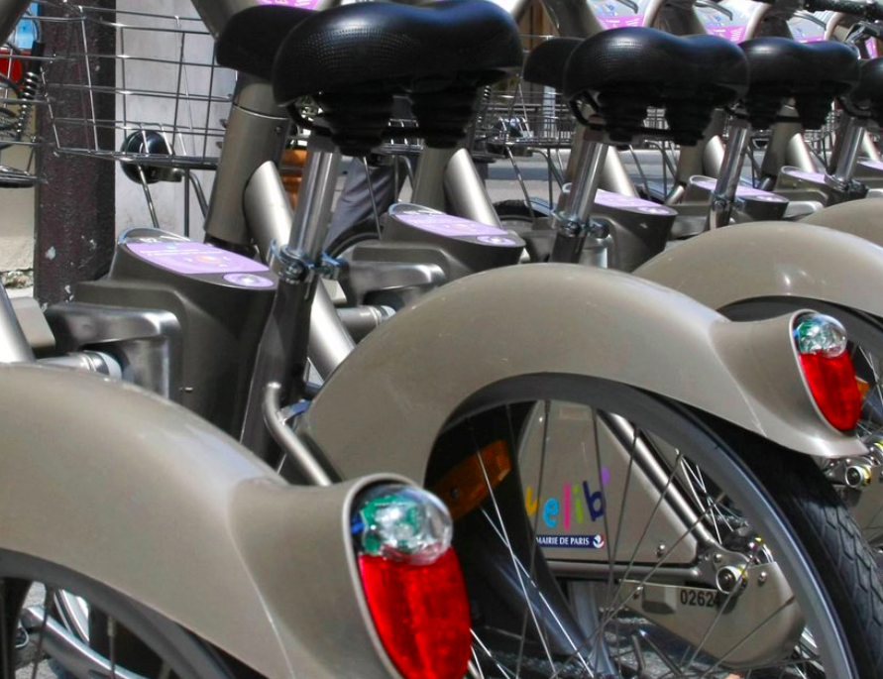
INTRODUCTION: HISTORY
1967 Amsterdam: Witte Fietse
1995 Copenhagen: Bycyklen
2013 NYC: Citibike Launches w/ 6000 bikes in Manhattan and BK
1996 Portsmouth UK: Bikeabout
2008 Washington DC: SmartBike DC
2007 Paris, France: Vélib & Barcelona, Spain: Bicing
2019 As of Feb, Citibike has:
+750 stations
+62K rides/day
+12K bikes
Total revenue for month~$4.7 mill
“The Real Story Behind the Global Bike-Share Boom.” CityLab, www.citylab.com/city-makers-connections/bike-share/.
Motivate International, Inc. “Citi Bike Monthly Operating Reports.” Citi Bike NYC, www.citibikenyc.com/system-data/operating-reports.
Notes:
1967: In Amsterdam, a group of activists introduce the Witte Fietsen, or White Bikes—
dozens of regular bicycles that were painted white and left unlocked for anyone to use. After many bike thefts, the program is quickly shut down
1995: Copenhagen’s Bycyklen, or City Bikes, allowed users to access sturdy, shared bicycles at specific locations throughout the city via a coin-operated system. Despite clear improvements over Amsterdam’s White Bikes, thefts and vandalism still plagued
the program.
1996: Portsmouth University in the U.K. introduced Bikeabout, a small bike-share system limited to students. Users had to swipe an individualized magnetic-stripe card to borrow a bike, which allowed them to be tracked when they weren’t returned. This helped theft.
2007: Paris launches the 6,000-bike Vélib’ system and the worldwide movement toward bike-share is off and running. By 2015, Paris will have a total of 18,000 bikes.
In Spain, Barcelona’s Bicing is the first entry in what quickly becomes a nationwide boom in that country. By 2013, 132 Spanish cities will have bike-share, making Spain a global leader in the phenomenon.

Slide 4
INTRODUCTION: HISTORY
Why are Bike Sharing Systems Beneficial?
Environmental
In Shanghai (2018), bike sharing systems cut down CO2 by 25,240 tons. A number big enough to consider as a component when meeting China’s Paris Accord greenhouse emissions requirements
Economic
If all Bike Sharing trips replaced car trips in 12 major cities in Europe, 73.25 deaths could be avoided each year (225 million Euros saving)
Zhang, Yongping, and Zhifu Mi. “Environmental Benefits of Bike Sharing: A Big Data-Based Analysis.” Applied Energy, vol. 220, 2018, pp. 296–301., doi:10.1016/j.apenergy.2018.03.101.
Otero, I., et al. “Health Impacts of Bike Sharing Systems in Europe.” Environment International, vol. 115, 2018, pp. 387–394., doi:10.1016/j.envint.2018.04.014.

Slide 5
INTRODUCTION: DATA
Online Citibike System Data Repository
Python:Cleaning, wrangling and exploratory analysis
R:Statical application
2096 observations from 05/27/2013-02/15/2019
"Date" "Trips_per_24hrs"
Hypothesis
Ho =Trips per day (for All Users) increase in the summer months

Slide 6
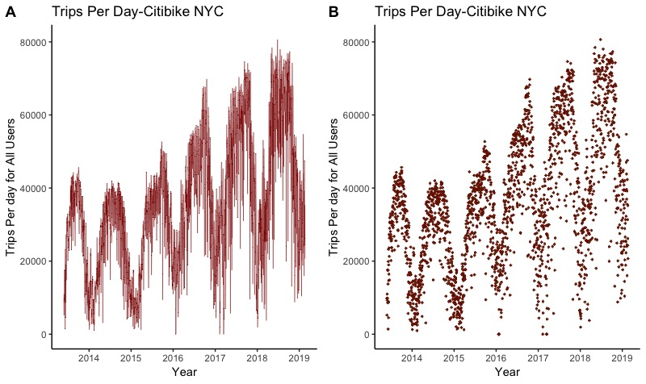
INTRODUCTION: PLOT TS

Slide 7
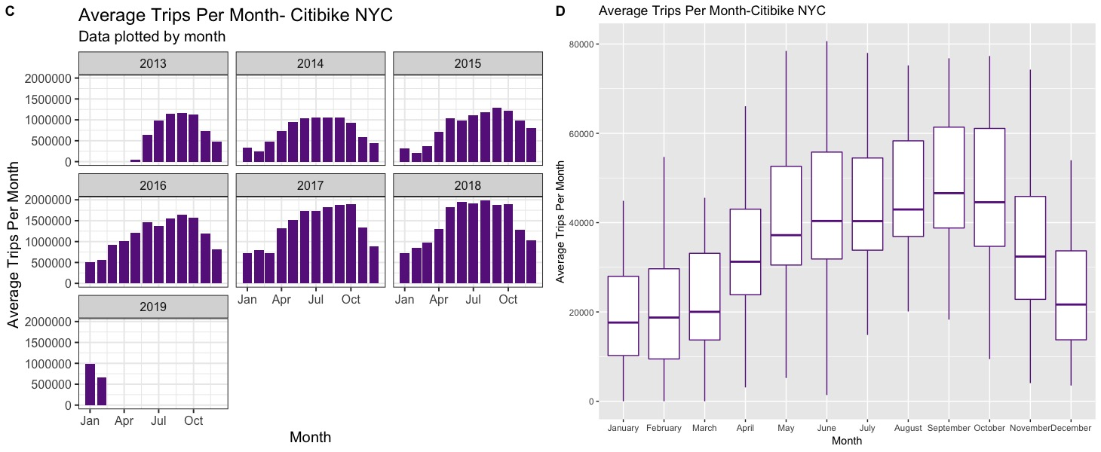
INTRODUCTION: PLOT TS

Slide 8
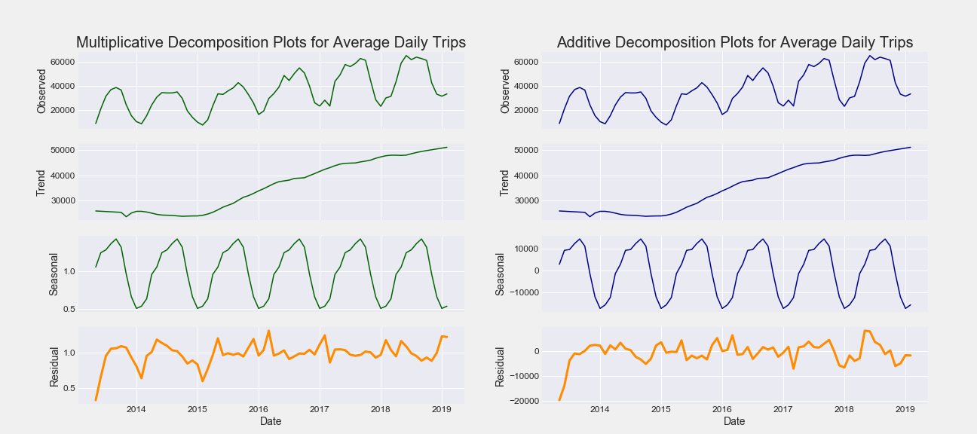
INTRODUCTION: PLOT TS
E

Slide 9
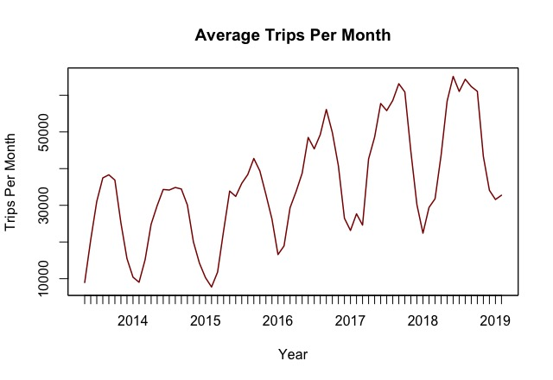
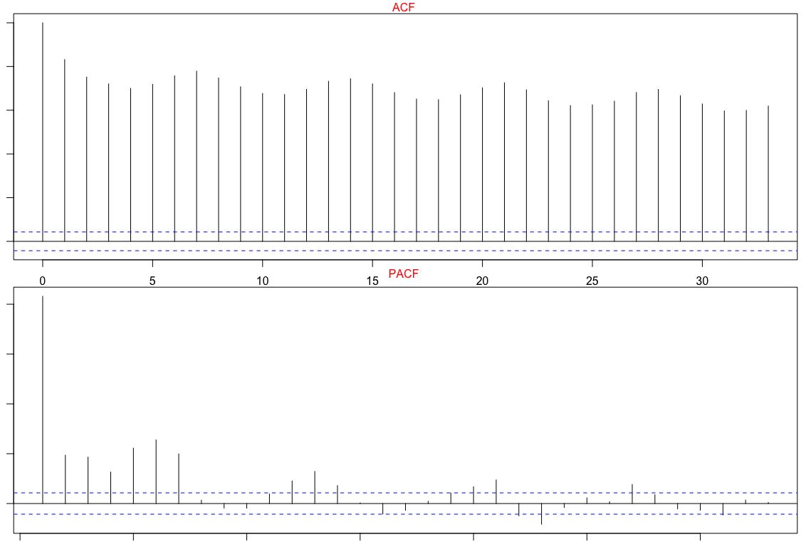

INTRODUCTION: PLOT TS
F

Slide 10
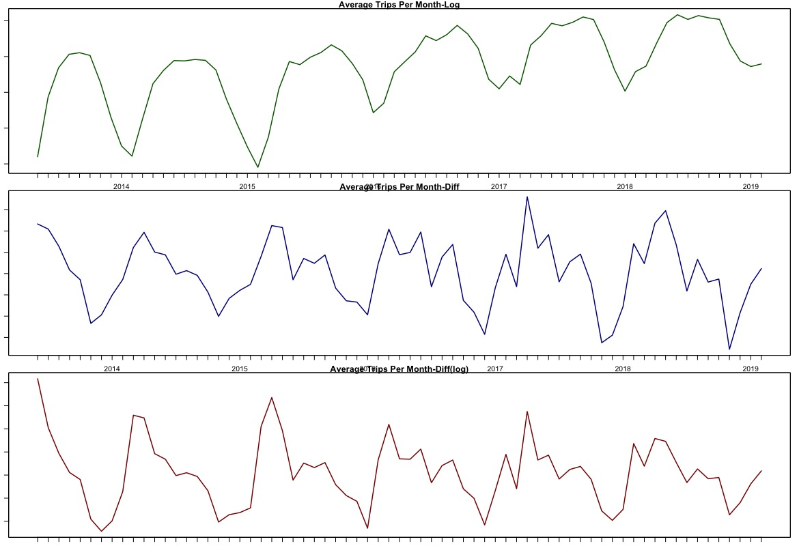



INTRODUCTION: TRANSFORMATIONS
G

Slide 11
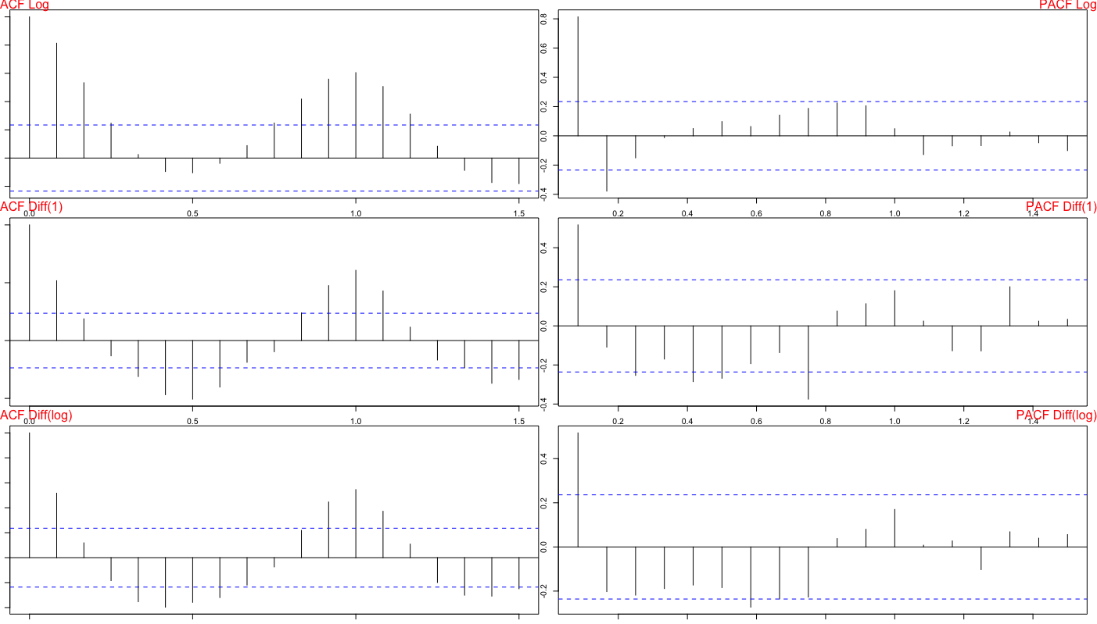
INTRODUCTION: ACF STRUCTURES
H

Slide 12
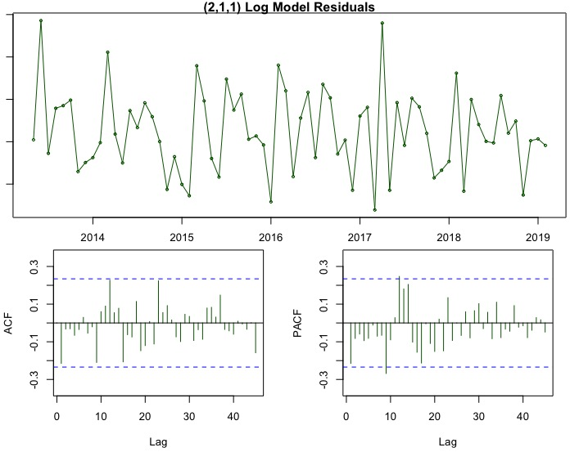
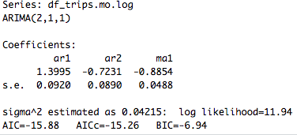
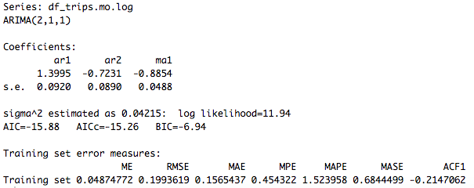
METHODS: MODEL SPECIFICATION
I

Slide 13
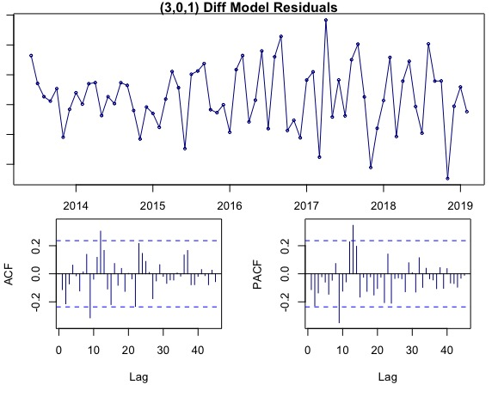
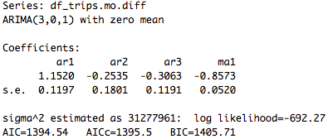
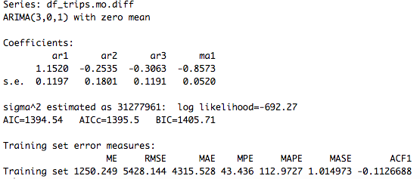
METHODS: MODEL SPECIFICATION
METHODS: MODEL SPECIFICATION
J

Slide 14
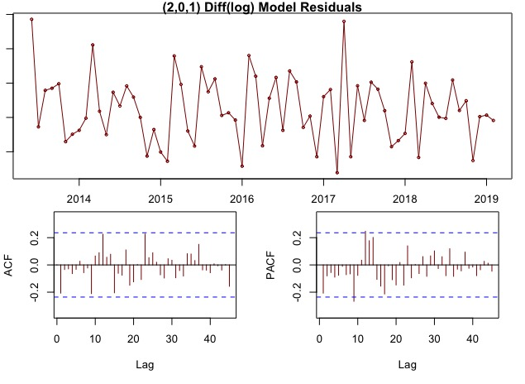
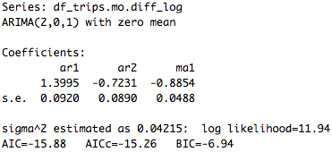
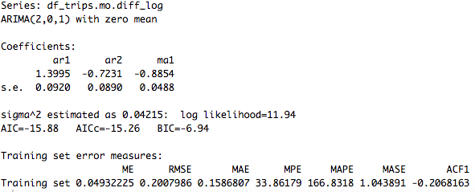
METHODS: MODEL SPECIFICATION
K

Slide 15
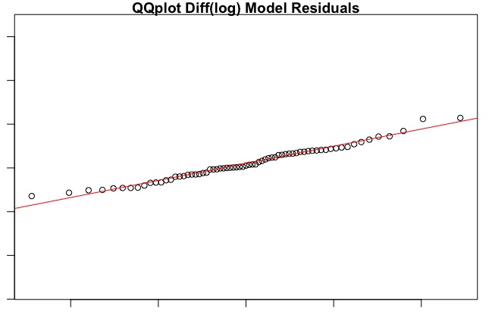
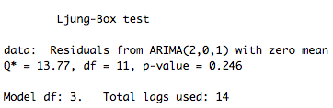
METHODS: MODEL DIAGNOSTICS
L

Slide 16
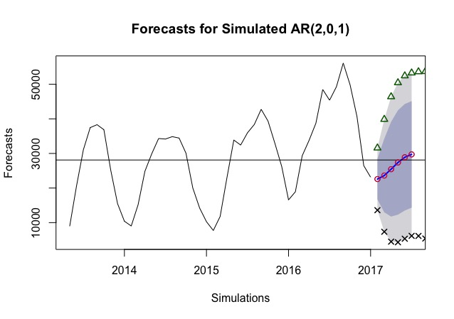
METHODS: FORECASTING
M

Slide 17
CONCLUSION
Trips per Day is a Seasonal TS
AR(2,0,1) of Diff(log) was best model
Best ACF/PCAF plots
Lowest RMSE
Forecast of Trips per Day confirmed proper selection of model
Test values found in lower and upper 95%

Slide 18
REFERENCES
“The Real Story Behind the Global Bike-Share Boom.” CityLab, www.citylab.com/city-makers-connections/bike-share/.
Motivate International, Inc. “Citi Bike System Data.” Citi Bike NYC, www.citibikenyc.com/system-data.
Zhang, Yongping, and Zhifu Mi. “Environmental Benefits of Bike Sharing: A Big Data-Based Analysis.” Applied Energy, vol. 220, 2018, pp. 296–301., doi:10.1016/j.apenergy.2018.03.101.
Otero, I., et al. “Health Impacts of Bike Sharing Systems in Europe.” Environment International, vol. 115, 2018, pp. 387–394., doi:10.1016/j.envint.2018.04.014.
Motivate International, Inc. “Citi Bike System Data.” Citi Bike NYC, www.citibikenyc.com/system-data.
Citibike Image: “Lined up Rental Citibank Bikes in Lower Manhattan. New York , NY , USA -.” Shutterstock.com, 2 Oct. 2018, www.shutterstock.com/image-photo/lined-rental-citibank-bikes-lower-manhattan-1192959820.

